Slide 1
Simulation Results
7 November 2025
Ricco Venterea

Slide 2
Workflow
binary
visualize_evolution
$$N=5$$
𝑁=5
BHT
Plummer conditions
Brute force
BHT
Plummer conditions
Mass ratio $=0.03$
Mass ratio =0.03
$$η=0.15$$
𝜂=0.15
Notes:
PS C:\Users\ricco\OneDrive\Desktop\Grad_Schools\Schools\UC_Riverside\PHYS_206\nbuddies> python .\main.py -n 5 --no_binary --m_ratio 0.03 --eta 0.15
Running simulation with: n_bh=5, use_tree=True, do_brute=False, make_comp=False, do_binary=False, m_ratio=0.03, eta=0.15

Slide 3
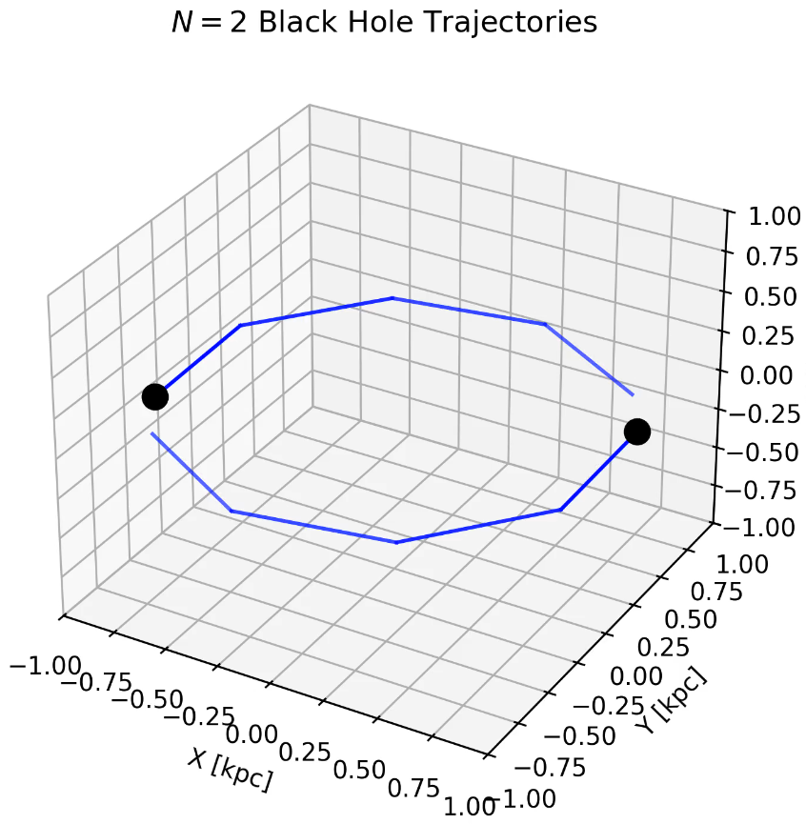
binary
Brute Force Result
BHT Tree Result

Slide 4
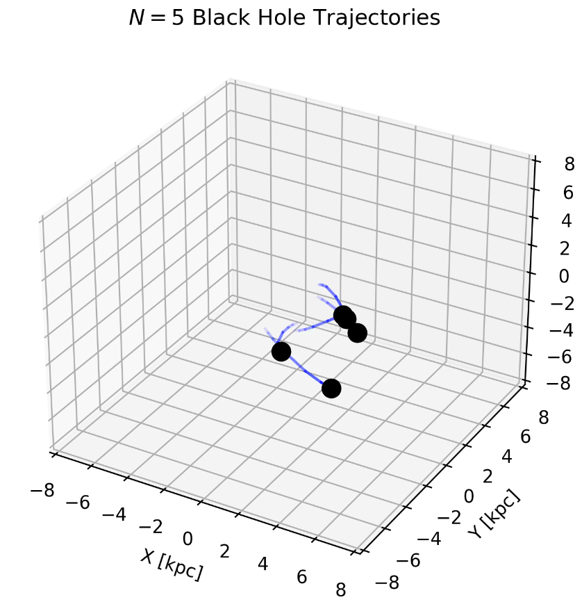
visualize_evolution
Notes:
ffplay

Slide 5
Improvements

Slide 6
Some Guiding Questions…
  Could we have a progress bar instead of outputting percentage of time elapsed?
  Add data/ and movie_dump/ to .gitignore?
  Can we display the number of black holes in our trajectory plots?

Slide 7
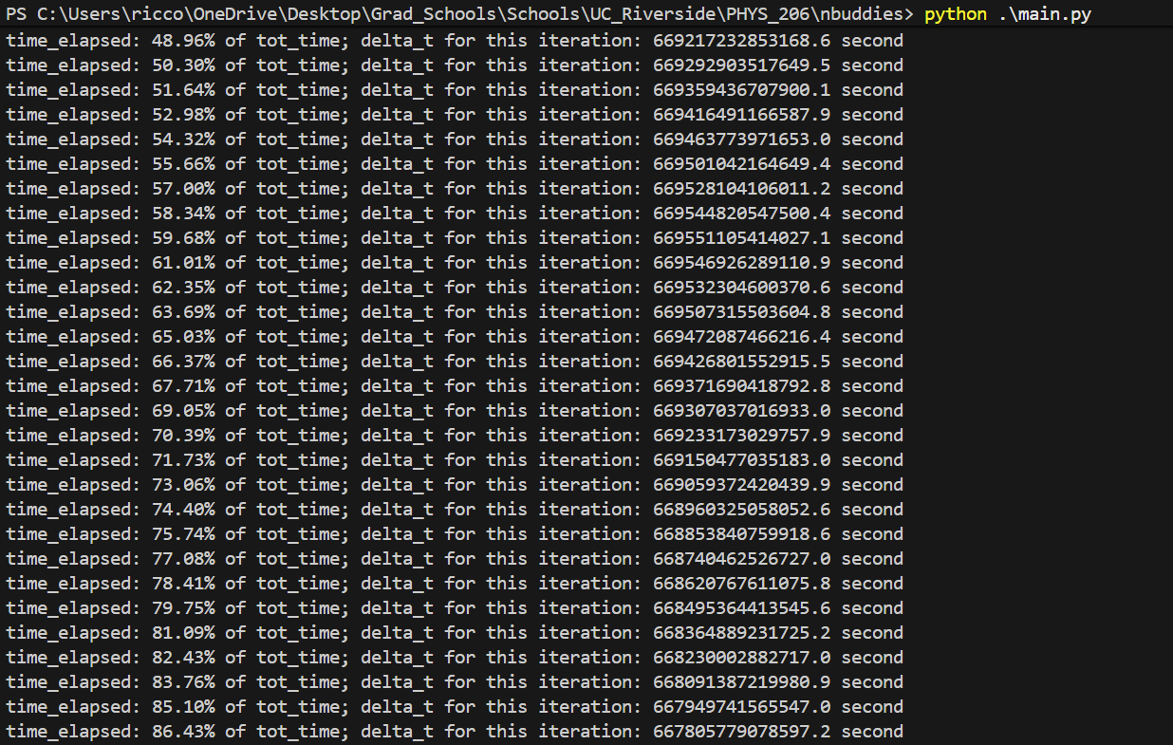
evolution2
Before
After

Slide 8
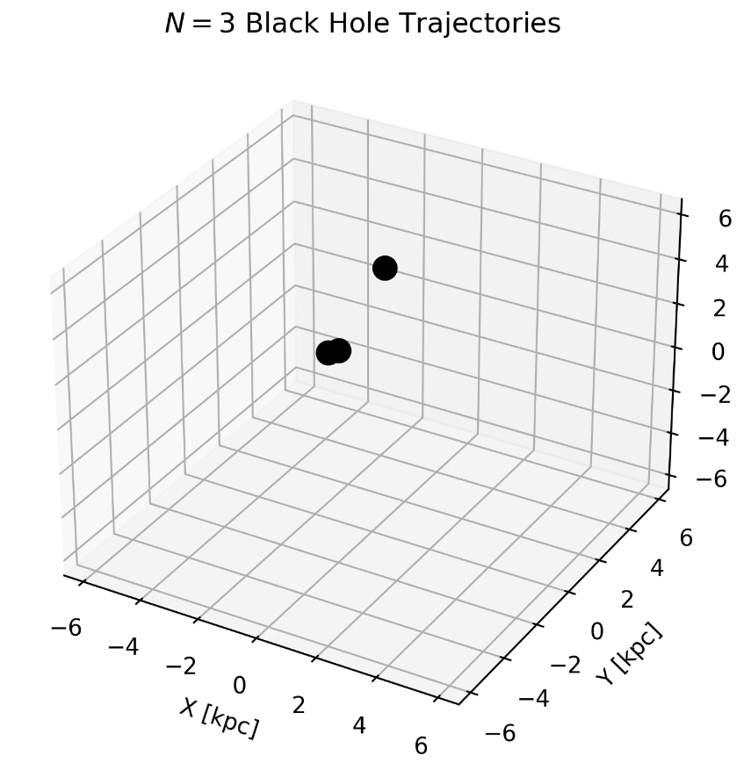

visualizations

Slide 9
visualize_evolution
Is it possible to create a single file where all parameters are tuned by user in the command line?
  Insert main.py

Slide 10
General Outline of Repo
BlackHoles_Struct -> class definition of black holes (BHs)
Forces -> calculate acceleration, jerk, snap, Barnes-Hut node approximation
ICs -> set and generate initial conditions using Plummer
binary -> run simulation (line 158)
binary_analytical -> class definition of analytical check on binary BHs to ensure conservation of physical quantities
evolution2 -> time step code (Euler, adaptive, etc.)
gravitree -> class definition of node using Barnes-Hut algorithm
visualizations -> create mkv movie along with BH animation tail
visualizations_comparisons -> create mkv movie comparing Barnes-Hut algorithm to brute force method
visualize_evolution -> run before making PR
Notes:
ffplay

