Slide 1



Dipartimento di Fisica e Astronomia
Galileo Galilei
Direct QR factorizations for tall-and-skinny matrices in MapReduce architectures
Austin R. Benson, David F. Gleich, James Demmel
IEE International Conference on Big Data (2013)
Management and Analysis of Physics Datasets – B
RICCARDO CORTE
ALESSANDRO MIOTTO
PROF. JACOPO PAZZINI
LORENZO RIZZI

Slide 2







Introduction: QR decomposition
QR Decomposition expresses a matrix A as A=QR, with Q orthogonal and R upper triangular.
It is key in solving linear systems, least squares, and numerical methods
When a matrix has many more rows than columns, it is called tall-and-skinny. Fast and accurate QR decomposition is crucial in data science, where datasets often contain many records but relatively few features.
=
x
=
A tall-and-skinny matrix ( )
An orthogonal matrix ( )
An upper triangular matrix

Slide 3




Distributed system setup: CloudVeneto
We will implement three algorithms* (from least to most accurate) for performing QR decomposition in parallel on distributed systems using Dask
10.67.22.154
Scheduler
Client
10.67.22.216
10.67.22.116
10.67.22.113
cloudveneto.large
CPU: 4 VCPUs
RAM: 8 GB RAM
Disk: 25 GB
cloudveneto.large
CPU: 4 VCPUs
RAM: 8 GB RAM
Disk: 25 GB
cloudveneto.large
CPU: 4 VCPUs
RAM: 8 GB RAM
Disk: 25 GB
(*) Direct QR factorizations for tall-and-skinny matrices in MapReduce architectures (Austin R. Benson, David F. Gleich, James Demmel)

Slide 4
METHOD 1:
Cholesky TSQR
./Cholesky.ipynb

Slide 5




Cholesky TSQR
Let B be a symmetric matrix. Its Cholesky decomposition reads
Let’s get back to QR. If A is a generic matrix, its QR decomposition is
Define the Gram matrix ( ) so that:
Gram MatMul
Cholesky decomp
Once we have R, compute

Slide 6















Cholesky TSQR
Let’s go parallel
Step 1: Gram matrix
./functions.py
def cholesky_tsqr(X_da : dask.array.Array):
chunks_delayed = [dask.delayed(gramMatMul)(chunk)
for chunk in X_da.to_delayed().ravel()]
Gram_global_delayed = dask.delayed(sum)(chunks_delayed)
R = dask.delayed(np.linalg.cholesky)(Gram_global_delayed)
R_inv = dask.delayed(Inverse)(R)
Q = X_da.map_blocks(MatMul, R_inv, dtype=X_da.dtype)
return Q, R
Worker 1
Worker 1
map
Worker 2
Worker 2
map
Worker 3
Worker 3
map

Slide 7

Cholesky TSQR
Step 1: Gram matrix
./functions.py
def cholesky_tsqr(X_da : dask.array.Array):
chunks_delayed = [dask.delayed(gramMatMul)(chunk)
for chunk in X_da.to_delayed().ravel()]
Gram_global_delayed = dask.delayed(sum)(chunks_delayed)
R = dask.delayed(np.linalg.cholesky)(Gram_global_delayed)
R_inv = dask.delayed(Inverse)(R)
Q = X_da.map_blocks(MatMul, R_inv, dtype=X_da.dtype)
return Q, R
Worker 1
Worker 1
reduce
Worker 2
Worker 2
reduce
reduce
Worker 3
Worker 3

Slide 8

Cholesky TSQR
Step 2: Cholesky decomposition
./functions.py
def cholesky_tsqr(X_da : dask.array.Array):
chunks_delayed = [dask.delayed(gramMatMul)(chunk)
for chunk in X_da.to_delayed().ravel()]
Gram_global_delayed = dask.delayed(sum)(chunks_delayed)
R = dask.delayed(np.linalg.cholesky)(Gram_global_delayed)
R_inv = dask.delayed(Inverse)(R)
Q = X_da.map_blocks(MatMul, R_inv, dtype=X_da.dtype)
return Q, R
Worker 1
Worker 1
Worker 2
Worker 2
Worker 3
Worker 3

Slide 9

Cholesky TSQR
Step 2: Recovering Q
./functions.py
Worker 1
Worker 1
Worker 1
def cholesky_tsqr(X_da : dask.array.Array):
chunks_delayed = [dask.delayed(gramMatMul)(chunk)
for chunk in X_da.to_delayed().ravel()]
Gram_global_delayed = dask.delayed(sum)(chunks_delayed)
R = dask.delayed(np.linalg.cholesky)(Gram_global_delayed)
R_inv = dask.delayed(Inverse)(R)
Q = X_da.map_blocks(MatMul, R_inv, dtype=X_da.dtype)
return Q, R
Worker 2
Worker 2
Worker 2
Worker 3
Worker 3
Worker 3

Slide 10






Cholesky TSQR
Step 2: Recovering Q
./functions.py
def cholesky_tsqr(X_da : dask.array.Array):
chunks_delayed = [dask.delayed(gramMatMul)(chunk)
for chunk in X_da.to_delayed().ravel()]
Gram_global_delayed = dask.delayed(sum)(chunks_delayed)
R = dask.delayed(np.linalg.cholesky)(Gram_global_delayed)
R_inv = dask.delayed(Inverse)(R)
Q = X_da.map_blocks(MatMul, R_inv, dtype=X_da.dtype)
return Q, R
Worker 1
Worker 1
map
Worker 2
Worker 2
map
Worker 3
Worker 3
map

Slide 11
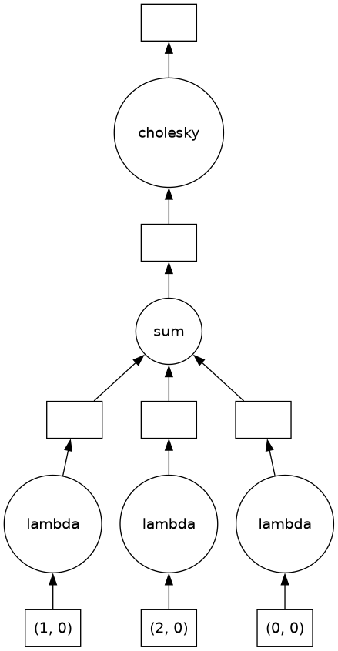
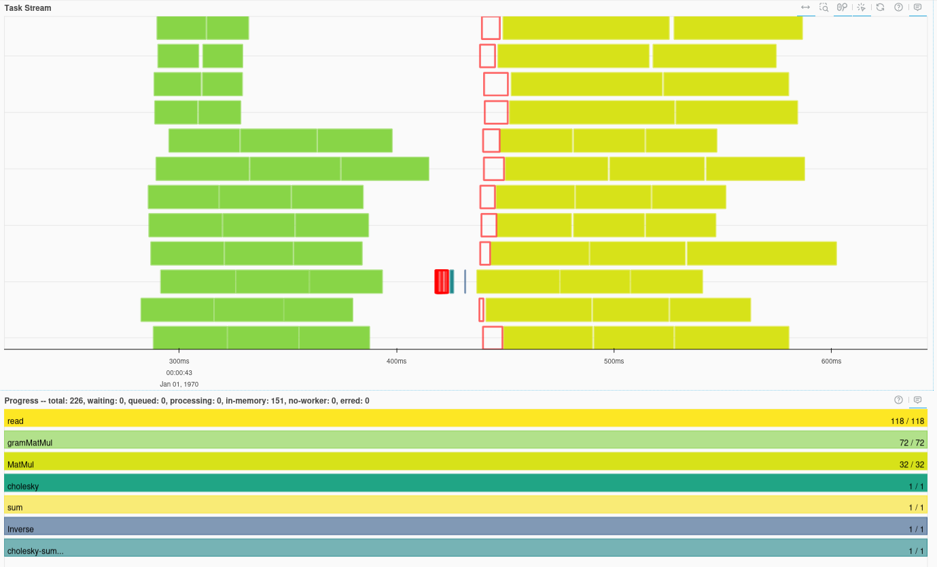
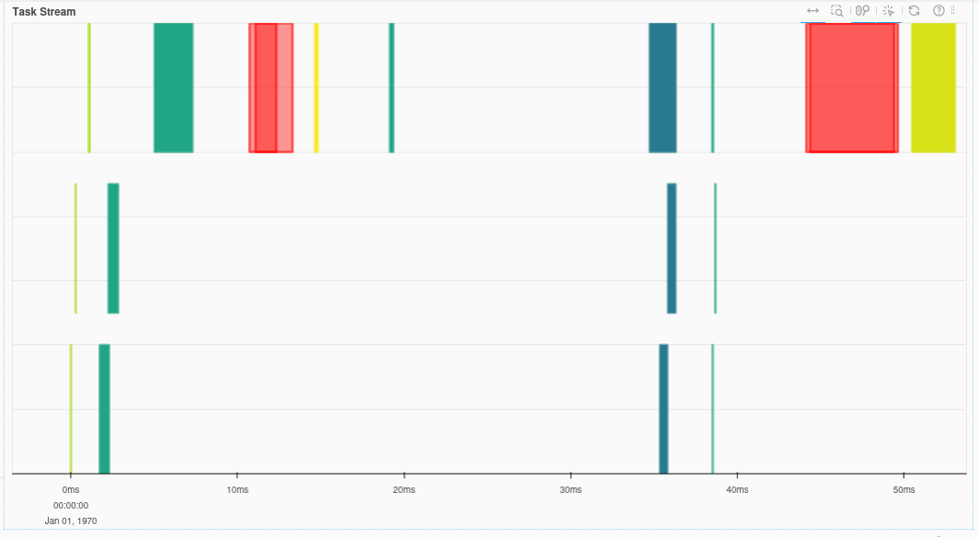
Cholesky TSQR
Computation of R
Computation of Q
First and second step
Third step
HIGGS dataset, 12 workers (only 3 displayed in the DAG out of simplicity)

Slide 12








Cholesky TSQR
A different version: pair reduction
As of now, one worker only gather all the Gram matrices and perform the sum (serial)
Let’s parallelize the sum too with a pairwise-reduction technique
Worker 1
Worker 1
./functions.py
Worker 2
Worker 2
def cholesky_tsqr(X_da : dask.array.Array):
…
while len(chunks_delayed) > 1:
new_level = []
for i in range(0, len(chunks_delayed), 2):
if i + 1 < len(chunks_delayed):
new_level.append(dask.delayed(sum)(chunks_delayed[i], chunks_delayed[i+1]))
else:
new_level.append(chunks_delayed[i])
chunks_delayed = new_level
…
return Q, R
Worker 3
Worker 3
Worker 4
Worker 4

Slide 13
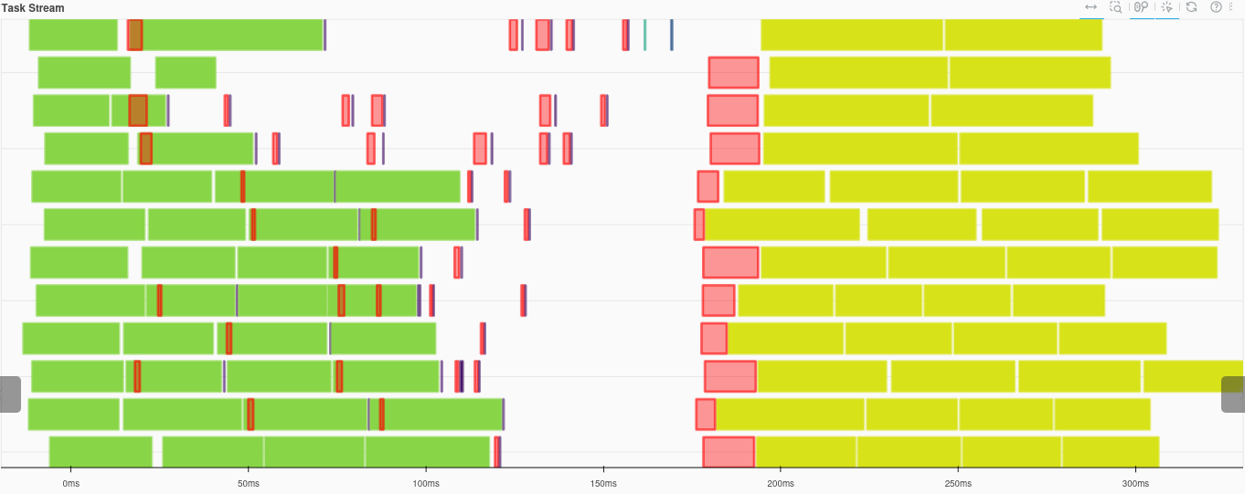


Cholesky TSQR
Computation of R
Computation of Q
Local Gram matrix
Block-wise MatMul
Transfer (of Gram, R_inv)
Pairwise sum
HIGGS dataset, 12 workers

Slide 14
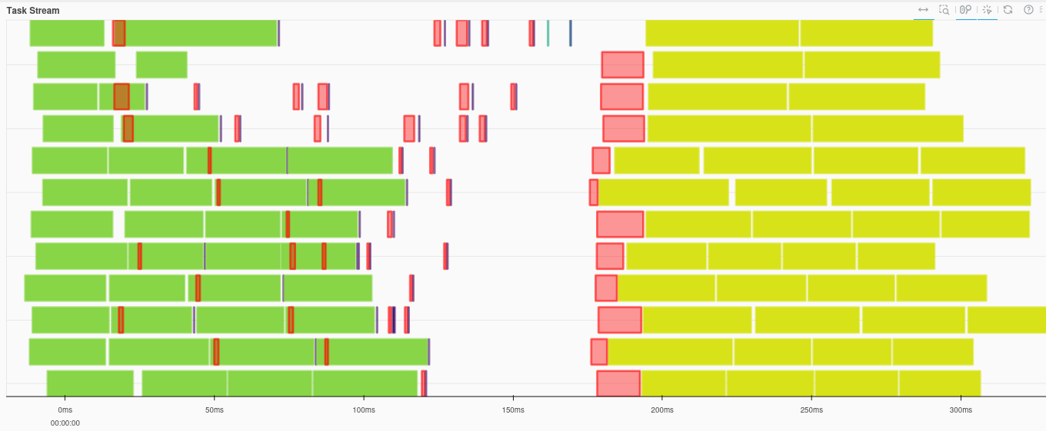
Cholesky TSQR
Comparing the two methods, the version without pairwise reduction proves slightly faster than the alternative.
Why? Adding multiple pairwise summations increases orchestration overhead.
It’s more efficient to transfer all the Gram matrices and aggregate them on a single worker, since these matrices are very small (typical in tall and skinny matrices).
Had the Gram matrices been larger (n larger) data transfers would have become a significant bottleneck, and the pairwise reduction approach might have been preferable.
HIGGS dataset, 12 workers

Slide 15
METHOD 2:
Indirect TSQR
./Indirect.ipynb

Slide 16



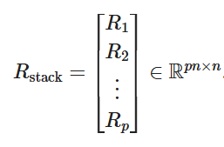


Indirect TSQR method
For an input matrix we perform partitioned QR factorizations:
Secondly, the global R matrix is obtained by stacking the shattered partitions:
Ultimately the global Q is recovered indirectly by means of the inverse of R:

Slide 17



Indirect TSQR
Step 1: Local QR
./functions.py
Worker 1
Worker 1
def indirect_tsqr(X_da):
n_cols = X_da.shape[1]
R_blocks = X_da.map_blocks(compute_R,
dtype=X_da.dtype,
chunks=(n_cols, n_cols))
R_stack = R_blocks.persist()
_, R = np.linalg.qr(R_stack)
I = np.eye(n_cols, dtype=X_da.dtype)
R_inv = solve_triangular(R, I, lower=False)
Q_da = X_da @ R_inv
return Q_da, R
map
Worker 2
Worker 2
map
Worker 3
Worker 3
map

Slide 18




Indirect TSQR
Step 2: Global QR
./functions.py
Worker 1
Worker 1
def indirect_tsqr(X_da):
n_cols = X_da.shape[1]
R_blocks = X_da.map_blocks(compute_R,
dtype=X_da.dtype,
chunks=(n_cols, n_cols))
R_stack = R_blocks.persist()
_, R = np.linalg.qr(R_stack)
I = np.eye(n_cols, dtype=X_da.dtype)
R_inv = solve_triangular(R, I, lower=False)
Q_da = X_da @ R_inv
return Q_da, R
reduce
Worker 2
Worker 2
reduce
reduce
Worker 3
Worker 3

Slide 19





Indirect TSQR
Step 2: Global QR
./functions.py
def indirect_tsqr(X_da):
n_cols = X_da.shape[1]
R_blocks = X_da.map_blocks(compute_R,
dtype=X_da.dtype,
chunks=(n_cols, n_cols))
R_stack = R_blocks.persist()
_, R = np.linalg.qr(R_stack)
I = np.eye(n_cols, dtype=X_da.dtype)
R_inv = solve_triangular(R, I, lower=False)
Q_da = X_da @ R_inv
return Q_da, R
Worker 1
Worker 1
Worker 2
Worker 2
Worker 3
Worker 3

Slide 20

Indirect TSQR
Step 3: Recovering Q
./functions.py
def indirect_tsqr(X_da):
n_cols = X_da.shape[1]
R_blocks = X_da.map_blocks(compute_R,
dtype=X_da.dtype,
chunks=(n_cols, n_cols))
R_stack = R_blocks.persist()
_, R = np.linalg.qr(R_stack)
I = np.eye(n_cols, dtype=X_da.dtype)
R_inv = solve_triangular(R, I, lower=False)
Q_da = X_da @ R_inv
return Q_da, R
Worker 1
Worker 1
Worker 1
map
Worker 2
Worker 2
Worker 2
map
Worker 3
Worker 3
Worker 3
map

Slide 21
Indirect TSQR
Step 3: Recovering Q
./functions.py
def indirect_tsqr(X_da):
n_cols = X_da.shape[1]
R_blocks = X_da.map_blocks(compute_R,
dtype=X_da.dtype,
chunks=(n_cols, n_cols))
R_stack = R_blocks.persist()
_, R = np.linalg.qr(R_stack)
I = np.eye(n_cols, dtype=X_da.dtype)
R_inv = solve_triangular(R, I, lower=False)
Q_da = X_da @ R_inv
return Q_da, R
Worker 1
Worker 1
map
Worker 2
Worker 2
map
Worker 3
Worker 3
map

Slide 22
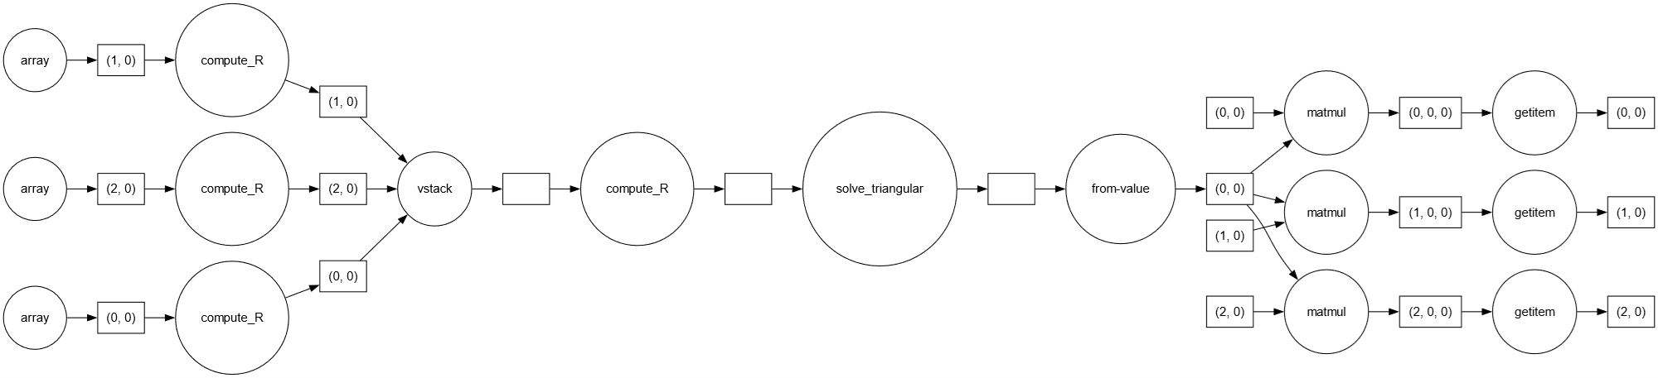
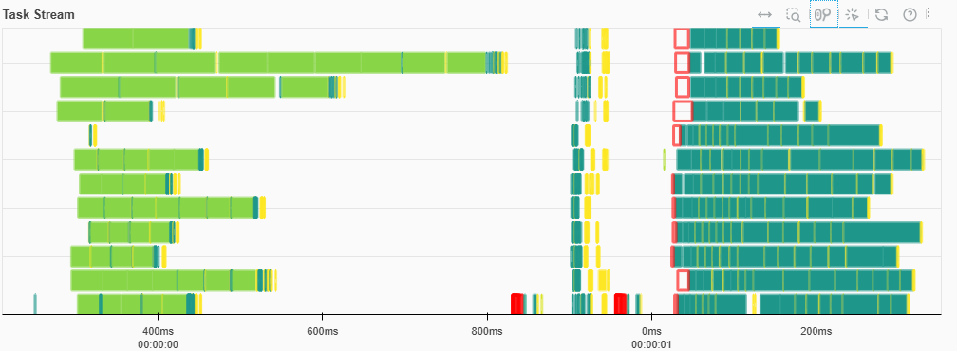
Indirect TSQR
Step 1
Step 2
Step 3
Higgs dataset

Slide 23
Indirect TSQR
Variations: Global QR
./functions.py
def indirect_parallel_delayed(X_da):
n_cols = X_da.shape[1]
R_blocks = X_da.map_blocks(compute_R,
dtype=X_da.dtype,
chunks=(n_cols, n_cols))
R_list = list(R_blocks.to_delayed().ravel())
R_stack = dask.delayed(np.vstack)(R_list)
R_delayed = dask.delayed(compute_R)(R_stack) I = np.eye(n_cols, dtype=X_da.dtype)
R_inv_delayed = dask.delayed(solve_triangular)
(R_delayed, I,
lower=False)
R_inv_da = da.from_delayed(R_inv_delayed,
shape=(n_cols, n_cols),
dtype=X_da.dtype)
Q_da = X_da @ R_inv_da return Q_da, R_delayed
./functions.py
def indirect_tsqr(X_da):
n_cols = X_da.shape[1]
R_blocks = X_da.map_blocks(compute_R,
dtype=X_da.dtype,
chunks=(n_cols, n_cols))
R_stack = R_blocks.compute()
_, R = np.linalg.qr(R_stack)
I = np.eye(n_cols, dtype=X_da.dtype)
R_inv = solve_triangular(R, I, lower=False)
Q_da = X_da @ R_inv
return Q_da, R

Slide 24
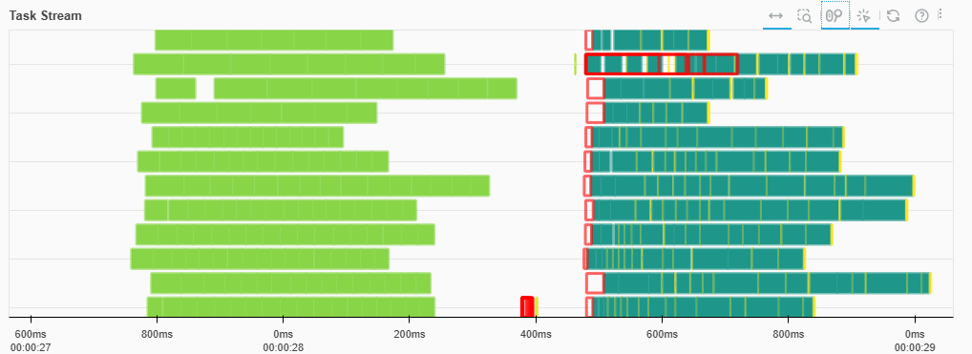
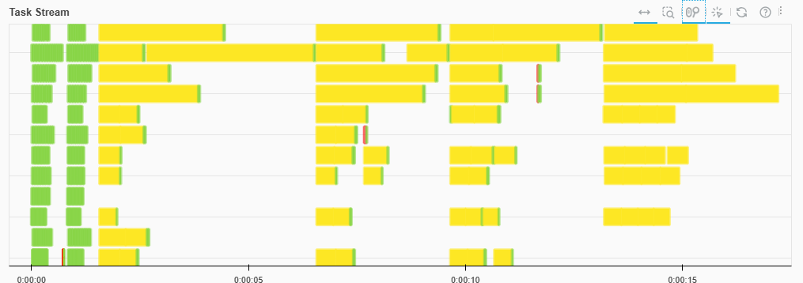
Indirect TSQR
Variations: Global QR

Slide 25
METHOD 3:
Direct TSQR
./Direct.ipynb

Slide 26


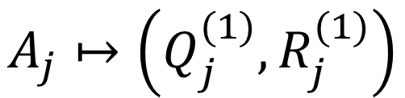
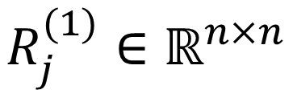
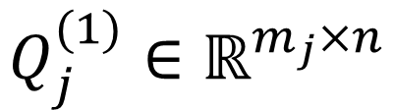
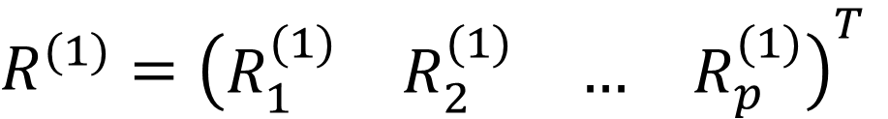





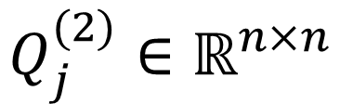
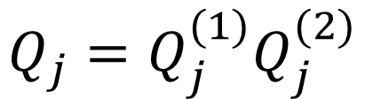





Direct TSQR
Input:
Step 1: Local QR
Step 2: Global QR
Step 3: Assembling Q
Output:

Slide 27
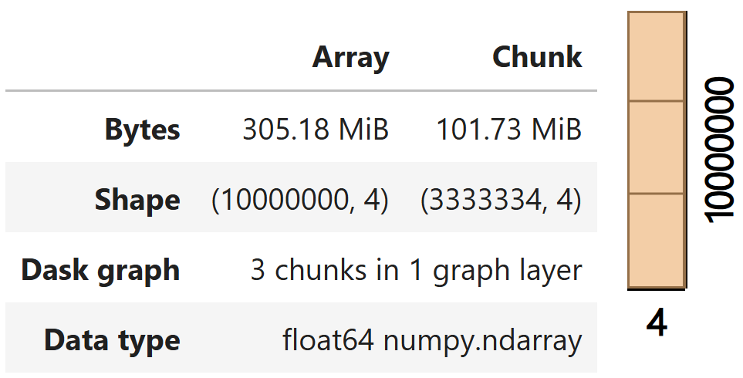



Direct TSQR
./functions.py
def direct_tsqr(A : da.Array):
n, row_chunks = A.shape[1], A.chunks[0]
p = len(row_chunks)
A_blocks = A.to_delayed().ravel().tolist()
QR1 = [delayed(qr)(block) for block in A_blocks]
Q1s = [qr[0] for qr in QR1]
R1s = [qr[1] for qr in QR1]
R1 = delayed(np.vstack)(R1s)
QR2 = delayed(qr)(R1)
Q2, R2 = QR2[0], QR2[1]
Q2s = [Q2[i*n:(i+1)*n, :] for i in range(p)]
Q_blocks = [da.from_delayed(
delayed(lambda Q1, Q2: Q1 @ Q2)(Q1, Q2),
shape=(row_chunks[i], n), dtype=A.dtype)
for i, (Q1, Q2) in enumerate(zip(Q1s, Q2s))]
Q = da.concatenate(Q_blocks)
return Q, da.from_delayed(R2, (n, n), dtype=A.dtype)
Worker 1
p = 3
Worker 2
Worker 3

Slide 28




Direct TSQR
./functions.py
Step 1: Local QR
def direct_tsqr(A : da.Array):
n, row_chunks = A.shape[1], A.chunks[0]
p = len(row_chunks)
A_blocks = A.to_delayed().ravel().tolist()
QR1 = [delayed(qr)(block) for block in A_blocks]
Q1s = [qr[0] for qr in QR1]
R1s = [qr[1] for qr in QR1]
R1 = delayed(np.vstack)(R1s)
QR2 = delayed(qr)(R1)
Q2, R2 = QR2[0], QR2[1]
Q2s = [Q2[i*n:(i+1)*n, :] for i in range(p)]
Q_blocks = [da.from_delayed(
delayed(lambda Q1, Q2: Q1 @ Q2)(Q1, Q2),
shape=(row_chunks[i], n), dtype=A.dtype)
for i, (Q1, Q2) in enumerate(zip(Q1s, Q2s))]
Q = da.concatenate(Q_blocks)
return Q, da.from_delayed(R2, (n, n), dtype=A.dtype)
Worker 1
Worker 1
map
Worker 2
Worker 2
map
Worker 3
Worker 3
map

Slide 29








Direct TSQR
./functions.py
Step 2: Global QR
def direct_tsqr(A : da.Array):
n, row_chunks = A.shape[1], A.chunks[0]
p = len(row_chunks)
A_blocks = A.to_delayed().ravel().tolist()
QR1 = [delayed(qr)(block) for block in A_blocks]
Q1s = [qr[0] for qr in QR1]
R1s = [qr[1] for qr in QR1]
R1 = delayed(np.vstack)(R1s)
QR2 = delayed(qr)(R1)
Q2, R2 = QR2[0], QR2[1]
Q2s = [Q2[i*n:(i+1)*n, :] for i in range(p)]
Q_blocks = [da.from_delayed(
delayed(lambda Q1, Q2: Q1 @ Q2)(Q1, Q2),
shape=(row_chunks[i], n), dtype=A.dtype)
for i, (Q1, Q2) in enumerate(zip(Q1s, Q2s))]
Q = da.concatenate(Q_blocks)
return Q, da.from_delayed(R2, (n, n), dtype=A.dtype)
Worker 1
Worker 1
reduce
Worker 2
Worker 2
reduce
reduce
Worker 3
Worker 3

Slide 30






Direct TSQR
./functions.py
Step 2: Global QR
def direct_tsqr(A : da.Array):
n, row_chunks = A.shape[1], A.chunks[0]
p = len(row_chunks)
A_blocks = A.to_delayed().ravel().tolist()
QR1 = [delayed(qr)(block) for block in A_blocks]
Q1s = [qr[0] for qr in QR1]
R1s = [qr[1] for qr in QR1]
R1 = delayed(np.vstack)(R1s)
QR2 = delayed(qr)(R1)
Q2, R2 = QR2[0], QR2[1]
Q2s = [Q2[i*n:(i+1)*n, :] for i in range(p)]
Q_blocks = [da.from_delayed(
delayed(lambda Q1, Q2: Q1 @ Q2)(Q1, Q2),
shape=(row_chunks[i], n), dtype=A.dtype)
for i, (Q1, Q2) in enumerate(zip(Q1s, Q2s))]
Q = da.concatenate(Q_blocks)
return Q, da.from_delayed(R2, (n, n), dtype=A.dtype)
Worker 1
Worker 1
Worker 2
Worker 2
Worker 3
Worker 3

Slide 31














Direct TSQR
./functions.py
Step 3: Assembling Q
def direct_tsqr(A : da.Array):
n, row_chunks = A.shape[1], A.chunks[0]
p = len(row_chunks)
A_blocks = A.to_delayed().ravel().tolist()
QR1 = [delayed(qr)(block) for block in A_blocks]
Q1s = [qr[0] for qr in QR1]
R1s = [qr[1] for qr in QR1]
R1 = delayed(np.vstack)(R1s)
QR2 = delayed(qr)(R1)
Q2, R2 = QR2[0], QR2[1]
Q2s = [Q2[i*n:(i+1)*n, :] for i in range(p)]
Q_blocks = [da.from_delayed(
delayed(lambda Q1, Q2: Q1 @ Q2)(Q1, Q2),
shape=(row_chunks[i], n), dtype=A.dtype)
for i, (Q1, Q2) in enumerate(zip(Q1s, Q2s))]
Q = da.concatenate(Q_blocks)
return Q, da.from_delayed(R2, (n, n), dtype=A.dtype)
Worker 1
Worker 1
Worker 2
Worker 2
Worker 3
Worker 3

Slide 32








Direct TSQR
./functions.py
Step 3: Assembling Q
def direct_tsqr(A : da.Array):
n, row_chunks = A.shape[1], A.chunks[0]
p = len(row_chunks)
A_blocks = A.to_delayed().ravel().tolist()
QR1 = [delayed(qr)(block) for block in A_blocks]
Q1s = [qr[0] for qr in QR1]
R1s = [qr[1] for qr in QR1]
R1 = delayed(np.vstack)(R1s)
QR2 = delayed(qr)(R1)
Q2, R2 = QR2[0], QR2[1]
Q2s = [Q2[i*n:(i+1)*n, :] for i in range(p)]
Q_blocks = [da.from_delayed(
delayed(lambda Q1, Q2: Q1 @ Q2)(Q1, Q2),
shape=(row_chunks[i], n), dtype=A.dtype)
for i, (Q1, Q2) in enumerate(zip(Q1s, Q2s))]
Q = da.concatenate(Q_blocks)
return Q, da.from_delayed(R2, (n, n), dtype=A.dtype)
Worker 1
Worker 1
map
Worker 2
Worker 2
map
Worker 3
Worker 3
map

Slide 33
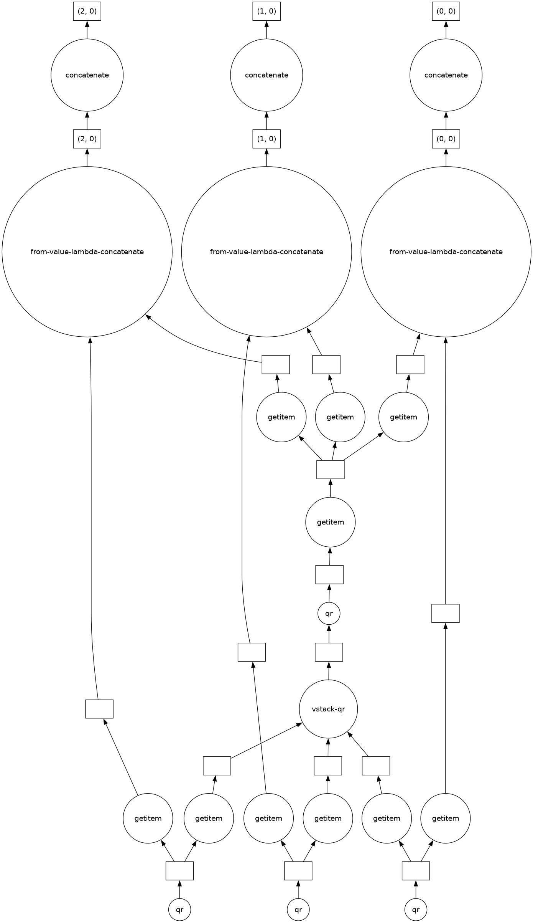
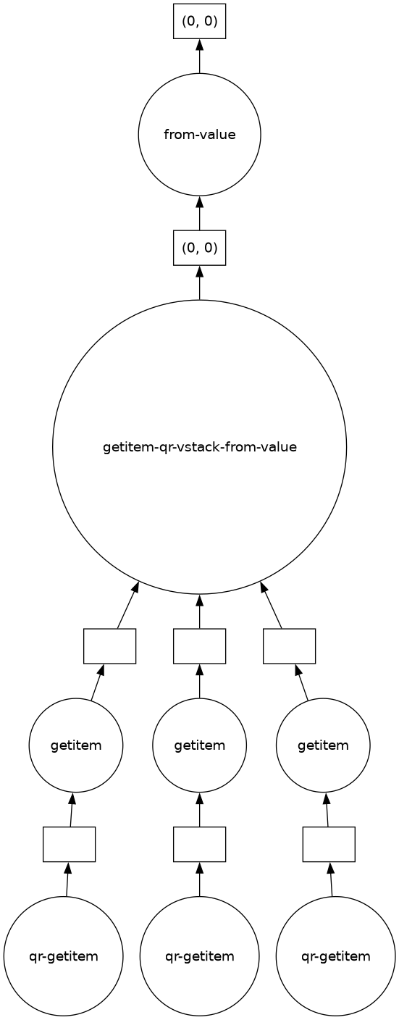
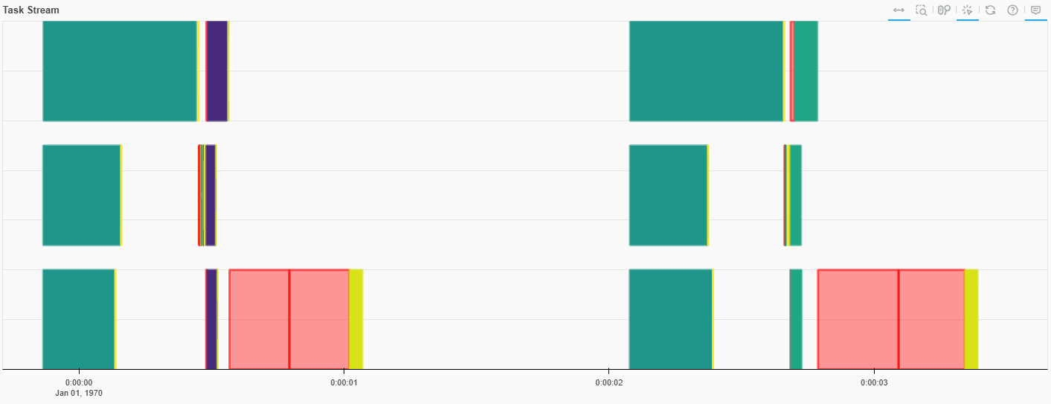
Direct TSQR
Step 3
Step 2
Step 2
Step 1
Step 1
Synthetic dataset

Slide 34
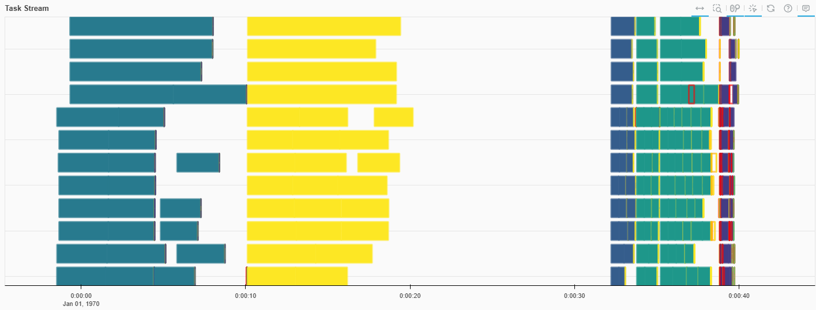
Direct TSQR
Our implementation
Dask’s implementation
direct_tsqr
dask.array.linalg.tsqr
(m, n) = (1e7, 4)
(m, n) = (1e7, 4)
Time: 2.21 s
Time: 2.34 s
Higgs dataset
Both Dask’s and our methods are computed and then compared with a delayed np.isclose() to avoid transferring Q to a single worker

Slide 35



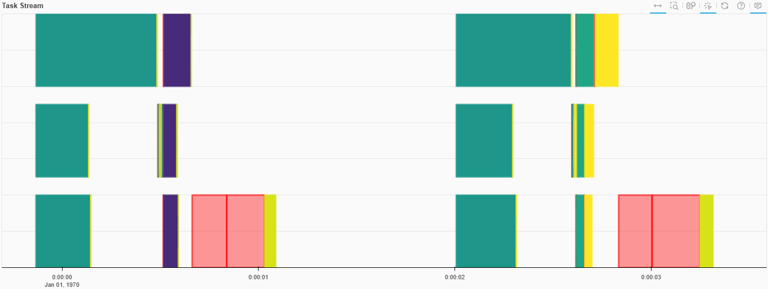
Direct TSQR - Singular Value Decomposition
./functions.py
Extension to SVD
SVD = delayed(svd)(R2)
U_R, S, Vt = SVD[0], SVD[1], SVD[2]
U_blocks = [da.from_delayed(delayed(lambda Q1, Q2, U_R:
Q1 @ Q2 @ U_R)(Q1, Q2, U_R),
shape=(row_chunks[i], n), dtype=A.dtype)
for i, (Q1, Q2) in enumerate(zip(Q1s, Q2s))]
U = da.concatenate(U_blocks)
return U, da.from_delayed(S, (n,), dtype=A.dtype), \
da.from_delayed(Vt, (n, n), dtype=A.dtype)
Our implementation
Dask’s implementation
direct_tsqr
dask.array.linalg.tsqr
(m, n) = (1e7, 4)
(m, n) = (1e7, 4)
Time: 2.14 s
Time: 2.23 s

Slide 36
BENCHMARK 1:
Partition number
This benchmark analyzes how the number of partitions affects the performance and accuracy of the TSQR algorithms, showing that optimal partitioning improves speed and excessive partitioning increases overhead, and highlighting the trade-offs between speed and numerical stability for each method.
./Benchmark_partitions.ipynb

Slide 37
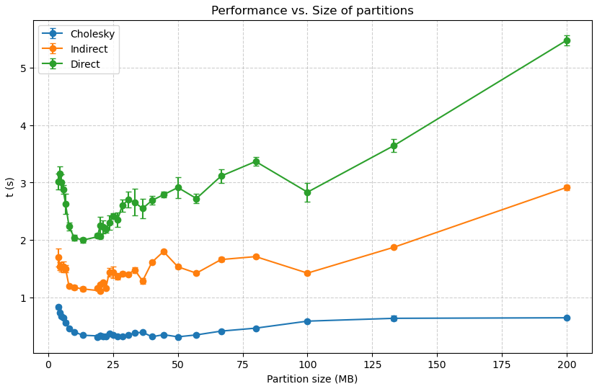
Benchmark 1: Partition number
First observation:
Too few partitions (e.g., 10 partitions for 12 workers) make each chunk large (and can leave some workers idle.)
Too many partitions create very small chunks, making computations easy, but the orchestration overhead increases, overall reducing performance.
500
100
40
N. of partitions
10
A sweet spot can be found
HIGGS dataset (2 GB), 12 workers. Repeat the algorithms 25 times each, collect the median and the MAD (median absolute deviation)

Slide 38




Benchmark 1: Partition number
Second observation:
It seems like Cholesky decomposition is faster than other state-of-the-art methods …
Although faster, Cholesky suffers from instability and inaccuracy. Specifically:
500
100
40
N. of partitions
10
HIGGS dataset (2 GB), 12 workers

Slide 39
BENCHMARK 2:
Workers number
This notebook benchmarks how varying the number of Dask workers affects the performance of the three TSQR algorithms on fixed-size datasets, showing that increasing workers improves speed for large datasets due to better parallelization
./Benchmark_workers.ipynb

Slide 40
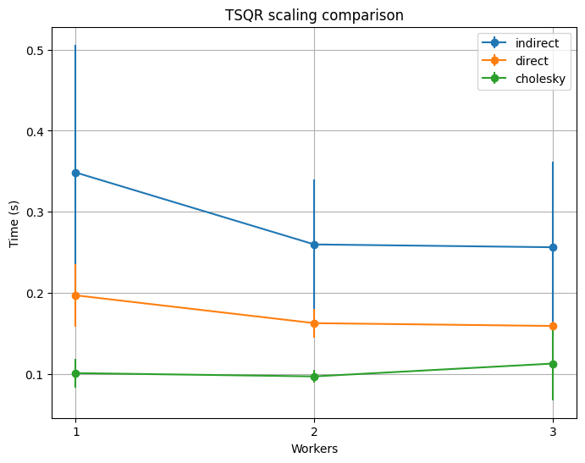
Benchmark 2: Workers number
cluster.scale(target)
Observations:
For a small dataset (e.g., < 500 Mb) The workload for a single worker isn’t excessive, and the results are comparable between the cases.
The standard deviation of the runtimes can be relatively high and oscillate significantly across runs. Due to light computational load and external factors.
California Housing dataset

Slide 41
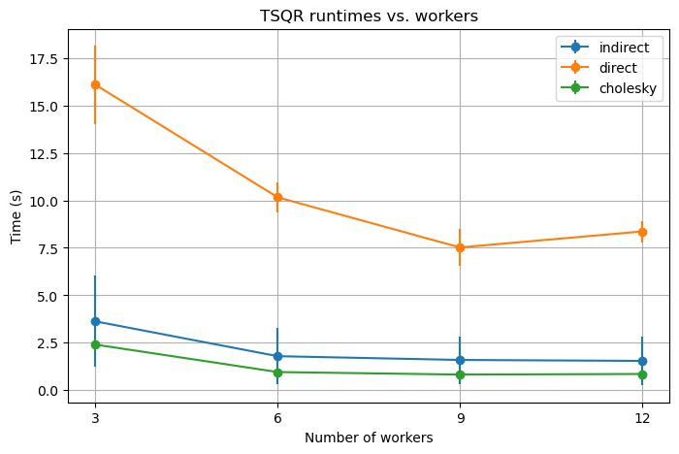
Benchmark 2: Workers number
cluster = SSHCluster(...)
Observations:
For a bigger dataset (e.g., ~ 3 Gb) The results depends heavily on the number of workers. The optimal number of workers is between 9-12.
In this study we also demonstrated a property of the indirect and direct TSQR methods. Where their performances are swapped depending on the dimension of the dataset. This result will be examined later.
HIGGS
dataset

Slide 42
BENCHMARK 3:
Matrix size
This benchmark measures how the execution time of the TSQR algorithms scales with increasing row counts for tall-and-skinny matrices, comparing parallel Dask-based methods to sequential NumPy QR.
./Benchmark_size.ipynb

Slide 43
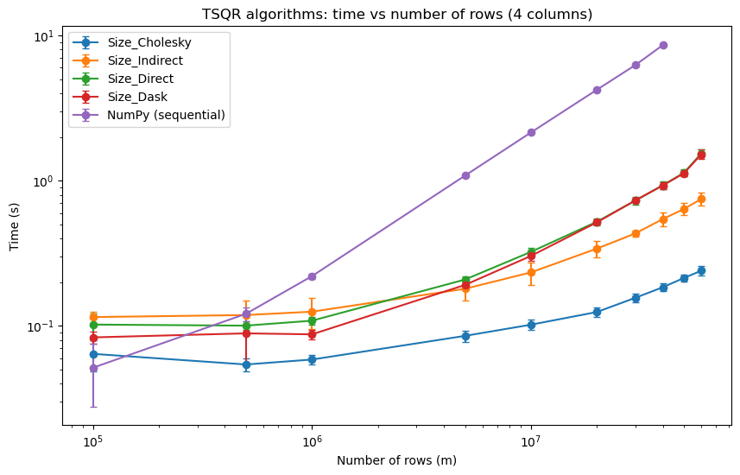



Benchmark 3: Matrix size
The asymptotic execution time of all TSQR algorithms increases roughly linearly with the number of rows, reflecting the time complexity of their steps:
Matrix-matrix multiplication
Matrix inversion
QR decomposition
Synthetic dataset
12 workers

Slide 44
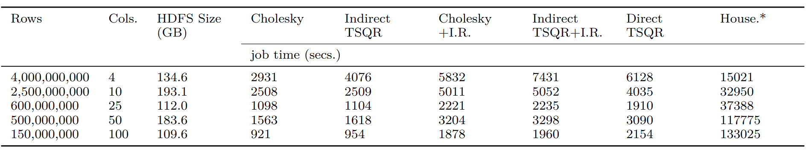
Benchmark 3: Matrix size
Our in-memory benchmark was designed to show the performance differences between TSQR methods and the state-of-the-art sequential QR algorithm.
While sequential calculation limits the matrix size, bigger matrices only amplify the performance gap with parallel implementations
The benchmarks by Benson et al. (2013) use much larger matrices, where disk read/write times become the main bottleneck, allowing them to create a performance model based on distributed computing platform specifications
Table VI, Benson et al. (2013)

Slide 45
BENCHMARK 4:
Stability
This benchmark evaluates how the orthogonality error of different TSQR algorithms depends on the condition number of the input matrix, and tests iterative correction methods for improving stability on ill-conditioned matrices.
./Benchmark_cond.ipynb

Slide 46
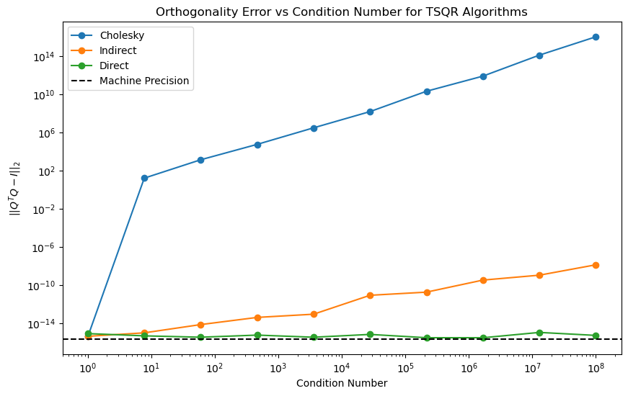
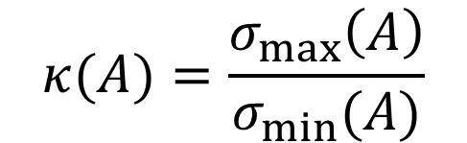
Benchmark 3: Stability
The condition number of a matrix measures how sensitive its output is to errors in the input
When the matrix A is ill-conditioned, the matrix inversion in the Cholesky and Indirect methods can produce a non-orthogonal matrix Q
Synthetic dataset
1000 ⨉ 4
3 workers (local)

Slide 47




Benchmark 3: Stability
Iterative refinement is a simple and fast post-processing technique that can improves the orthogonality of Q
near-orthogonal
orthogonality error
./Benchmark_cond.ipynb
Iterative refinement with adaptive step 𝛼
def iterative_refinement(Q : np.ndarray, n_iter : int):
for _ in range(n_iter):
E = np.eye(n) - Q.T @ Q
error_norm = np.linalg.norm(E)
alpha = min(0.5, 1.0 / (1.0 + error_norm))
Q = Q + alpha * Q @ E
return Q

Slide 48
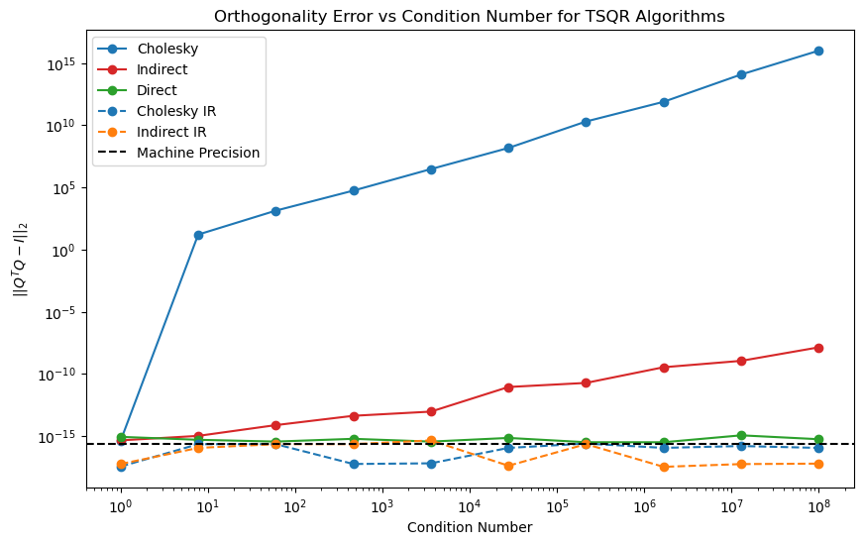
Benchmark 3: Stability
Synthetic dataset
1000 ⨉ 4
3 workers (local)

