Slide 1


LITHIUM RED, CRUDE APPROXIMATION
Quantum Information with Atoms and Photons
Riccardo Corte 05/02/2025

Slide 2
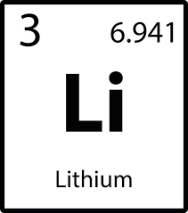


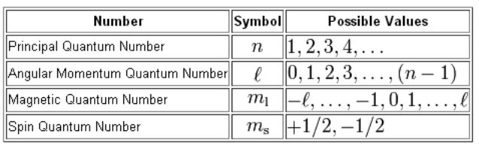
Introduction
The Lithium atom can be addressed as an hydrogen-like system

Slide 3

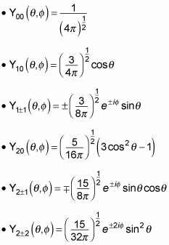

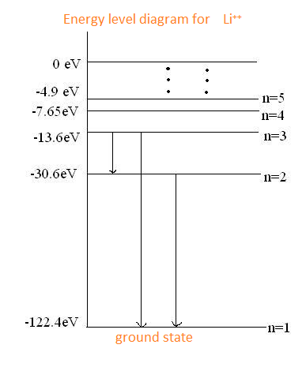

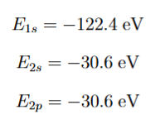
Wavefunction and Energies

Slide 4




Electrostatic potential
Charge density:
Gauss Law:
Poisson equation:

Slide 5


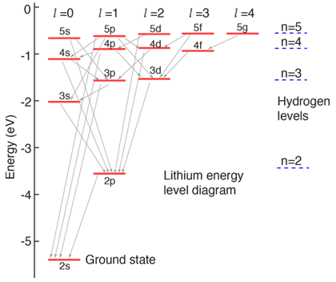


Perturbation theory
Perturbative Hamiltonian:
First order effective Hamiltonian:
Results obtained:

Slide 6
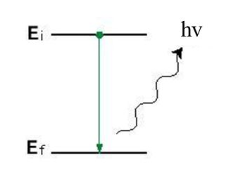


Red Lithium flame frequency
Photon emission:
Conservation of energy:
Corresponding Wavelength:

Slide 7

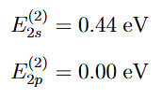

Second Order Perturbation theory
Second order effective Hamiltonian:
Energy corrections:
New Wavelength:

Slide 8
