Slide 1
The Future for Donkey Games
What kind of game do you want to make?
By Ric Clark, Data Analyst

Slide 2
What are main drivers of sales in games development?
Genre
Platform (e.g. Wii, PC)
Publisher
Developer
Review scores
Capacity for sequels
Sales Geographic split
Target audience

Slide 3
Assumptions & limitations of data (& data analysis)
Two datasets from 2016 and 2019
Top 50 games by sales
Japanese sales
EU Sales
Missing values, geo-spatial analysis

Slide 4
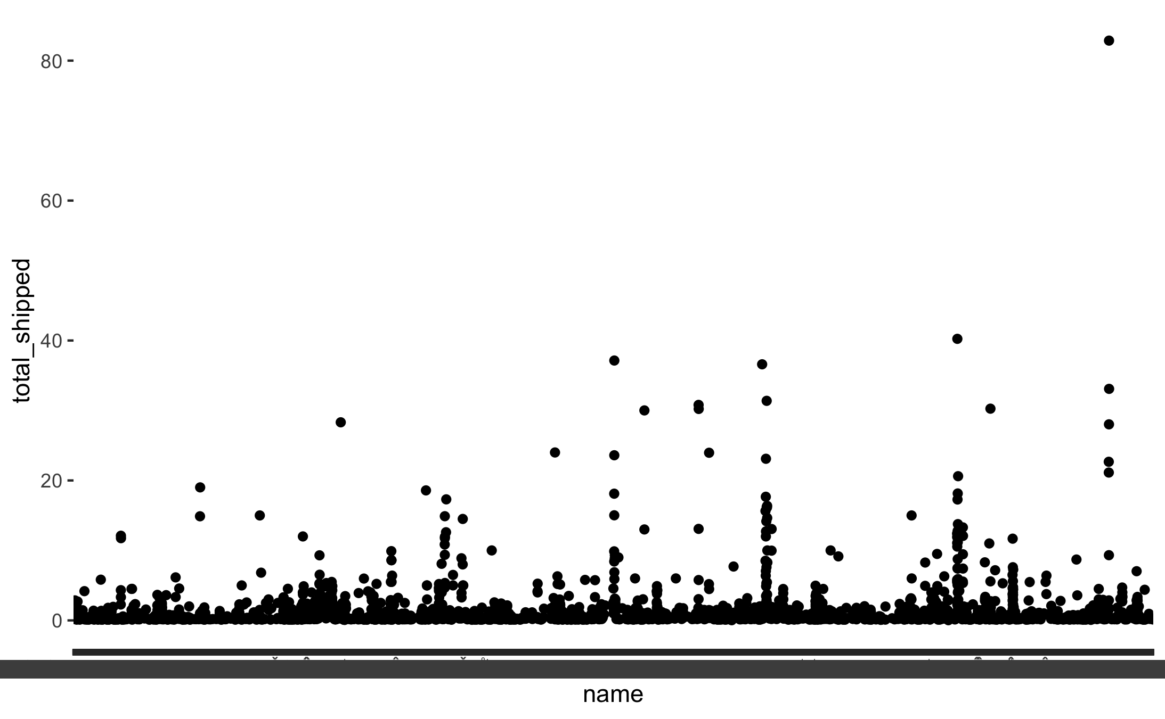
The sound of popularity…

Slide 5
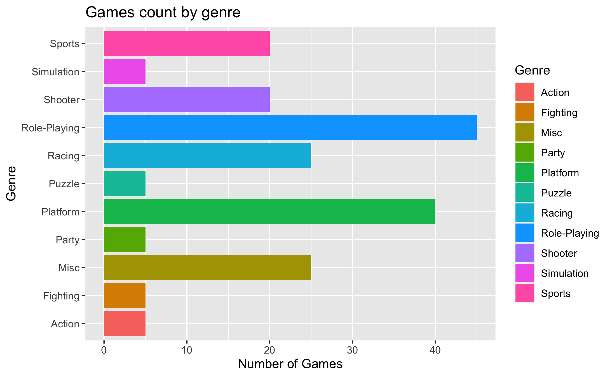
What are the most common genres?

Slide 6
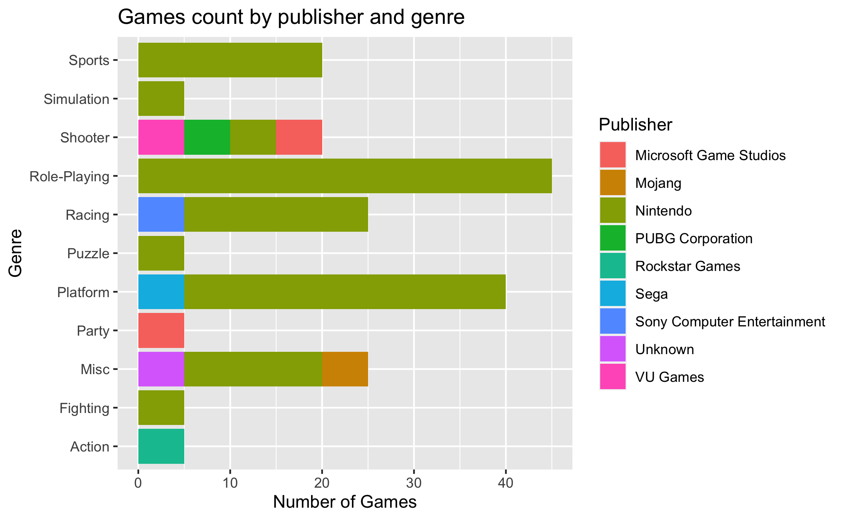
Who are the biggest publishers of those games?

Slide 7
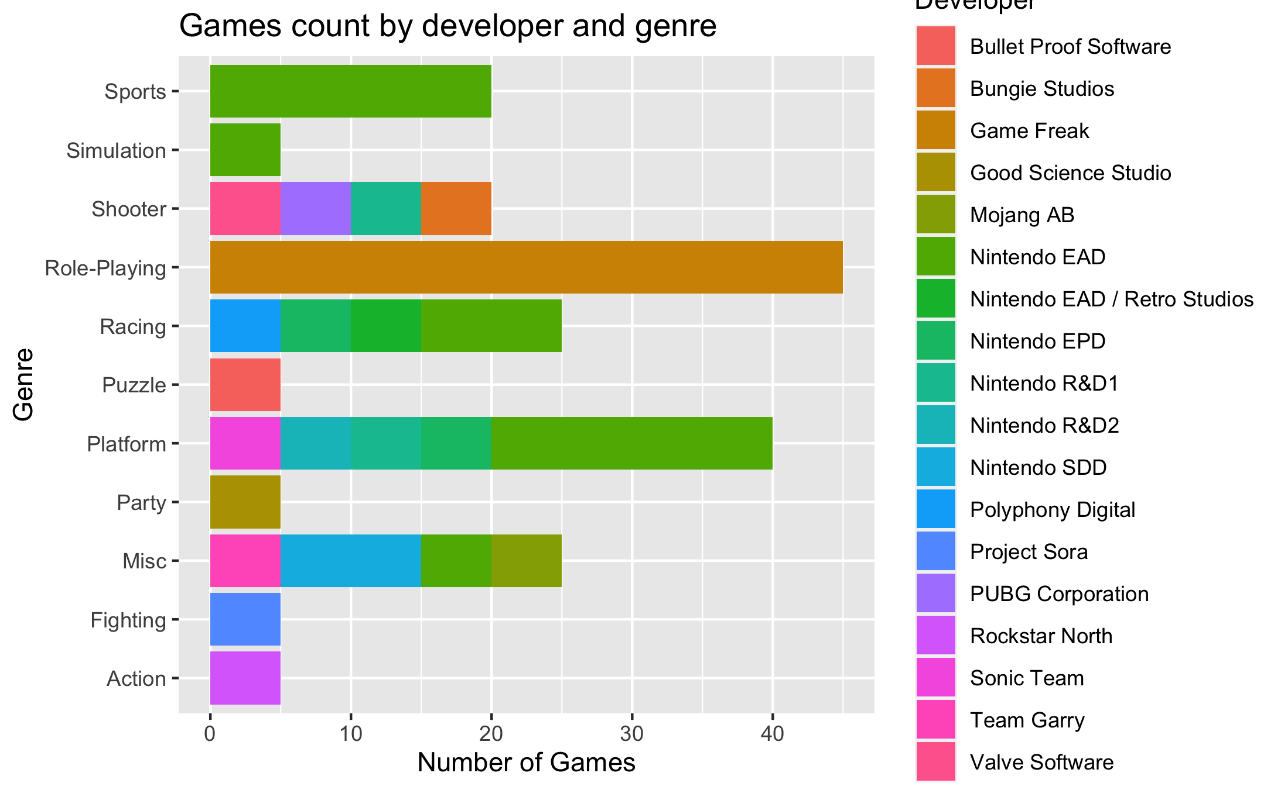
Would you consider some help from another developer?

Slide 8
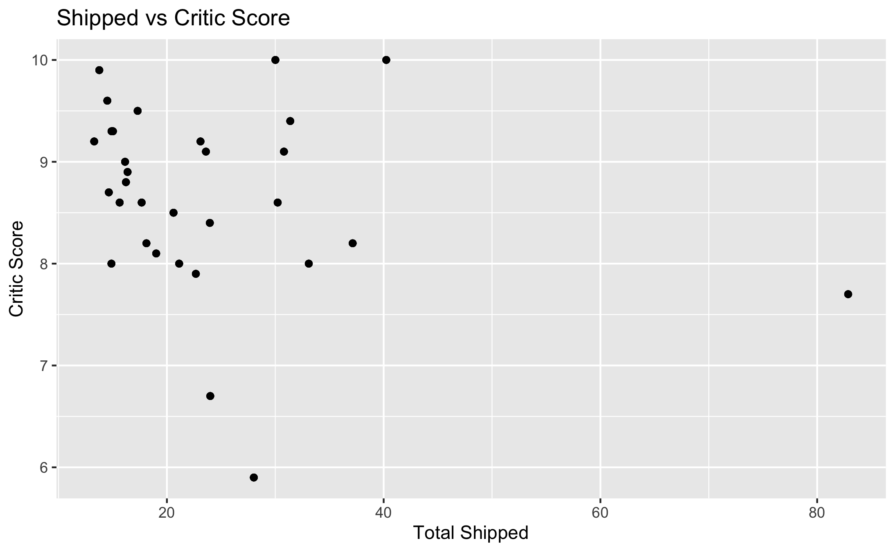
Is there a relationship between global sales and critic scores?

Slide 9
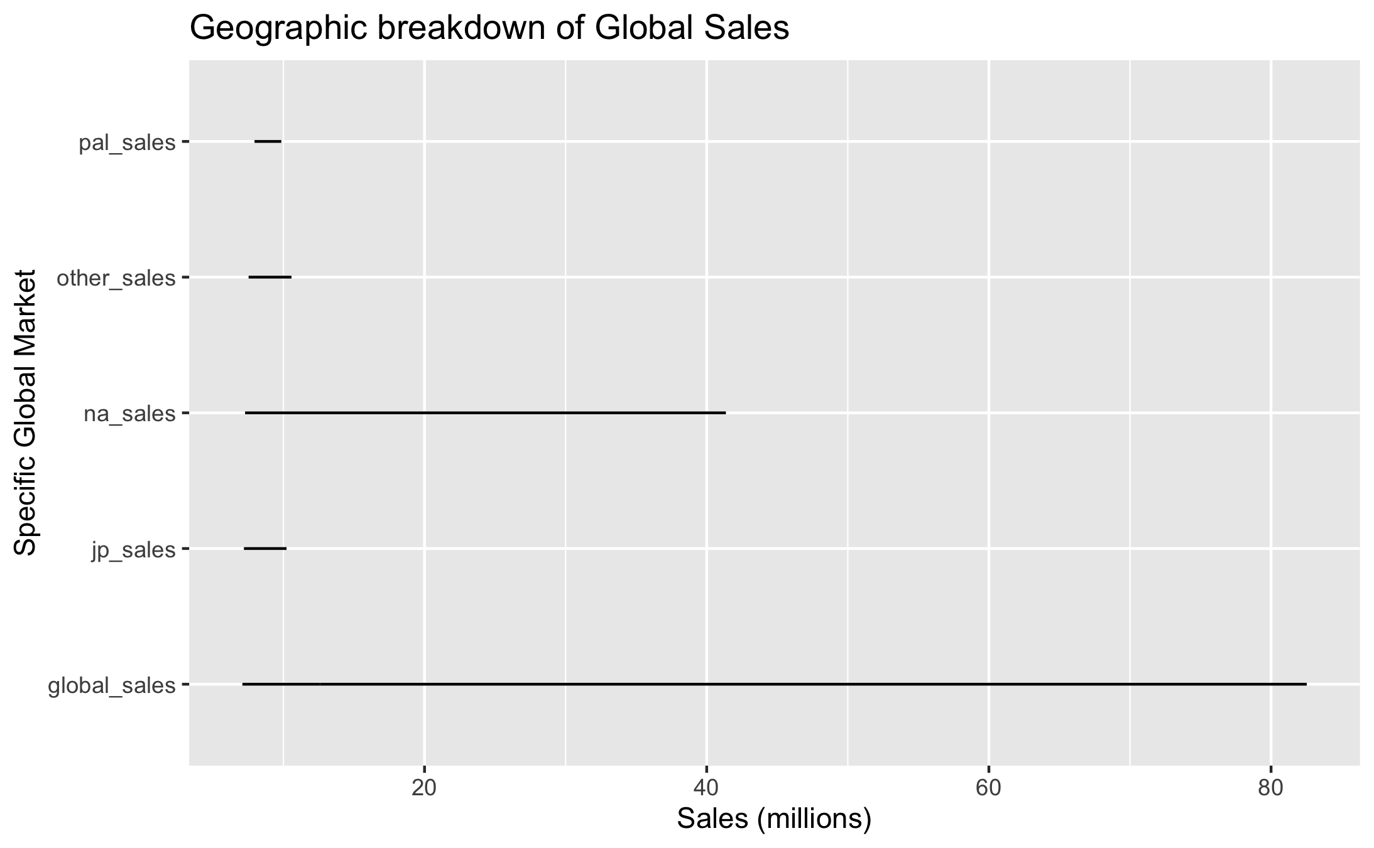
What is the most important market to break?

Slide 10
Conclusions?
Massive global sellers are rare. Scalability is a concern for a small developer like Donkey Games
There has been a proliferation of the most popular games in role playing and “platform” games
Nintendo have been the most successful publishers
Game Freak have had incredible success as developers (were you to want to work with them)
There doesn’t seem to be a massive correlation between critic reviews and sales
North America is the market that you want to conquer if you want global sales

Slide 11
With more time I would like to do the following?
Re-examine the global split as I am not convinced the Japanese market doesn’t have a bigger impact
Calculate missing data
Calculate average sales volumes per year to examine trends
Cut off to the last 3 years
Create a historical model
Create a forward-looking model

