Slide 1
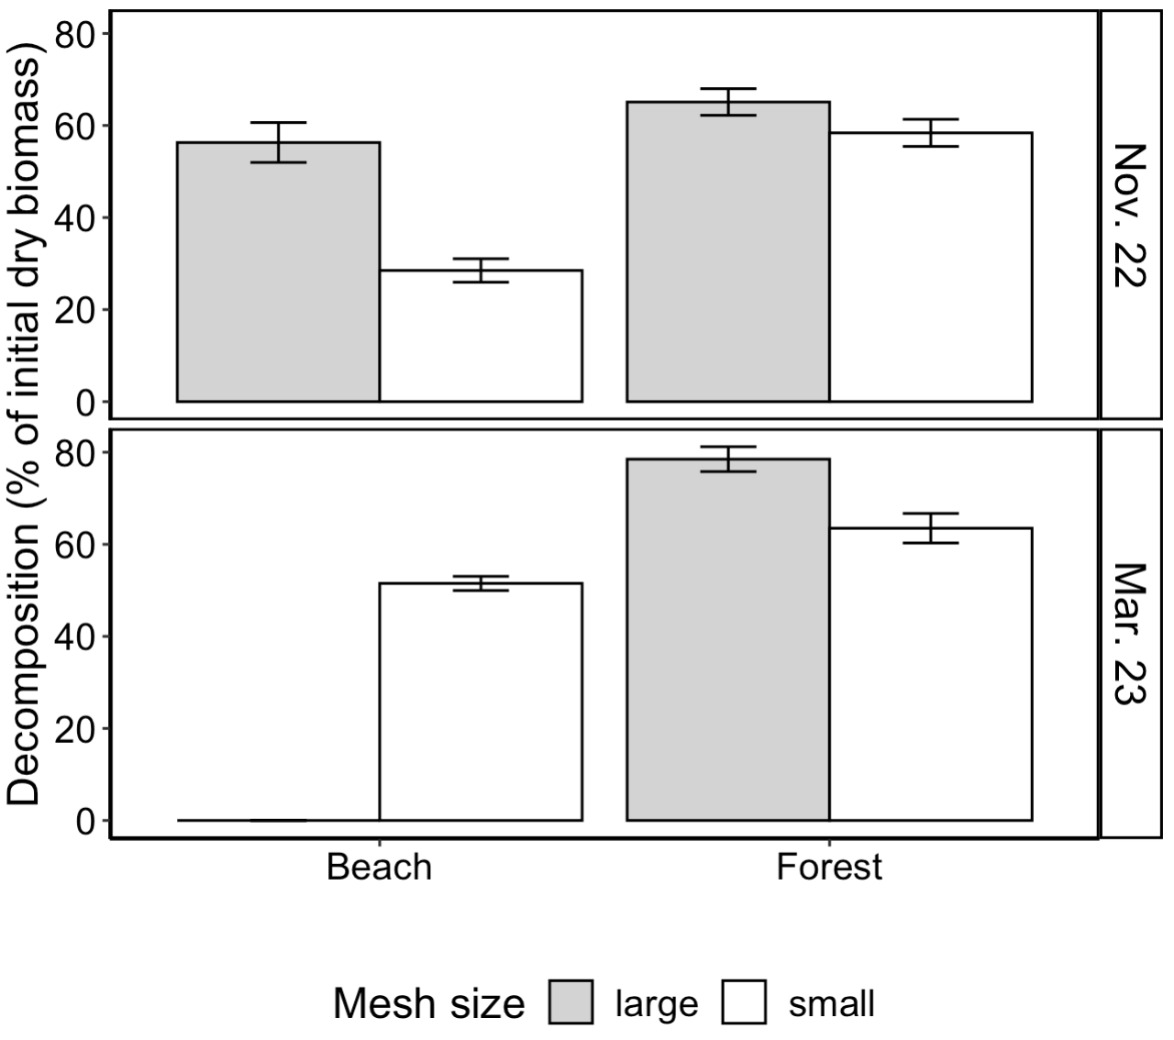
A
B
Notes:
Figure 1, Mesh bag decomposition

Slide 2
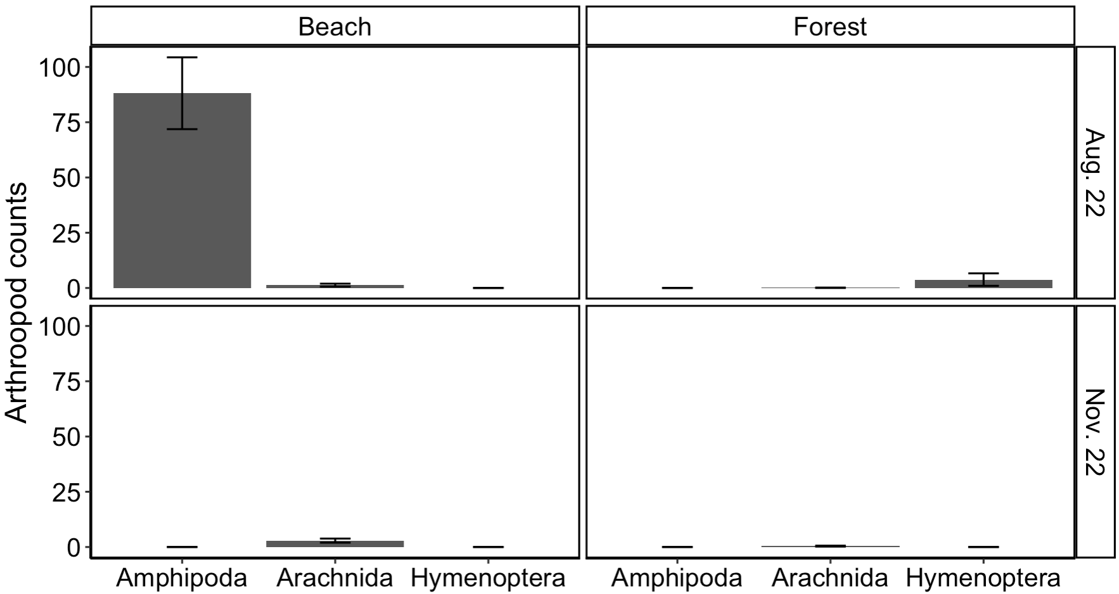
A
B
C
D
Notes:
Figure 2, Mesh bag arthropods

Slide 3
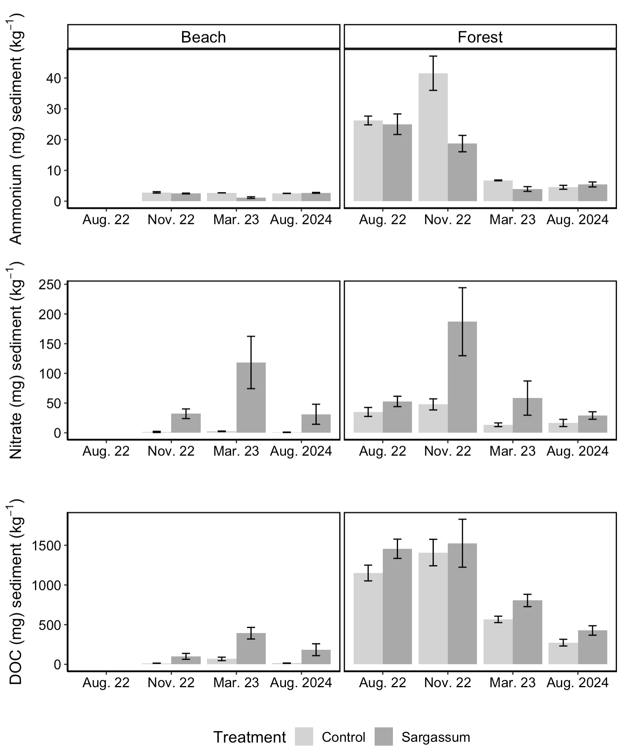
A
B
C
D
E
F
Notes:
Figure 3. chemicals

Slide 4
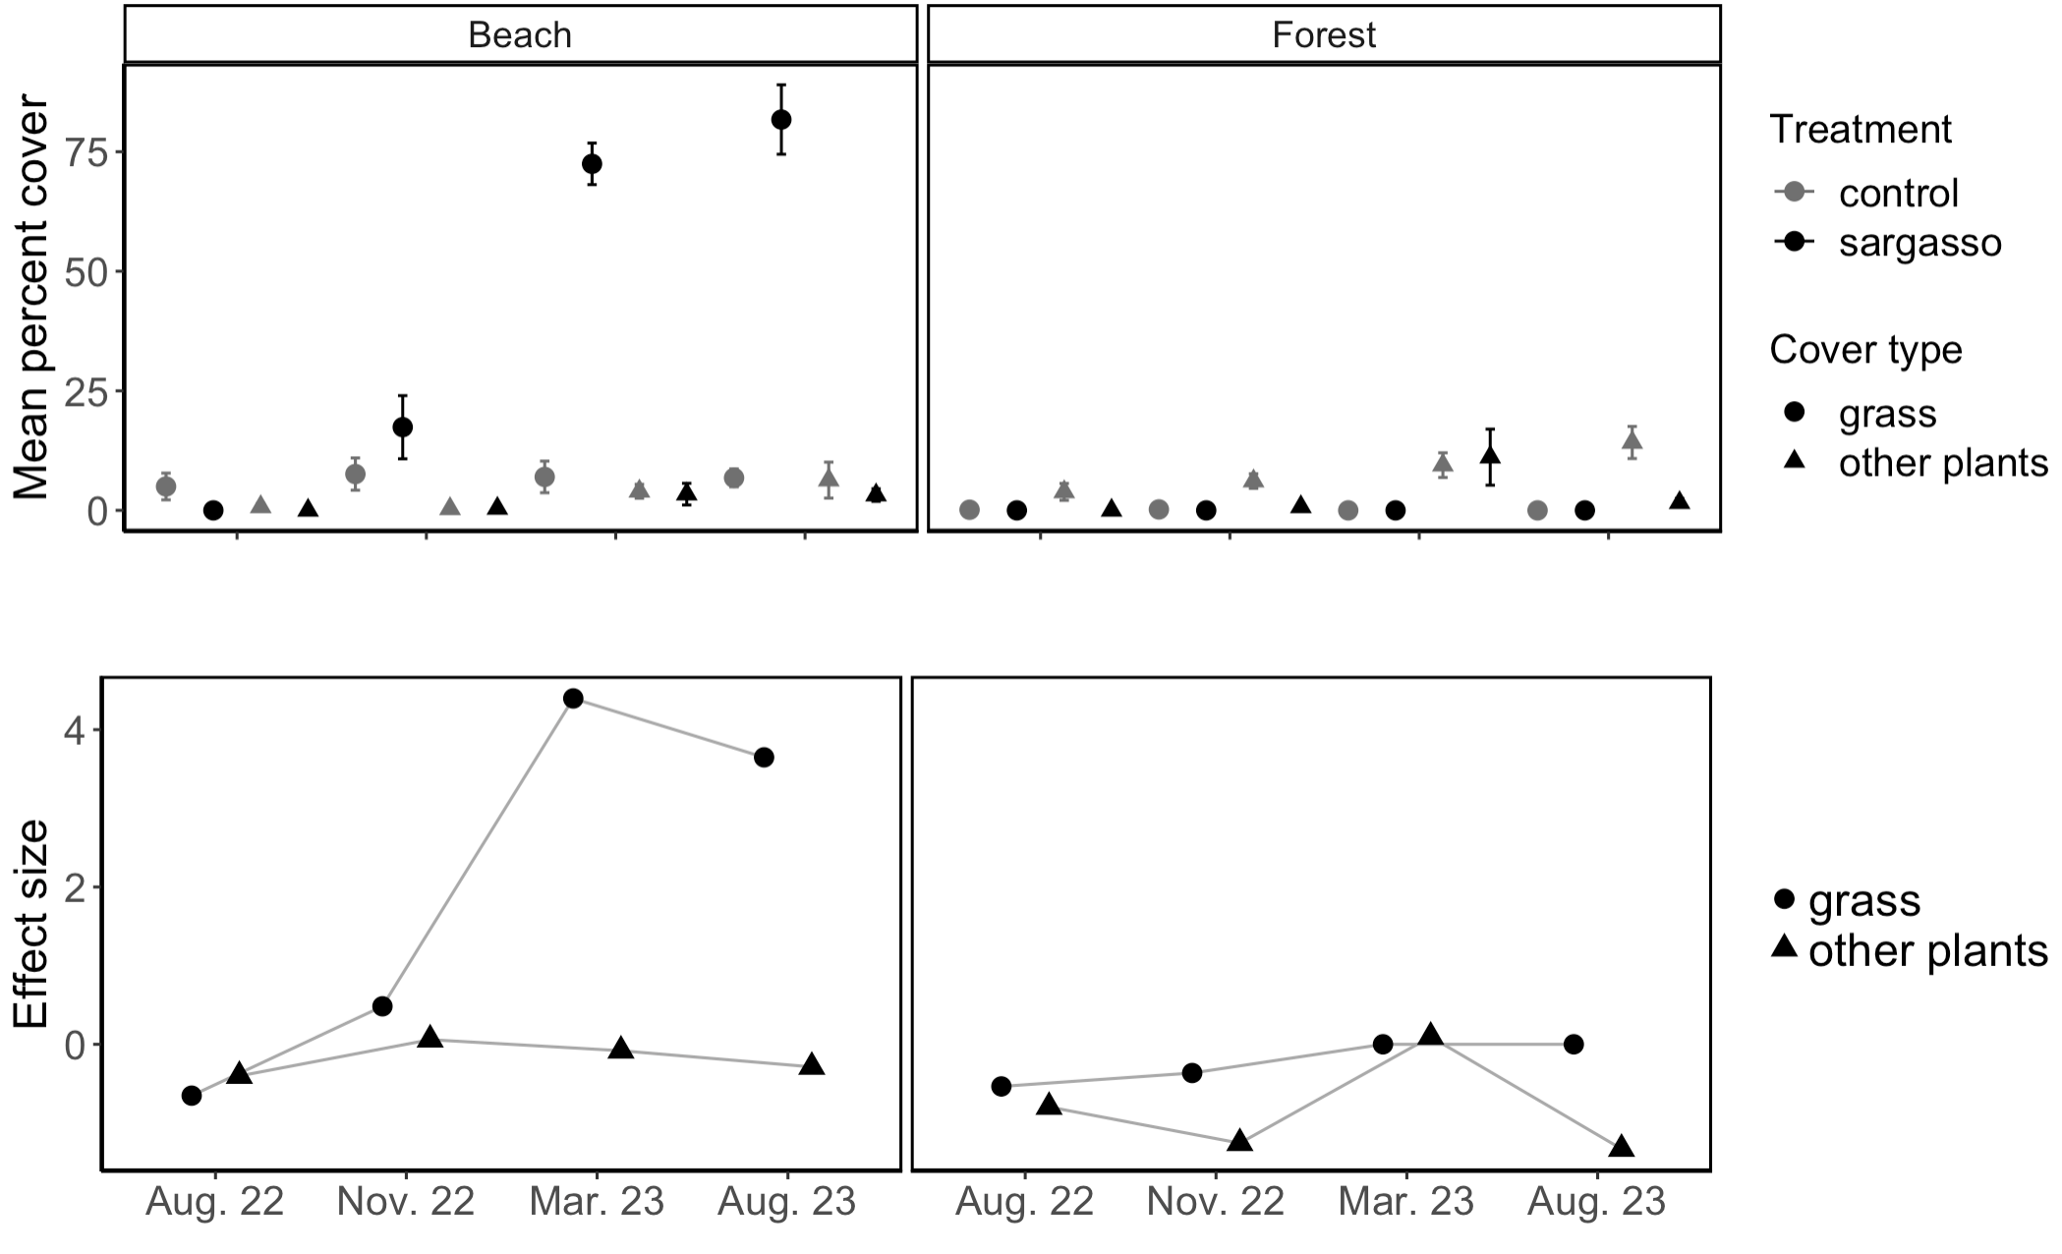
A
B
C
D
Notes:
Figure 5. plot interiors

Slide 5
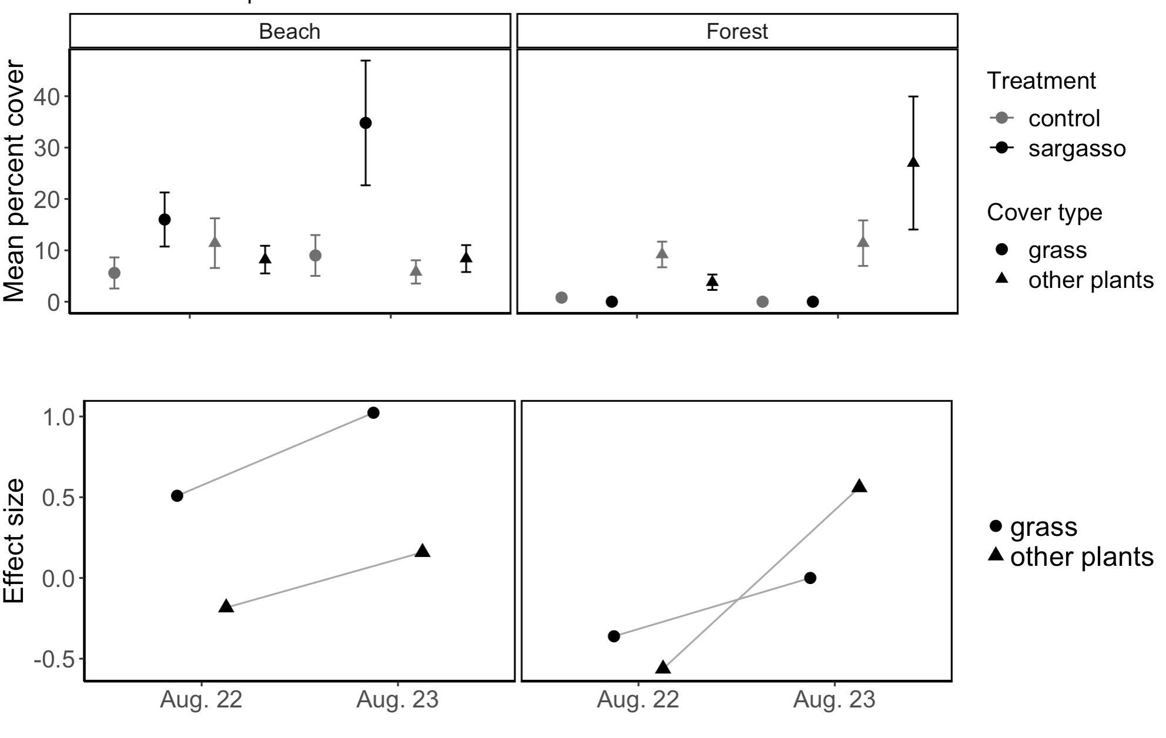
A
B
C
D
perimeter
Notes:
Figure 6. perimeter

Slide 6
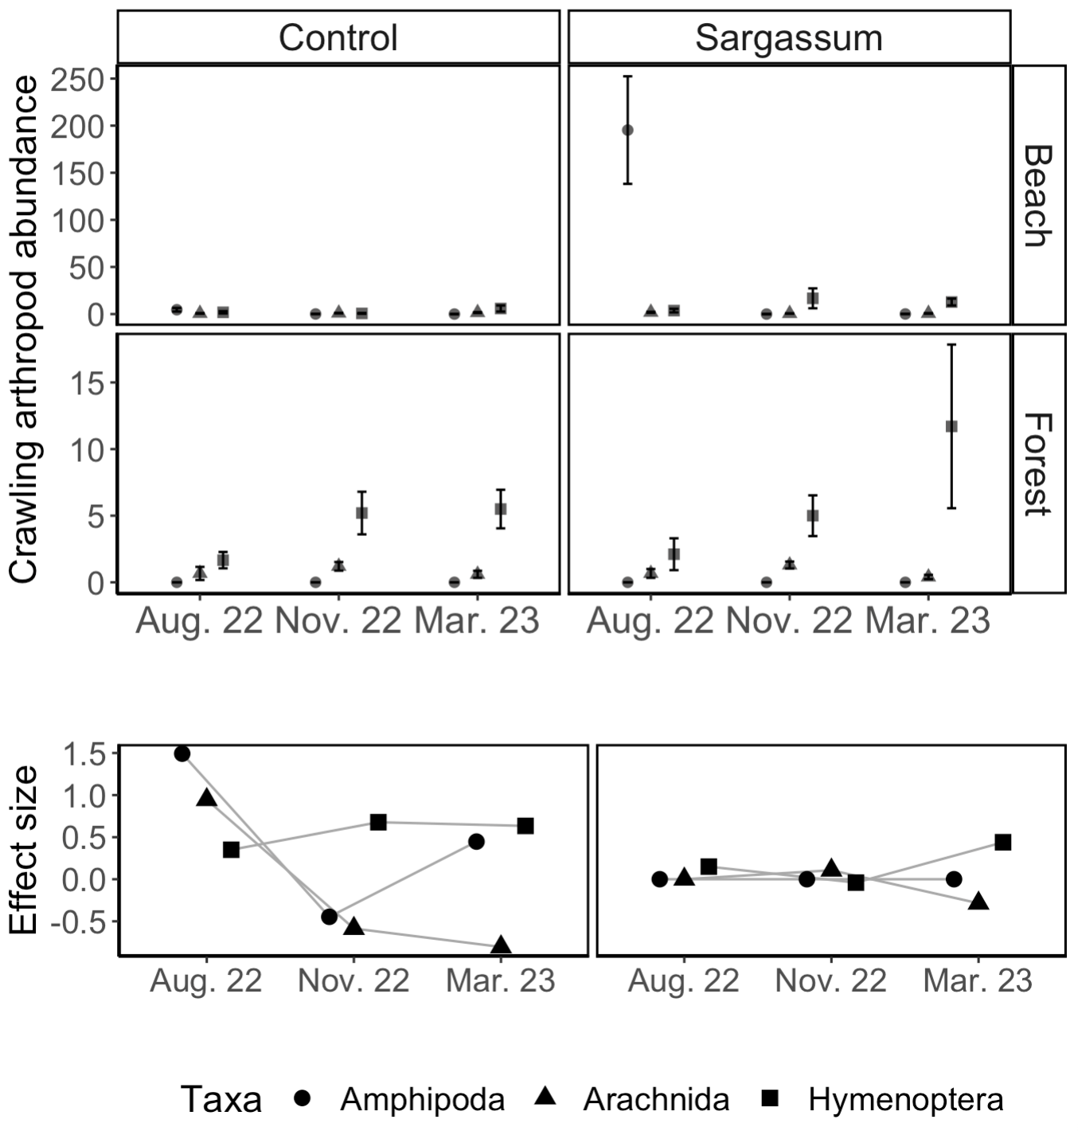
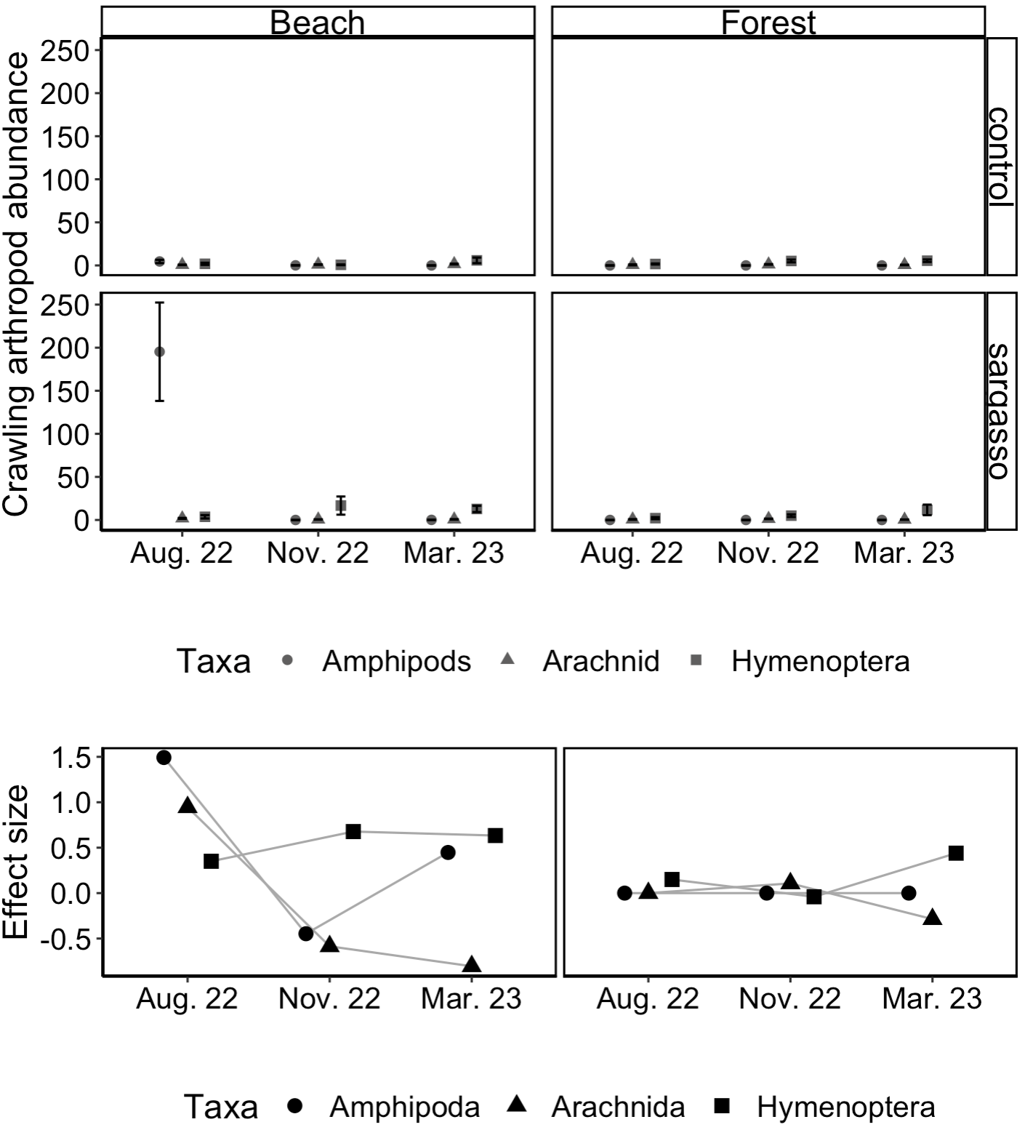
A
B
C
D
E
F
Notes:
Figure 7. crawlers

Slide 7
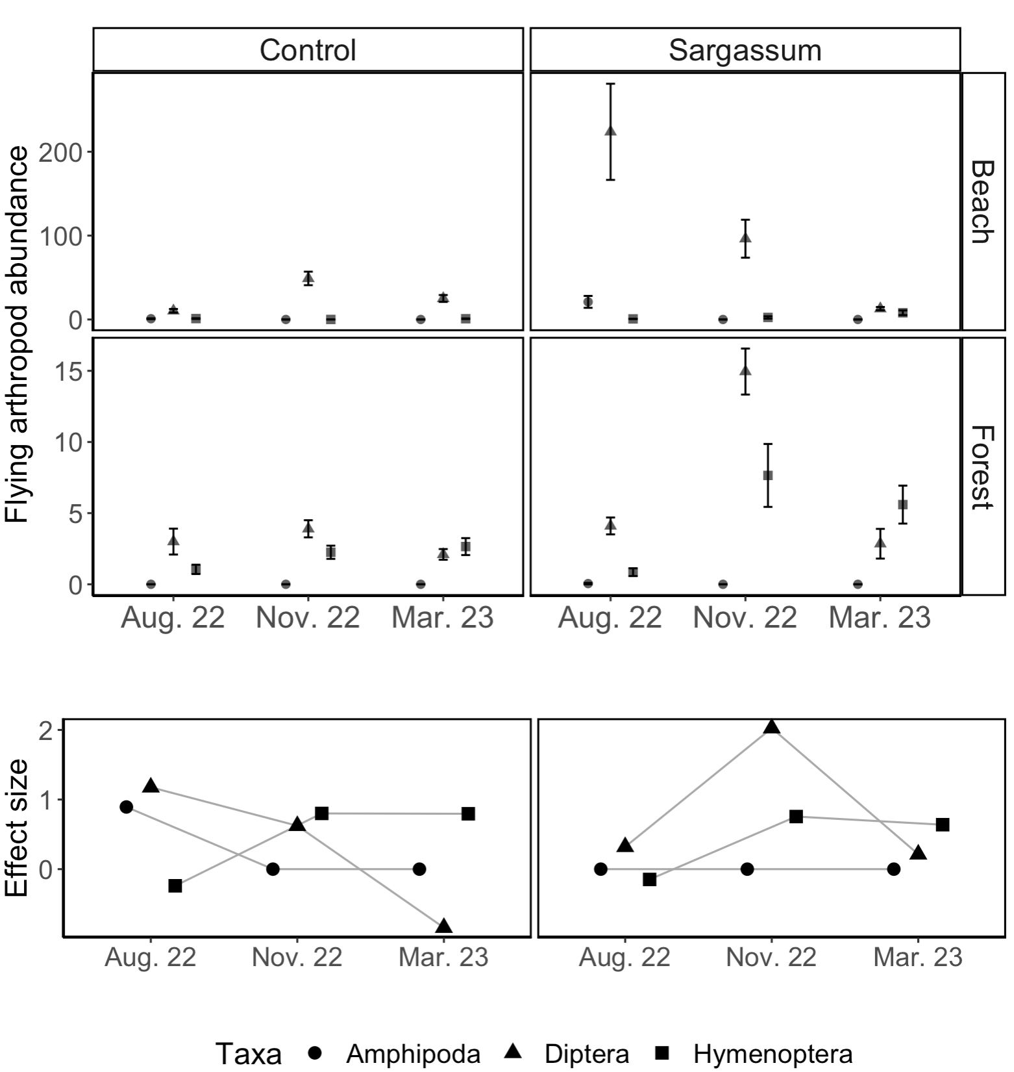
A
B
C
D
E
F
Notes:
Figure 8. flyers

