Slide 1
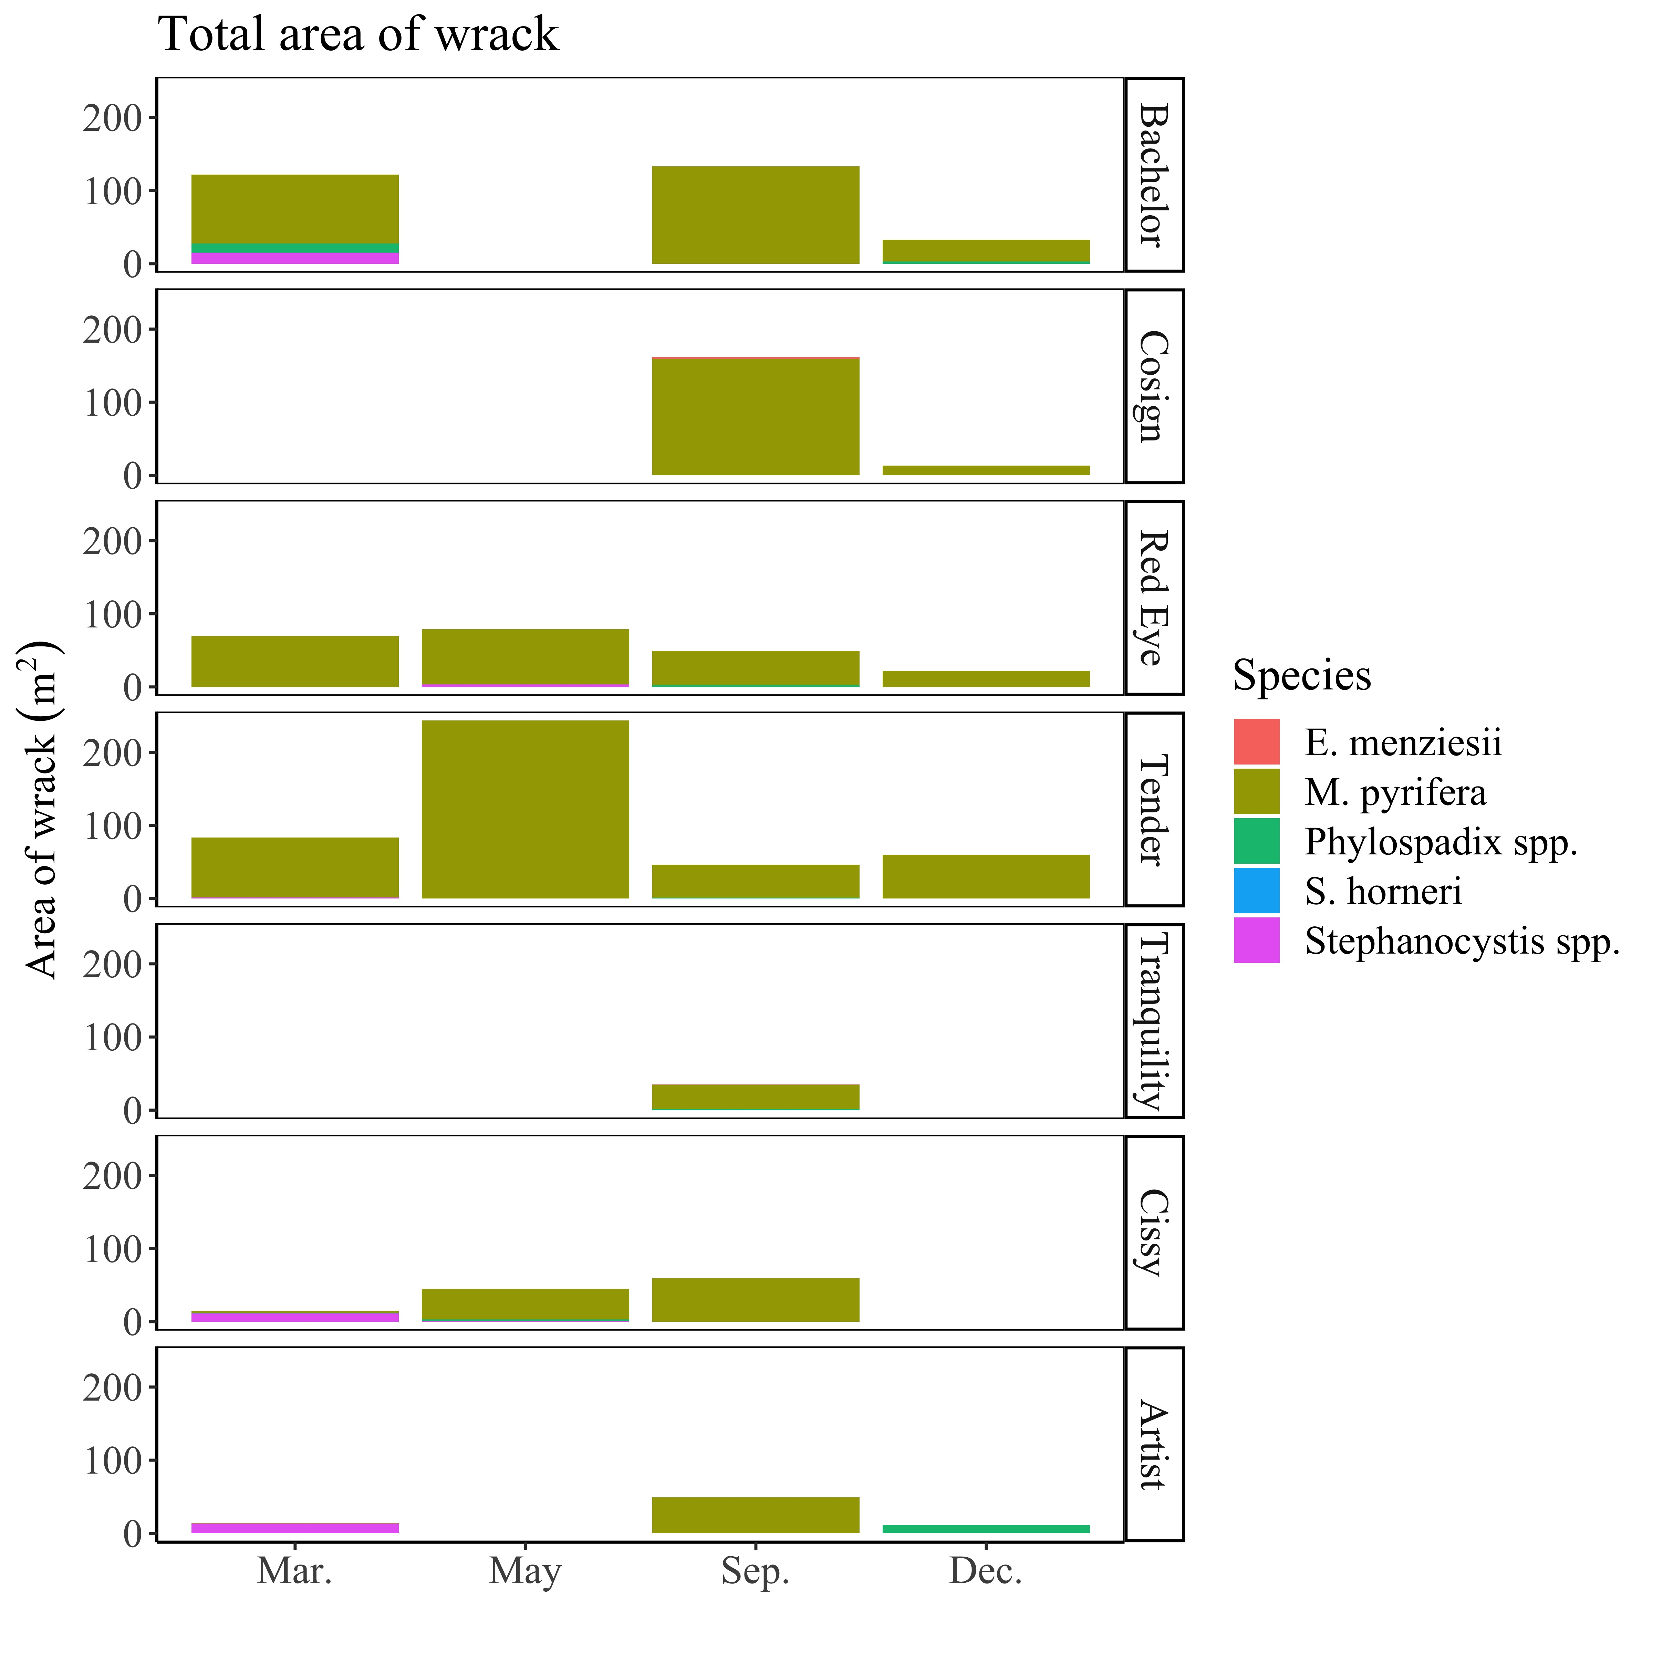
A
0
B
*
*
C
D
E
*
*
0
F
0
G
0

Slide 2
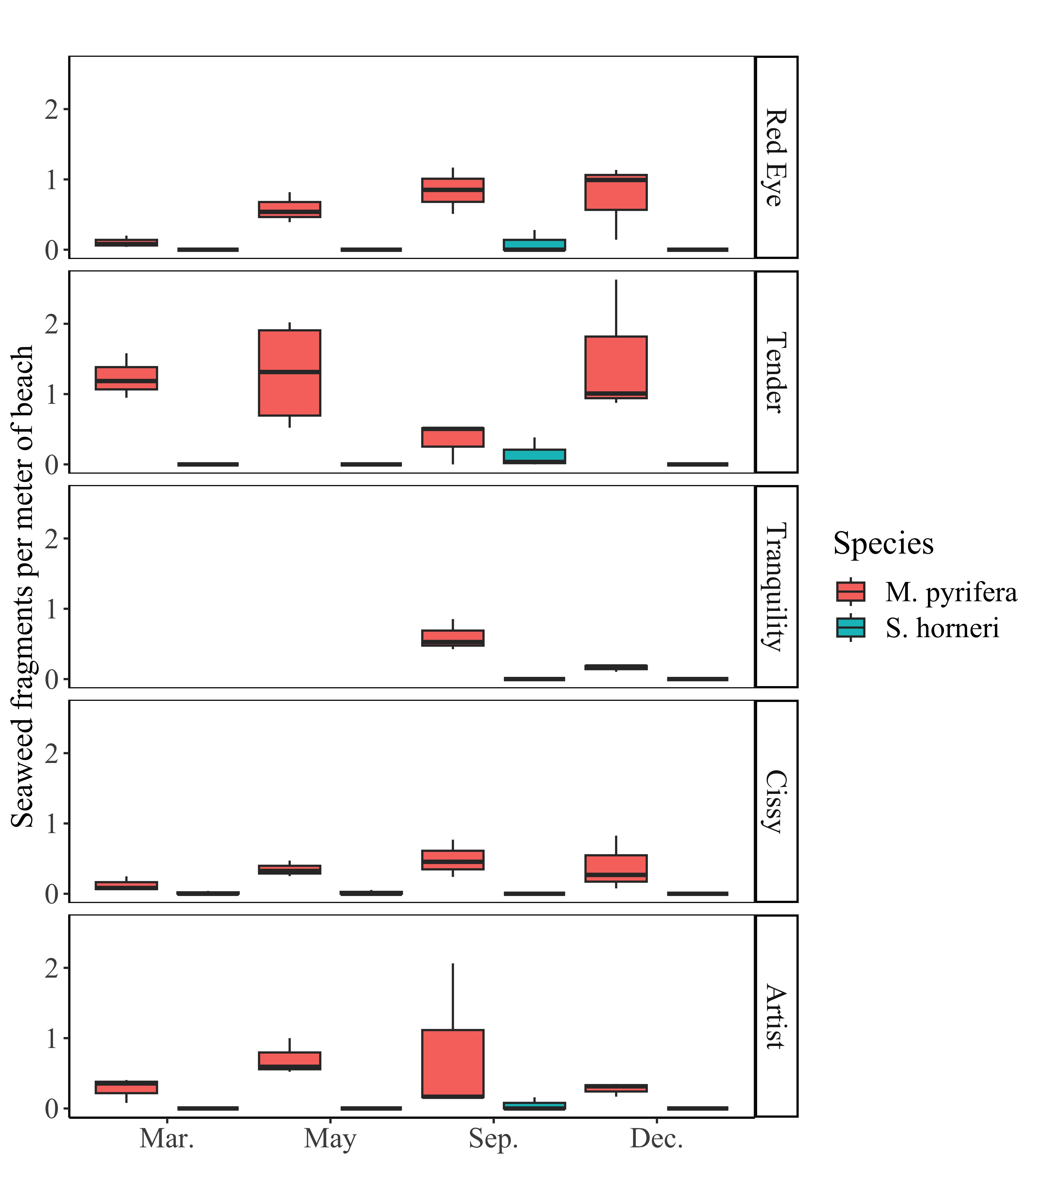
A
B
C
*
*
D
E

Slide 3
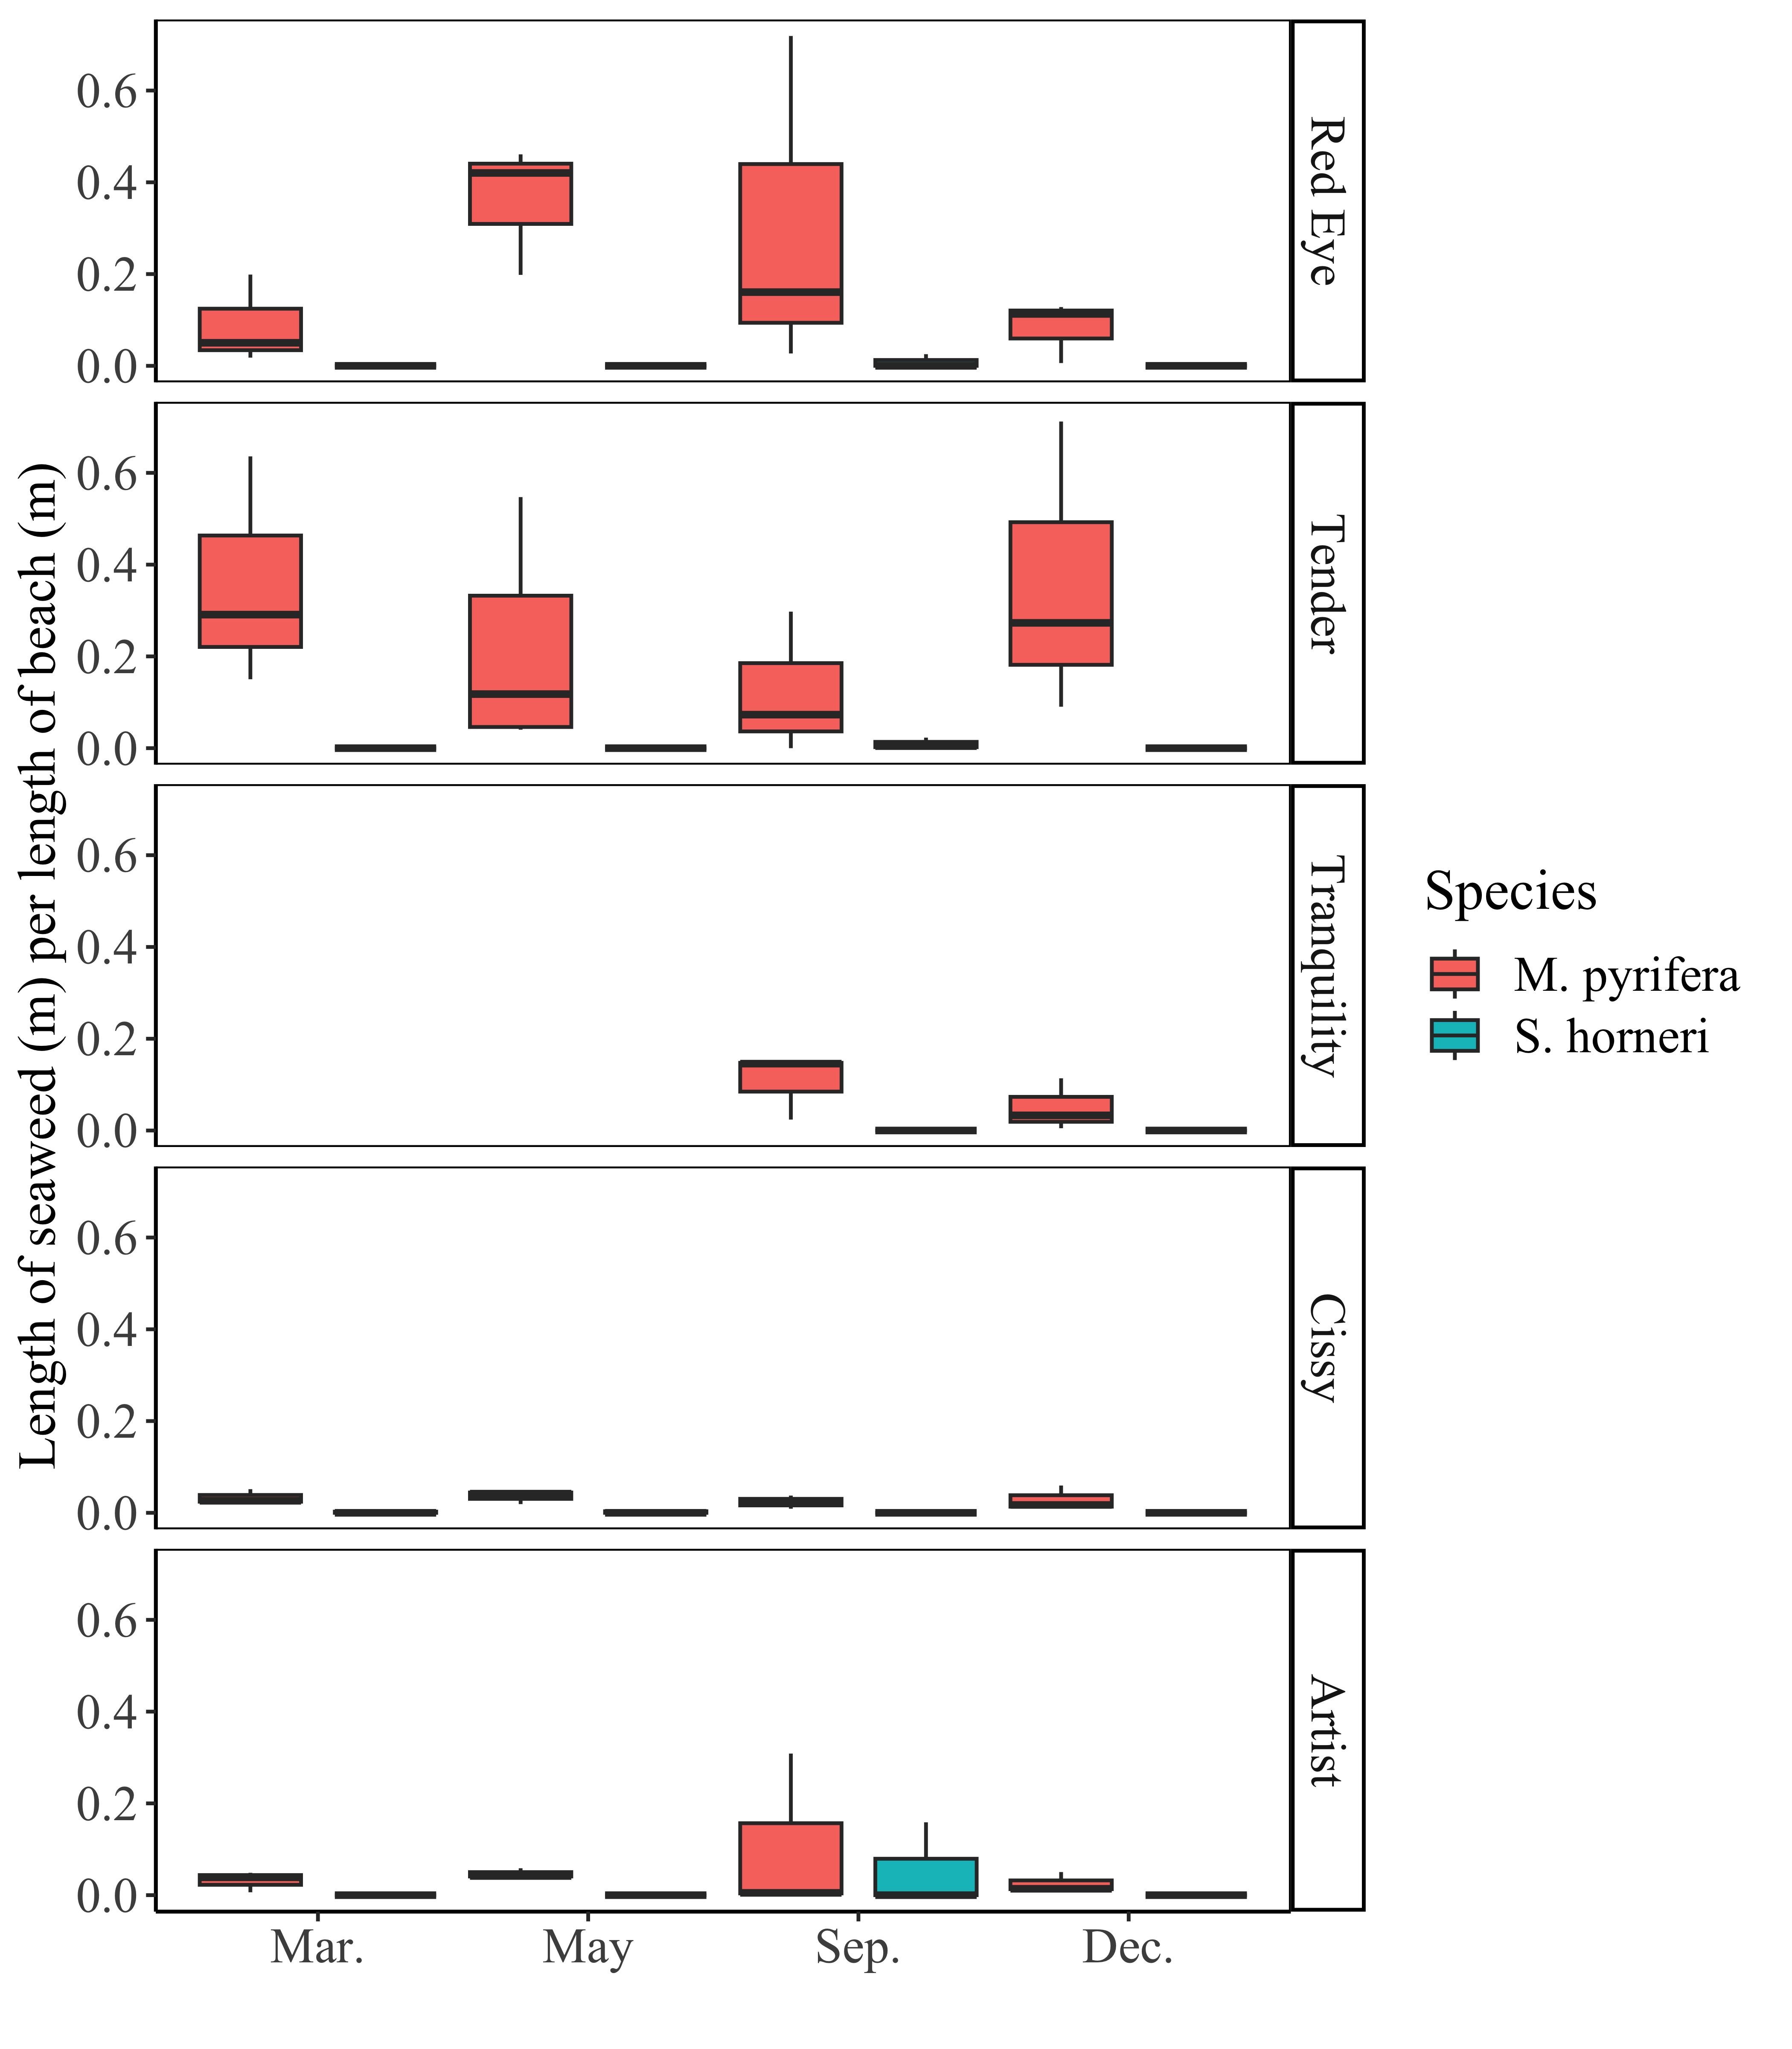
A
B
C
*
*
D
E

