Slide 1
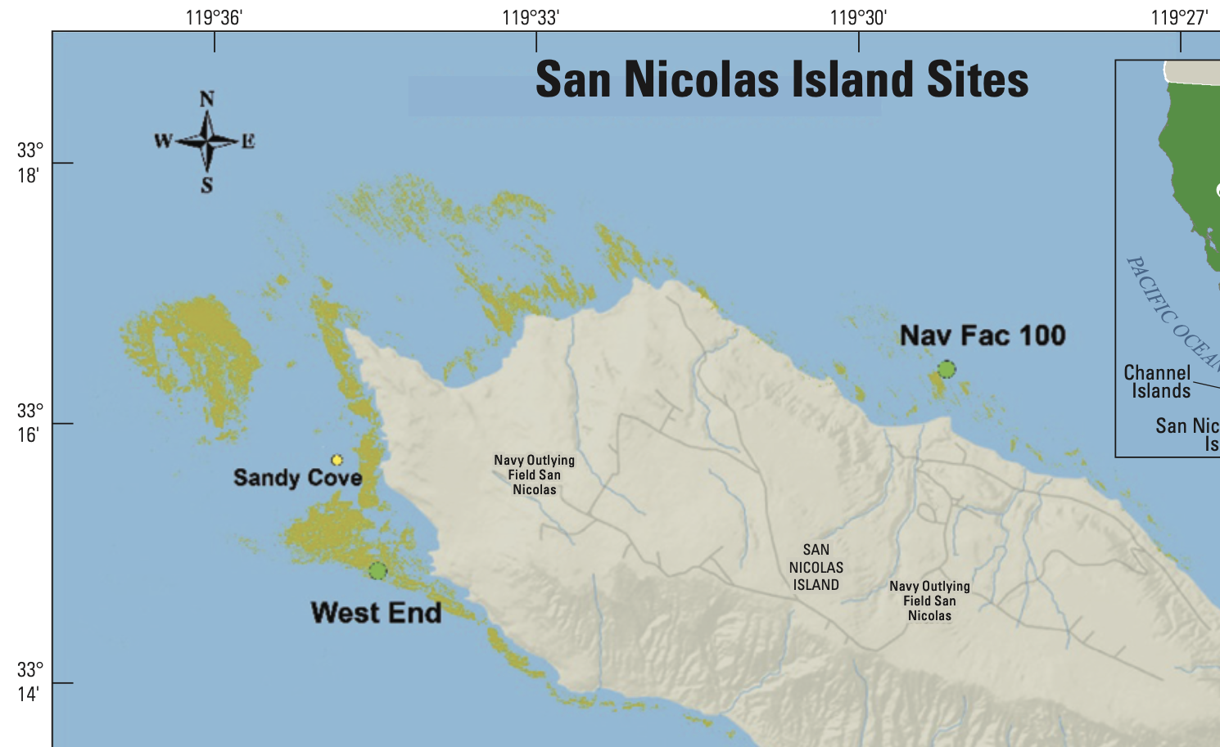
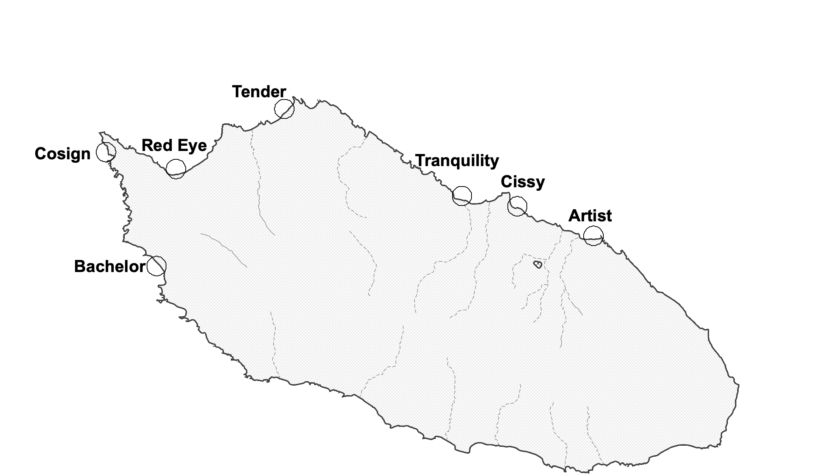
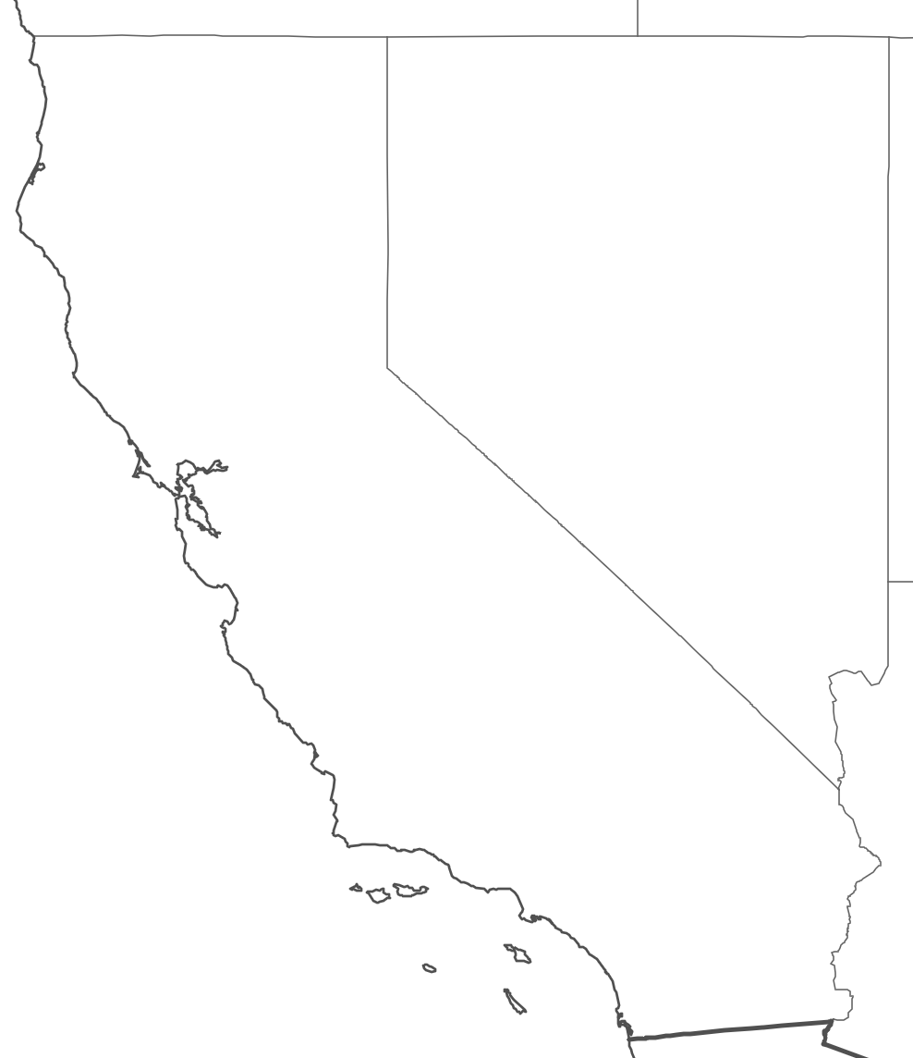

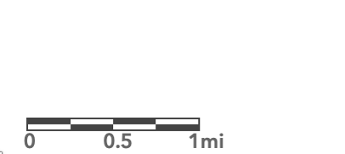
San Nicolas Island Sites
California
San Nicolas Island
0 0.8 1.6 km
Map image is the intellectual property of Esri and is used herein under license. Copyright © 2024 Esri and its licensors. All rights reserved.

