Slide 1
Efficient Software-Based Fault Isolation
Robert Wahbe, Steven Lucco, Thomas E. Anderson, Susan L. Graham

Slide 2
Problem and Motivation
Applications often developed as multiple modules (e.g. Quark Xpress, POSTGRES)
Desirable to isolate the discrete components of a modular application during runtime
Want to minimize the ability of misbehaving components to affect other running modules
Allows the fault to be precisely located and fixed

Slide 3
Prior Solutions
Common approach: hardware-based isolation
Each module gets its own address space; logically separate
Isolated modules can communicate using an RPC interface
Large impact on performance: several orders of magnitude slower

Slide 4
Proposal
If RPC calls are frequent but do little computation, the costs will pile up with existing hardware-based approaches
A purely software-based approach is superior in most circumstances
Segment a single address space into “fault domains”
An isolated module’s code can only operate within its own fault domain
Domains crossable only via a regulated user-level RPC interface
Slight impact on overall performance, but saves big with RPC; no need to cross hardware boundaries

Slide 5
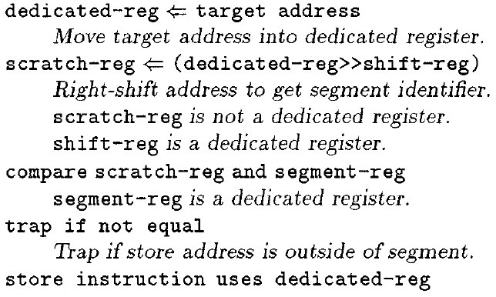
Segment Matching
Goal: identify instructions that attempt illegal modifications of the address space (other modules’ data)
Instructions that cannot be proven (via static analysis) to not reach outside the fault domain are deemed “unsafe”
Before every unsafe instruction, insert some code to check that the target address is within the appropriate segment of the fault domain
If not, raise an exception

Slide 6
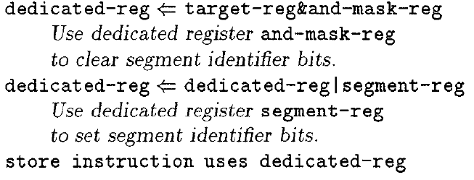
Sandboxing
Goal: force the module to only use address within its fault domain, making it incapable of interfering with other parts of the application
Similar approach: insert code before every unsafe instruction
Inserted code changes the target address to be within the appropriate segment within the fault domain
May lead to undefined behavior

Slide 7
Shared Process Resources
Sandboxing does not protect resources that are associated with the entire address space
E.g. open files, sockets
Solution: distrusted modules can only access such resources by going through trusted “arbitration code”
This code determines whether the access is safe before allowing it to occur
Code is stored within a special fault domain
All relevant system calls in the module are converted to RPC requests into the arbitration domain

Slide 8
Fast Cross-Domain Calls
Each function exported from a fault domain has a preconstructed call and return “stub” procedure
Responsible for passing arguments into the callee domain and return values into the caller domain, and for safely switching control between them
A read-only “jump table” is the only way for control to leave an untrusted fault domain
Read-only allows it to be hardcoded, thus trustworthy
Operates completely at user-level; no context-switching or other hardware services required

Slide 9
Performance Evaluation
Performance measured in three aspects:
Overhead required to perform encapsulation (sandboxing)
Latency associated with cross-domain function calls (RPC)
Real-world example application (POSTGRES)

Slide 10
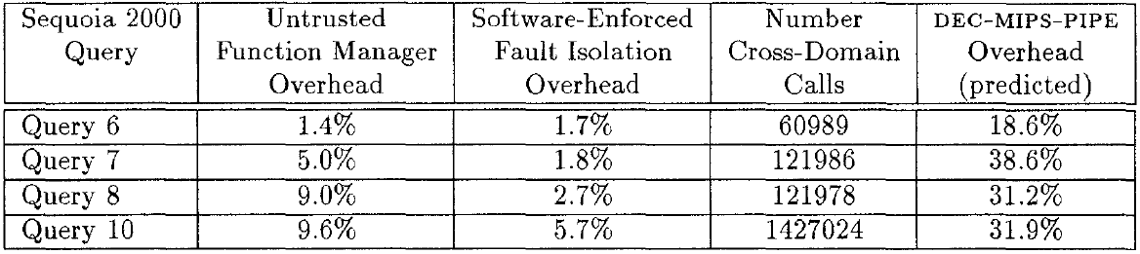
Performance Evaluation: POSTGRES

Slide 11
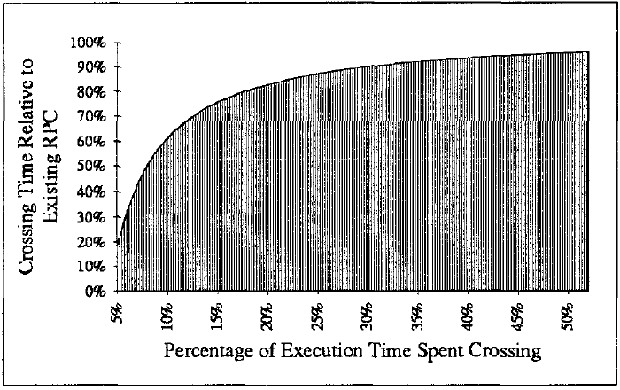
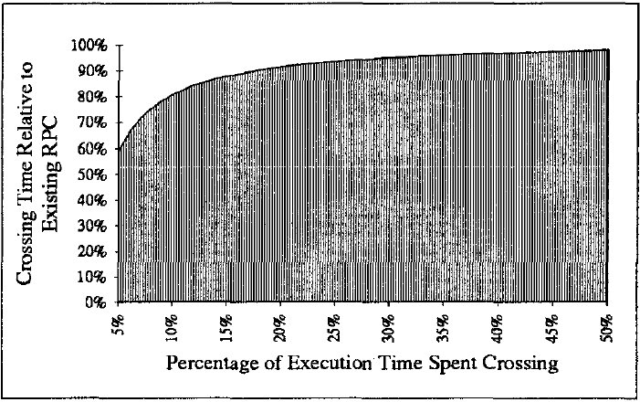
Performance Evaluation: Overall
Assuming entire application is encapsulated
Assuming half of time is spent executing distrusted module code

Slide 12
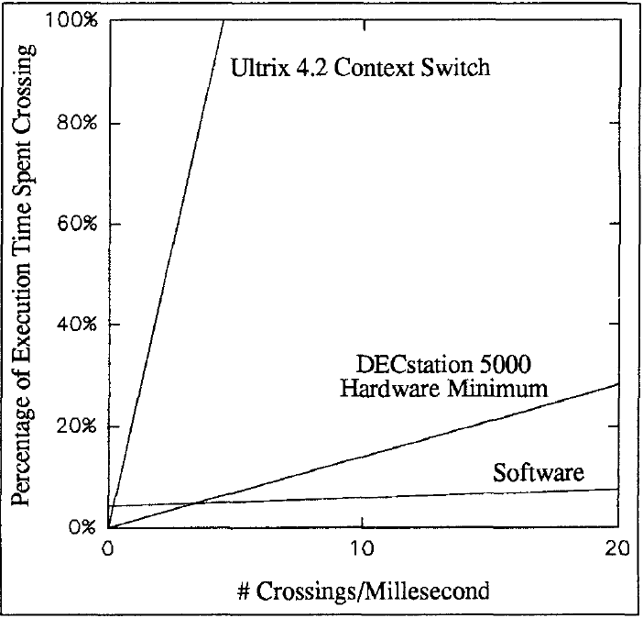
Performance Evaluation: Stability
Time spent crossing domains is independent of the crossing behavior of the application
Millisecond

Slide 13
Takeaways and Conclusion
This method of software-based isolation and inter-module communication appears to be superior to existing hardware methods in general
Single address space seems to be the way to go vs. explicitly separate address spaces
Results can be further improved through assorted optimizations (detailed in Section 3.3

