Slide 1
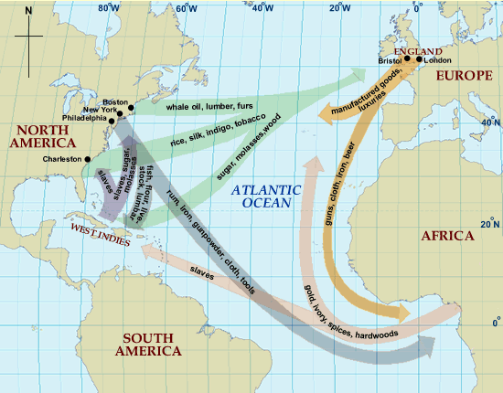
TRIANGULAR TRADE
Notes:
Questions:
1.) Which arrow on the map represents the Middle Passage?
2.) What types of products did the colonies ship to Europe?
3.) How did the economic activity in the Americas encourage the slave trade?
4.) What did whites trade Africans for slaves?

Slide 2
THE MIDDLE PASSAGE

Slide 3
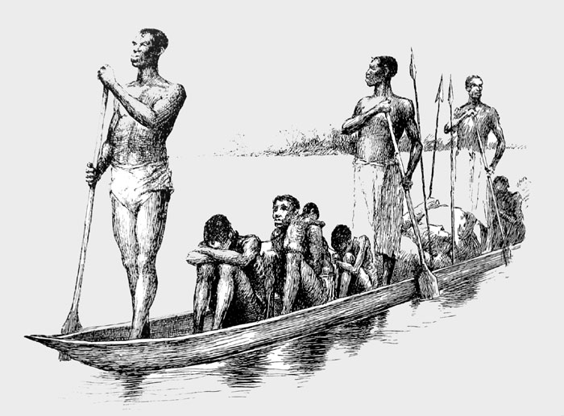
Notes:
Questions
1.) What part of the slave trade is shown here? (African slavers kidnap other Africans for exchange with Europeans)
2.) Where do you think these people are going? (To slave fortresses or to slave ships)
http://africanhistory.about.com/od/slaveryimages/ig/Slavery-Images-Gallery/TransportingSlaves.htm
?

Slide 4
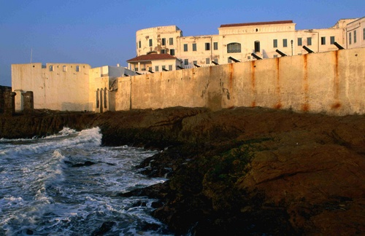
Cape Coast Castle, Ghana.
A slave fortress.
Notes:
Question
1.) What happened here? (Slaves were kept imprisoned until a European slave ship arrived)
http://l.yimg.com/us.yimg.com/i/travel/tg/lp/8d/500x500_8d2a8a9696158a4db54a0fc32d14e5fb.jpg

Slide 5
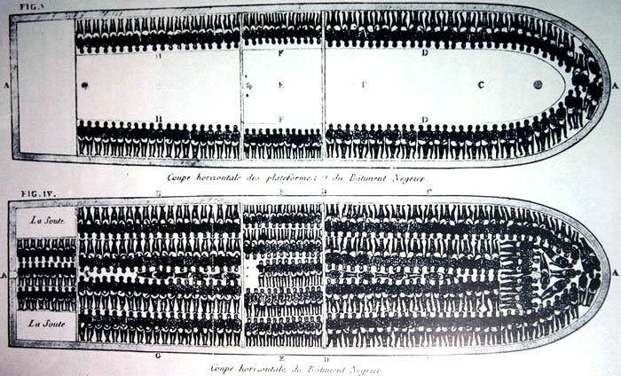
The slave ship Brookes
Notes:
Question
1.) What do you see in this picture?
2.) How many people were put on this ship? (426)
http://africanhistory.about.com/od/slaveryimages/ig/Slavery-Images-Gallery/SlaveShipBrookes.htm

Slide 6
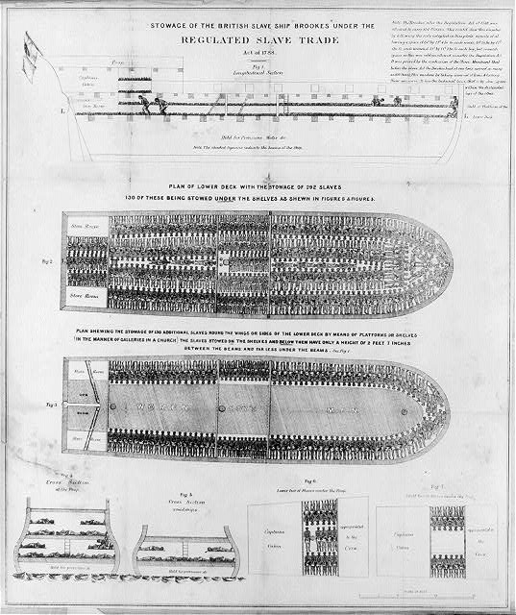
Notes:
Question
Where can you see the amount of headroom the slaves had in the tween decks?
http://africanhistory.about.com/od/slaveryimages/ig/Slavery-Images-Gallery/SlaveShipBrookes002.htm

Slide 7
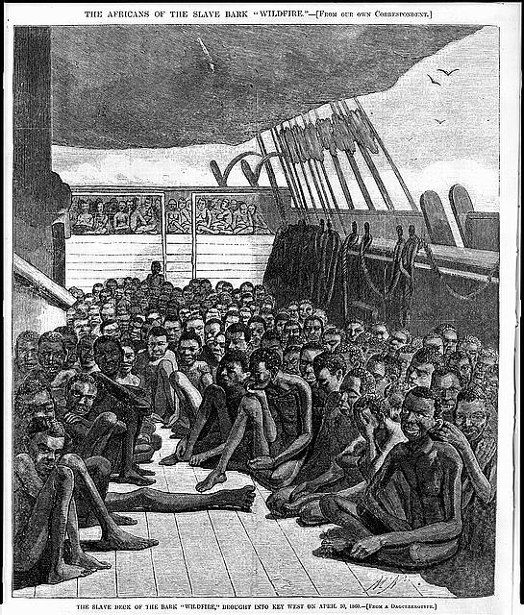
Notes:
Questions
1.) Why are the slaves on the deck?
http://africanhistory.about.com/od/slaveryimages/ig/Slavery-Images-Gallery/SlaveBarkWildfire.htm

Slide 8
MEMORIALS

Slide 9
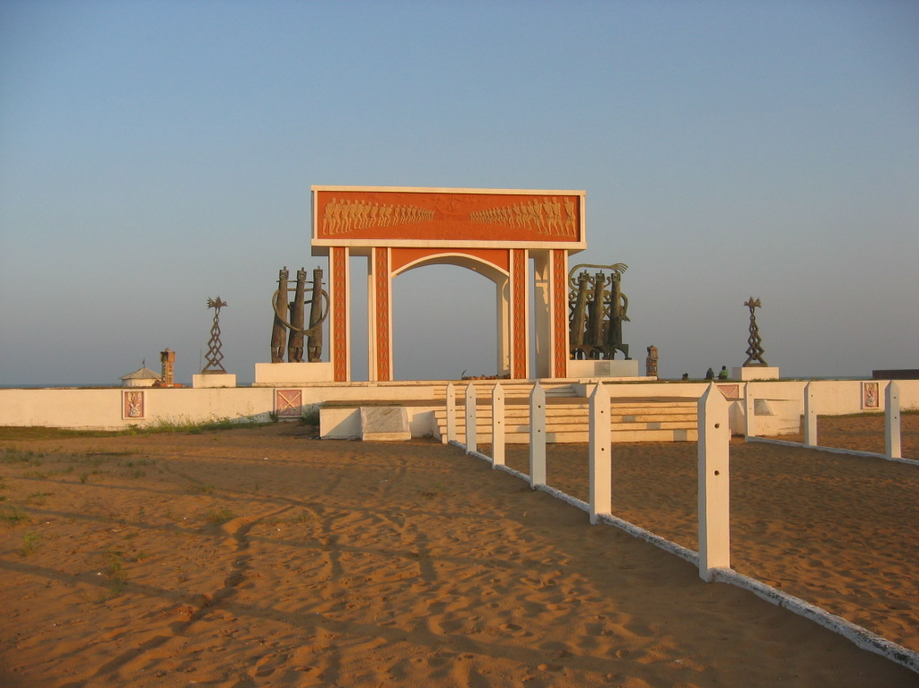
Fortuné Bandeira (artist), Door of No Return, Benin, Africa
Notes:
Description
This monument commemorates the point of departure from Africa to the Americas.
Questions:
1.) Why is it called the “Door of No Return?”
2.) What images does it use to commemorate what happened here?
http://www.
history.ac.uk/ihr/Focus/Slavery/articles/araujo.html.

Slide 10
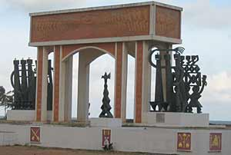
Notes:
http://www.npr.org/programs/re/archivesdate/2004/apr/slavery/

Slide 11
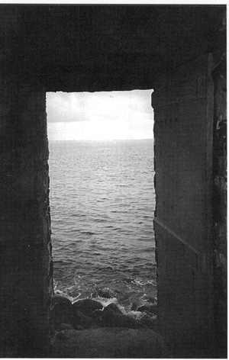
Notes:
An Actual “Door of No Return” at Goree Island, Senegal. Photo by Mike Lord
http://research.history.org/Historical_Research/Research_Themes/ThemeEnslave/SlaveTrade.cfm

Slide 12
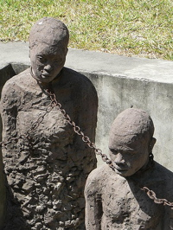
Notes:
Description
Memorial to the slave market in Zanzibar, Tanzania, Africa
Questions
1.) What images does the artist use to commemorate the slave trade?
2.) How does this compare to the Door of no Return?
http://www.radioopensource.org/the-hidden-histories-of-slavery/

Slide 13
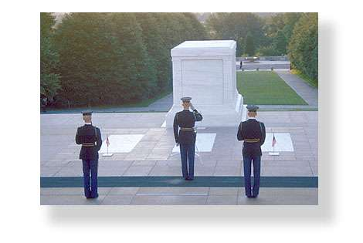
Notes:
Description: Tomb of the Unknowns, Washington, DC. Used to commemorate all the dead soldiers whose identities are not known.
http://www.apples4theteacher.com/holidays/veterans-day/tomb-of-unknown-soldier.html

Slide 14
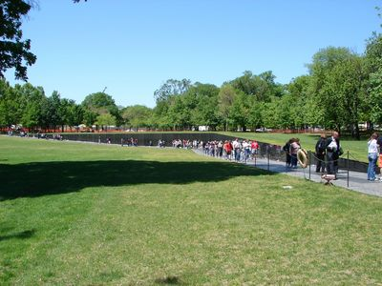
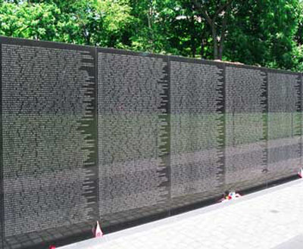
Notes:
Description Vietnam War Memorial, Washington, DC
Questions
1.) What is the design of this memorial like?
2.) What is on the walls? Could you do something like this for the Middle Passage? Why or why not?
Detail Photo: http://www.visitingdc.com/memorial/vietnam-memorial-wall-picture.htm

Slide 15
Summary Question
What images would you use to memorialize the slave trade?
Would you pick a statue, a wall, a building?

Slide 16
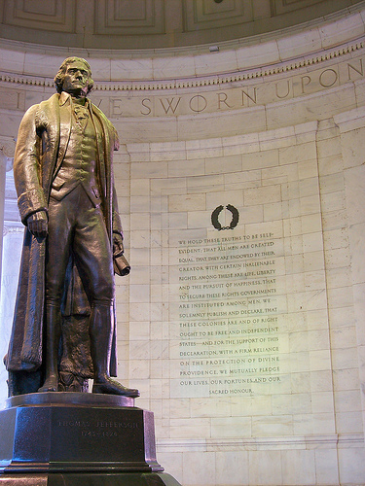
Inscription from the Jefferson Memorial, Washington DC
Notes:
What do you think is the purpose of an inscription on a memorial wall?

