Slide 1
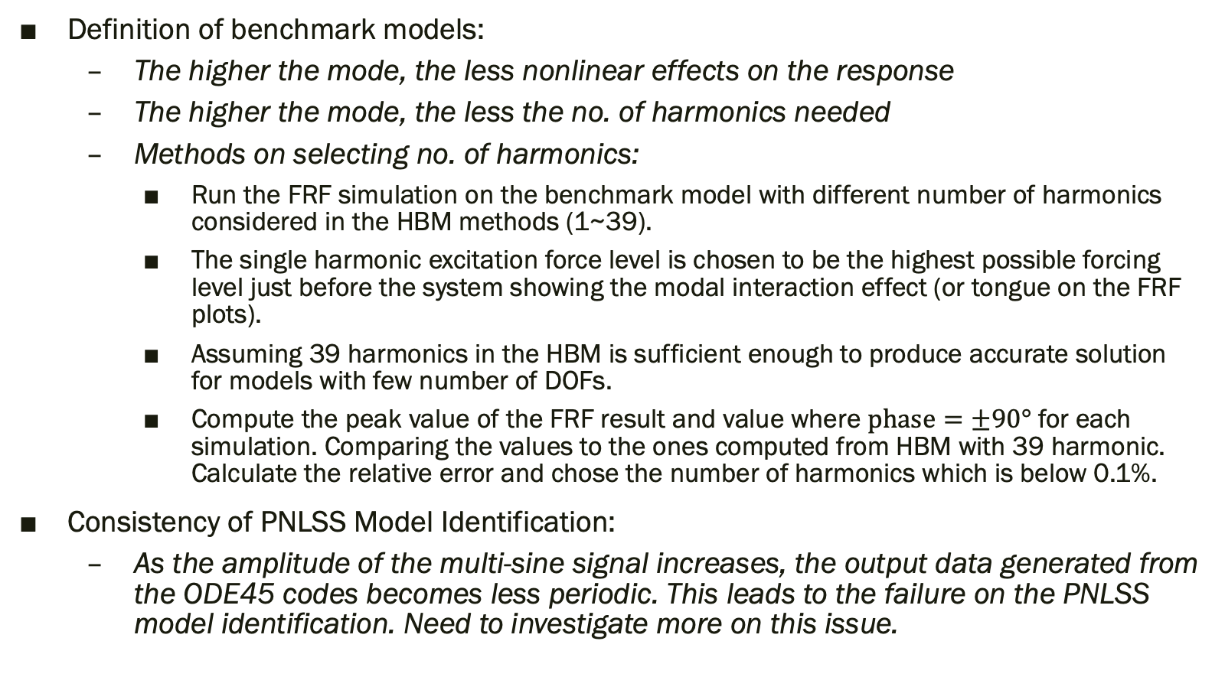
Summary:
Definition of benchmark models:
The higher the mode, the less nonlinear effects on the response
The higher the mode, the less the no. of harmonics needed
Methods on selecting no. of harmonics:
Run the FRF simulation on the benchmark model with different number of harmonics considered in the HBM methods (1~39).
The single harmonic excitation force level is chosen to be the highest possible forcing level just before the system showing the modal interaction effect (or tongue on the FRF plots).
Assuming 39 harmonics in the HBM is sufficient enough to produce accurate solution for models with few number of DOFs.
Compute the peak value of the FRF result and value where $phase=±90°$ for each simulation. Comparing the values to the ones computed from HBM with 39 harmonic. Calculate the relative error and chose the number of harmonics which is below 0.1%.
Consistency of PNLSS Model Identification:
As the amplitude of the multi-sine signal increases, the output data generated from the ODE45 codes becomes less periodic. This leads to the failure on the PNLSS model identification. Need to investigate more on this issue.

Slide 2
To Do List for Benchmark Identification:
Plot deflection shape for each mode on different points on the backbone curve
Plotting mode characteristic to physical amplitude to check the negative damping factor for benchmark model III

