Slide 1
Project ii Group 2 Meeting 1
27 Jun 2019

Slide 2
Topics:
Definition of benchmark models Specify representative levels of harmonic excitation
Consistency of PNLSS Model Identification

Slide 3
I. Definition of benchmark models
Specify the target frequency range
Specify representative levels of harmonic excitation
Phase diagram study
Damping factor study
Study Frequency–Amplitude dependence of NNMs

Slide 4
Benchmark Model I: Flat clamped-clamped beam model (Duffing Oscillator)
Specify frequency range - FRF
Specify number of excitation harmonics

Slide 5
Benchmark Model I: Flat clamped-clamped beam model (Duffing Oscillator)
Phase Diagram
Damping Factor
Frequency–Amplitude Dependence

Slide 6
Benchmark Model II: Flat clamped-clamped beam model (Nm = 5)
Mode I
Mode III
Mode V

Slide 7
Benchmark Model II: Flat clamped-clamped beam model (Nm = 5)
Mode I
Mode III
Mode V

Slide 8
Benchmark Model II: Flat clamped-clamped beam model (Nm = 5)
Mode I
Mode III
Mode V

Slide 9
Benchmark Model II: Flat clamped-clamped beam model (Nm = 5)
Mode I
Mode III
Mode V

Slide 10
Benchmark Model II: Flat clamped-clamped beam model (Nm = 5)
Mode I
Mode III
Mode V

Slide 11
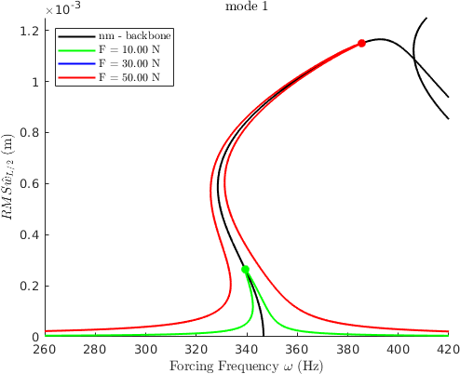
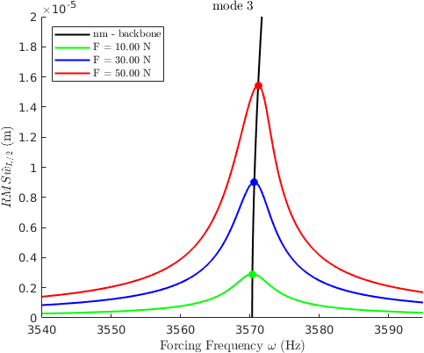
Benchmark Model III: Curved clamped-clamped beam model (Nm = 3)
Mode I
Mode II
Mode III

Slide 12
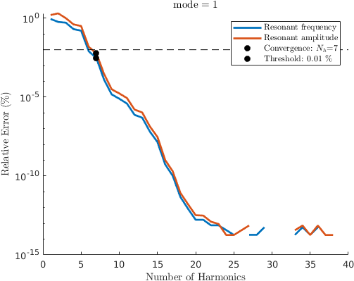
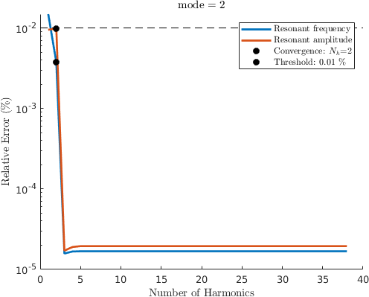
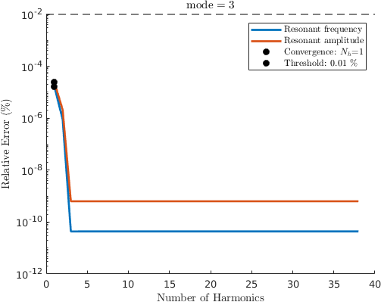
Benchmark Model III: Curved clamped-clamped beam model (Nm = 3)
Mode I
Mode II
Mode III

Slide 13
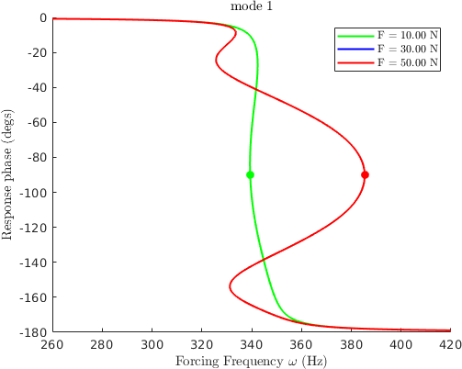
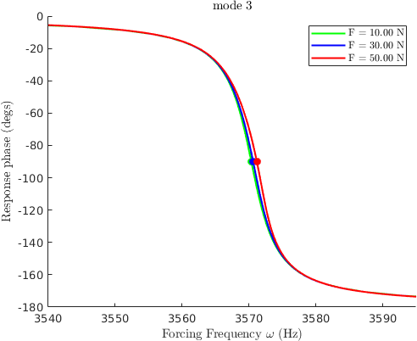
Benchmark Model III: Curved clamped-clamped beam model (Nm = 3)
Mode I
Mode II
Mode III

Slide 14
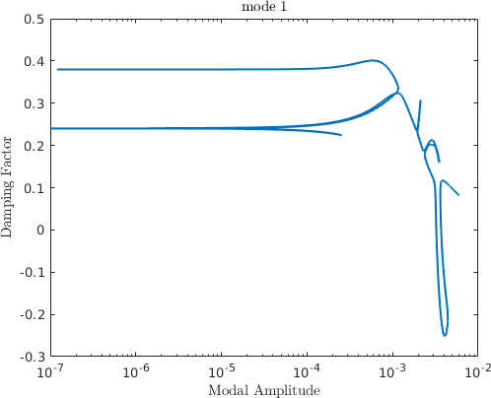
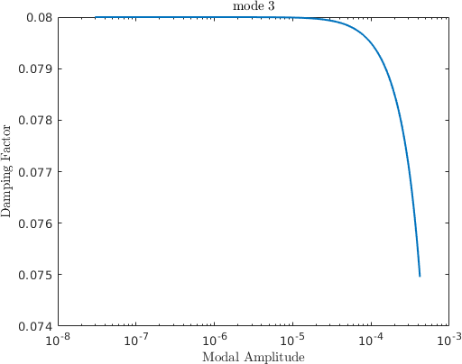
Benchmark Model III: Curved clamped-clamped beam model (Nm = 3)
Mode I
Mode II
Mode III

Slide 15
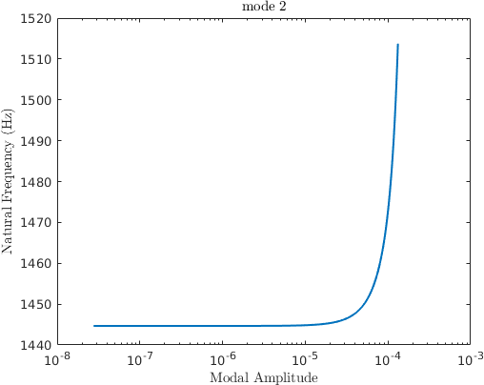
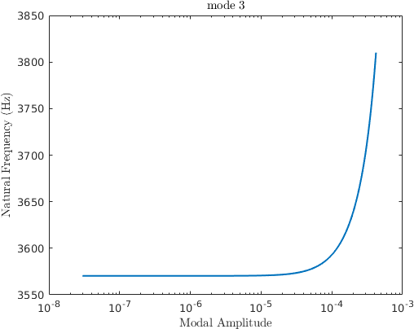
Benchmark Model III: Curved clamped-clamped beam model (Nm = 3)
Mode I
Mode II
Mode III

Slide 16
Benchmark Model IV: Cantilever beam with elastic dry friction element
Mode I
Mode II
Mode III

Slide 17
Benchmark Model IV: Cantilever beam with elastic dry friction element
Mode I
Mode II
Mode III

Slide 18
Benchmark Model IV: Cantilever beam with elastic dry friction element
Mode I
Mode II
Mode III

Slide 19
Benchmark Model IV: Cantilever beam with elastic dry friction element
Mode I
Mode II
Mode III

Slide 20
Benchmark Model IV: Cantilever beam with elastic dry friction element
Mode I
Mode II
Mode III

Slide 21
Benchmark Model V: Cantilever beam with unilateral spring element
Mode I
Mode II
Mode III

Slide 22
Benchmark Model V: Cantilever beam with unilateral spring element
Mode I
Mode II
Mode III

Slide 23
Benchmark Model V: Cantilever beam with unilateral spring element
Mode I
Mode II
Mode III

Slide 24
Benchmark Model V: Cantilever beam with unilateral spring element
Mode I
Mode II
Mode III

Slide 25
Benchmark Model V: Cantilever beam with unilateral spring element
Mode I
Mode II
Mode III

Slide 26
II. Consistency of PNLSS Model Identification
Set up ODE45 multi-sine generation codes for the input and output data in time series
Set up PNLSS model analysis codes

