Slide 1
Response/Rebuttal Workshop

Slide 2
Outline
What are we trying to avoid?
What is the review process, and how does the response/rebuttal fit in?
Guiding principles
Common reviewer comments
A process and strategy

Slide 3
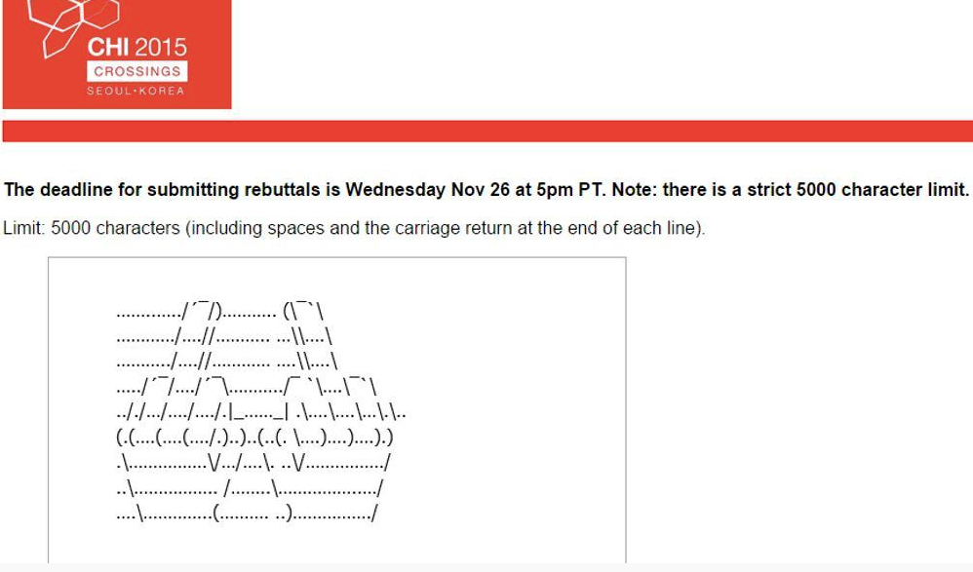
What to avoid…
https://twitter.com/_chinosaur/status/535542394302005249
Notes:
https://twitter.com/_chinosaur/status/535542394302005249

Slide 4
Review Process
You submit a paper submission
AC sends the submission to 3 external reviewers
AC receives 3 reviews, and writes a meta-review
You get the reviews, and write a response
AC and reviewers read the response and (hopefully) modify their scores
2AC assigned and reads everything to help make a decision

Slide 5
Role of the Peer-Review Process
Identify strengths and weaknesses of a work
Determine whether (and how) a work adds to our collective knowledge (as a community)
Identify opportunities for improvement
Response: Facilitate (a limited) dialogue with reviewers
Correct factual errors
Respond to suggestions

Slide 6
Guiding Principles
Your reviewers are trying to help
Your AC is really trying to help, and needs help
Avoid thinking about it as a combative process

Slide 7
A great response…
Provides the AC with reasons why the submission should be accepted
Convinces the 2AC that the submission can be improved in time to address reviewer concerns (or that the concerns aren’t really issues)
Identifies the major issues, discusses how they will be addressed
Identifies factually incorrect things in the reviews

Slide 8
Common Pitfalls (Responses)
Fixating on fixable issues
Fixating on small issues
Fixating on the wrong issues
Thinking that your reviewers are idiots
Thinking that your reviewers are flat out wrong (they might be right!)
Taking a combative tone (I think)

Slide 9
Guiding Principles
Your reviewers are trying to help
Your AC is really trying to help, and needs help
Avoid thinking about it as a combative process
Be respectful of your reviewers
Help reviewers save face

Slide 10
What to do…
Skim reviews
Have a drink
Go to sleep
Read reviews
Panic, etc.
Go to sleep
Re-read reviews
Annotate reviews w/ positive comments and negative comments
Identify major issues (3-4)
Determine what you will do with each of the major issues
Re-articulate the strengths of the work as you see them [R#]
Identify each major issue, and talk about how you will address them

Slide 11
Annotation Strategy
I think there are three kinds of issues that reviewers have. Figure out whether each comment is:
Small potatoes (obvious)
Big potatoes (actual weakness)
Rationale missing/unclear
Factually incorrect

Slide 12
Common Reviewer Issues
Claims are too strong
Missing references
Poorly situated in prior work
Contribution unclear
“Authors should have done X”
Missing/wrong statistical test
Authors are uncritical (missing limitations)
Discuss in relation to idea X
Typo/figure label wrong
Logical problem in argument
Taste

