Slide 1
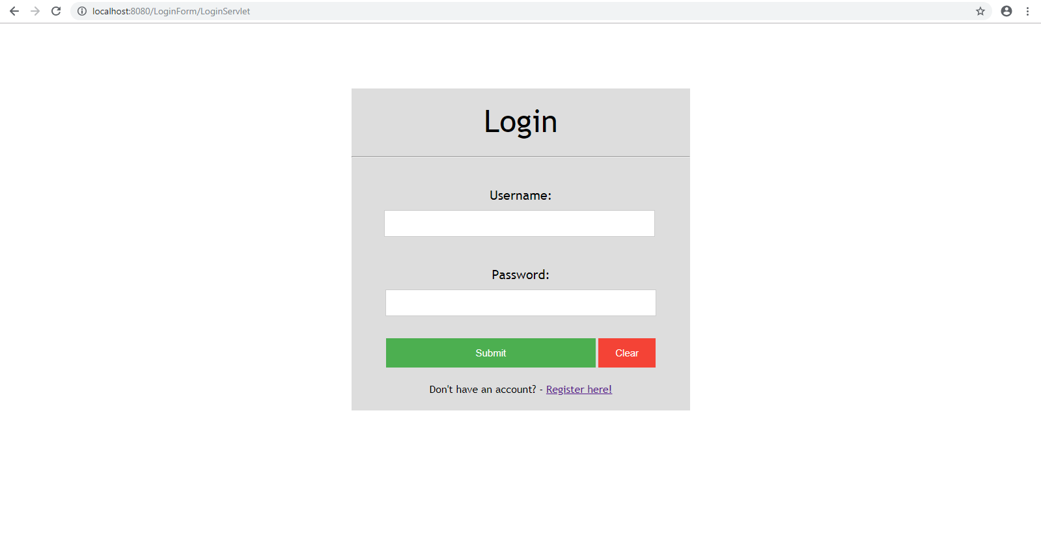

Slide 2
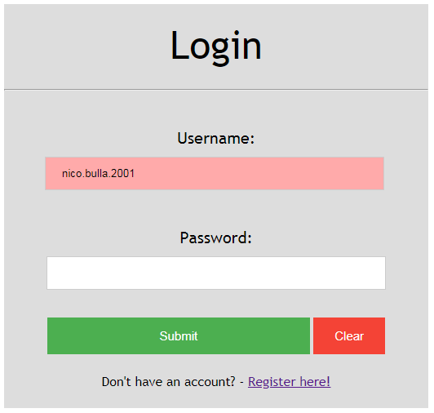

Slide 3
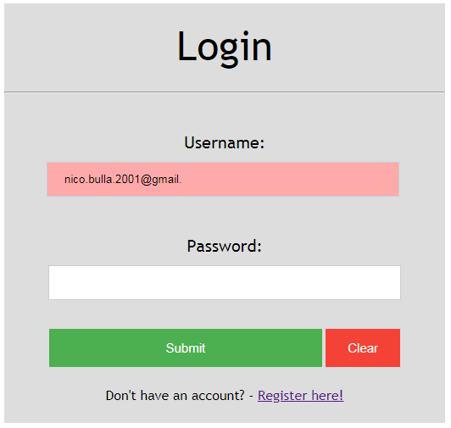

Slide 4
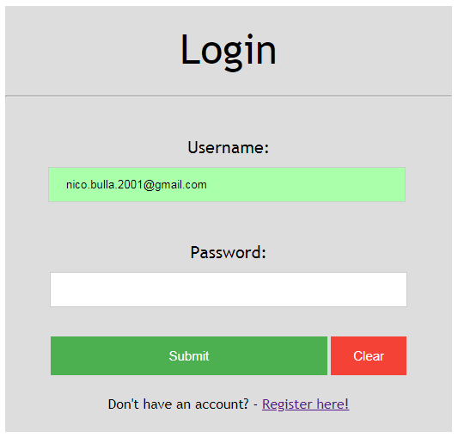

Slide 5
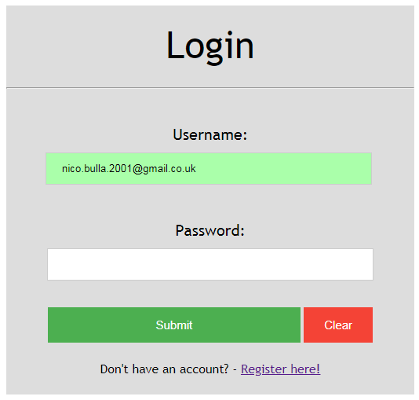

Slide 6
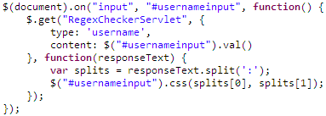
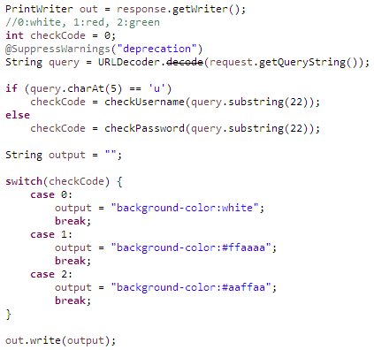
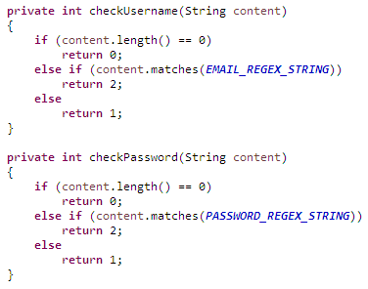
1. GET request
3. Apply response
AJAX (asynchronous JavaScript and XML) using jQuery
(background client-server communication)
2. Checks with regex
Triggers whenever value of input field changes (same for password field)

Slide 7
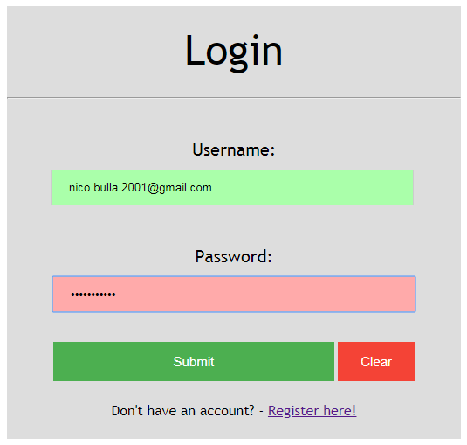
badpassword

Slide 8
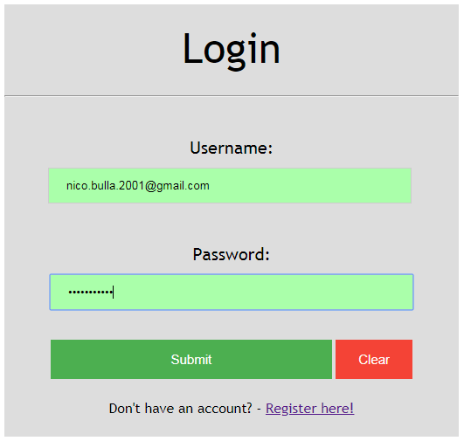
AGoodPass1!

Slide 9
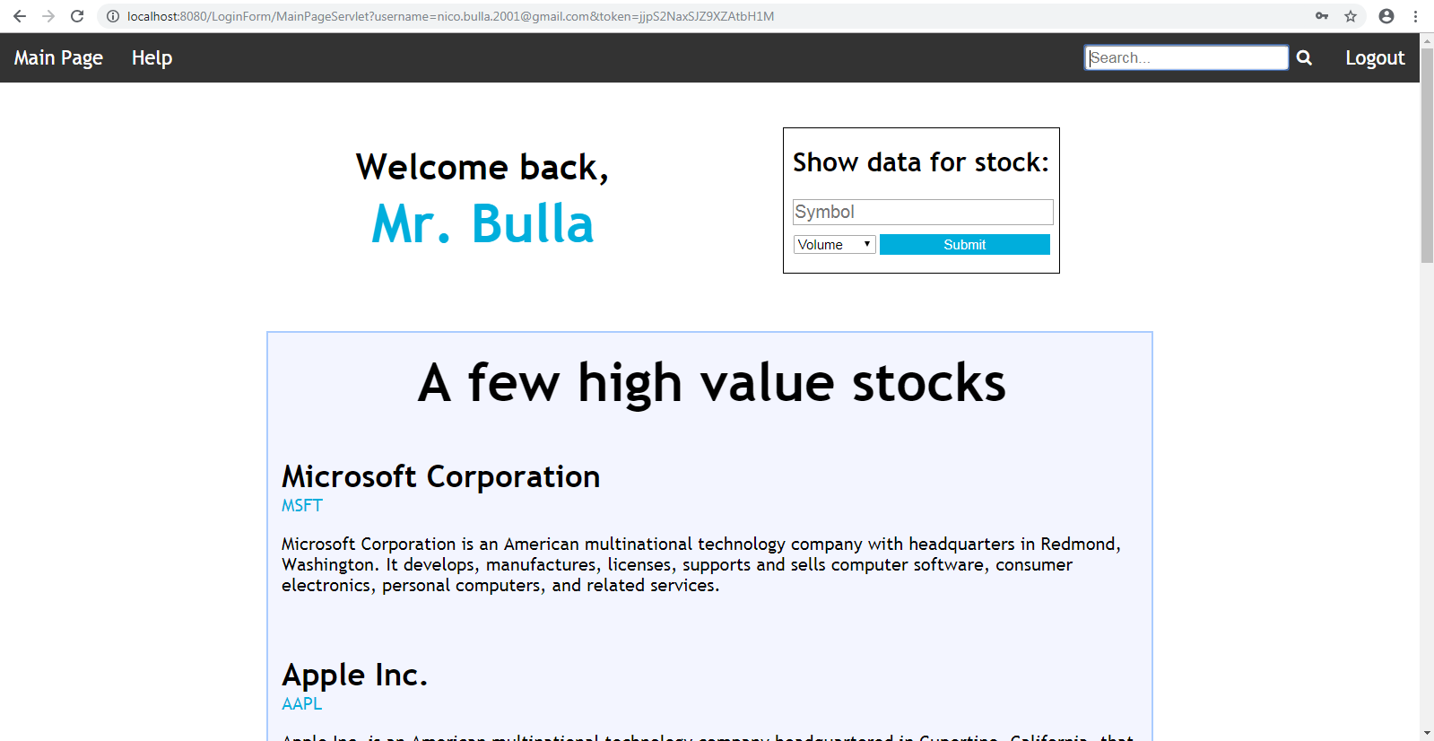

Slide 10

Domain and path
GET request parameters
Cookies are used if no GET request parameters are present
but are always supplied
Redirection to login page if no form of authentication
exists or if it is invalid

Slide 11
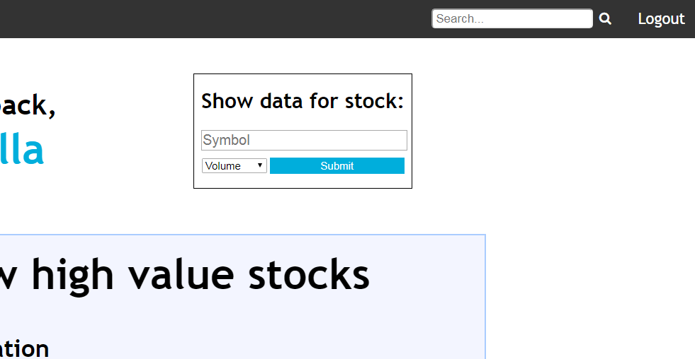
Removes email and token from session manager
and deletes cookies by setting their expiration to 0 seconds

Slide 12
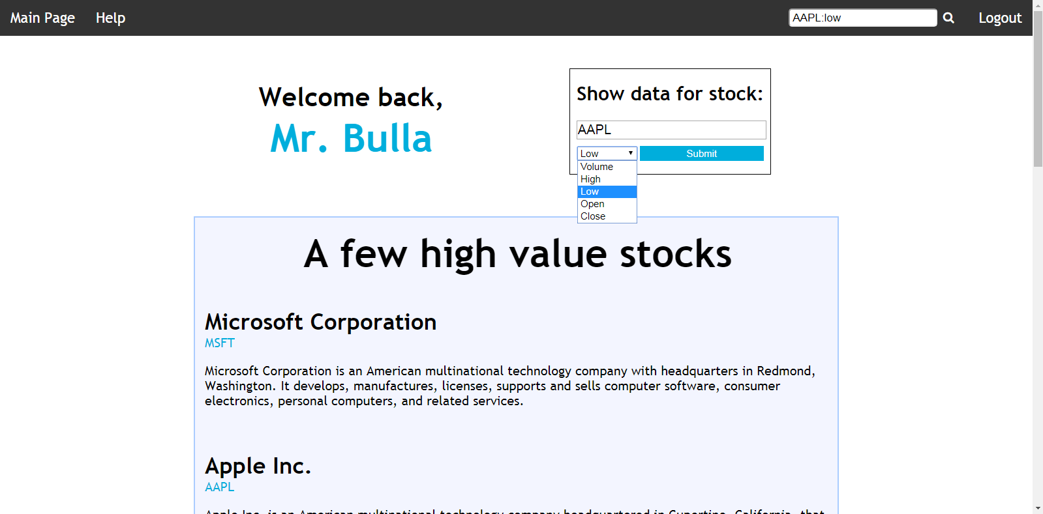

Slide 13
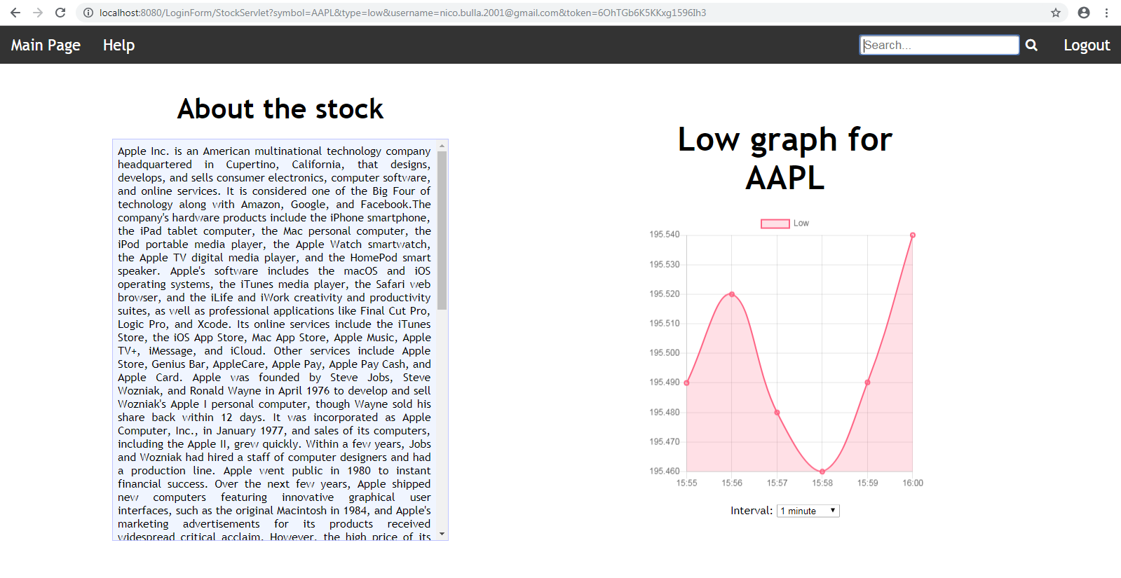

Slide 14
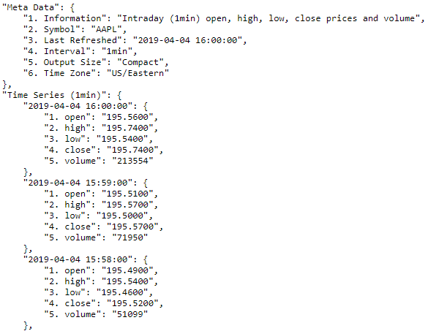
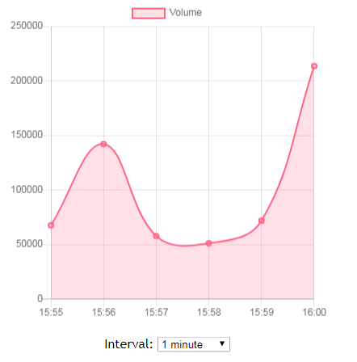

Slide 15

