Slide 1
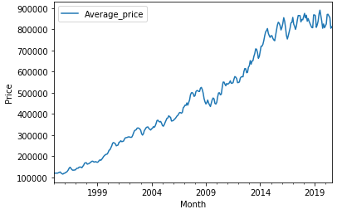
Average house price change in Barnet

Slide 2
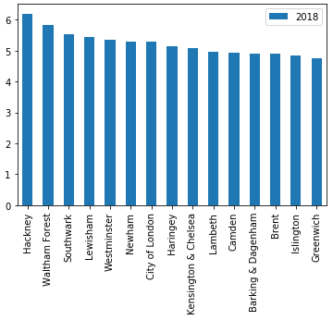
Top 15 Boroughs that have seen the greatest change in price

Slide 3
Conclusions:
The average housing price has been increasing tremendously from 1998-2018 but seems to fluctuate in a certain range in recent years
The Hackney Borough has most increase in housing price

