Slide 1


























Validating Data Tables
With the pointblank Package
rich-iannone
@riannone
rich@rstudio.com

Slide 2
Data Validation in pointblank
PRIMARY WORKFLOWS
You really need to understand and get ahead of data quality issues.
You need to check your data before it proceeds further down a pipeline.
SECONDARY WORKFLOWS
Validating data tables in testthat-type unit tests.
Data checks to get logical values for programming.
OVERALL DESIGN CONSIDERATIONS FOR PACKAGE
Work with local tables and database tables with minimal changes in the API.
Provide extra tools for understanding new local and remote datasets.
Have reporting outputs translated to multiple spoken languages.
EN ▪︎ FR ▪︎ DE ▪︎ IT ▪︎ ES
Give a lot of attention to making the package docs and examples the best they can be.

Slide 3
The Data Quality Workflow
You really need to understand and get on top of your data quality.
This centers around data quality reporting that summarizes the results of validation steps.
The reporting can be stored, published, exported, and transformed.
This workflow aligns with a key tenet of the 📦:
discover, communicate, and help solve DQ issues.

Slide 4

The Data Quality Workflow
This report-based workflow begins with creating the agent.
create_agent()
The agent is an integral part of the data quality workflow.

Slide 5
The Data Quality Workflow
actions
The agent is given the target table…
…and some directives on interrogation.
end_fns
lang
create_agent()
The agent is an integral part of the data quality workflow.

Slide 6



























The Data Quality Workflow
create_agent()
interrogate()
The agent is an integral part of the data quality workflow.
The agent performs the interrogation. Final step of workflow.
Use validation functions to generate a validation plan.

Slide 7




Post-Interrogation Operations
get_agent_report()
get_data_extracts()
create_agent()
interrogate()
get_sundered_data()
get_agent_x_list()
The agent is an integral part of the data quality workflow.
The agent performs the interrogation. Final step of workflow.
Use validation functions to generate a validation plan.
Use post-interrogation functions for reporting and root-cause analysis.

Slide 8
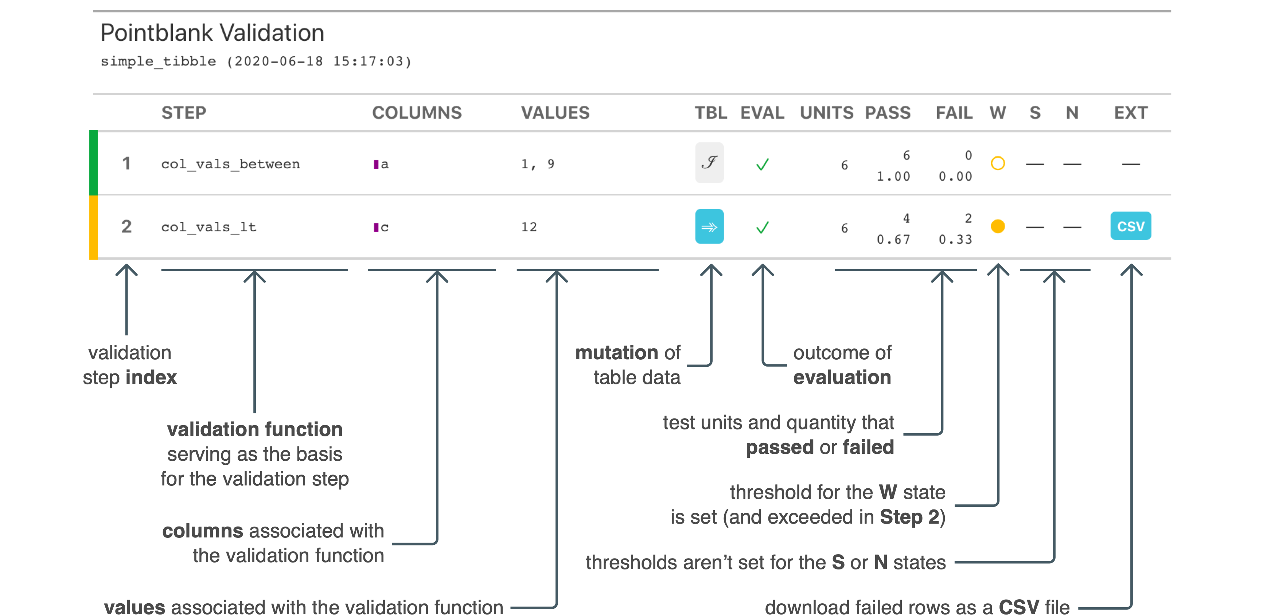
Post-Interrogation Operations
STEP 2
STEP 3
Get table fragments for failing test units (from row-based validations)
STEP 1
get_data_extracts()
STEP 4
get_sundered_data()
interrogate()
Get two table pieces, split across the passing and failing test units.

Slide 9
Data Validation with a Simple Table
a
b
c
yko2
1
23.1
lju7
0
16.3
qib0
1
21.2
sd33
1
24.9
NA
2
NA
Let’s start with a
simple table
5 rows, 3 columns

Slide 10
Data Validation with a Simple Table
VALIDATION RULES BASED ON DOMAIN KNOWLEDGE
a
b
c
1
All values in c should be greater than 15
2
All values in b should be either 0 or 1
yko2
1
23.1
3
All values in a should fit a pattern of
three lowercase letters and a digit
lju7
0
16.3
qib0
1
21.2
4
Values in c must be ≥20 if b is 1; if b is 0
then values in c must be <20
sd33
1
24.9
5
Columns a, b, and c should not have
any missing values.
NA
2
NA
simple table
validation plan
5 rows, 3 columns
5 steps

Slide 11
Data Validation with a Simple Table
TRANSLATION OF RULES TO AVAILABLE VALIDATION FUNCTIONS
a
b
c
1
All values in c should be greater than 15
col_vals_gte(
)
2
All values in b should be either 0 or 1
col_vals_in_set(
)
yko2
1
23.1
3
All values in a should fit a pattern of
three lowercase letters and a digit
lju7
0
16.3
col_vals_regex(
)
qib0
1
21.2
4
Values in c must be ≥20 if b is 1; if b is 0
then values in c must be <20
col_vals_expr(
)
+
case_when(
)
sd33
1
24.9
5
Columns a, b, and c should not have
any missing values.
NA
2
NA
col_vals_not_null(
)
simple table
validation plan
validation functions
5 rows, 3 columns
5 steps
5 col_vals_*() functions

Slide 12
Data Validation with a Simple Table
TRANSLATION OF RULES TO AVAILABLE VALIDATION FUNCTIONS
a
b
c
1
All values in c should be greater than 15
col_vals_gte(
c, 15
)
2
All values in b should be either 0 or 1
col_vals_in_set(
b, c(0, 1)
)
yko2
1
23.1
3
All values in a should fit a pattern of
three lowercase letters and a digit
lju7
0
16.3
col_vals_regex(
a, "[a-z]{3}[0-9]"
)
qib0
1
21.2
4
Values in c must be ≥20 if b is 1; if b is 0
then values in c must be <20
col_vals_expr(
~
case_when(
b == 1 ~ c >= 20,
sd33
1
24.9
b == 0 ~ c < 20
)
)
5
Columns a, b, and c should not have
any missing values.
NA
2
NA
col_vals_not_null(
vars(a, b, c)
)
simple table
validation plan
validation functions
5 rows, 3 columns
5 steps
5 col_vals_*() functions

Slide 13
Data Validation with a Simple Table
INTERROGATION OF TABLE USING THE VALIDATION PLAN
1
col_vals_gte(
col_vals_gte(
c, 15
c, 15
)
a
b
c
)
2
col_vals_in_set(
col_vals_in_set(
b, c(0, 1)
b, c(0, 1)
)
yko2
1
23.1
)
3
col_vals_regex(
a, “[a-z]{3}[0-9]"
)
lju7
0
16.3
col_vals_regex(
a, "[a-z]{3}[0-9]"
)
~
col_vals_expr(
~
col_vals_expr(
case_when(
qib0
1
21.2
4
case_when(
b == 1 ~ c >= 20,
b == 1 ~ c >= 20,
b == 0 ~ c < 20
b == 0 ~ c < 20
)
)
sd33
1
24.9
)
)
5
vars(a, b, c)
col_vals_not_null(
vars(a, b, c)
)
NA
2
NA
col_vals_not_null(
)
simple table
validation functions
5 rows, 3 columns
5 col_vals_*() functions
1
All values in c should be greater than 15
2
All values in b should be either 0 or 1
3
All values in a should fit a pattern of
three lowercase letters and a digit
4
Values in c must be ≥20 if b is 1; if b is 0
then values in c must be <20
5
Columns a, b, and c should not have
any missing values.
validation plan
5 steps

Slide 14

Data Validation with a Simple Table
INTERROGATION OF TABLE USING THE VALIDATION PLAN
STEP 1
a
b
c
1
col_vals_gte(
c, 15
)
col_vals_in_set(
b, c(0, 1)
)
yko2
1
23.1
INTERROGATE
lju7
0
16.3
INTERROGATION
qib0
1
21.2
sd33
1
24.9
REPORT
NA
2
NA
UNITS
PASS
FAIL
4
1
TEST UNITS
5
0.8
0.2
simple table
5 rows, 3 columns

Slide 15
Data Validation with a Simple Table
INTERROGATION OF TABLE USING THE VALIDATION PLAN
STEP 2
a
b
c
2
col_vals_in_set(
b, c(0, 1)
)
col_vals_gte(
c, 15
)
yko2
1
23.1
INTERROGATE
lju7
0
16.3
qib0
1
21.2
sd33
1
24.9
REPORT
NA
2
NA
UNITS
PASS
FAIL
4
1
TEST UNITS
5
0.8
0.2

Slide 16
Data Validation with a Simple Table
INTERROGATION OF TABLE USING THE VALIDATION PLAN
STEP 3
3
col_vals_regex(
a, "[a-z]{3}[0-9]"
)
col_vals_expr(
~
case_when(
a
b
c
col_vals_in_set(
b, c(0, 1)
)
b == 1 ~ c >= 20,
INTERROGATE
b == 0 ~ c < 20
)
)
yko2
1
23.1
lju7
0
16.3
qib0
1
21.2
sd33
1
24.9
REPORT
NA
2
NA
UNITS
PASS
FAIL
3
2
TEST UNITS
5
0.6
0.4

Slide 17
Data Validation with a Simple Table
INTERROGATION OF TABLE USING THE VALIDATION PLAN
STEP 4
a
b
c
4
col_vals_expr(
~
case_when(
col_vals_regex(
a, “[a-z]{3}[0-9]"
)
b == 1 ~ c >= 20,
b == 0 ~ c < 20
)
)
yko2
1
23.1
INTERROGATE
lju7
0
16.3
qib0
1
21.2
sd33
1
24.9
REPORT
NA
2
NA
UNITS
PASS
FAIL
4
0
TEST UNITS
4
1.0
0

Slide 18
Data Validation with a Simple Table
INTERROGATION OF TABLE USING THE VALIDATION PLAN
STEP 5 EXPANSION TO THREE DISCRETE STEPS
5
col_vals_not_null(
vars(a)
)
col_vals_expr(
~
case_when(
vars(c)
col_vals_not_null(
vars(b)
col_vals_not_null(vars(a, b, c))
col_vals_not_null(
)
a
b
c
)
b == 1 ~ c >= 20,
MULTIPLE COLUMNS,
WILL EXPAND
b == 0 ~ c < 20
)
)
yko2
1
23.1
lju7
0
16.3
qib0
1
21.2
sd33
1
24.9
NA
2
NA

Slide 19
Data Validation with a Simple Table
INTERROGATION OF TABLE USING THE VALIDATION PLAN
STEP 5 EXPANSION TO THREE DISCRETE STEPS
a
b
c
5
col_vals_not_null(
vars(a)
)
yko2
1
23.1
6
col_vals_not_null(
vars(b)
)
lju7
0
16.3
7
col_vals_not_null(
vars(c)
)
qib0
1
21.2
sd33
1
24.9
NA
2
NA

Slide 20
Data Validation with a Simple Table
INTERROGATION OF TABLE USING THE VALIDATION PLAN
STEP 5
a
b
c
5
col_vals_not_null(
vars(a)
)
yko2
1
23.1
6
col_vals_not_null(
vars(b)
)
lju7
0
16.3
7
col_vals_not_null(
vars(c)
)
qib0
1
21.2
INTERROGATE
sd33
1
24.9
REPORT
NA
2
NA
UNITS
PASS
FAIL
4
1
TEST UNITS
5
0.8
0.2

Slide 21
Data Validation with a Simple Table
INTERROGATION OF TABLE USING THE VALIDATION PLAN
STEP 6
a
b
c
5
col_vals_not_null(
vars(a)
)
yko2
1
23.1
6
col_vals_not_null(
vars(b)
)
lju7
0
16.3
7
col_vals_not_null(
vars(c)
)
qib0
1
21.2
INTERROGATE
sd33
1
24.9
REPORT
NA
2
NA
UNITS
PASS
FAIL
5
0
TEST UNITS
5
1.0
0

Slide 22
Data Validation with a Simple Table
STEP
UNITS
PASS
FAIL
INTERROGATION OF TABLE USING THE VALIDATION PLAN
STEP 7
1
col_vals_gte()
4
1
5
0.8
0.2
a
b
c
5
col_vals_not_null(
vars(a)
)
2
col_vals_in_set()
4
1
5
0.8
0.2
yko2
1
23.1
6
col_vals_not_null(
vars(b)
)
3
col_vals_regex()
3
2
5
0.6
0.4
lju7
0
16.3
7
col_vals_not_null(
vars(c)
)
4
col_vals_expr()
4
0
qib0
1
21.2
4
1.0
0
INTERROGATE
4
1
sd33
1
24.9
5
col_vals_not_null()
5
REPORT
0.8
0.2
NA
2
NA
5
0
UNITS
PASS
FAIL
6
col_vals_not_null()
5
1.0
0
4
1
TEST UNITS
5
0.8
0.2
7
col_vals_not_null()
4
1
5
0.8
0.2

Slide 23
The Data Validation Report
STEP
UNITS
PASS
FAIL
1
col_vals_gte()
4
1
5
0.8
0.2
a
b
c
2
col_vals_in_set()
4
1
5
0.8
0.2
yko2
1
23.1
3
col_vals_regex()
3
2
5
lju7
0
16.3
0.6
0.4
qib0
1
21.2
4
col_vals_expr()
4
0
4
1.0
0
sd33
1
24.9
4
1
5
col_vals_not_null()
5
0.8
0.2
NA
2
NA
6
col_vals_not_null()
5
0
5
1.0
0
7
col_vals_not_null()
4
1
5
0.8
0.2

Slide 24
The Data Validation Report
STEP
UNITS
PASS
FAIL
4
1
For better reporting on data quality, can set thresholds and use side effects.
1
col_vals_gte()
5
0.8
0.2
2
col_vals_in_set()
4
1
5
0.8
0.2
Failure thresholds can be set for three states
3
col_vals_regex()
3
2
5
0.6
0.4
W
S
N
4
col_vals_expr()
4
0
4
WARNING
STOP
NOTIFY
1.0
0
5
col_vals_not_null()
4
1
5
Let’s set:
0.8
0.2
R CODE
5
0
W to 1
1
2
3
4
5
6
7
8
action_levels(
warn_at = 1,
stop_at = 2
)
6
col_vals_not_null()
5
1.0
0
S to 2
(N not set)
7
col_vals_not_null()
4
1
5
0.8
0.2

Slide 25
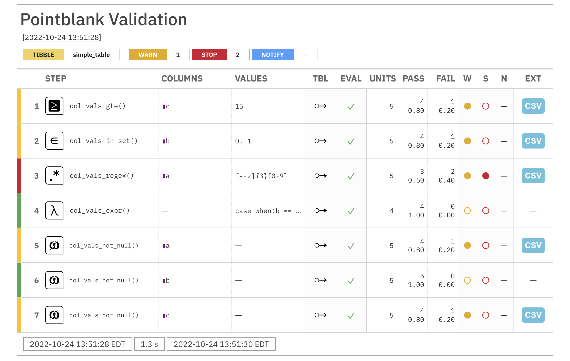
The Data Validation Report
STEP
UNITS
PASS
FAIL
W
S
N
1
col_vals_gte()
4
1
5
0.8
0.2
2
col_vals_in_set()
4
1
5
0.8
0.2
3
col_vals_regex()
3
2
5
0.6
0.4
4
col_vals_expr()
4
0
4
1.0
0
5
col_vals_not_null()
4
1
5
0.8
0.2
6
col_vals_not_null()
5
0
5
1.0
0
7
col_vals_not_null()
4
1
5
0.8
0.2

Slide 26
The Data Validation Report
STEP
UNITS
PASS
FAIL
W
S
N
1
col_vals_gte()
4
1
5
0.8
0.2
2
col_vals_in_set()
4
1
5
0.8
0.2
3
col_vals_regex()
3
2
5
0.6
0.4
4
col_vals_expr()
4
0
4
1.0
0
5
col_vals_not_null()
4
1
5
0.8
0.2
6
col_vals_not_null()
5
0
5
1.0
0
7
col_vals_not_null()
4
1
5
0.8
0.2

Slide 27
The Data Validation Report
STEP
UNITS
PASS
FAIL
1
col_vals_gte()
4
1
5
0.8
0.2
2
col_vals_in_set()
4
1
5
0.8
0.2
3
col_vals_regex()
3
2
5
0.6
0.4
4
col_vals_expr()
4
0
4
1.0
0
5
col_vals_not_null()
4
1
5
0.8
0.2
6
col_vals_not_null()
5
0
5
VALIDATION
FUNCTION
ASSOCIATED
COLUMNS AND VALUES
TEST UNITS:
TOTAL
PASSING
FAILING
STATES:
WARNING
STOP
NOTIFY
1.0
0
7
col_vals_not_null()
4
1
VALIDATION
STEP INDEX
TABLE MUTATION STATE
5
0.8
0.2
TBL EVAL RESULT
DOWNLOAD EXTRACTS

Slide 28
Code Needed for the Data Validation
STEP
UNITS
PASS
FAIL
1
4
1
R CODE
col_vals_gte()
5
1
2
3
4
5
6
7
8
9
10
11
12
13
14
15
16
17
18
0.8
0.2
agent <-
create_agent(
tbl = simple_table,
actions = action_levels(warn_at = 1, stop_at = 2),
) %>%
col_vals_gte(vars(c), 15) %>%
col_vals_in_set(vars(b), c(0, 1)) %>%
col_vals_regex(vars(a), "[a-z]{3}[0-9]") %>%
col_vals_expr(~case_when(
b == 1 ~ c >= 20,
b == 0 ~ c < 20
)) %>%
col_vals_not_null(vars(a, b, c)) %>%
interrogate()
agent
2
col_vals_in_set()
4
1
5
0.8
0.2
3
col_vals_regex()
3
2
5
0.6
0.4
4
col_vals_expr()
4
0
4
1.0
0
5
col_vals_not_null()
4
1
5
0.8
0.2
6
col_vals_not_null()
5
0
5
1.0
0
7
col_vals_not_null()
4
1
5
0.8
0.2

Slide 29


Learning More About pointblank
You can try out dozens of pointblank examples in RStudio Cloud
The link is available in the package README and the project website
The link is available in the package README and
in the project website:
github.com/rich-iannone/pointblank
rich-iannone.github.io/pointblank

Slide 30








































































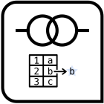
Learning More About pointblank
You can try out dozens of pointblank examples in RStudio Cloud
The link is available in the package README and the project website
github.com/rich-iannone/pointblank
rich-iannone.github.io/pointblank
pointblank’s Function Reference section has per-function info
https://rich-iannone.github.io/pointblank/reference

Slide 31
Validating Data Tables
With the pointblank Package
rich-iannone
@riannone
rich@rstudio.com

