Slide 1
CS 5260: AI Programming Project part 2
Richard White

Slide 2
RECAP ParT 1:
What
How
Node structure are “heart” of the search. Generate successors,
“Build an anytime, forward-searching, depth-bounded, utility-driven scheduler.”
Actions – applies operations in form of “events” against the world state
saves/holds on to Schedules which lead to top quality
Percepts - accesses world/observable state
Actions must satisfy (SAT problem) pre-conditions in an FOL-like manner
Heuristic Local Depth-First Search with backtracking and pruning
Scheduler operates as an Agent on behalf of a Country

Slide 3
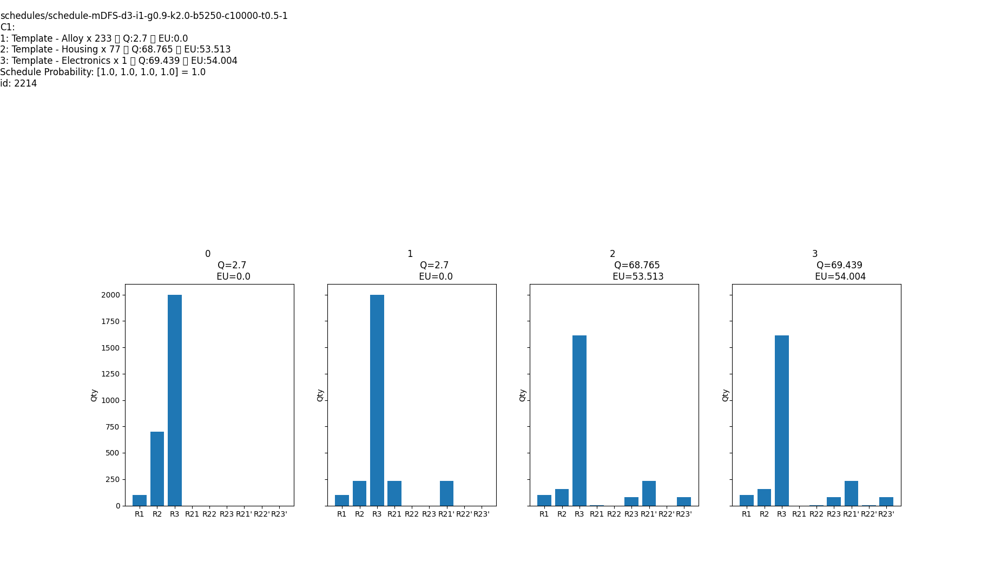
General Improvements:

Slide 4
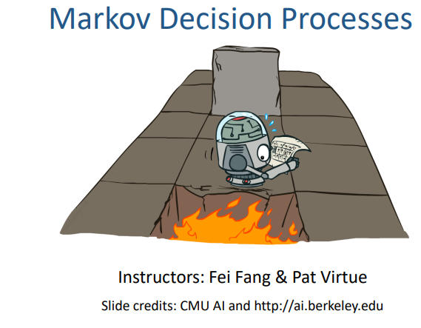

Where to go from here:
MATH
INTUITION
Existing code for the Transition System and Quality functions to an arbitrary bounded depth
Model behavior of an Agent and how actions may potentially be executed, in a Probabilistic manner
Bellman
Non-deterministic Behavior – “pseudo-random choice”
Need to find a way to Simplex/ 1 Directional Traversal from root Node an arbitrary number of times, taking weighted

Slide 5
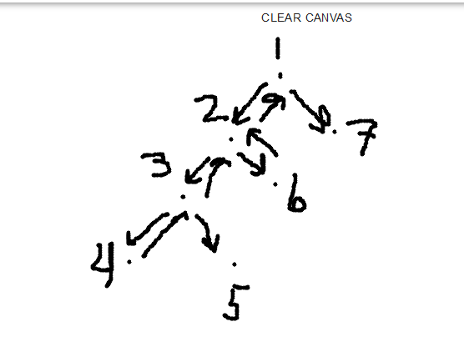
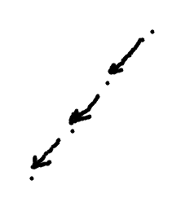
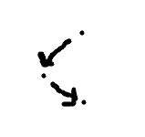
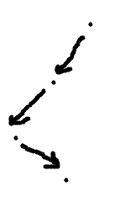

No Takebacks/re-dos!
https://letsdrawtogether.net/

Slide 6
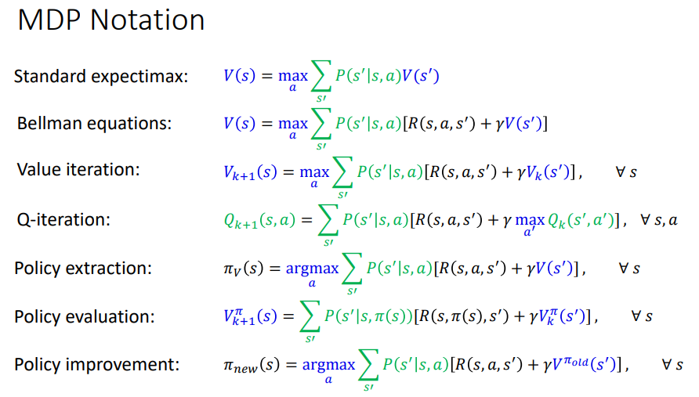
http://www.cs.cmu.edu/~./15281-f19/lectures/15281_Fa19_Lecture_15_MDPs_II.pdf

Slide 7
Learning Policies
Half the Time, attempt to take the best actions/ schedule seen to date.
Other half, explore completely new routes.
Gradual Improvement over time.
Extraction
“top solutions” from prior runs.
Evaluation
Run a “top solution” found from previous searches.
Improvement
Explore new paths.

Slide 8
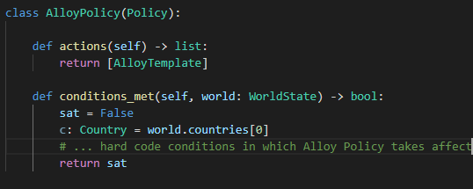
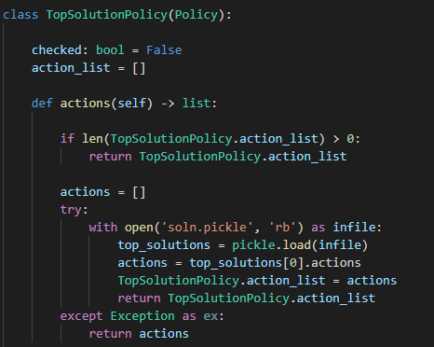
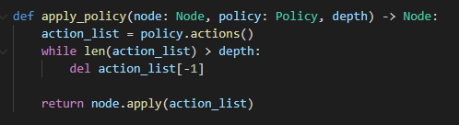
Policy Types
Dynamic
(macros) multi-step plans
Feature/encoded

Slide 9
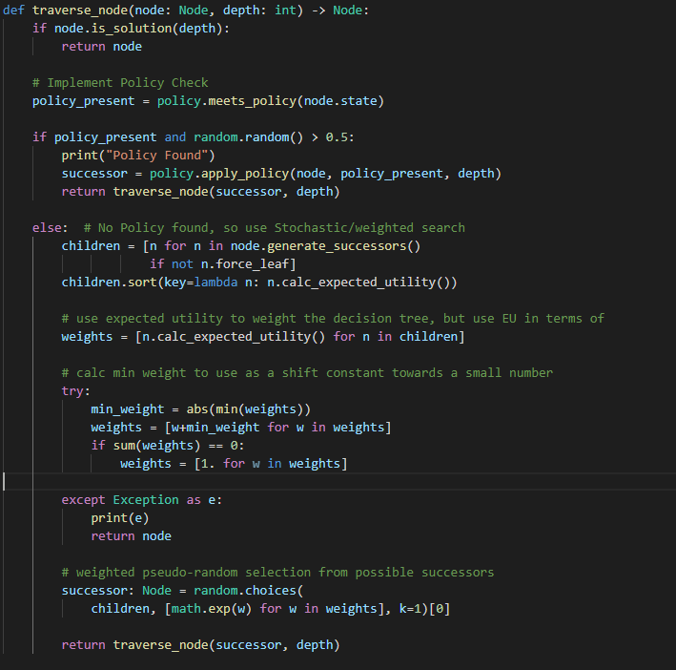

No more Frontier
Each run independent
1-directional node traversal starting at root
Normalize Decision space
= 1

Slide 10
AI Deployment
Back End - Python
Flask
Front End - JavaScript
Node/React/Material

Slide 11
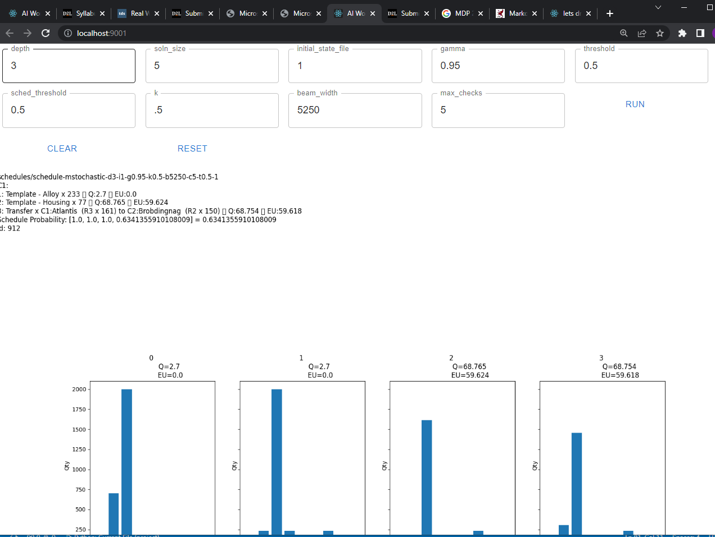

Slide 12
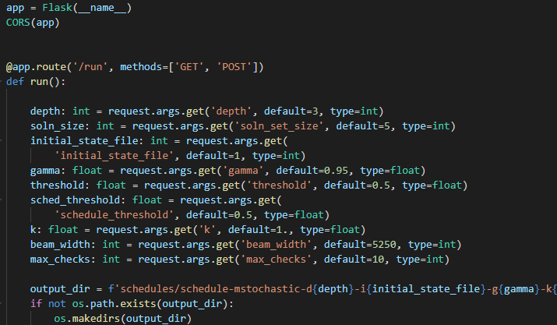
AI Deployment – Flask Backend (replacing run once app with reactive webserver)

Slide 13
Colleague References
Jared Beach- inspired by Front-End design
We further discussed implementing a
Kate Studzinzki/Jared B/Jeff Baranski- Helpful in study-groups content shared on Piazza leading up to exams
Notes:
Trust: People will tend to obey authority figures, even if they are asked to perform objectionable acts. Police, CEO. Trust is noy just limited to people, think process too.

