Slide 1
CS 5260: AI Programming Project
Richard White

Slide 2
Purpose:
What
Why
We are implementing a search agent, whose purpose is to provide insight and recommend a sequence actions, or ‘moves’ pertaining to user input (or actuators) to optimize a players’ underlying game state, or utility.
Other thoughts
This is an ‘open ended’ project which allowed taking many creative decisions in the design and implementation of the AI/search agent.
“Build an anytime, forward-searching, depth-bounded, utility-driven scheduler.”
Hands on experience building an AI/search algorithm aimed at solving a specific problem/domain

Slide 3
Problem Set-up
We exist in a world with Countries.
We represent 1 of the Countries.
Countries are collections of resources.
A Utility function describes the quality of a Countries “State”
Actions are how countries interact in the world, thus impact/change world state
Countries internally transform their own material through transforms
Countries interact with each other through a Trade/Transfer action
We must define a Utility function to build the best schedules which reflect the actions taken to obtain optimized state.
Notes:
Information gathering
Engaging with victim
Attacking
Closing interaction

Slide 4

GIVEN Components:
World
A collection of Countries
Country
A collection of Resources
Resource
Underlying ‘physical’ resources Countries track

Slide 5
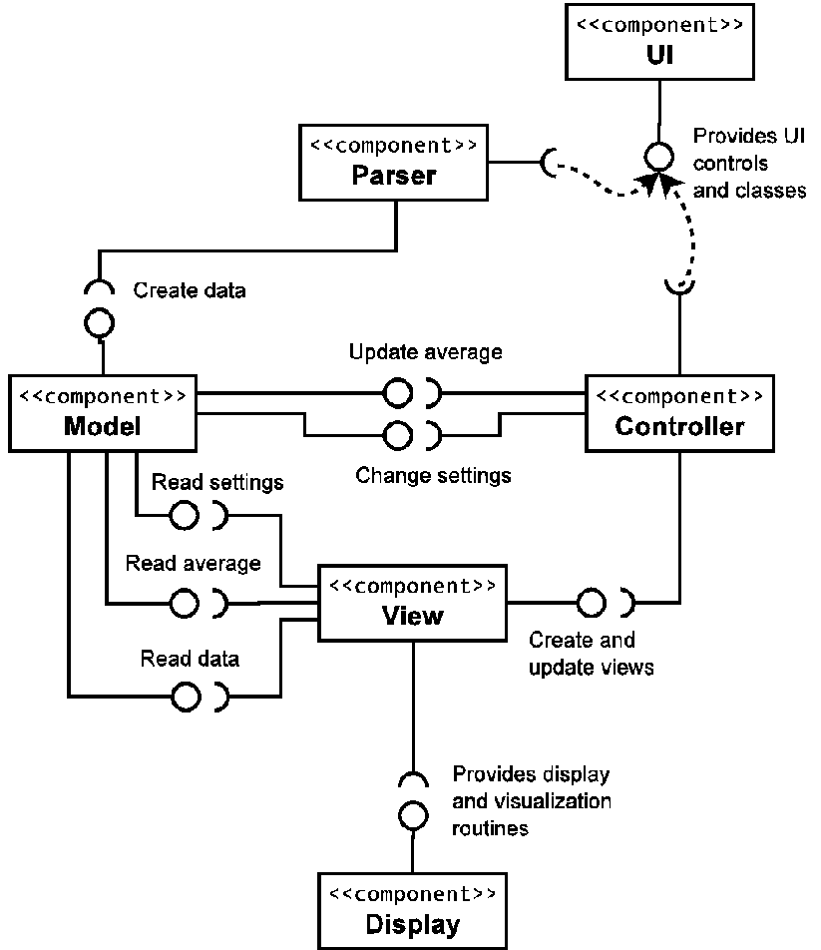
Implementation Details/Structures:
world/country/resource
‘material’ components of the objective game/world state
(graph vertices)
Actions/Events – state transitions (graph edges)
Quality – implementation of the Utility function
Schedule – sequence of Actions from some initial starting point

Slide 6
Implementation Details/Structures (part 2):
node
Tree/Search abstraction: each Node represents the world state at a particular “moment”/has a history and future
Frontier
The active search data-structure
DFS – priority Stack
UCS – priority Queue
Goals – abstraction used to build up Quality

Slide 7

Quality:
Composite Goal Based Implementation:
Tracking Progress Towards Completion of Goals
“End Homelessness”
“Balanced ‘Technology’”
“Low Waste (Sustainability)”
“Resources On Hand”

Slide 8
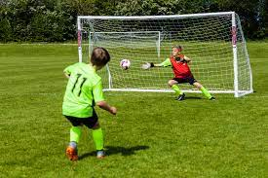
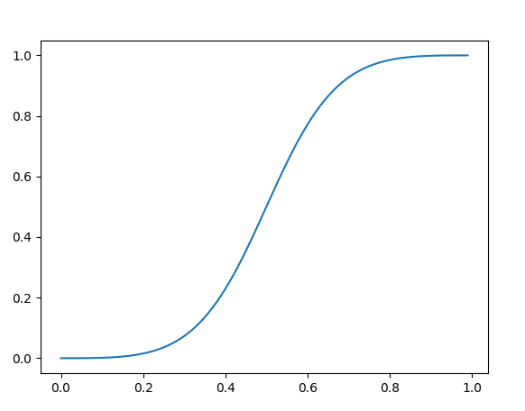
Goal Calculation:
Goal Based Implementation:
S- curved (approx. inv-logit function)
Why?
‘standard’ Sigmoid functions generally take on a range from [-inf, inf], and equal 0.50 at ‘center’ x =0.
While the output takes on range [0,1]
I like the output squashing behavior but also wanted to fit the input into a more finite domain.

Slide 9
Node
Tree structure
Composite Pattern
World state – “objective reality” (Vetices)
Parent
Successors (children)
‘snapshot in time’
Actions - edges
Quality/Utility function
Discounted Quality/Utility function

Slide 10
Edge Traversal/Generating successors
Events/Actions:
is_viable:
SAT/Satisfiability: Boolean check if proposal/Transform is allowable
probability:
Likelihood other country accepts our proposal:
apply:
Pure function: Prior State + Action -> Next State
AlloyTemplate
HousingTemplate
ElectronicsTemplate
Transfer

Slide 11
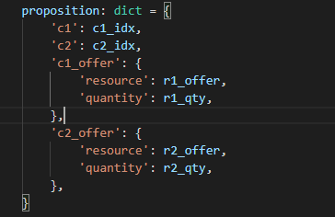
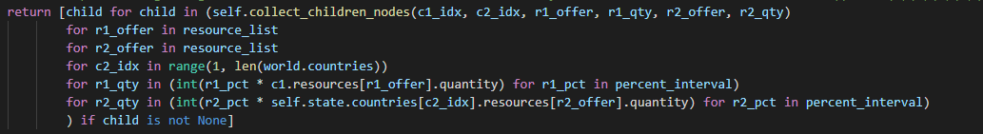
Generating Transfer successors
Trading Template
Probability of Success
Sets additional Decay on “Discount Reward”
Trade Search Space:
5 for-loops… stacked
(7 resources C1)(6 resources C2)(5 C2)(5 percentages C1)(5 percentages C2) = max 5,250 successors

Slide 12

Tunable Parameters:
Model: DFS/UCS
Depth: max steps to traverse
Initial World State: 4 variants
Gamma: [0-1]
Action tolerance/threshold: [0-1]
Schedule tolerance/threshold: [0-1]
Solution set size: (typically 2-3)
Schedule name: str
Beam width: narrow successors

Slide 13
Gamma:
range [0-1]
0.95,
0.9,
0.80,
0.63 (1- 1/e) Penetration depth
Recommendation:
Relate it to the depth of search seeking:
Large depths, g closer to 1, smaller depths, smaller g:
G:= 1- 1/d
D = 20, g = 0.95
d =3, .67

Slide 14
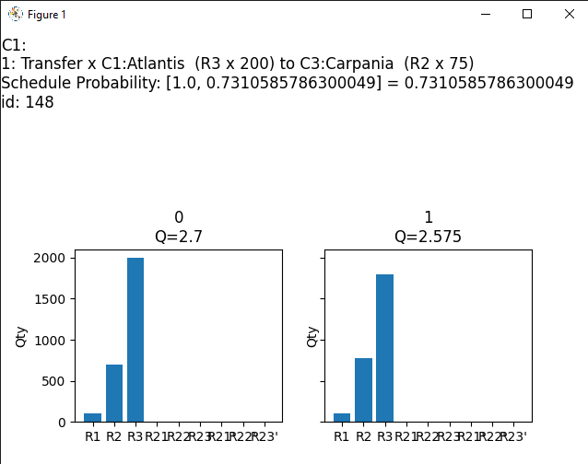
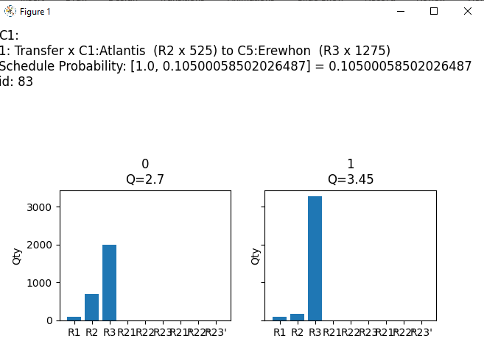
Action/Schedule Tolerance:
Each schedule has a probability associated with it: A chain of products of the probabilities of each action occurring successfully.
Action threshold applies to any 1 operation meeting/exceeding a probability
Tolerance/Threshold defines a cap/bound by which our search will not waste time seeking out schedules which violate the allowable threshold

Slide 15

Beams
Heuristic Depth First Search
Priority stack
children are placed onto frontier in asc order,
such that the last elements appended have the highest utility
Using Beams
After generating all successors, cut off/narrow which ones are placed onto the stack

Slide 16
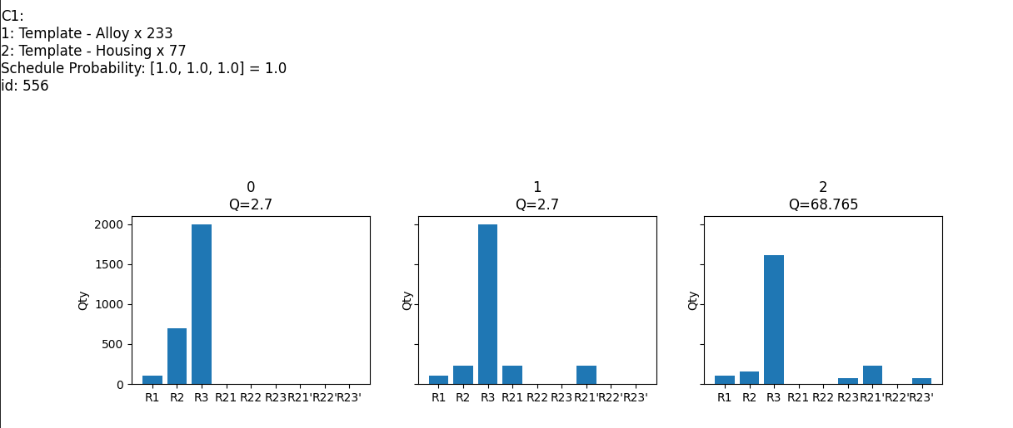
Beams (2)
main.py –d 2 –b 50 => (X)
main.py –d 2 –b 500 => (X)
main.py –d 2 –b 5000 => ~50,000 (#556)

Slide 17
Beams (3)
How about depth 10?
using beams, can explore an output space of about b^10 vs. 5250^10
Takeaways
Beams are a powerful tool to help limit the scope of searched, especially when dealing with many successors generated, or a large depth required

Slide 18
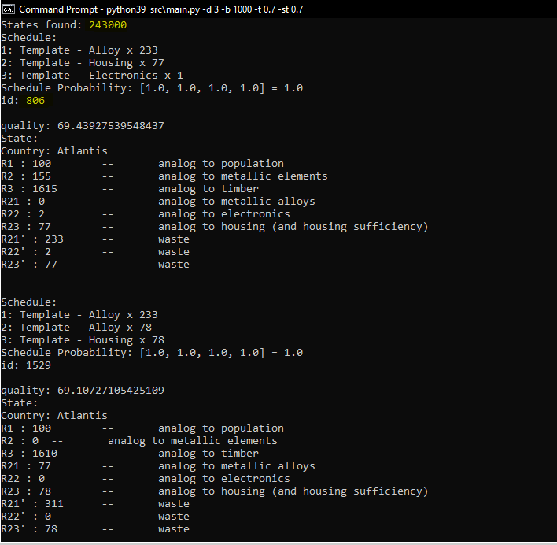
Search in real-time:
Every 1000 viable states found, re-prints the top 3 (or however many defined in the solution set size)
Prints the id sequence/occurrence order by which the given node was checked as a solution:
Ex: 200,000 states checked:
Best path found at id 806.
Can be used to inform the Beam

Slide 19
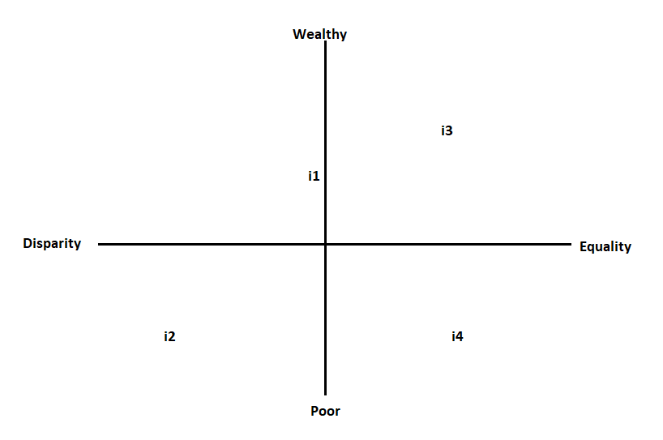
Initial States:
4 variants:
i1: normal
i2: brutal
i3: easy
i4: hard

Slide 20
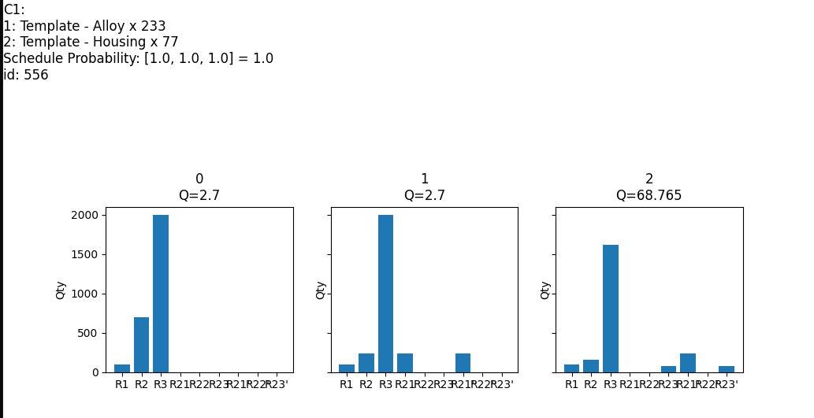
I1 findings/tests:
Python src\main.py –i 1 –d 2 –b 100 –t0.50 –st0.50

Slide 21
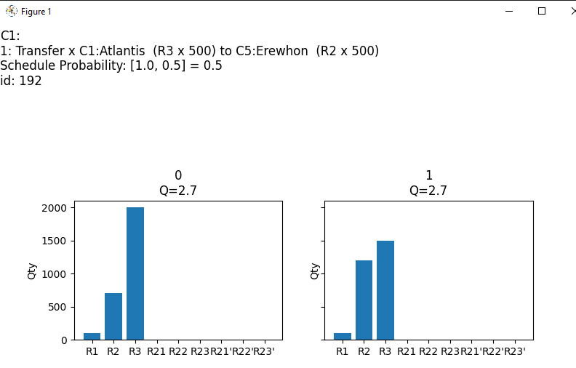
I1 findings/tests:
Python src\main.py –i 1 –d 2 –b 100 –t0.50 –st0.50

Slide 22
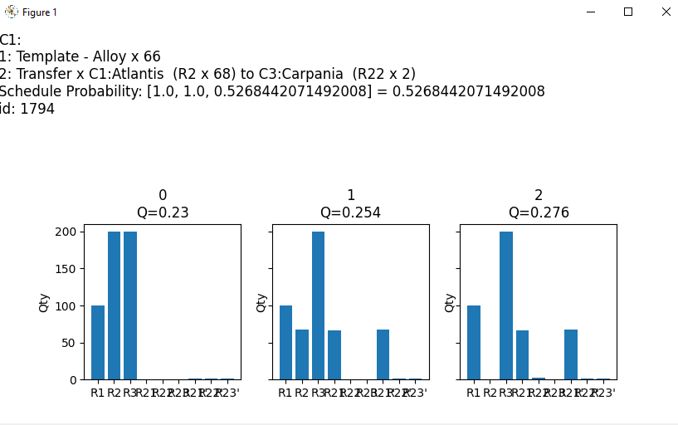
I2 findings/tests:
Python src\main.py –i 2 –d 2 –b 100 –t0.50 –st0.50 : 101 states, best opt: 0
Python src\main.py –i 2 –d 2 –b 500 –t0.50 –st0.50 : best opt: 1794/2001

Slide 23
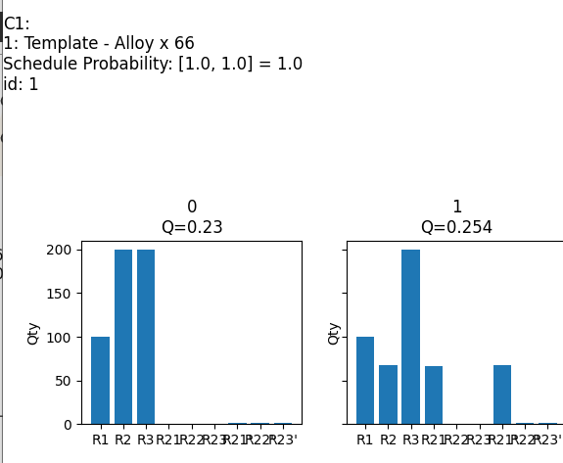
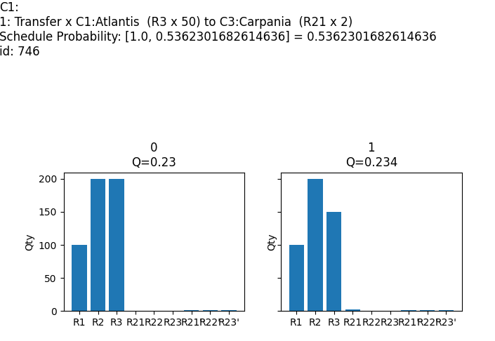
I3 findings/tests:
Python src\main.py –i 2 –d 2 –b 100 –t0.50 –st0.50 – 101 states, best opt: 0
Python src\main.py –i 2 –d 2 –b 500 –t0.50 –st0.50 – 2001 states, best opt: 1794/2001

Slide 24
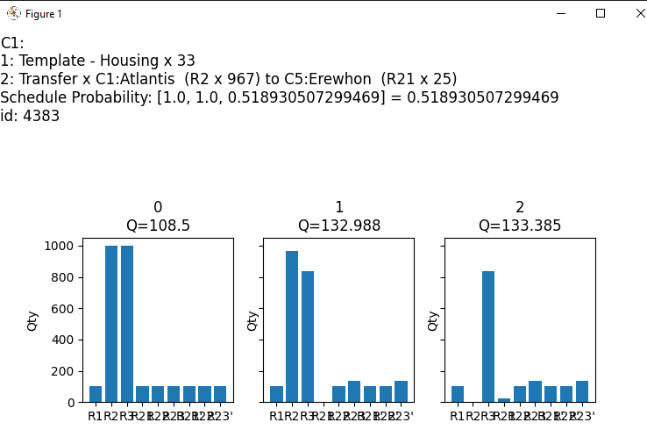
I3 findings/tests:
Python src\main.py –i 3 –d 2 –b 50 –t0.50 –st0.50 : 1701 states, best opt: 0

Slide 25
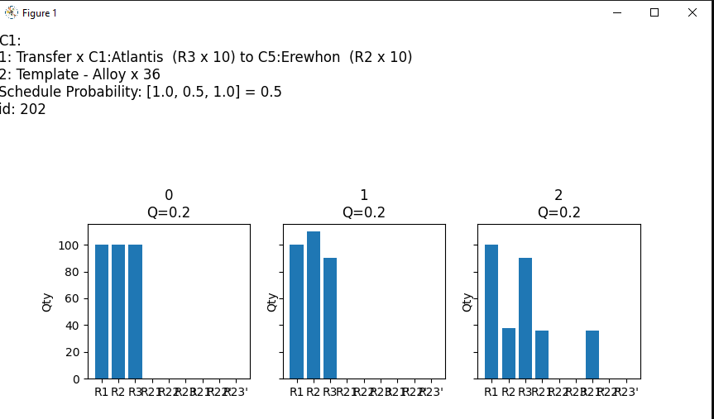
I4 findings/tests:
Python src\main.py –i 4 –d 2 –b 5000 –t0.50 –st0.50 : 20905 states, best opt: 202

Slide 26
Colleague References
Jared Beach- general guiding discussions/topics
Layne Mosely – guiding discussions/questions asked
Katherine Studzinki- “Actions” inheritance
Jeff Baranski- Trade templating
Notes:
Trust: People will tend to obey authority figures, even if they are asked to perform objectionable acts. Police, CEO. Trust is noy just limited to people, think process too.

