Slide 1
CS 5260: AI Programming Project
Richard White

Slide 2
Purpose:
What
Why
We are implementing a search agent, whose purpose is to provide insight and recommend a sequence actions, or ‘moves’ pertaining to user input (or actuators) to optimize a players’ underlying game state, or utility.
Other thoughts
This is an ‘open ended’ project which allowed taking many creative decisions in the design and implementation of the AI/search agent.
“Build an anytime, forward-searching, depth-bounded, utility-driven scheduler.”
Hands on experience building an AI/search algorithm aimed at solving a specific problem/domain

Slide 3
Problem Set-up
We exist in a world with Countries.
We represent 1 of the Countries.
Countries are collections of resources.
A Utility function describes the quality of a Countries “State”
Actions are how countries interact in the world, thus impact/change world state
Countries internally transform their own material through transforms
Countries interact with each other through a Trade/Transfer action
We must define a Utility function to build the best schedules which reflect the actions taken to obtain optimized state.
Notes:
Information gathering
Engaging with victim
Attacking
Closing interaction

Slide 4

GIVEN Components:
World
A collection of Countries
Country
A collection of Resources
Resource
Underlying ‘physical’ resources Countries track

Slide 5
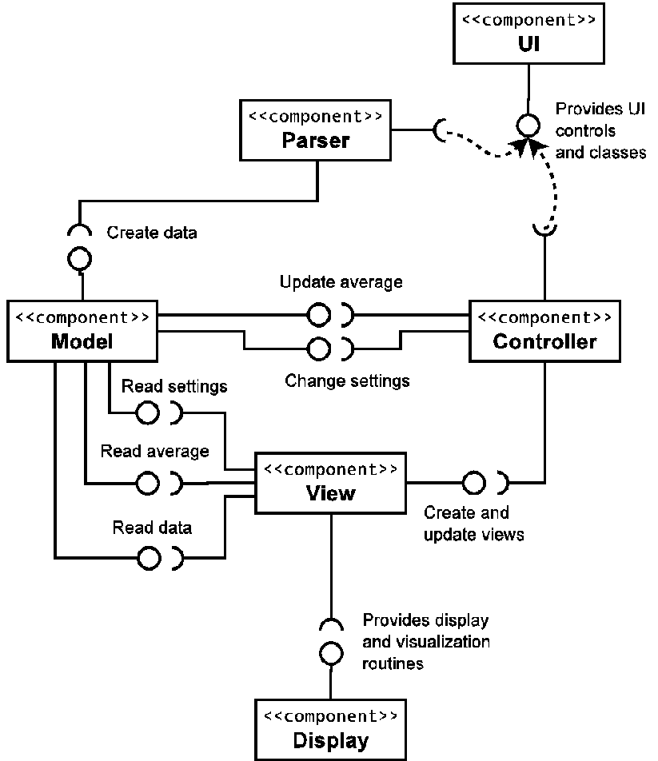
Implementation Details/Structures:
world/country/resource
‘material’ components of the objective game/world state
(graph vertices)
Actions/Events – state transitions (graph edges)
Quality – implementation of the Utility function
Schedule – sequence of Actions from some initial starting point

Slide 6
Implementation Details/Structures (part 2):
node
Tree/Search abstraction: each Node represents the world state at a particular “moment”/has a history and future
Frontier
The active search data-structure
DFS – priority Stack
UCS – priority Queue
Goals – abstraction used to build up Quality

Slide 7
Node
Tree structure
Composite Pattern
World state – “objective reality”
Parent
Successors (children)

Slide 8
Searching for solutions

Slide 9

Quality Calculation:
Goal Based Implementation:
Housing Goal
(No Homelessness)
Electronics/’Tech’
‘Balanced technology usage’
dependent on Housing needs met
Waste
‘Sustainability’ and cleanliness
On-Hand Resources
‘inventory’/conservation

Slide 10
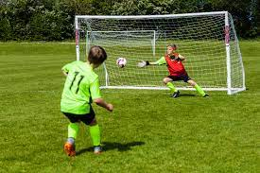
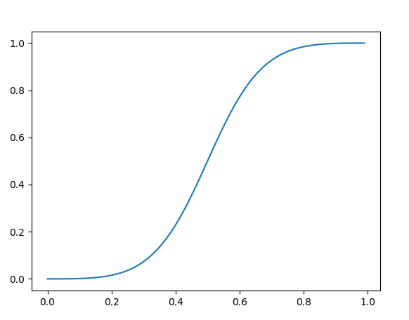
Goal Calculation:
Goal Based Implementation:
S- curved (approx. inv-logit function)
Why?
‘standard’ Sigmoid functions generally take on a range from [-inf, inf], and equal 0.50 at ‘center’ x =0.
While the output takes on range [0,1]
I like the output squashing behavior, but wanted to fit the input into a more finite domain.

Slide 11

Tunable Parameters:
Model: DFS/UCS
Depth: max steps to traverse
Initial World State: 4 variants
Gamma: [0-1]
Action tolerance/threshold: [0-1]
Schedule tolerance/threshold: [0-1]
Solution set size: (typically 2-3)
Schedule name: str

Slide 12
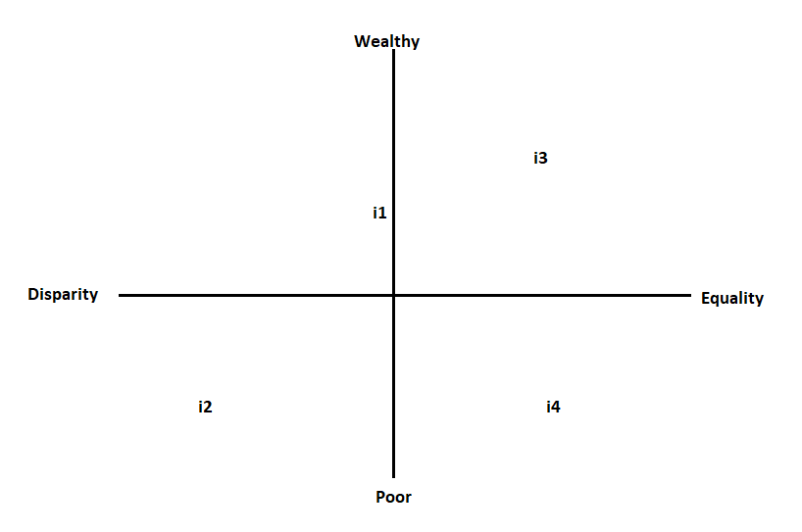
Initial States:
4 variants:
i1: normal
i2: brutal
i3: easy
i4: hard

Slide 13
Initial States:
4 variants:
i1: normal
i2: brutal
i3: easy
i4: hard

Slide 14
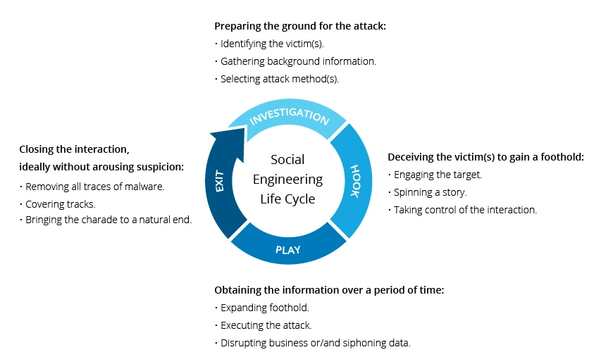
lifecycle of social engineering
https://www.imperva.com/learn/application-security/social-engineering-attack/
Notes:
Information gathering
Engaging with victim
Attacking
Closing interaction

Slide 15
References
Notes:
Trust: People will tend to obey authority figures, even if they are asked to perform objectionable acts. Police, CEO. Trust is noy just limited to people, think process too.

