Slide 1


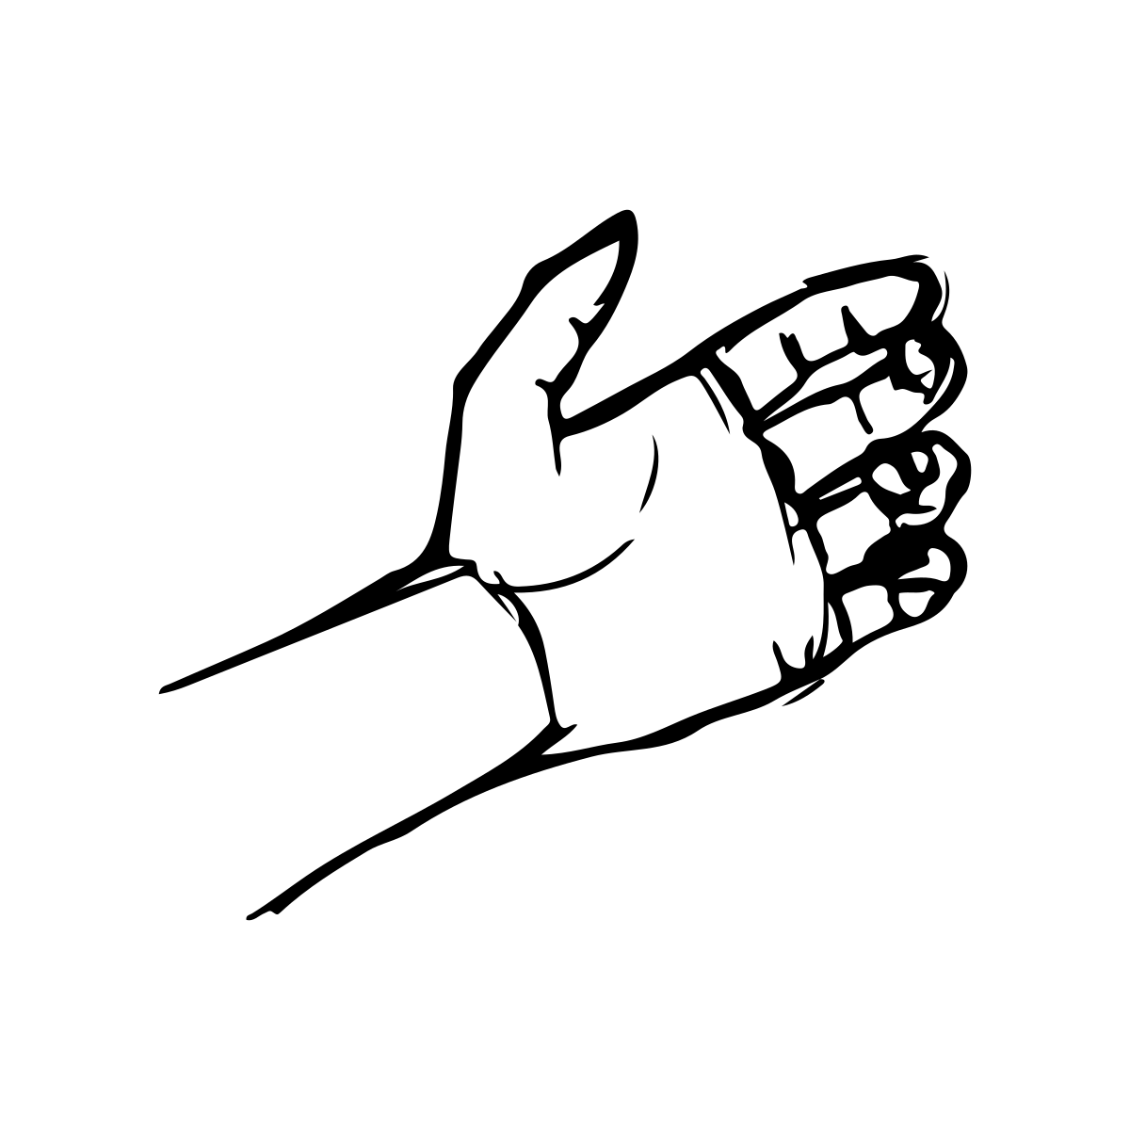
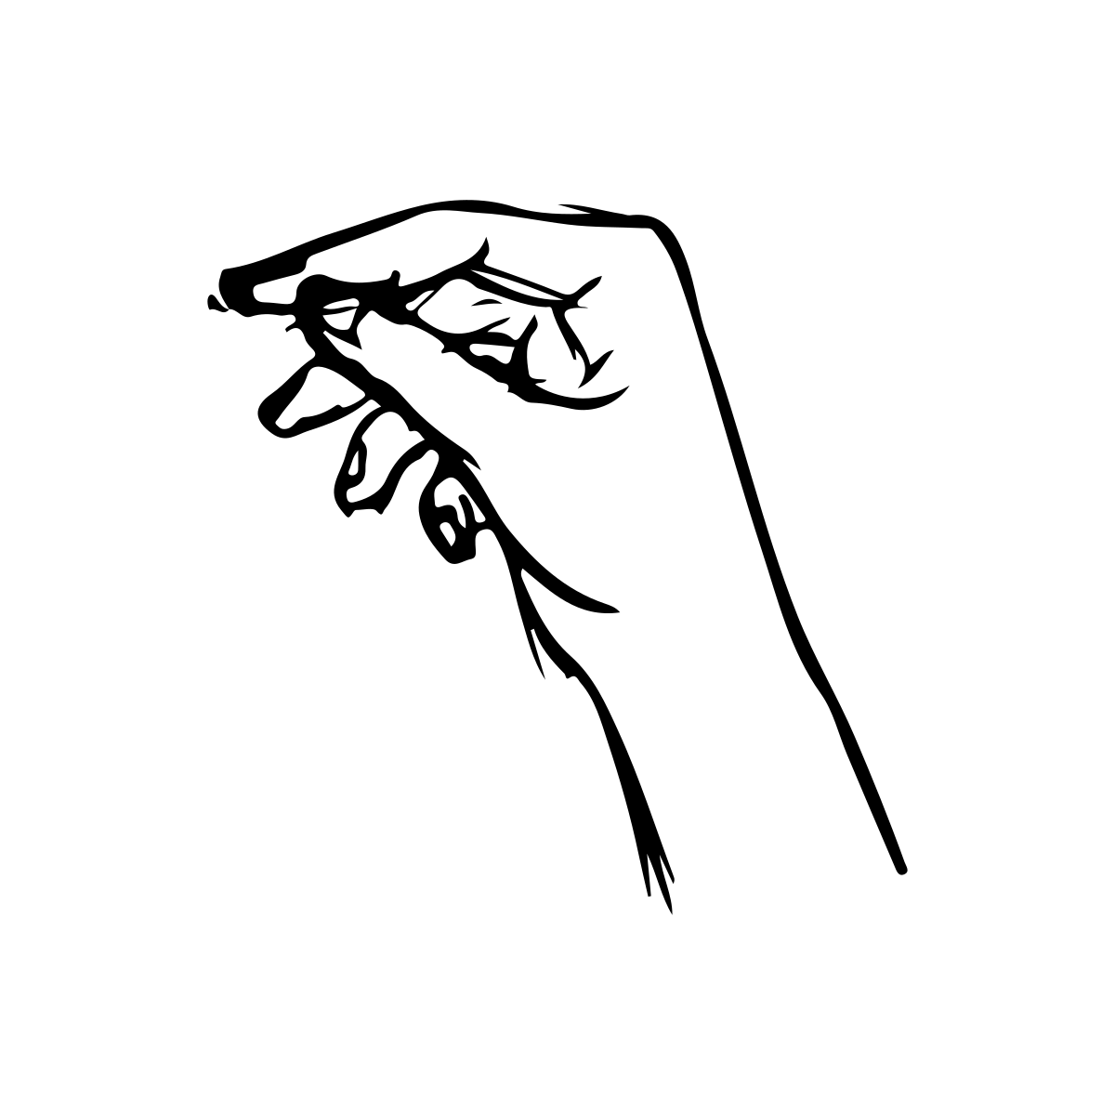

A
Pre-training
Training
Post-training
Forced choice task (same/different)
5 sessions (1 per day)
Name 10 knots
Tie 10 knots
Name and Tie 10 knots
Forced choice task (same/different)
B
Name
Tie
Name & Tie
POLKA
SPANGLE

