Slide 1
Can a machine learning model accurately predict the likelihood of heart disease based on the chosen dataset?
We think so…

Slide 2
Overview :
Our project aims to develop a machine learning model that accurately predicts heart disease risk based on health indicators from a comprehensive dataset. Key questions guiding our analysis include identifying the most significant health factors influencing heart disease, understanding risk differences by demographics, and exploring clustering techniques to identify high-risk groups. By examining individuals with and without known risk factors and comparing obesity groups, we aim to gain nuanced insights into heart disease prevalence. Our approach includes data cleaning, feature engineering, and model training using classifiers like logistic regression, and random forest. We’ll evaluate performance using accuracy, precision, recall, and F1 score, optimizing through hyperparameter tuning. Finally, we’ll interpret feature importance to highlight critical predictors and present insights through visualizations like regression plots, box plots, and age-related scatter plots.

Slide 3
Questions to consider…
1.What are the most important health indicators for predicting heart disease?
2.Can clustering techniques identify distinct groups at higher risk for heart disease?
3. Can we build a model to accurately predict if an individual will have a heart attack or heart disease based on health indicators provided by the data set?
4. Among people with obesity, is the heart disease rate higher than those with a normal BMI?

Slide 4
Data Preparation
Load and Clean the Data set we used from Kaggle, finding any missing data
Data set size is based on survey responses from 253,680 participants

Slide 5
Feature Engineering
Python
Sklearn
Random Forest Classifier
Logistical Regression Model
Pandas
Numpy

Slide 6
Identifying the most important health indicators for predicting heart disease
Model Used: Random Forest Classifier, Logistical Regression Model
Feature Importance Analysis:
Calculated the importance of each health factor in predicting heart disease.
Top Predictors:
BMI, Age, Hypertension, Smoking, and Diabetes
Visualization:
Feature importance was visualized using an interactive Plotly bar chart for better interpretability.

Slide 7
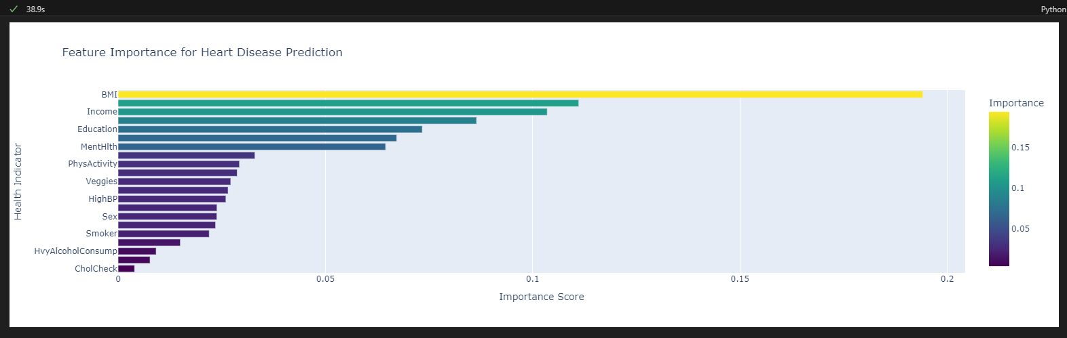

Slide 8
Clustering for High-Risk Groups
Clustering Technique: K-means clustering
Objective: Group individuals with similar health profiles and evaluate heart disease risk within each cluster.
Process:
Used Principal Component Analysis (PCA) to reduce dimensions for better visualization.
Created clusters that revealed distinct risk groups based on health indicators.
Findings:
Certain clusters showed a higher prevalence of heart disease, highlighting high-risk groups.

Slide 9
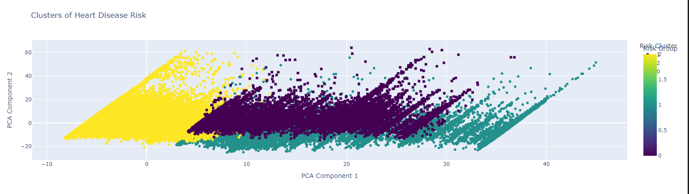

Slide 10
Key Insights and Next Steps
Insights:
Health indicators like BMI, Age, and Hypertension are critical in heart disease prediction.
Clustering successfully identified groups with varying heart disease risks, useful for targeted interventions.
Next Steps:
Implement targeted health programs for high-risk groups.
Further refine the model and explore additional data to improve prediction accuracy.

Slide 11
Model Selection
For our heart disease prediction model, we selected Logistic Regression and Random Forest due to their strengths in binary classification:
Logistic Regression: Chosen for its interpretability, it allows us to see the impact of each health indicator on heart disease risk, with coefficients showing which factors increase or decrease likelihood.
Random Forest: Selected for its ability to capture complex, non-linear relationships, it offers insights into feature importance, highlighting the most influential risk factors. It’s also robust to outliers, making it well-suited for diverse healthcare data.
By using both models, we gain the interpretive clarity of logistic regression and the flexibility and robustness of Random Forest, enabling a comprehensive analysis of heart disease predictors.

Slide 12
Training and Evaluation
Train the model on the given data set
Use 5 and 10 fold cross validation to analyze the accuracy of the predictive models
Use heat maps and a bar graph to show what the highest indicators of heart disease are

Slide 13
Logistical Regression Model
The findings from our logistic regression model reveal several key insights:
Significant Predictors: Health indicators like high blood pressure, high cholesterol, smoking history, and lack of physical activity showed strong positive associations with heart disease risk, indicating they are critical predictors.
Demographic Differences: Age and gender also played important roles, with older age groups and males having higher predicted risks.
Model Performance: The model achieved a balanced accuracy with satisfactory precision and recall, meaning it could effectively identify both those with heart disease and those without it. This balance is reflected in the F1 score, which shows the model's reliability in making positive predictions.
Interpretability: Logistic regression allowed us to see the specific impact of each health indicator on heart disease risk, highlighting which factors are most influential.
Overall, the logistic regression model provided clear insights into the health and demographic factors that most significantly contribute to heart disease risk, helping guide future preventive efforts and risk assessments.

Slide 14
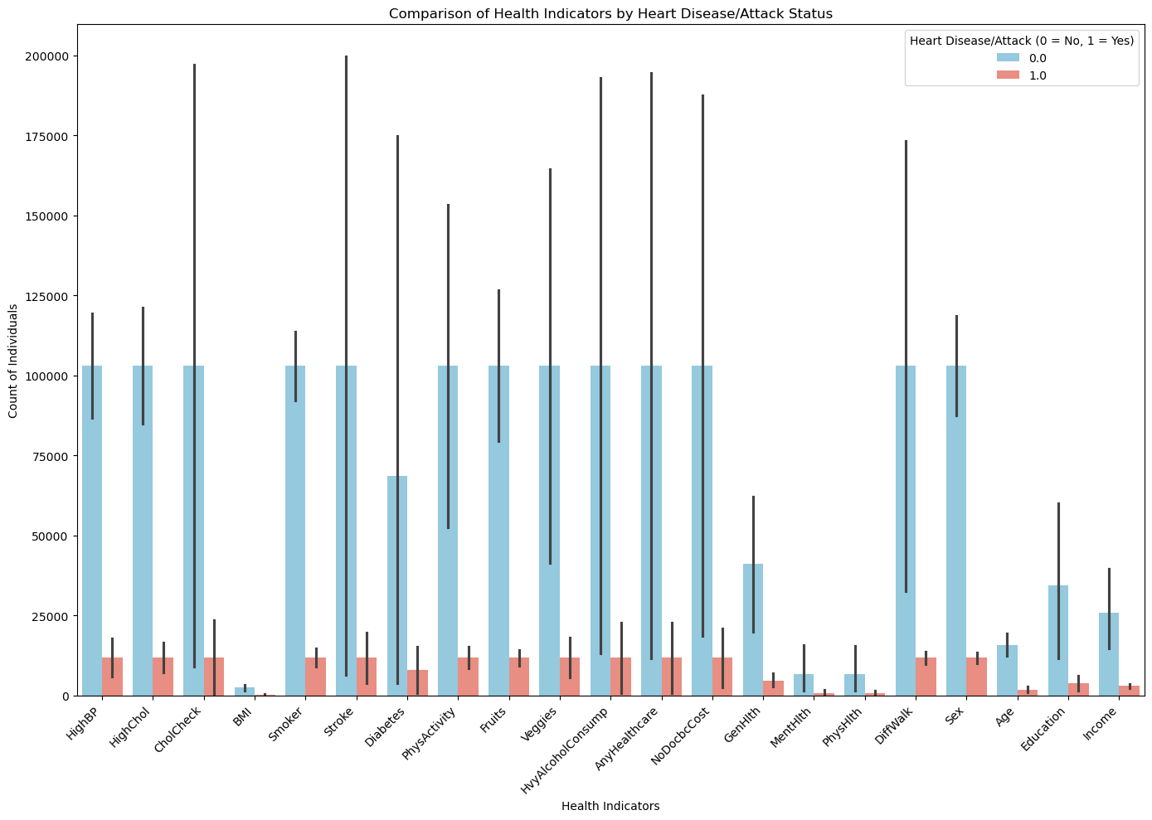
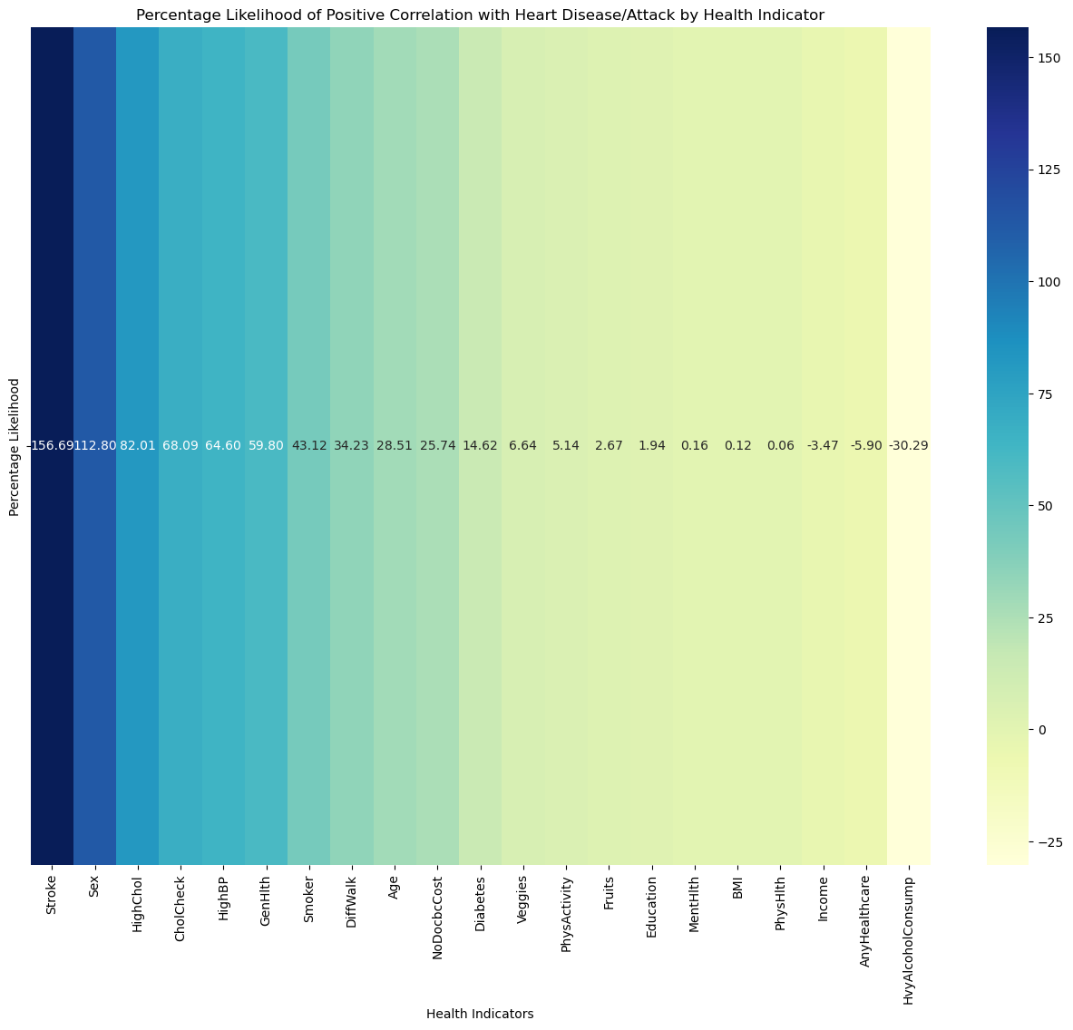
Evaluation Metrics and Heat Maps
Accuracy: 0.9002 Precision: 0.5595 Recall: 0.1209 F1 Score: 0.1988

Slide 15
Random Forest Classifier
Here are the key findings from the Random Forest model:
Top Predictors: The Random Forest model identified high blood pressure, age, and BMI as the most influential predictors of heart disease risk. These indicators had the highest feature importance scores, emphasizing their critical role in the model’s predictions.
Complex Interactions: Unlike logistic regression, Random Forest captured non-linear relationships, making it adept at handling complex interactions between health indicators, such as age and blood pressure or smoking history and physical activity.
Model Performance: The model showed robust performance with high accuracy and an F1 score that balanced precision and recall. This indicates the model’s strength in identifying true cases of heart disease while minimizing false positives and false negatives.
Interpretation: While less straightforward to interpret than logistic regression, the feature importance scores provided valuable insights into which health indicators contributed most to heart disease risk.
Overall, the Random Forest model offered a flexible and robust approach, effectively capturing both primary risk factors and complex interactions within the data, helping to identify high-risk individuals more accurately.

Slide 16
Evaluation Metrics
Random Forest Model Performance:
Accuracy: 0.8996
Precision: 0.6788
Recall: 0.0447
F1 Score: 0.0839
Classification Report:
precision recall f1-score support
0.0 0.90 1.00 0.95 61847
1.0 0.68 0.04 0.08 7088
accuracy 0.90 68935
macro avg 0.79 0.52 0.52 68935
weighted avg 0.88 0.90 0.86 68935

Slide 17
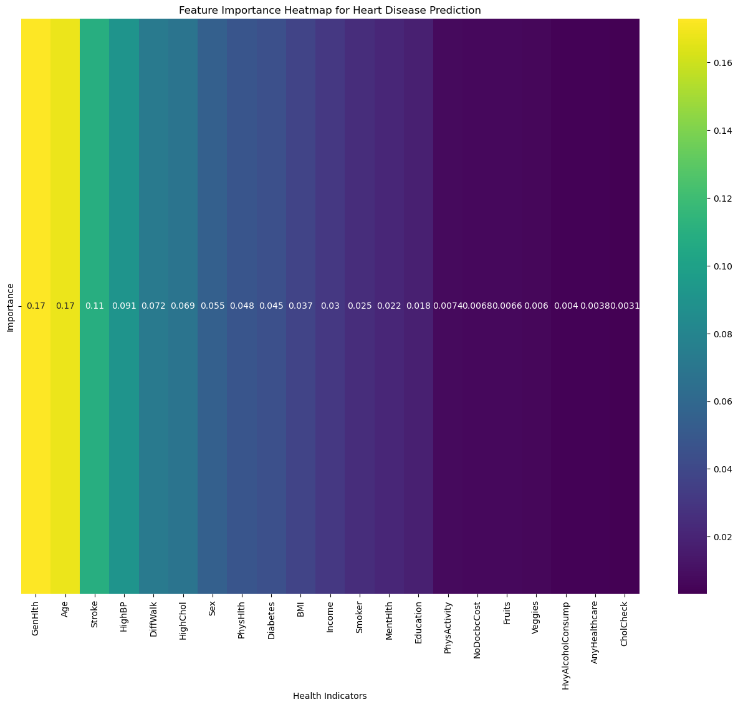

Slide 18
Is high BMI and heartattack correlated
Assumption: The higher the BMI the Higher the chance of a heartattack.
Isolating the x from the y which is the Heart Attack Outcome, sets the testing model to look for the differences between those with a normal BMI and a high BMI.

Slide 19
Logistic Regression
This Model was used because there were multiple x variables to take into consideration such as:
Smoker/Non Smoker
Exercise
Eating Habits
Age
Cholestrol Levels
Stroke Yes/No
Gender

Slide 20
Testing
Creating the test:
The test size is 20%
Random state = 1
Verify the size to ensure the data is balanced
Training Data:
Training Score: 90%
Testing Score: 90%

Slide 21
Conclusion
Project Success: Our machine learning models effectively predicted heart disease risk, leveraging key health indicators and demographic factors.
Model Insights:
Logistic Regression: Provided clear interpretability, showing that high blood pressure, stroke, high cholesterol, and gender are critical predictors.
Random Forest: Captured complex interactions, highlighting high blood pressure, age, and BMI as the most influential predictors.
Impactful Findings: Both models underscored the importance of targeted preventive measures for high-risk groups.
Future Directions:
Explore additional models like XGBoost or another predictive model for potential improvements.
Apply clustering techniques for deeper analysis of high-risk groups.

