Slide 1
Form Input Validation
Mark Richmond

Slide 2
Why Form InPUT?
Forms are the main means by which data is collected on a web page
Forms allow the web page to pass a collection of data in a simple manner
Forms are a convenient means of communication for both the website owner and the website visitor

Slide 3
WHY FORM INPUT VALIDATION?
User Convenience
Better Quality Data
Protect Against Security Vulnerabilities

Slide 4
Types of Form INPUT VALIDATION
HTML Validation
JavaScript Validation
Back End Validation

Slide 5
HTML FORM Validation
Required Attribute
Input Types
Input Patterns

Slide 6
Input types
email
url
number
range
password
color
date
datetime
datetime-local
time
week
month
search
tel

Slide 7
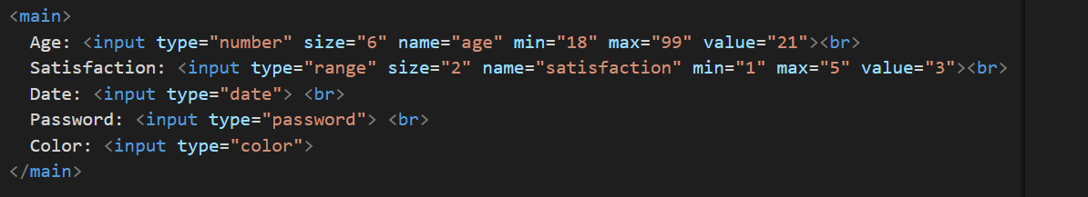
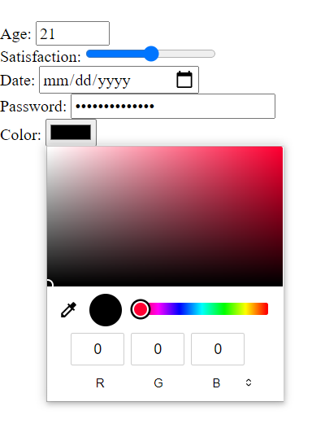
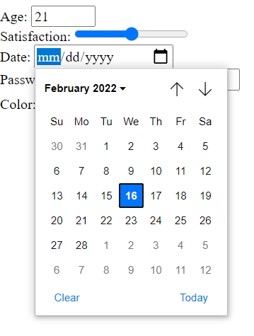
HTML TYPE Validation Example

Slide 8
Input patterns
Text String including sequences of numbers, symbols, and letters in the form of a Regular Expression that indicates what pattern the input should follow. Input that does not follow the pattern will be rejected by the validation.

Slide 9
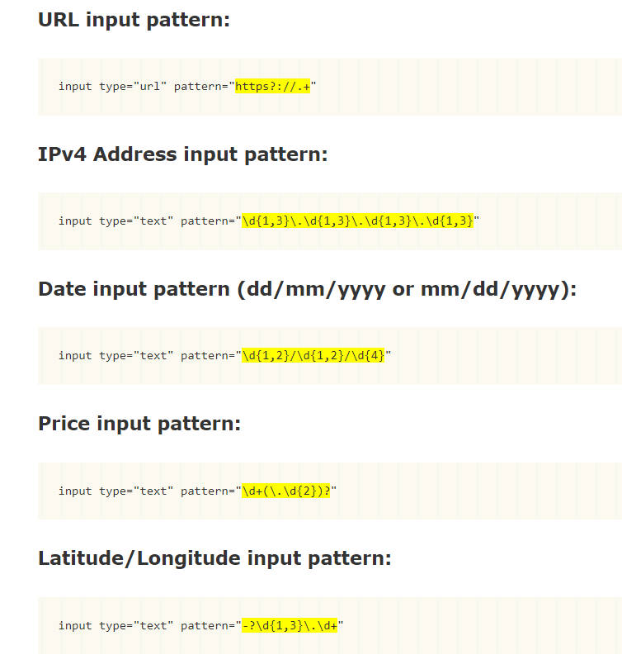
HTML Pattern Validation Example

Slide 10
JavaScript FORM VALIDATION
JavaScript can be used to evaluate any input field by:
Reading the value
Evaluating the value
Accepting or rejecting the value
Resetting focus

Slide 11
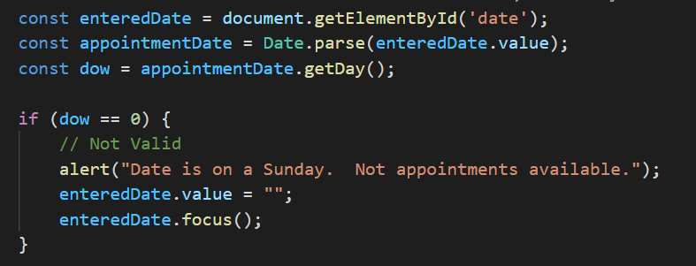
JAVASCRIPT FORM VALIDATON EXAMPLE
Validate that the date is not a Sunday

Slide 12
Back End validation
Once the data has been sent to the server, any form of validation can be performed.
One example is the processing of a credit card during a purchase.

Slide 13
CSS Styling to Indicate validity
Change of color
Change of font
Use of images
Animation
No limits, except for aesthetics

Slide 14
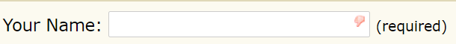
CSS Examples
<style>
input:required:invalid, input:focus:invalid {
color: red;
}
input:required:invalid, input:focus:invalid {
background-image: url(/images/invalid.png);
background-position: right top;
background-repeat: no-repeat;
}
</style>

Slide 15
SUMMARY
Form input validation is an important part of collecting data on a website. It is easy to implement, and it simplifies the data input on a website while protecting both the user and the web owner.

