Slide 1
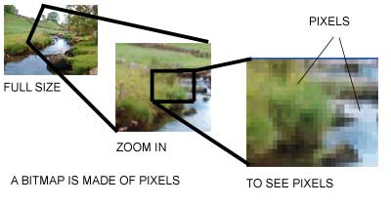

Slide 2
Vector Graphics

Slide 3
Vector Graphics

Slide 4
Vector Graphics

Slide 5
Vector G

Slide 6
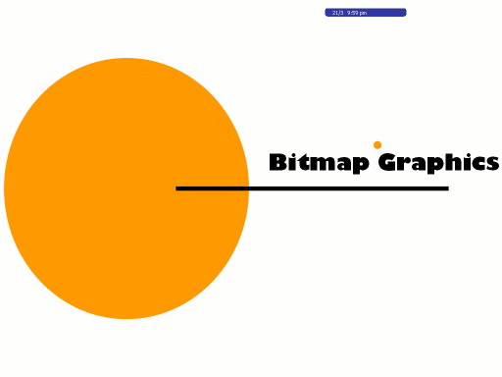

Slide 11


