Slide 1
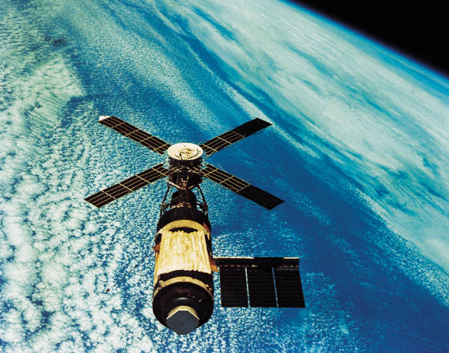
Marketing Strategies for SPACE ADVENTURES
A Science-Fiction Film
by J. Warber
15 January 2010

Slide 2
Goals and Objectives
International support/recognition for the film
Financial returns

Slide 3
Trilogy’s Vision
Widespraed name recognition
An animated TV series following the release of the film
An expanding marketing and franchising department

Slide 4
Positioning our Product
Internet developpment
Release of the soundtrack to the film
Toys and stuffed animals
Clothing and hats

Slide 5
The Space Adventures Web Site
http://www.space.com
Latest news on the feature film
Ability to purchase Space Adventures paraphernalia
Profile of a charactor each month
Blog for fans
Interactive games with the characters

Slide 6
The Soundtrack
Targeted to a wider market
International availability
Use as a promotional item

Slide 7
Toys and Dolls
Merchandiser will create toys and dolls
Distribution
Large Toy stores/chains
Household stores
Children’s Clothing stores

Slide 8
Clothing and Hats
Use as promotional items before release of film
Adult and Children’s sizes
Distribution
Large Toy stores/chains
Household stores
Clothing stores (that sell similar merchandise)

Slide 9
Summary
30 years of marketing experience
Past record of successful film marketing
The Wave - grossed £15 million
Money Made Me Rich - grossed £35 million
Spaced Out - grossed £55 million

