Slide 1
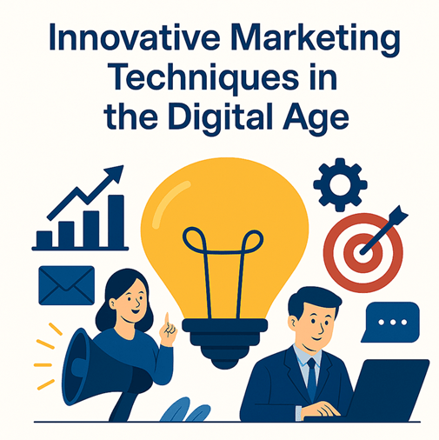

Slide 2
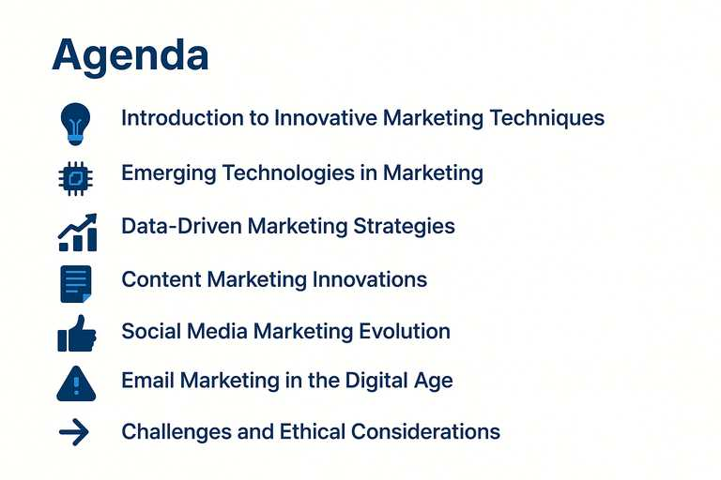
Introduction to Innovative Marketing Techniques
Emerging Technologies in Marketing
Data-Driven Marketing Strategies
Content Marketing Innovations
Social Media Marketing Evolution
Email Marketing in the Digital Age
Challenges and Ethical Considerations
Conclusion and Future Trends

Slide 3
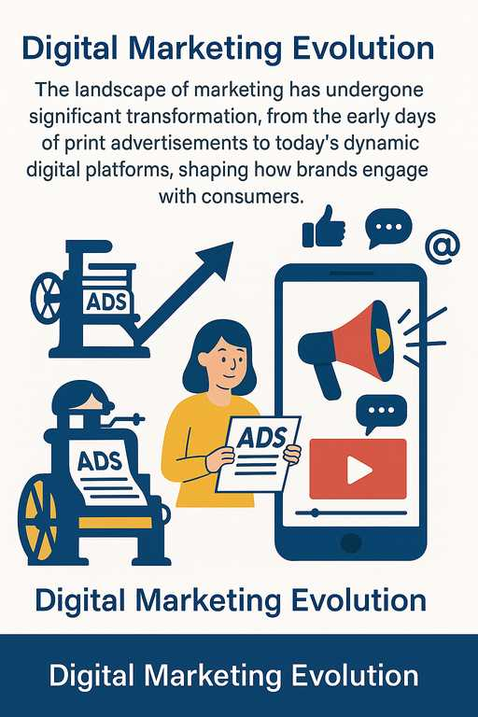
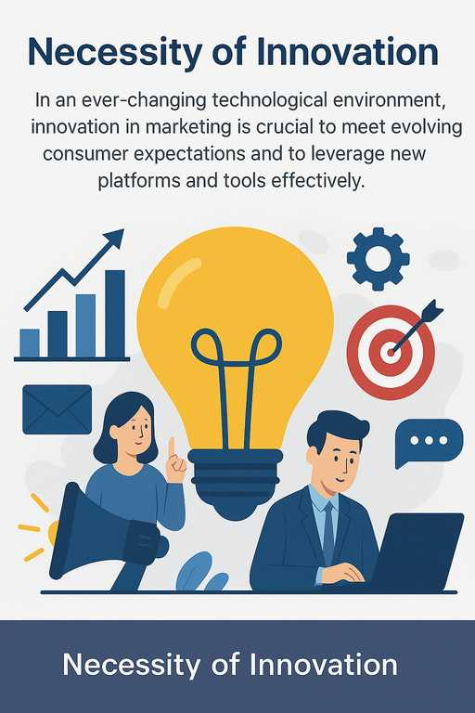

Introduction to Innovative Marketing Techniques
Understanding the Landscape of Modern Marketing

Slide 4

Emerging Technologies in Marketing
Harnessing Innovation for Competitive Advantage
Artificial Intelligence and Machine Learning: AI and machine learning facilitate data analysis and automate processes, enabling marketers to create predictive models and enhance customer experiences through tailored content.
Augmented Reality and Virtual Reality: These immersive technologies allow brands to offer unique, engaging experiences that influence consumer behavior and enhance product visualization prior to purchase.
Blockchain in Marketing: Blockchain technology enhances transparency and security within marketing operations, enabling trust in data integrity and smoother transactions between brands and consumers.
Notes:
Emerging technologies are reshaping the marketing landscape, providing innovative opportunities to engage consumers. Artificial intelligence and machine learning enhance data-driven decision-making, while augmented and virtual reality create timeless experiences. Blockchain further enriches the marketing ecosystem by improving transparency and data security, paving the way for more trustworthy interactions between brands and their audiences.

Slide 5
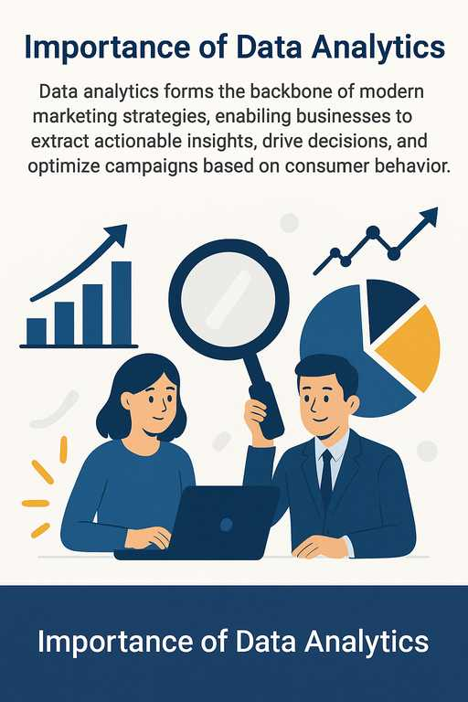
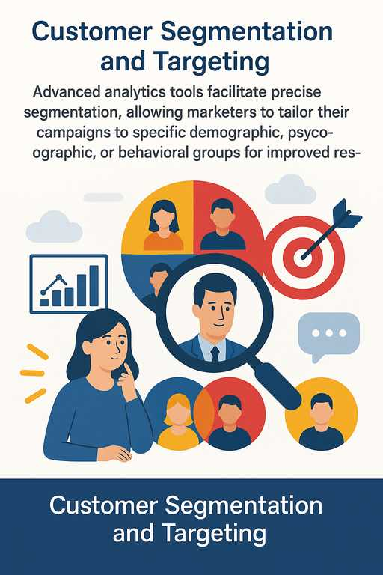
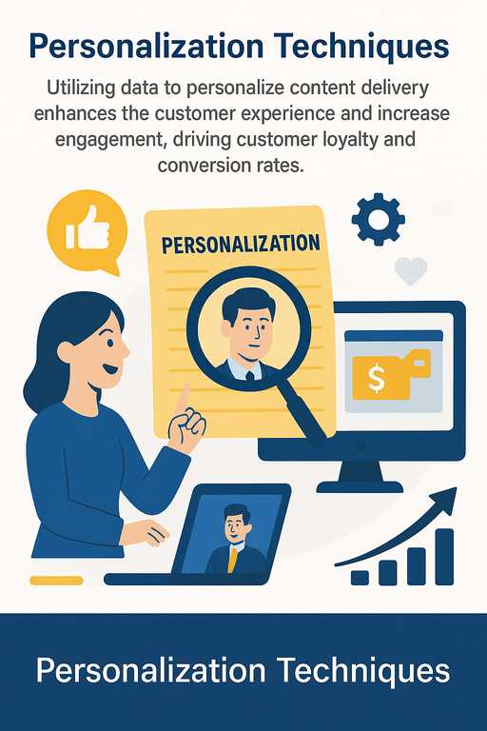
Data-Driven Marketing Strategies
Leveraging Analytics for Enhanced Insights
Notes:
In the realm of data-driven marketing strategies, implementing analytics plays a vital role in understanding consumer behaviors and preferences. By segmenting the market effectively, we can reach specific audiences with tailored content, enhancing their experience. Personalization takes this a step further, ensuring that our messages resonate on an individual level, which is crucial to building strong customer relationships.

Slide 6



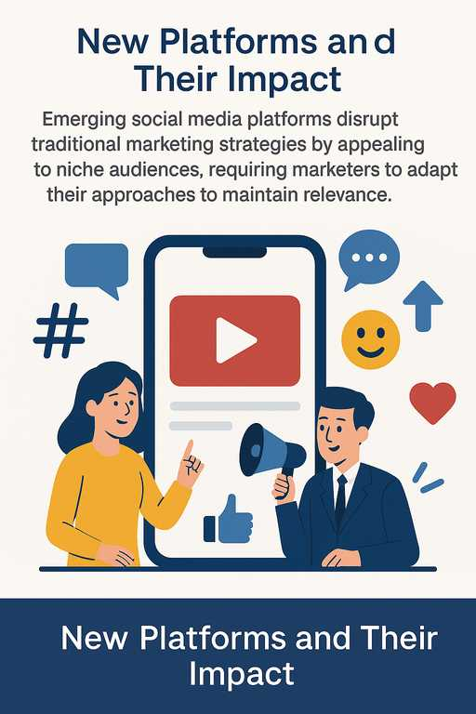
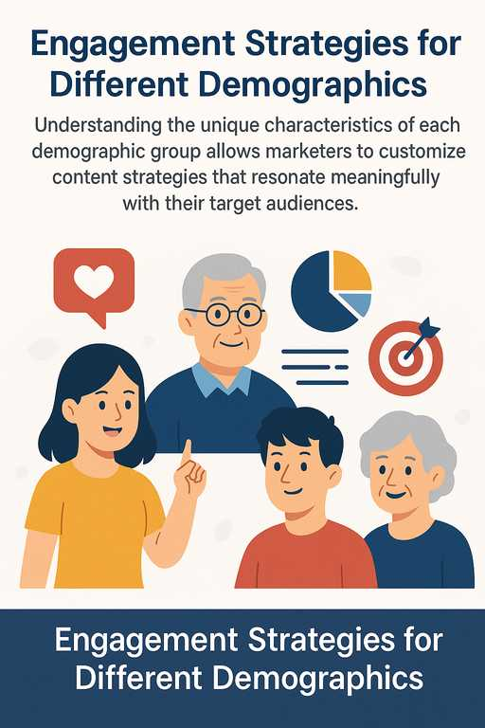

Social Media Marketing Evolution
Navigating New Platforms and Strategies
Notes:
Social media marketing is in a constant state of evolution, demanding that marketers stay attuned to the latest platforms and their unique audiences. Diving into demographic-specific strategies allows us to engage effectively with diverse groups while examining successful campaigns provides valuable takeaways for improving engagement and driving results in future initiatives.

Slide 7






Email Marketing in the Digital Age
Revolutionizing Outreach Through Innovation
Automation and Personalization
Automation streamlines email marketing processes, enhancing efficiency, while personalization tailors messages to recipient preferences, boosting engagement rates significantly.
Segmentation Strategies
Effective segmentation empowers marketers to deliver relevant content to distinct consumer subsets, improving open rates and overall campaign performance.
Measuring Success and ROI
Evaluating the success of email marketing through precise metrics allows marketers to refine their strategies and demonstrate the impact of campaigns to stakeholders.
Notes:
In today's fast-paced digital environment, email marketing continues to be a powerful tool for outreach. The ability to automate campaigns while personalizing content ensures both efficiency and relevance. Applying effective segmentation strategies not only enhances the customer experience but also enables marketers to accurately measure success and return on investment.

Slide 8

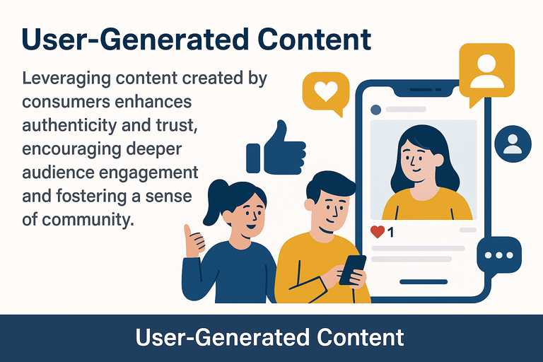
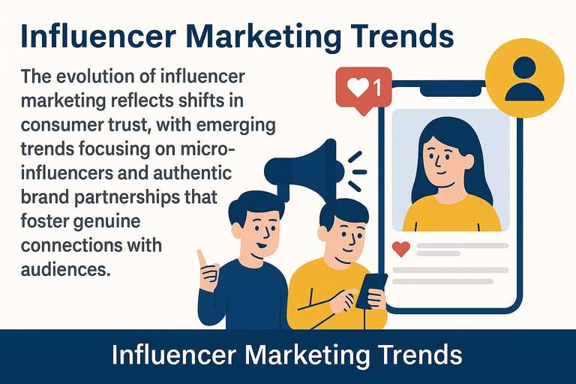
Content Marketing Innovations
Creating Engaging & Interactive Experiences
Notes:
Content marketing in the digital age is thriving on innovation and engagement. By harnessing the power of interactive content and compelling storytelling, brands can create memorable experiences that resonate with consumers. Embracing user-generated content enhances authenticity, while evolving influencer marketing taps into real stories and relatable voices, enriching the consumer-brand relationship.

Slide 9
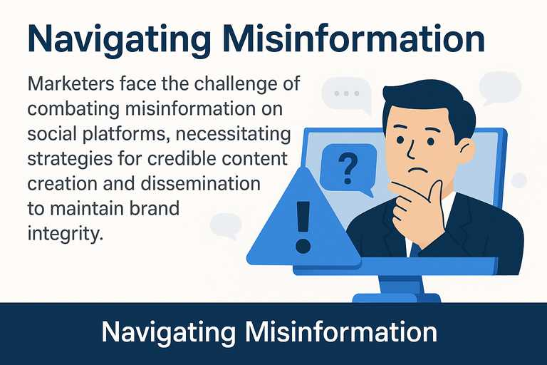

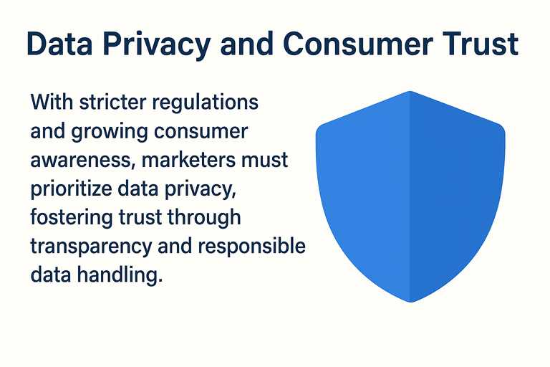
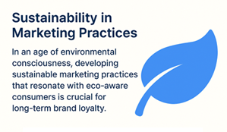
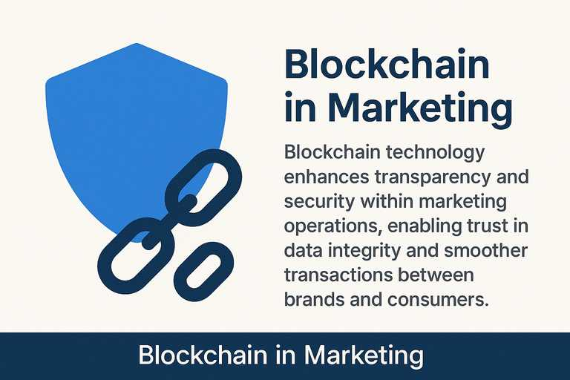
Challenges and Ethical Considerations
Navigating Complex Issues in Modern Marketing
Notes:
As we embrace innovative marketing techniques, we must navigate numerous challenges and ethical considerations. Data privacy has become paramount, reinforcing the need for transparency in our practices. Additionally, confronting misinformation while promoting sustainability can significantly enhance brand reputation and consumer trust, creating a responsible marketing landscape.

Slide 10



Charting the Path Ahead in Marketing
Predictions for the Future of Marketing
Emerging trends indicate an increasing reliance on AI, immersive technology, and ethical considerations, shaping how brands engage consumers moving forward.
Call to Action for Marketers
Marketers are encouraged to adopt innovative approaches, embrace new technologies, and remain ethically vigilant, ensuring their strategies align with evolving consumer values.
Notes:
In conclusion, we've explored numerous innovative marketing techniques that can equip brands for success in today's digital age. As we look to the future, the role of emerging technologies will only expand, necessitating that marketers remain adaptable and ethical in their practices. The call to action is clear: marketers must embrace these changes and commit to innovative strategies that resonate with today's conscious consumers.

