Slide 1
Personalised Synthetic Controls for Efficient Trial Design
Dr. Richard Jackson

Slide 2
Introduction
The problem: evidence without a concurrent control arm
Personalised synthetic controls (PSC)
Estimation
PSC as causal inference
Comparison with other causal / comparative methods
PSCs in practice
PSCs in clinical trials
Limitations and Future Directions

Slide 3
The Problem…

Slide 4
The Problem
Comparing information from 2 different sources
Estimating Efficacy in a reliable way
Can the model act as some sort of ‘Synthetic Controls’

Slide 5
The Problem
Comparing information from 2 different sources
Estimating Efficacy in a reliable way
Can the model act as some sort of ‘Synthetic Controls’

Slide 6
Synthetic Controls (a recap)
An approach which creates a synthetic comparison group to act as counter-factual evidence
Widely used in areas which measure the effects of policies. (economics, political science, public health, education, environmental policy, marketing)
Weights
Synthetic Control
Trt Group

Slide 7
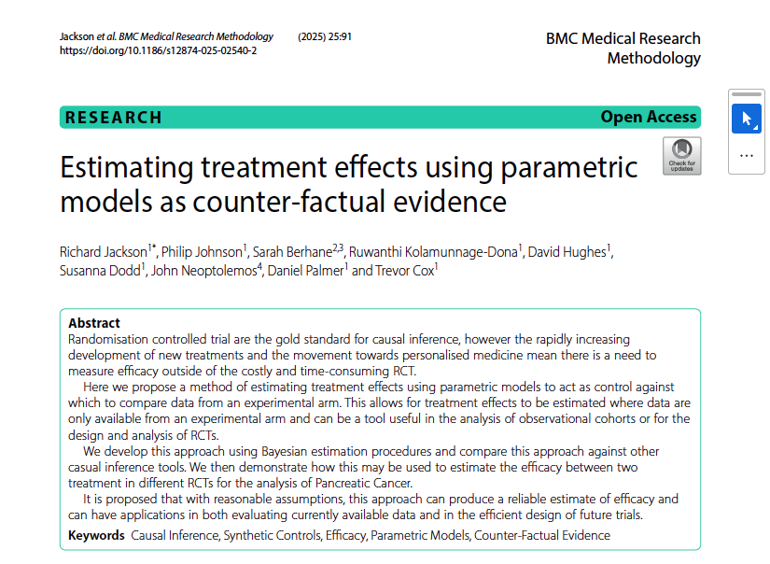

Slide 8
Uses in Practice
Replicating Trial analysis
RCT data
Observational data
Predicting phase III outcomes
Estimating Treatment Effects

Slide 9
Future Work
Proximity Weights
YODA

