Slide 1
Personalised Synthetic Controls for Efficient Trial Design
Dr. Richard Jackson

Slide 2
The problem: evidence without a concurrent control arm
Synthetic controls - recap
Personalised synthetic controls (PSC)
Estimation
PSC as causal inference
Comparison with other causal / comparative methods
PSCs in practice
PSCs in clinical trials
Limitations and Future Directions

Slide 3
The Problem…

Slide 4
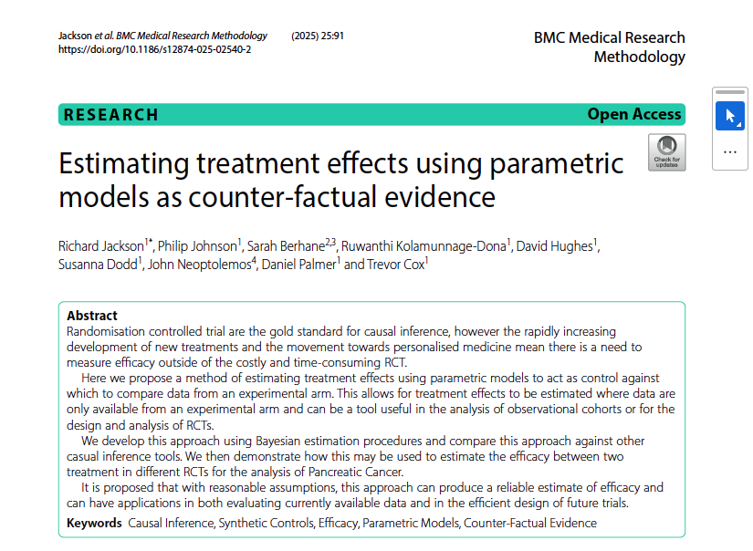

Slide 5
Uses in Practice
Replicating Trial analysis
RCT data
Observational data
Predicting phase III outcomes
Estimating Treatment Effects

Slide 6
Future Work
Proximity Weights
YODA

