Slide 1
Personalised Synthetic Controls
Causal inference and prospective clinical trial design
Dr Richard Jackson
Notes:
45-minute seminar: PSC, causal framing, comparisons, applications, SCT design.

Slide 2
Outline
The problem: evidence without a concurrent control arm
Synthetic controls - recap
Personalised synthetic controls (PSC)
Patient-level prediction and likelihood
Bayesian estimation (MCMC)
PSC as causal inference
Comparison with other causal / comparative methods
The psc R package (software)
Applications in practice
Synthetically controlled trials (4 slides)
Limitations and future directions

Slide 3
The problem
RCTs remain the gold standard but require large samples, time, and cost
Scarce resources in rare disease and early-phase oncology
Single-arm trials are common but lack a concurrent comparator for efficacy
Substantial prior information on control care exists (historical trials, registries)
Challenge: credible causal estimate of experimental treatment vs standard of care
Notes:
From SCT manuscript: enforced ignorance vs information available at design.

Slide 4
Synthetic controls - a recap
Causal inference tool (Abadie): construct a synthetic control from donor units
Donors weighted so treated and synthetic cohorts match pre-treatment covariates
Typically targets a population-averaged treatment effect (ATE)
Increasing use in healthcare and cancer research (Thorlund et al.)
Limitations: few donors, heterogeneous patients, unstable weights under poor overlap

Slide 5
Personalised synthetic controls
Parametric counterfactual model (CFM) from external / historical control data
Patient-level predicted outcome under control given covariates X
Compare observed outcomes in evaluation cohort to CFM predictions
Beta: systematic deviation from counterfactual (treatment / policy effect)
Personalised linear predictor (Jackson et al., BMC Med Res Methodol 2025)

Slide 6
PSC - methods
Likelihood: product of patient-level survival or GLM contributions
Bayesian estimation of beta; uncertainty in CFM parameters incorporated
CFM often from RCT control arm (flexible parametric survival, 11+ covariates)
Subgroup and transportability analyses via row indices / weights
Shareable CFM object without releasing individual development data

Slide 7
Patient-level prediction
Counterfactual survival from the CFM vs observed outcome for individual patients

Slide 8
Patient-level prediction (example)

Slide 9
Estimation: defining the likelihood
Standard survival likelihood, conditional on CFM parameters and patient covariates
For each patient i: contribution from event time and censoring indicator
Linear predictor: Gamma_i = X_i' gamma + beta
gamma from the counterfactual model; beta is the treatment-effect parameter
Product over patients: L(D | Lambda, Gamma) compared to CFM predictions

Slide 10
Why Bayesian estimation?
A plug-in MLE for beta (e.g. optim in R) can appear unbiased in simulation
But the counterfactual model is not known with certainty
CFM coefficients have their own uncertainty and correlation
We need that uncertainty propagated into inference on beta
Bayesian MCMC: informative priors on CFM parameters + weak prior on beta

Slide 11
Bayesian MCMC procedure
Target: posterior P(beta | B, D) proportional to L(D | B, beta) pi(B) pi(beta)
pi(B): MVN from CFM coefficient estimates and variance-covariance matrix
pi(beta): weakly informative (e.g. N(0, 1000) on log hazard ratio)
Each MCMC iteration: draw CFM parameters B; propose beta; compute likelihood ratio
Accept/reject proposal; repeat for nsim iterations (multiple chains, burn-in, thin)
Output: posterior draws for beta — summary() and plot() in the psc package
Notes:
pscfit workflow: pscData -> init -> pscEst -> postSummary. See ?pscEst and ?pscfit in the psc package.

Slide 12
PSC as causal inference
Potential outcomes Y(0) and Y(1); observe Y(1), estimate Y(0) via CFM
Estimand: ATT conditional on measured covariates X
Identification: exchangeability given X, SUTVA, covariate overlap / transportability
Counterfactual control fixed before enrolment; depends on realised trial population
Beta on log-hazard scale: contrast vs counterfactual predictions
Notes:
Pfizer deck: Rubin framework; HR as contrast of potential outcomes.

Slide 13
How PSC compares with other methods
RCT: randomisation gives ITT treatment effect (gold standard when feasible)
Propensity scores / IPW: balance observational cohorts to ATE or ATT
MAIC / STC: align two trial populations for indirect comparison A vs B
Classical synthetic controls: donor weights for population-level ATE
PSC: validated CFM + evaluation cohort gives beta vs control model (not A vs B)
Notes:
HDSforum comparison; different estimand from MAIC/STC.

Slide 14
The psc R package
R package for Personalised Synthetic Controls (v2.0.1)
Compare a data cohort to a counterfactual model (CFM)
Supports flexsurvreg survival models and glm outcomes
Bayesian MCMC for treatment-effect parameter beta
Key functions: pscCFM(), pscfit(), summary(), plot()
Related: pscDesign (trial simulation) in development
Install: devtools::install_github("richJJackson/psc")
Docs: https://richjjackson.github.io/psc/
library(psc) library(survival) # counterfactual model (from control data) CFM <- pscCFM(surv.mod) # evaluation cohort (e.g. single arm) fit <- pscfit(CFM, data) summary(fit) plot(fit)
Minimal workflow
Notes:
psc package on GitHub richJJackson/psc. pscCFM wraps a fitted model for sharing; pscfit runs the comparison. Mention vignette and gemCFM example data in package.

Slide 15
Applications and case studies
Retrospective: single-arm or one-arm vs external control model
Calibration: PSC on control arm of RCT (ESPAC Gem arm)
Benchmarking: observational cohort vs known trial (HCC Atezo-Bev)
Prediction: Phase II single-arm HR vs Phase III RCT

Slide 16
Application: ESPAC trials
Step 1 - Study population: are Gem development data and ESPAC-4 comparable?
Step 2 - Model validation: PSC on Gem arm gives calibration HR approx 0.98
Step 3 - GemCap vs Gem: PSC HR comparable to direct RCT comparison
Greater uncertainty under PSC despite similar effective sample size

Slide 17
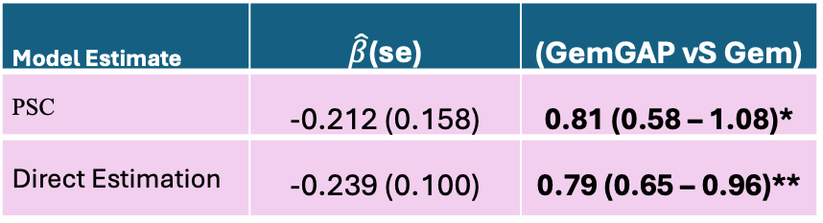
Application: ESPAC trials
Step 3: Estimate Hazard Ratio
Conclusion:
Hazard ratio comparing GemCap to Gemcitabine are comparable using both methods
Measures of dispersion greater using PSC method (despite a similar number of patients being used in each approach)
Model Estimate | $\hat{β}$(se) | (GemGAP vS Gem)
PSC | -0.212 (0.158) | 0.81 (0.58 – 1.08)*
Direct Estimation | -0.239 (0.100) | 0.79 (0.65 – 0.96)**

Slide 18
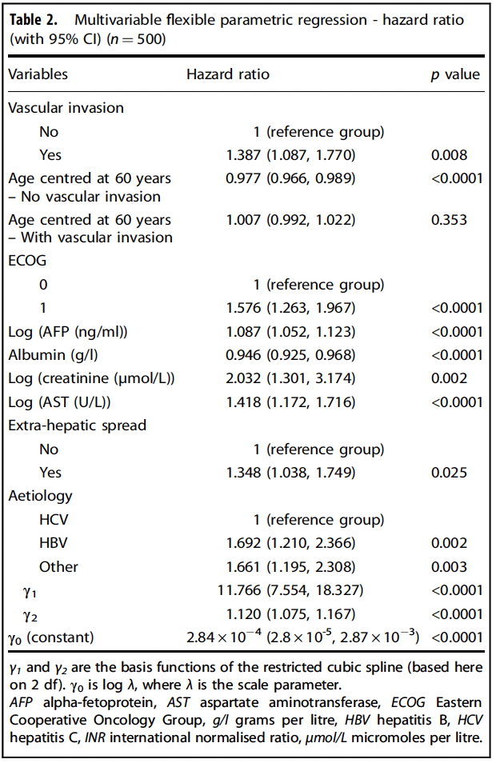
Application: HCC (Atezo-Bev vs Sorafenib)

Slide 19

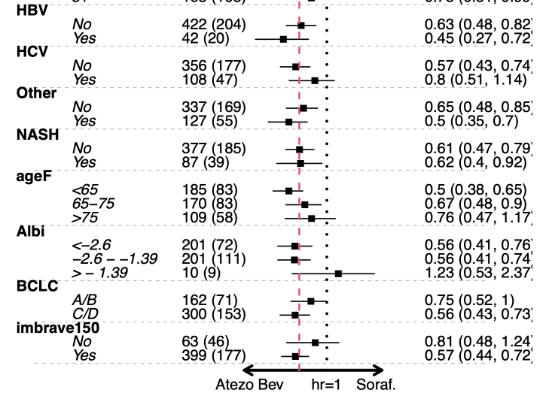
Atezo Bev Vs Sorafenib
Overall impact suggests improved survival with Atezo Bev [HR: 0.58 (0.44-0.74)]

Slide 20
HCC: eligibility subgroups (IMBRAVE 150)

Slide 21
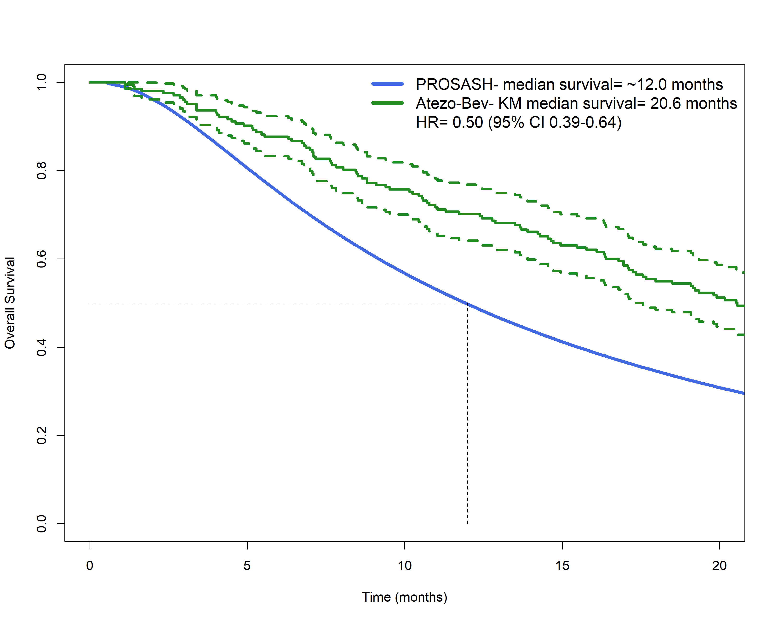
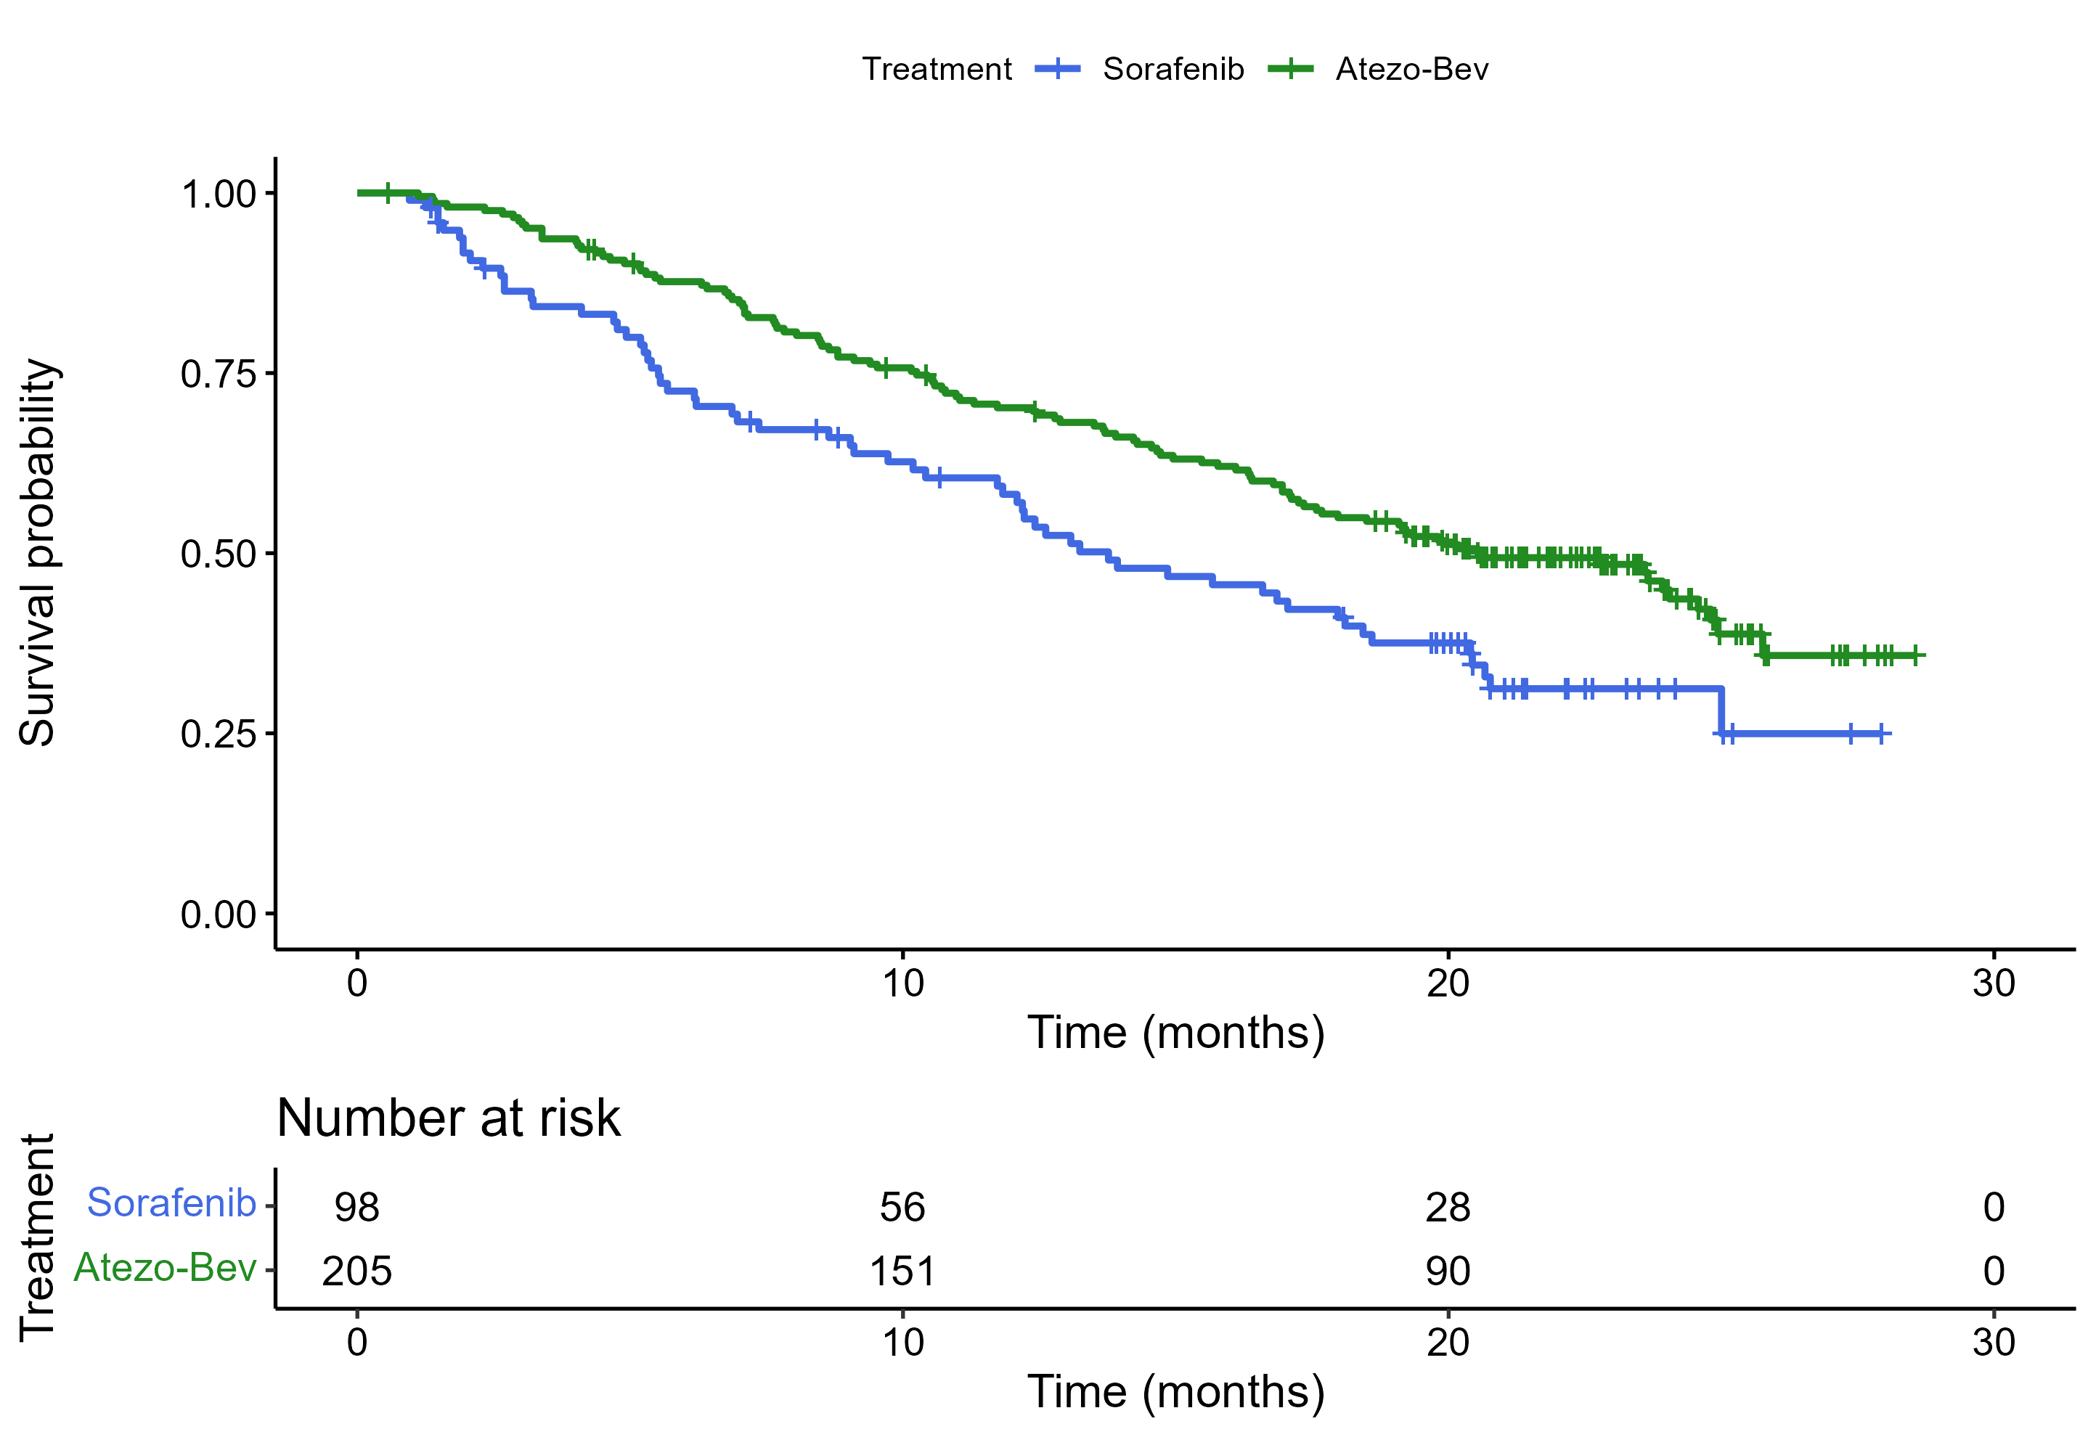
Predicting Phase III outcomes from Phase II data...
Single Arm Phase II.
Phase III
0.63 (0.46-0.86)
0.50 (95% CI 0.39-0.64)

Slide 22
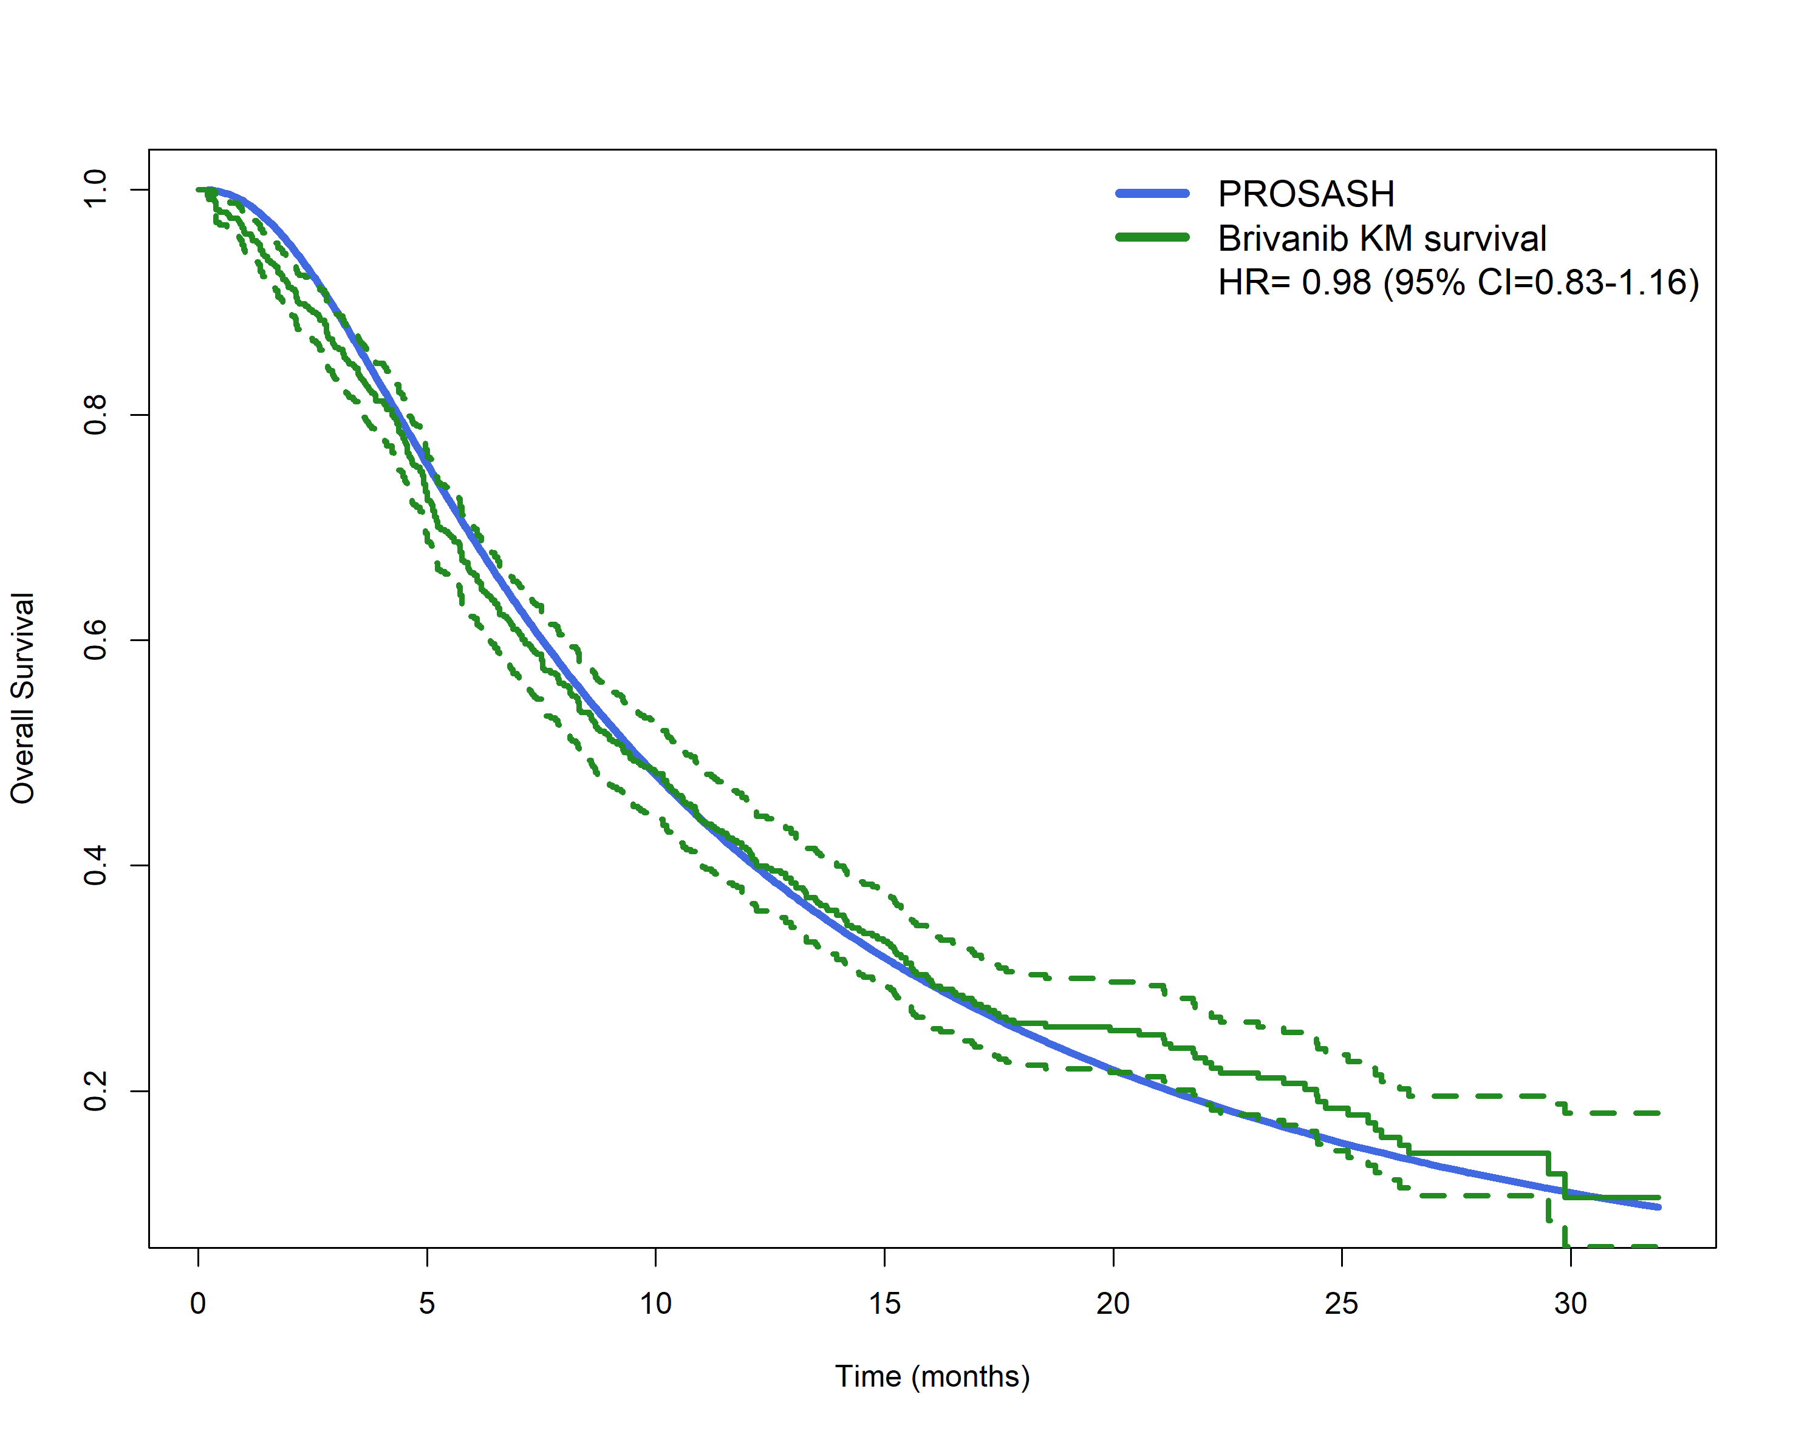
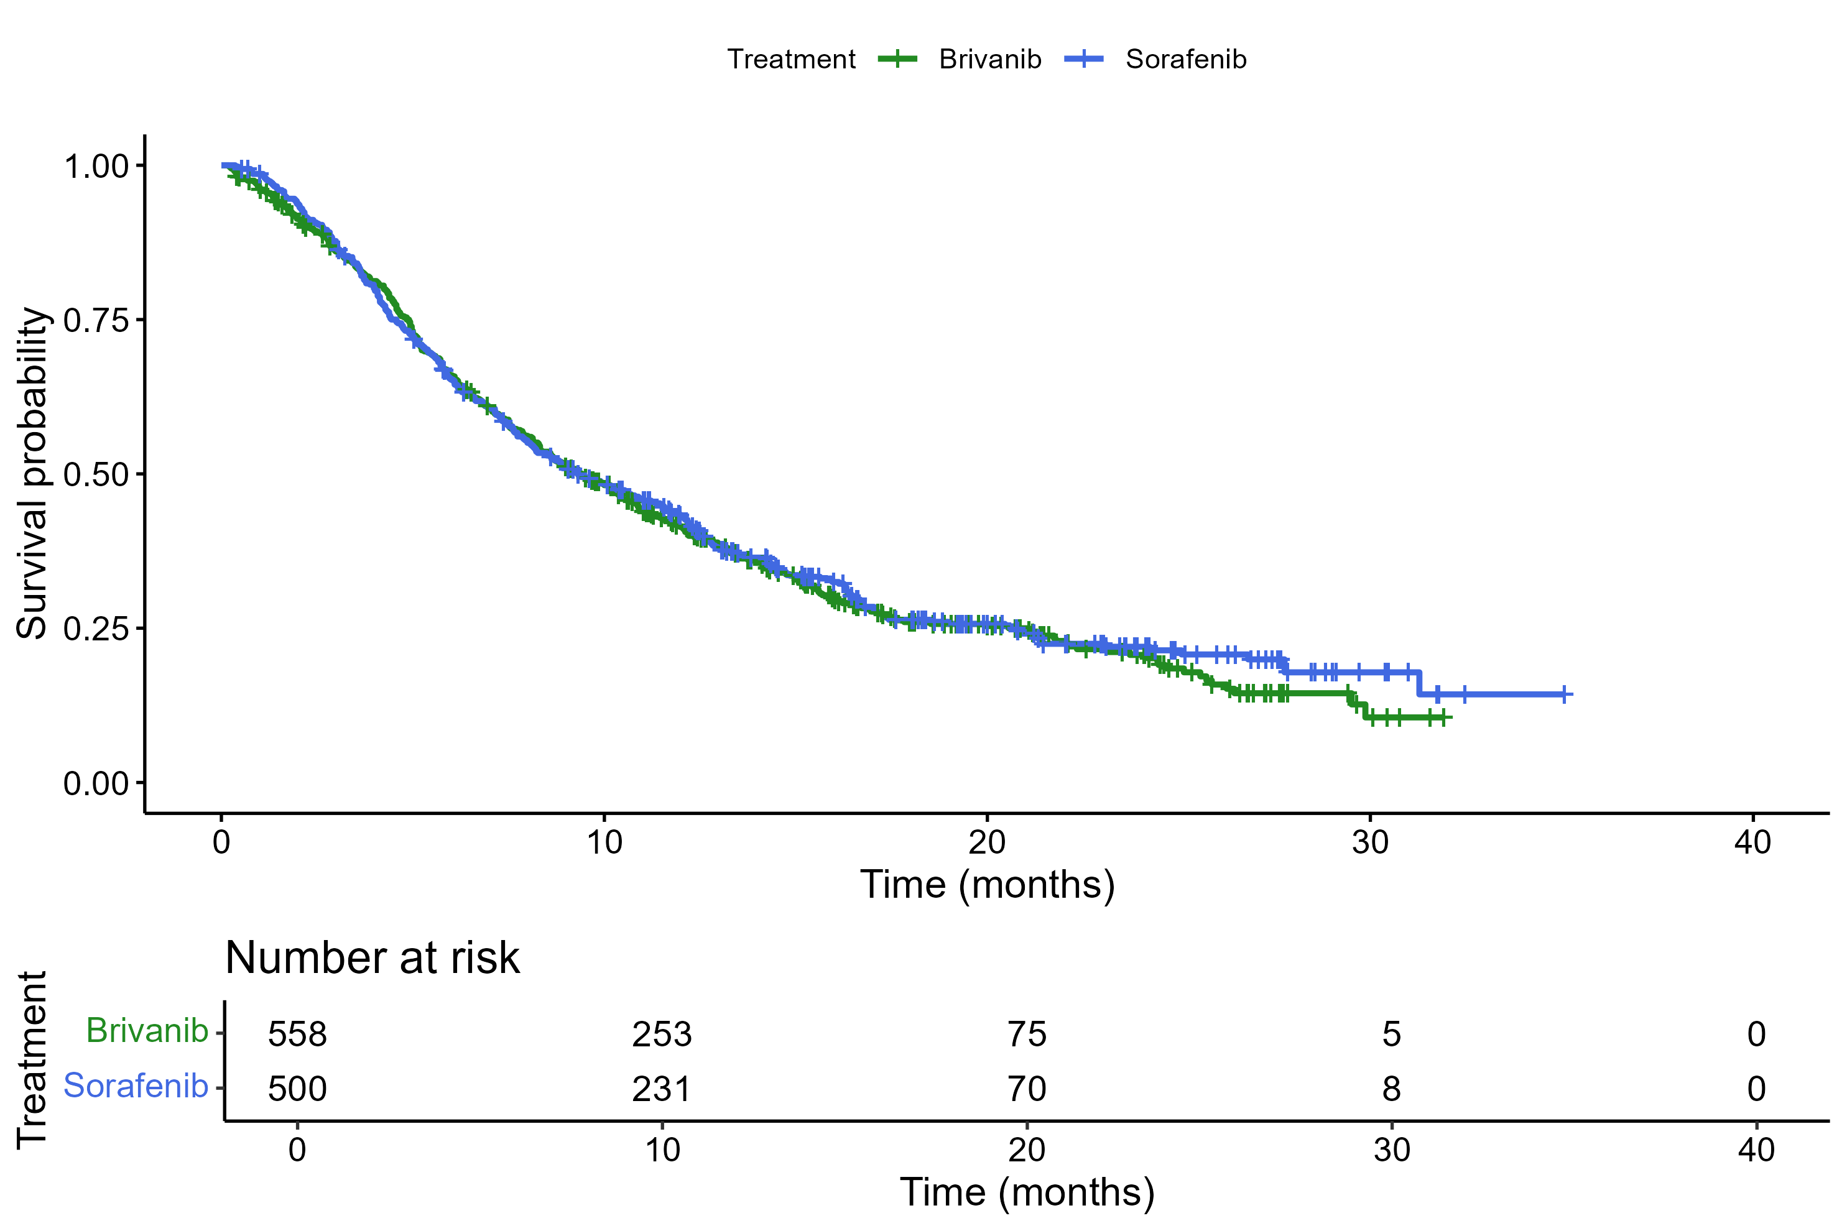
Sorafenib Vs Brivanib
Single Arm Phase II.
Phase III
0.98 (95% CI= 0.83-1.16)
1.04 (95% CI= 0.90-1.20)

Slide 23
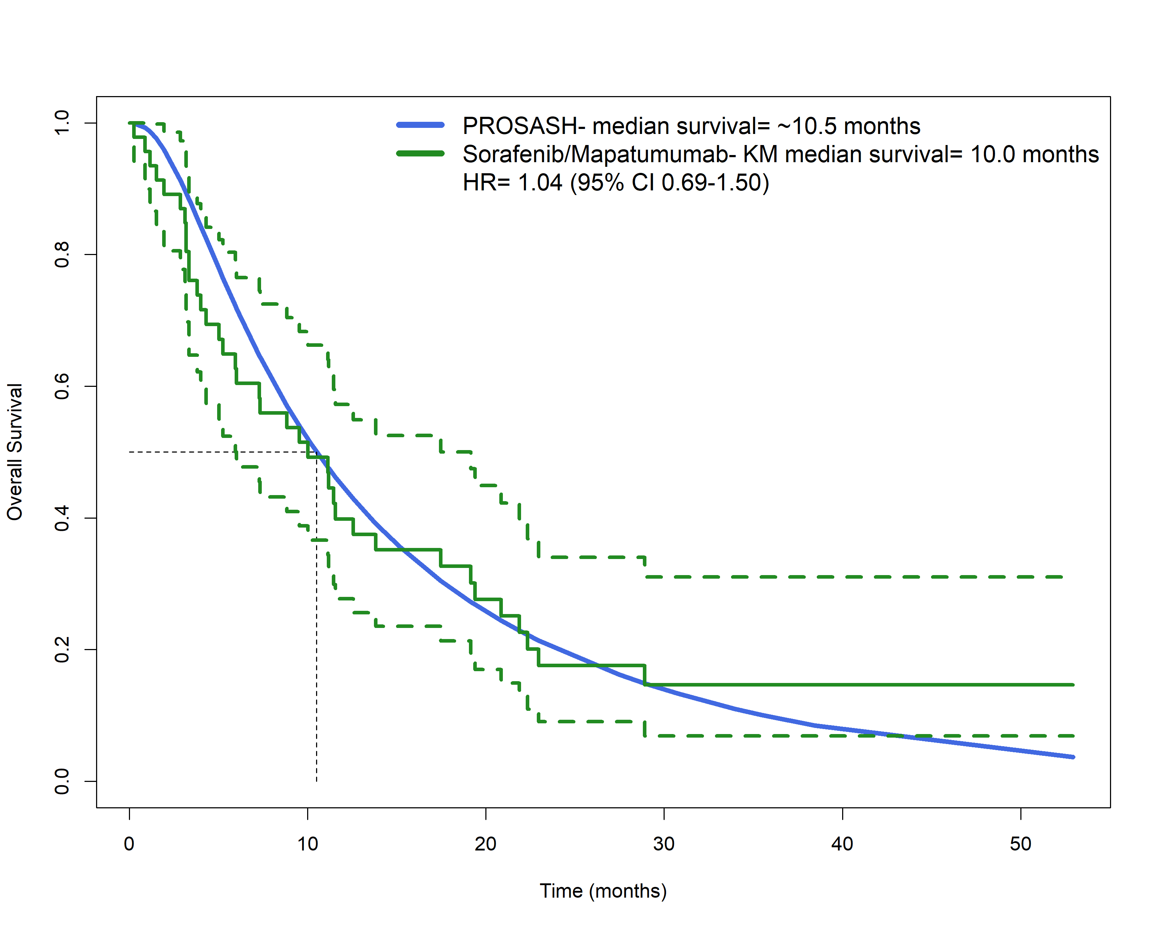
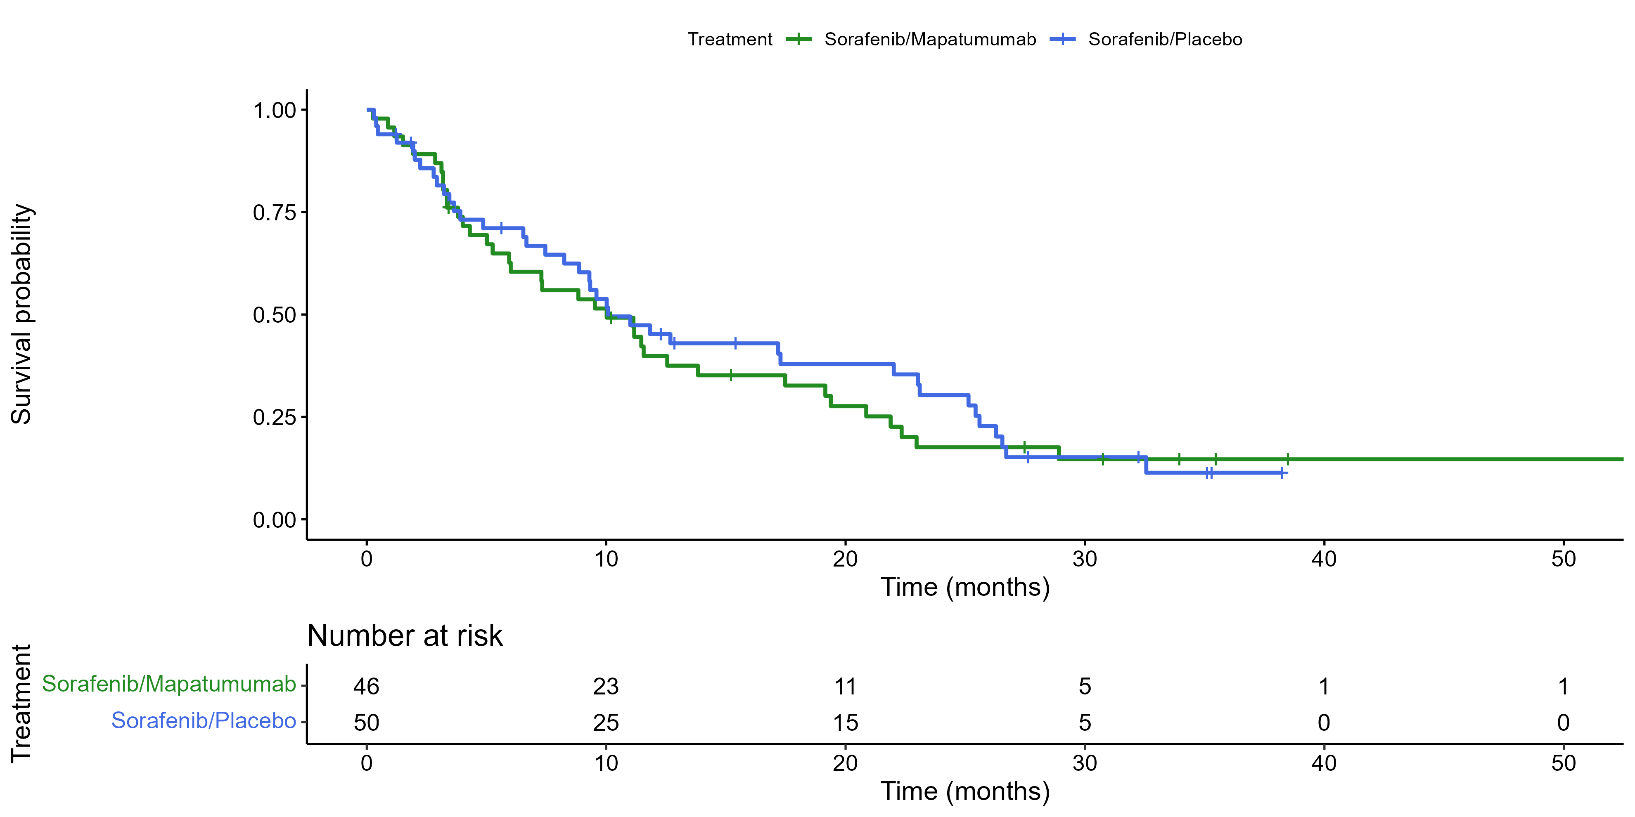
Sorafenib Vs Soraf./Mapatumumab
Single Arm Phase II.
Phase III
1.04 (95% CI= 0.69-1.50)
HR= 1.10 (95% CI= 0.70-1.73)

Slide 24
SCT: overview
Synthetically controlled trials (SCTs) use external evidence as the control arm in prospective studies
Motivation: scarce patients in rare disease and early-phase oncology; prior control information exists
Contrasts with enforced ignorance: historical data and registries increasingly inform design
Builds on synthetic control causal inference (Abadie) and personalised SC (Jackson et al.)
Regulatory and HTA interest in external controls, digital twins, and single-arm enrichment
Goal: transparent prospective design with pre-specified synthetic control before first patient
Notes:
From: Synthetically Controlled Trials in Early Phase Clinical Trials (manuscript).

Slide 25
SCT: design and estimand
Collect Y(1) prospectively; derive Y(0) from pre-specified external / model-based control
Population-averaged SC: weighted average of external controls (e.g. entropy balance)
Personalised SC (PSC): parametric CFM gives patient-specific counterfactuals
Estimand: ATT in the enrolled cohort, conditional on measured covariates
Assumptions: exchangeability given X, SUTVA, overlap between trial and external data
Design options: fully synthetic (single arm), partially synthetic (+ validation RCT arm), standard RCT

Slide 26
Thank you
Questions and discussion

Slide 27
Further work
Proximity-weighted PSC for covariate shift and transportability
Simulation under deliberate exchangeability violations (pscDesign package)
Multiple treatments, non-proportional hazards, alternative effect measures
Small randomised control subsample for prospective validation
Software: psc R package (Jackson et al., BMC Med Res Methodol 2025;25:91)

Slide 28
Limitations
Requires overlap: unstable weights (population SC) or CFM extrapolation (PSC)
Restrict eligibility at design to regions supported by the synthetic control
Unmeasured confounding; outcome definitions and SOC context must align
SCT evidence is not equivalent to a fully randomised trial; efficiency has a cost
Model validation and transport diagnostics should be pre-specified

Slide 29
Further work
Proximity-weighted PSC for covariate shift and transportability
Simulation under deliberate exchangeability violations (pscDesign package)
Multiple treatments, non-proportional hazards, alternative effect measures
Small randomised control subsample for prospective validation
Software: psc R package (Jackson et al., BMC Med Res Methodol 2025;25:91)

Slide 30
Thank you
Questions and discussion

