Slide 1
Personalised Synthetic Controls
Dr Richard Jackson,
Lead Statistician, Cancer and Early Phase Trials
Liverpool Clinical Trials Centre

Slide 2
Introduction
Problem….
… A Solution
Estimation
Application
Future Work
Discussion

Slide 3
Problem
Notes:
Considering the scenario whereby the dataset and the model receive different treatments!!!

Slide 4
Model
Developed on data obtained from an RCT
Developed on the basis of flexible parametric splines (parametric!)
Includes 11 prognostic covariates
Validated on empirical datasets
Published
Aim: How to compare an observational dataset against a predictive model

Slide 5
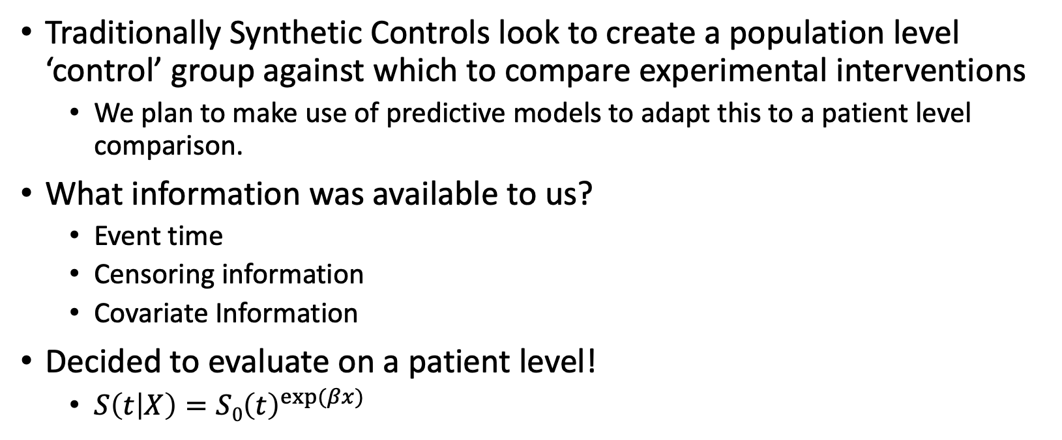
Solution: Synthetic Control
Traditionally Synthetic Controls look to create a population level ‘control’ group against which to compare experimental interventions
We plan to make use of predictive models to adapt this to a patient level comparison.
What information was available to us?
Event time
Censoring information
Covariate Information
Decided to evaluate on a patient level!
$S\left(t | X\right)={S0\left(t\right)}^{exp⁡(βx)}$

Slide 6
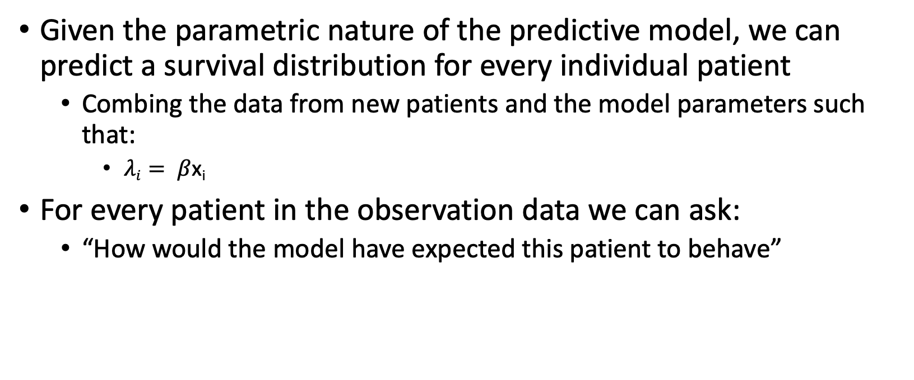
Personalised Prediction
Given the parametric nature of the predictive model, we can predict a survival distribution for every individual patient
Combing the data from new patients and the model parameters such that:
$λi= β$x_{i}
For every patient in the observation data we can ask:
“How would the model have expected this patient to behave”

Slide 7

Patient level prediction
Example 1: Predicted survival (with event time)
$λ=λ$₁

Slide 8

Patient level prediction
Example 2: Predicted survival (with event time)
$$λ=λ2$$

Slide 9

Patient level prediction
Example 3: Predicted survival (with event time)
$$λ=λ3$$

Slide 10

Patient level prediction
Assuming that the predictive model is valid….
Based on the data, x, and the model parameters, $γ$
What is the probability that a patient died (or was censored) when they did?

Slide 11

Patient level prediction
What is the probability a patient died when they did?
$\operatorname{Pr}\left(T=t|x_{i},γ\right)≈f(t|x_{i},γ)$
NB: f(t) = S(t)h(t)

Slide 12

Patient level prediction
What is the probability a patient was censored when they where?
$\operatorname{Pr}\left(T>t|x_{i},γ\right)≈S(t|x_{i},γ)$

Slide 13
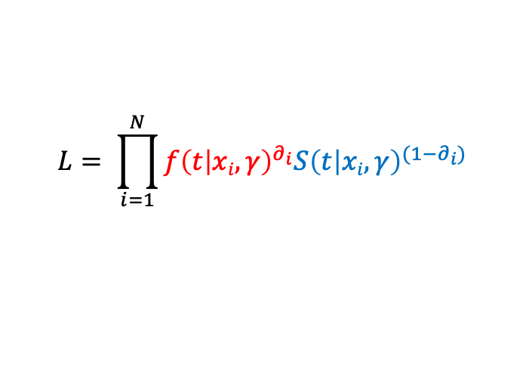
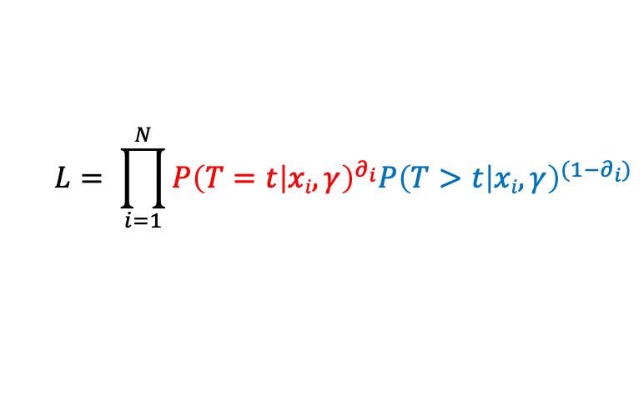
Estimation
Defining the likelihood
Standard Likelihood for survival data, but conditional on parameters of the predictive model and patient covariates
$$L= \prod_{i=1}^{N}{{P\left(T=t | xi,γ\right)}^{∂_{i}}{P\left(T>t | xi,γ\right)}^{(1−∂_{i})}}$$
$$L= \prod_{i=1}^{N}{{f\left(t | xi,γ\right)}^{∂_{i}}{S\left(t | xi,γ\right)}^{(1−∂_{i})}}$$

Slide 14
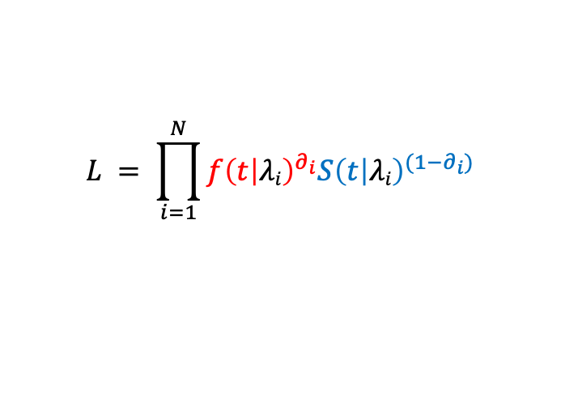
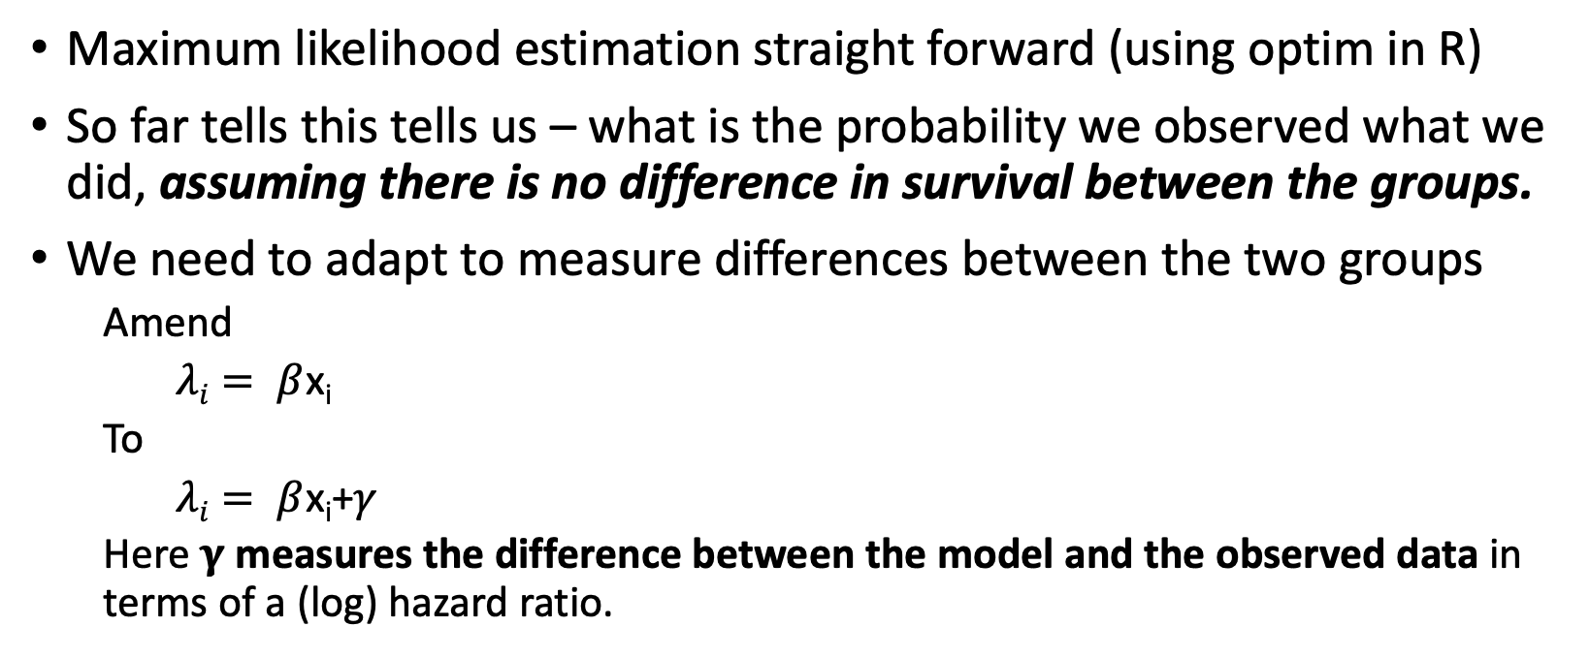
Estimation
Maximum likelihood estimation straight forward (using optim in R)
So far tells this tells us – what is the probability we observed what we did, assuming there is no difference in survival between the groups.
We need to adapt to measure differences between the two groups
Amend
$λi= β$x_{i}
To
$λi= β$x_{i}+$γ$
Here $γ$ measures the difference between the model and the observed data in terms of a (log) hazard ratio.
$$L = \prod_{i=1}^{N}{{f\left(t | λi\right)}^{∂_{i}}{S\left(t | λi\right)}^{(1−∂_{i})}}$$

Slide 15

Revisiting the problem
$$γ$$

Slide 16
Estimation
Estimation straight forward using Maximum Likelihood techniques
Using optim in R, we can obtain an estimate of the (log) hazard ratio
Simulation studies show this to be unbiased
However…..
We need to acknowledge that the model we based this on is not perfect
Model parameters have their own source of uncertainty (and correlation)
Need to build this uncertainty into the estimation approach

Slide 17
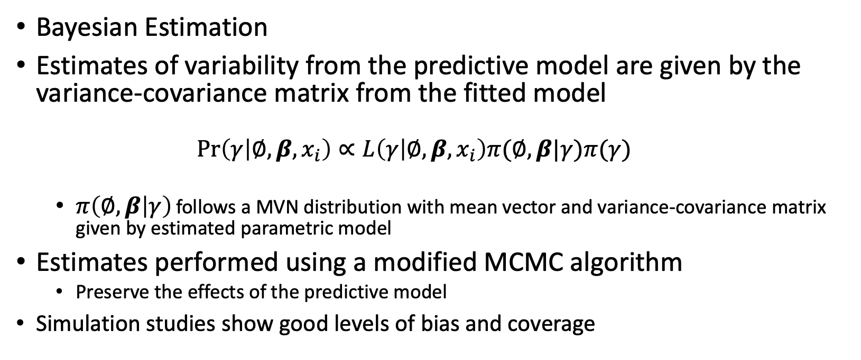
Estimation
Bayesian Estimation
Estimates of variability from the predictive model are given by the variance-covariance matrix from the fitted model
$$Pr\left(γ | ∅,β,x_{i}\right)∝L\left(γ | ∅,β,x_{i}\right)π(∅,β|γ)π(γ)$$
$π\left(∅,β | γ\right)$ follows a MVN distribution with mean vector and variance-covariance matrix given by estimated parametric model
Estimates performed using a modified MCMC algorithm
Preserve the effects of the predictive model
Simulation studies show good levels of bias and coverage

Slide 18
Causal Estimand
So far, method allows estimation of the difference between a model and a dataset
Can we infer a treatment effect?
Rubin set forth the conceptual framework for causal estimation
Assuming patients are exposed to two possible treatments
Outcomes: Y(0) and Y(1)
HR: = log[Y(1)] / log [Y(0)]
In out context, we observe Y(1) for every patient and Y(0) is estimated as a ‘potential outcome’
Patient level estimands then averaged over a group (or sub-group) to obtain population averaged hazard ratios

Slide 19
Application: ESPAC Trials

Slide 20
Application: ESPAC Trials

Slide 21
Application: ESPAC Trials
Step 1: Study Population
Are two datasets comparable
Step 2: Model Validation
Does the model predict ‘Gem’ survival?
Fitting the PSC against the Gem arm allows for a measure of calibration (HR: 0.98)

Slide 22
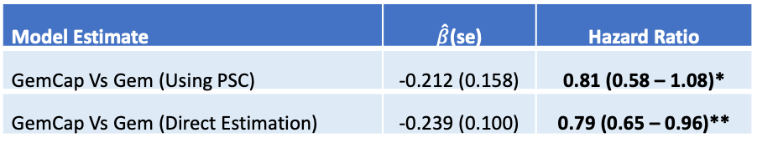
Application: ESPAC Trials
Step 3: Estimate Hazard Ratio
Model Estimate | $\hat{β}$(se) | Hazard Ratio
GemCap Vs Gem (Using PSC) | -0.212 (0.158) | 0.81 (0.58 – 1.08)*
GemCap Vs Gem (Direct Estimation) | -0.239 (0.100) | 0.79 (0.65 – 0.96)**
Conclusion:
Hazard ratio comparing GemCap to Gemcitabine are comparable using both methods
Measures of dispersion greater using PSC method (despite a similar number of patients being used in each approach)

Slide 23
Discussion
PSC offer an opportunity to directly compare a cohort of data against a predictive model
What began as a solution to a problem has grown into an approach with a broad applications
PSC can be made to compare treatments outside of clinical trials
Typical setting envisaged is comparing RCT data to observational cohort
Strength of randomization held within the predictive model but opportunities for selection/confounder bias still exist.
Possibility for sub-group analysis
PSC will ‘correct’ for whoever is being compared against them
Can impact on the analysis of available data and future trial design

Slide 24
Discussion
However…
Strength of their uses depend on their settings
Some care required to ensure that model is not extrapolating beyond it’s use
A number of conditions are required for us to infer a treatment effect
Data must be from patients in the same setting
Outcome defined in the same way (e.g. start point for TTE outcomes)
Stable Unit Treatment Value Assumption (SUTVA) – response depends only on the treatment received – not on the setting
No unobserved confounders
Results need to be generalizable (and/or transportable) onto patient population
Some assumptions can be checked through model validation

Slide 25
Future Uses
As the PSC offers a likelihood approach to estimating difference between treatments there are a number of extensions that can be applied:
Comparing multiple treatments
Correcting for poorly calibrated models
Allowing for non-proportional models
Relationship other than a hazard ratio
Incorporating Propensity scores/other adjusting covariates
Incorporating in trial design
Randomise to a small number of controls for the purpose of validation

Slide 26
Causal Estimation
Other methods of causal estimation outside of RCTs do exist
Propenstiy Score/Multivariable Analyses
Predominently performed on observational data
Network Meta-Analysis
Require treatments to fit within a network of completed RCTs (unlikely for new treatments)

