Slide 1

Twitter Sentiment Analysis
RNS INSTITUTE OF TECHNOLOGY
BENGALURU - 98
DEPARTMENT OF INFORMATION SCIENCE & ENGINEERING
Presentation on Internship
Richa Singh
USN: 1RN18IS086
New Age Solutions Technologies
Internal Guide
Mr. T S Bhagavath Singh
Associate Professor , Dept of ISE, RNSIT
External Guide
Mr. Aman Upadhyay
NASTECH

Slide 2
AGENDA
Abstract
About the Company
Introduction
Literature Survey
Requirements
System Design
Detailed Design
Implementation
Testing
Conclusion and Future Enhancements
References

Slide 3
ABSTRACT
With the advancement of web technology and its growth, there is a huge volume of data present on the web for internet users and a lot of data is generated too.
The Internet has become a platform for online learning, exchanging ideas, and sharing opinions. Social networking sites like Twitter, Facebook, Google+ are rapidly gaining popularity as they allow people to share and express their views about topics, have discussions with different communities, or post messages across the world.
There has been a lot of work in the field of sentiment analysis of Twitter data. This survey focuses mainly on sentiment analysis of Twitter data which is helpful to analyze the information in the tweets where opinions are highly unstructured, heterogeneous, and are either positive or negative or neutral in some cases
The sentiment analysis is the one which has been applied with Twitter data set toward identifying the emotion of any user and based on those different problems can be solved

Slide 4
About the Company
NASTECH is one of the leading Global Certification and Training service providers for technical and management programs for educational institutions.
They collaborate with educational institutes to understand their requirements and form a strategy in consultation with all stakeholders to fulfill those by skilling, reskilling, and upskilling the students and faculties on new-age skills and technologies.
Their LMS solutions provide a centralized source of information and education that will cater to all the needs of educational institutions.

Slide 5
INTRODUCTION
Modern society runs over social media most time of every day. Web users spend the most time on social media and they share many details with their friends.
Such information obtained from their chat has been used in several applications.
The sentiment analysis is the one which has been applied with Twitter data set toward identifying the emotion of any user and based on those different problems can be solved.
In the marketing field, companies use it to develop their strategies, to understand customers’ feelings towards products or brands, how people respond to their campaigns or product launches and why consumers don’t buy some products.

Slide 6
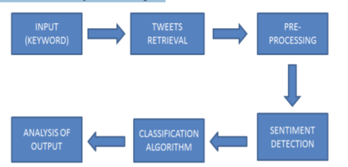
LITERATURE SURVEY
Tweets are unambiguous short texts messages that are up to a maximum of 140 characters. We choose Twitter as the source for opinion mining simply because of its popularity and data mining.
The workflow for sentiment analysis is shown in four main modules: data collection module, a data processing module, classification module, and analysis of output.

Slide 7
a. Input (Keyword):
choose a subject, collect the tweets with that keyword and perform sentiment analysis on those tweets.
b. Tweets Retrieval: Tweets can be structured, semi-structured, and unstructured type. Sentiment Analysis research, we can collect tweets using different programming languages like R or python
c. Pre-Processing: Data pre-processing is nothing but filtering the data to remove the incomplete noisy and inconsistent data. Following tasks are involved in the pre-processing task: • Removal of Retweets (in case of the Twitter dataset) • Removing URLs, Special characters, Punctuations, Numbers, etc. • Removing Stop words • Stemming • Tokenization
d. Sentiment Detection: Finding the polarity ( positive, negative, neutral ) using a classification algorithm

Slide 8
f. Analysis of Output: The fundamental thought of sentiment analysis is to change unstructured data into significant or meaningful data. After the completion of the analysis, the results are displayed on graphs like pie charts, bar charts and line graphs.
Use of sentiwordnet as a lexical resource for sentiment analysis (Stefano Baccianella, Andrea Esuli, and Fabrizio Sebastiani,) added to the efficiency of previous traditional methods of classification.
Additionally find the SentiWordNet score of all tokenized words in a particular tweet and add it with its posterior probability.

Slide 9
WordNet is a lexical database for the English language. It contains definitions of words according to their part of speech. Additionally, it provides synset(cluster), synonyms of words and phrases. There are many research labs that provide their own version of WordNet. SentiWordNet is one of such type of WordNet which provides positivity, negativity, and objectivity scores of the word in addition to the definition of the word

Slide 10
Requirements
Hardware Requirements
Software requirements & other requirements
Operating system: Windows 7/8/10/11 or Linux
Twitter dataset
Modern web browser with internet access
Python 3
Processor: Intel i5 or more
RAM: 8 GB or more
Cache: 512 KB
Hard disk: 16 GB
Monitor : 1024 x 720 display
Speed: 2.7GHZ or more

Slide 11
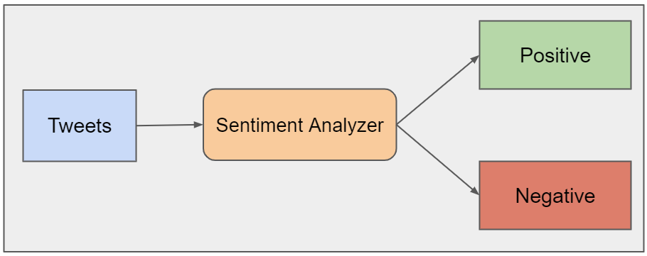
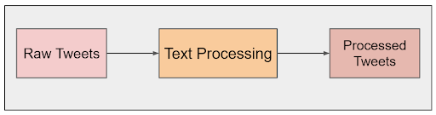
System Design
Overview of the system
Overview of Text Processing

Slide 12
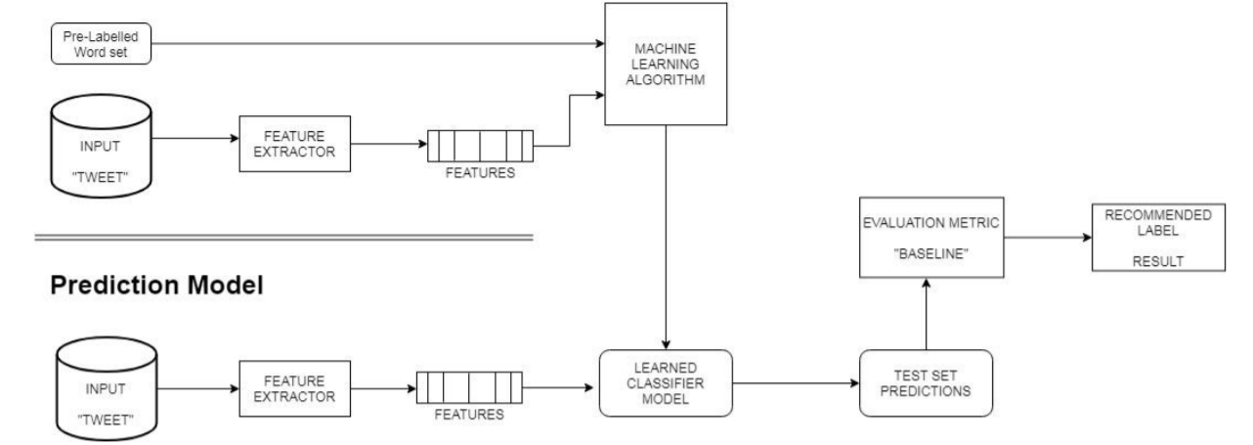
Detailed Design
Detailed design of the system

Slide 13
Implementation / Coding
Project structure
Import libraries and datasets
Perform exploratory data analysis
Plot word cloud
Perform data cleaning
Perform count vectorization
Train Naïve Bayes classifier
Assess trained model performance

Slide 14
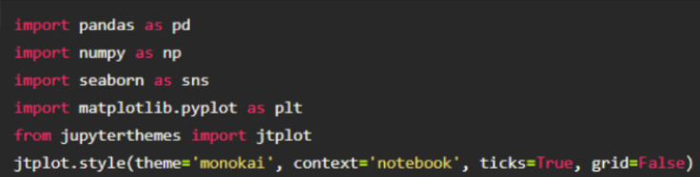
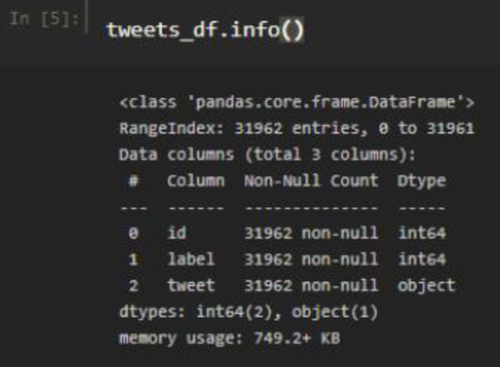
Import libraries and datasets
Exploratory data analysis

Slide 15
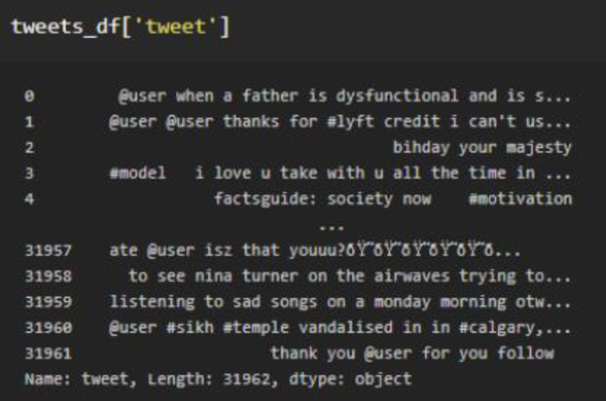
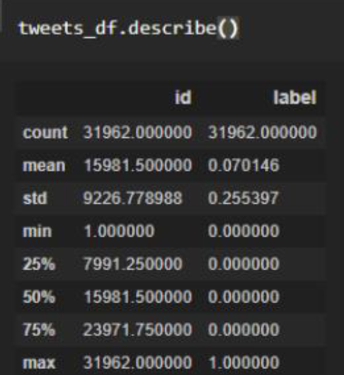

Slide 16
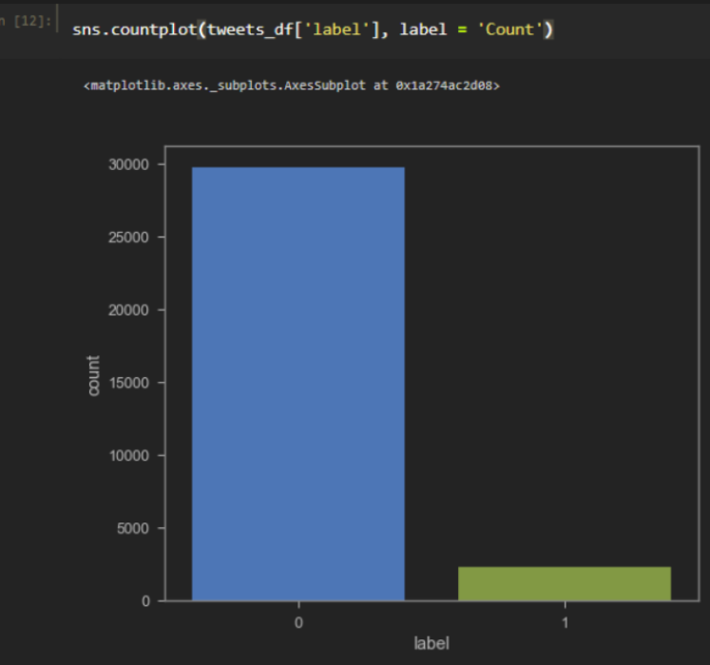
Count plot using seaborn library
0 in the graph denotes positive tweets
1 in the graph denotes negative tweets

Slide 17
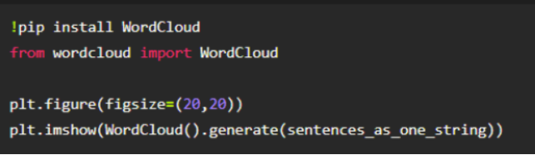
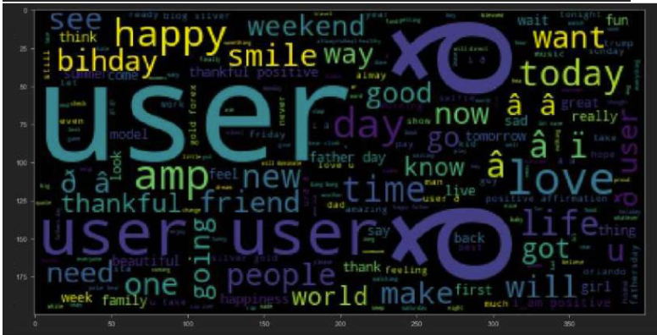
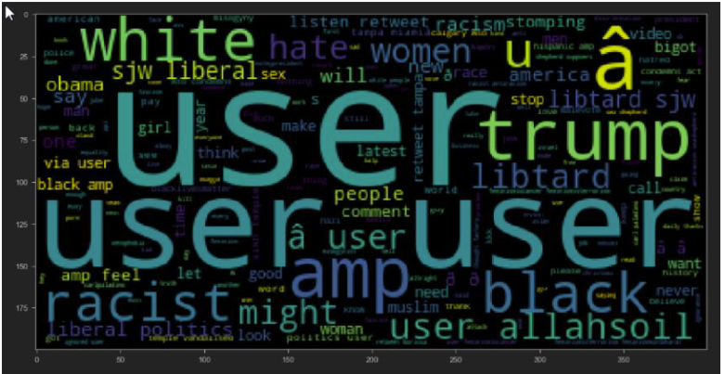
Plot word cloud

Slide 18
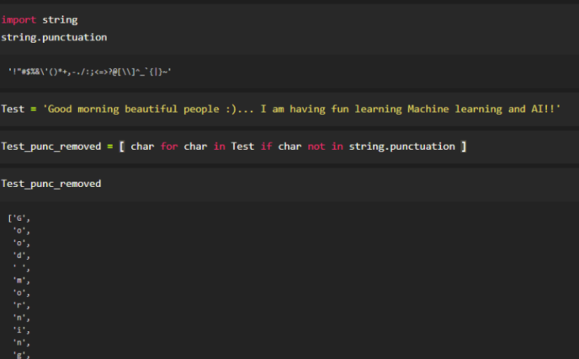
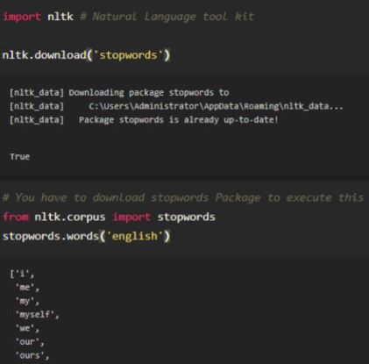
Perform data cleaning
Remove stop words and punctations from text

Slide 19
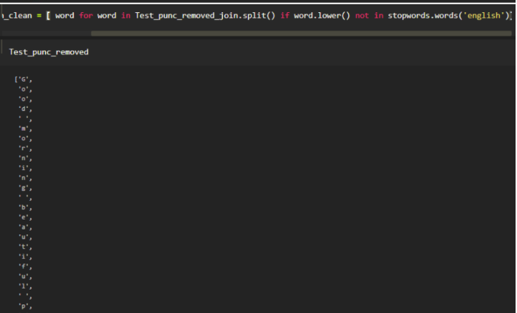

Slide 20
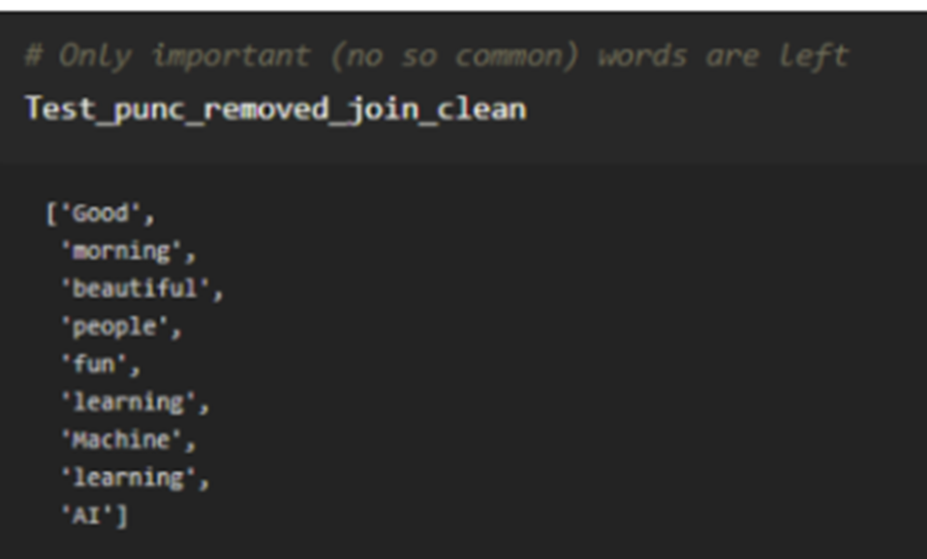

Slide 21
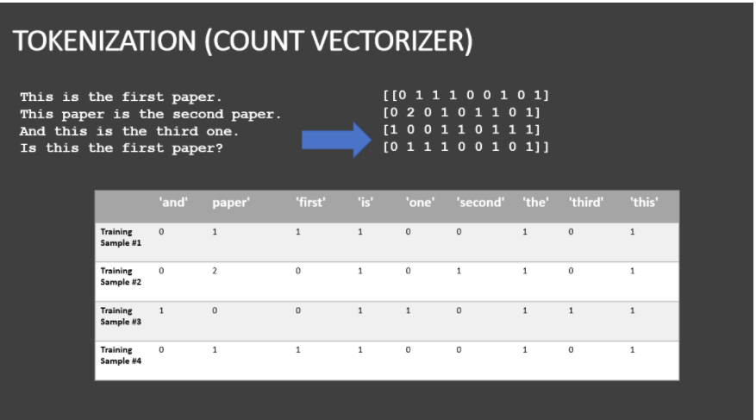
Perform count vectorization

Slide 22
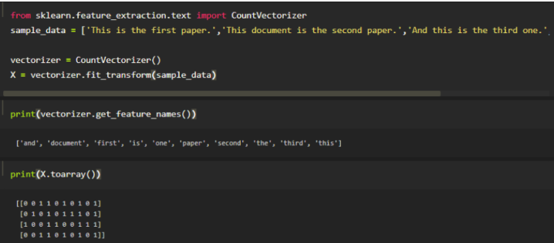

Slide 23
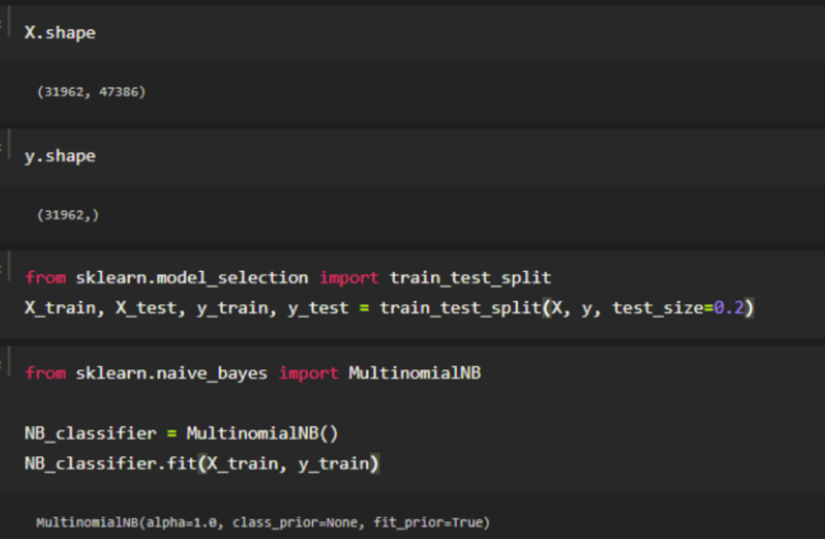
Train Naïve Bayes classifier

Slide 24
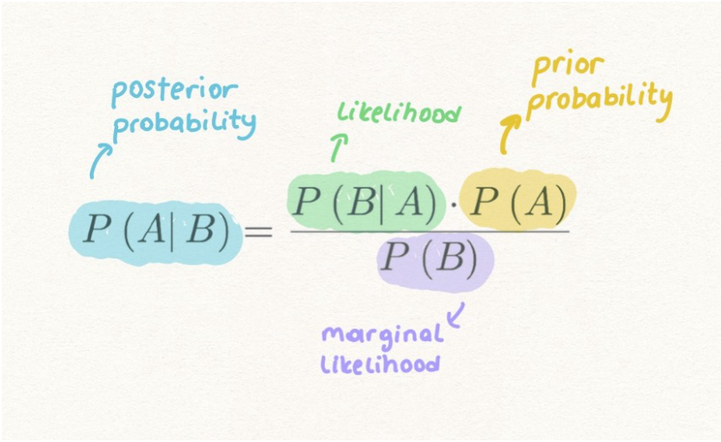
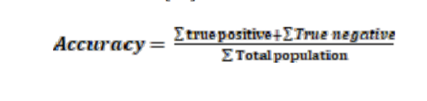
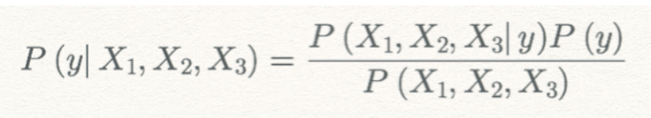
Testing
Testing is done by finding the maximum posterior probability of the test data and then finding its accuracy.

Slide 25
CONCLUSIONS
Sentiment analysis has been an important tool for brands looking to learn more about how their customers are thinking and feeling. It is a relatively simplistic form of analytics that helps brands find key areas of weakness (negative sentiments) and strengths (positive sentiments).
During Brexit and the 2016 US election, these data tools were used to measure emotions and attempt to predict the outcome of these events. This has led to non-brand organizations turning to sentiment analysis for their own needs.
Naïve Bayes algorithm can be used for classification of the training dataset and test data as it gives better accuracy compared to other algorithms.
Sentiment analysis model can also be applied to the stock market, customer feedback services for a particular product, etc.

Slide 26
Future Enhancements
Finding Sarcasm in the text and predicting emotion accordingly.
Sentiment analysis can be done on live tweets on a large-scale using Twitter API
Future Enhancement can be done for Sentiment analysis for Dravidian Languages
Many analyzers don’t perform well when the number of classes is increased. Also, it’s still not tested that how accurate the model will be for topics other than the one in consideration. Hence sentiment analysis has a very bright scope of development in the future.
Machine Learning algorithm’s accuracy to be increased.
Database is limited for processing structured data and has a limitation when dealing with a large amount of data.

Slide 27
REFERENCES
[1] https://www.kaggle.com for Twitter sentiment dataset
[2] https://ieeexplore.ieee.org/document/7877424
[3] https://ieeexplore.ieee.org/document/9537243
[4] https://ieeexplore.ieee.org/document/8474783
[5] https://ieeexplore.ieee.org/document/7912034
[6] https://ieeexplore.ieee.org/document/8252118
[7] https://ieeexplore.ieee.org/document/8515844

Slide 28
THANK YOU

