Slide 1
Data Engineering Academy October 2021
BJSS Academy

Slide 2

Week 1
Introduction to Data Analysis with Nieves
SQL, Python basics, pandas, data warehouses and modelling
Learn about the work done by Data Analysts, often a precursor to a Data Engineers tasks

Slide 3

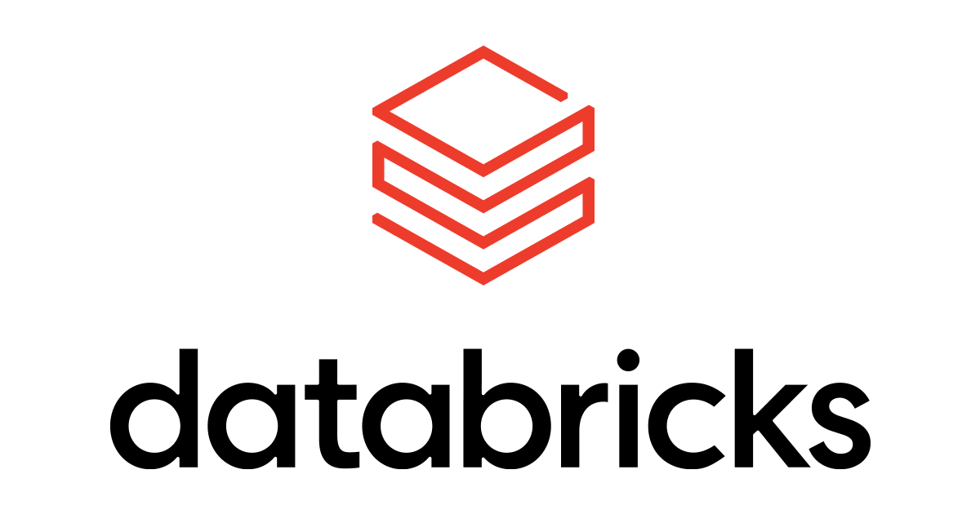
Week 2 + 3
Mornings working through DP-203 (Azure Data Engineering) self led learning paths
Afternoons working through Azure ETL batch processing course
We will learn how to built and deploy a batch ETL pipeline in Azure
From deploying infrastructure to logging and monitoring and everything in between

Slide 4
Week 4
Same mornings as previous couple of week
Afternoons looking more in-depth into Spark and how to handle large datasets
Mini project dealing with large traffic dataset

Slide 5
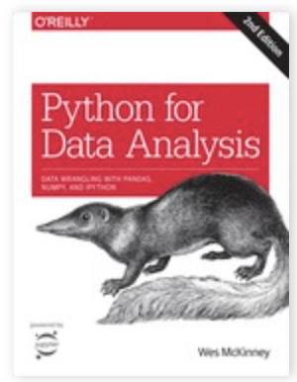
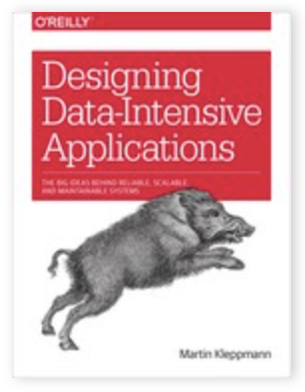
Misc
We will meet at 9, 1230, 1630 each day?
Over some midday meets we will run a reading club
We will be reading two books: Python for Data Analysis (4, 5, 10, 12) and Designing-Data Intensive Applications (5, 6, 10, 11)
Each person will present one of the chapters to the group and we can discuss thoughts

Slide 6
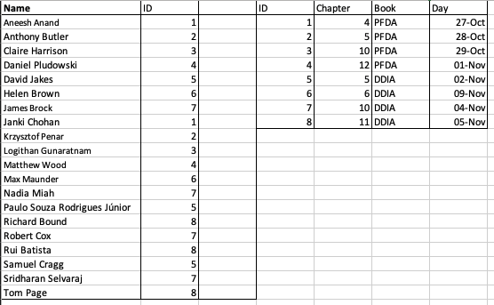
Reading groups

Slide 7
Technical requirements
Below lists the software you need to install prior to starting the course:
homebrew - https://brew.sh
pyenv - this is used to manage your Python versions - https://github.com/pyenv/pyenv. https://kepler.bjss.com/display/BJSSAC/Python+version+and+dependency+management
VSCode - https://code.visualstudio.com
iTerm2 (optional) - https://iterm2.com
MariaDB - https://mariadb.com/kb/en/installing-mariadb-on-macos-using-homebrew/
DBeaver - https://dbeaver.io/download/
Scala stuff - as part of this course you will complete a Spark course which uses Scala. The following are required:
Java 11 - https://www.oracle.com/java/technologies/javase-jdk11-downloads.html
InteliJ - https://www.jetbrains.com/idea/
Course materials - https://sundog-education.com/sparkscala/ - both the SparkScalaCourse.zip and ml-100k.zip

