Slide 1
Case study: Contributing to Eclipse
Create a user account https://dev.eclipse.org/site_login/createaccount.php
Log into https://projects.eclipse.org/ and agree to the Contributor License agreement
Logon to the Gerrit Web UI at https://git.eclipse.org/r/ using the email address you registered with your Eclipse (and Bugzilla) account and your Eclipse password.
https://git.eclipse.org/r/#/settings/ and upload your public SSH key
Clone platform.ui from git.eclipse.org (this takes a while)
Fix something and upload the change

Slide 2
Agenda
Introduction
Exercises
Setup & Cloning the Sample Repository
Local Development with EGit
Gerrit Code Review
Contribution to Eclipse
Q & A

Slide 3


Git
Version Control
Distributed
Created 2005 for Linux Kernel development
Enables collaborative Workflows

Slide 4

Git at Eclipse
Projects could move to git
Gerrit available for all projects
EGit and JGit projects used Git and Gerrit
CVS support ended
2010
2011
2012
2013
2014

Slide 5
Development with Git and Eclipse

Slide 6













Gerrit
git
git
git
git
clone repository
Developer PC
Developer PC
git
git

Slide 7
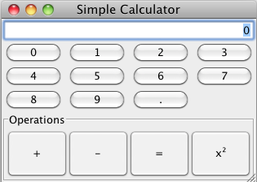
Sample Application

Slide 8
Git Exercises
  1 Setup & Clone the example repository
  2 Develop a feature
  3 Work on branches in parallel
  4 Fetch the latest state
Copyright © S. Lay, M. Sohn
Notes:
Distribute per mail? Shared folder?
*

Slide 9
Git in a nutshell

Slide 10
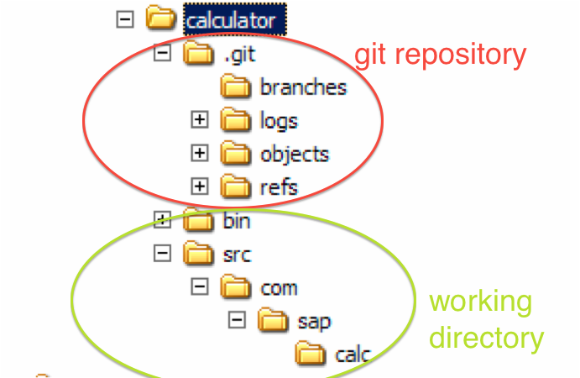
Git Concepts: Storage
Notes:
Distribute per mail? Shared folder?
*

Slide 11
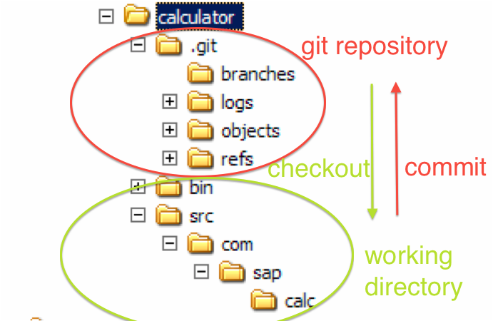
Git Concepts: Storage
Notes:
Distribute per mail? Shared folder?
*

Slide 12
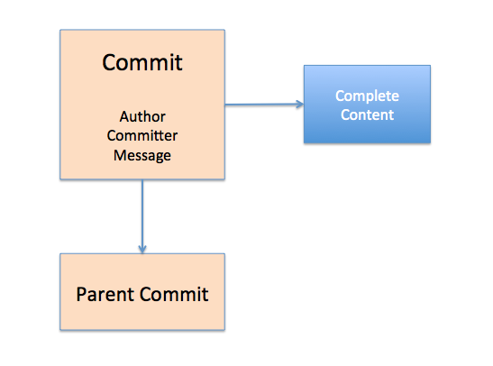
Git Concepts: Commits
Notes:
Distribute per mail? Shared folder?
*

Slide 13
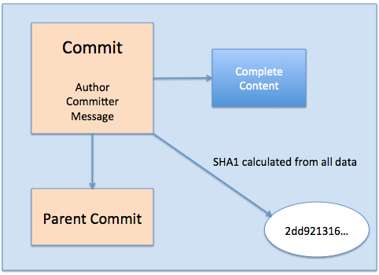
Git Concepts: Commits
Notes:
Distribute per mail? Shared folder?
*

Slide 14
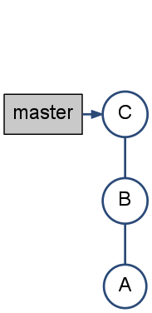
Git Concepts: Branches
Notes:
Distribute per mail? Shared folder?
*

Slide 15
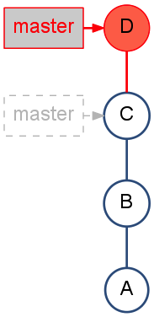
Git Concepts: Branches
Notes:
Distribute per mail? Shared folder?
*

Slide 16
Git Exercises
  5 Merging, Rebasing, Resolving Conflicts
  6 History view
  7 Change a series of commits
  8 Git blame
Notes:
Distribute per mail? Shared folder?
*

Slide 17
Gerrit code review

Slide 18
Originally developed by Google for code review of the Android OS project

Slide 19
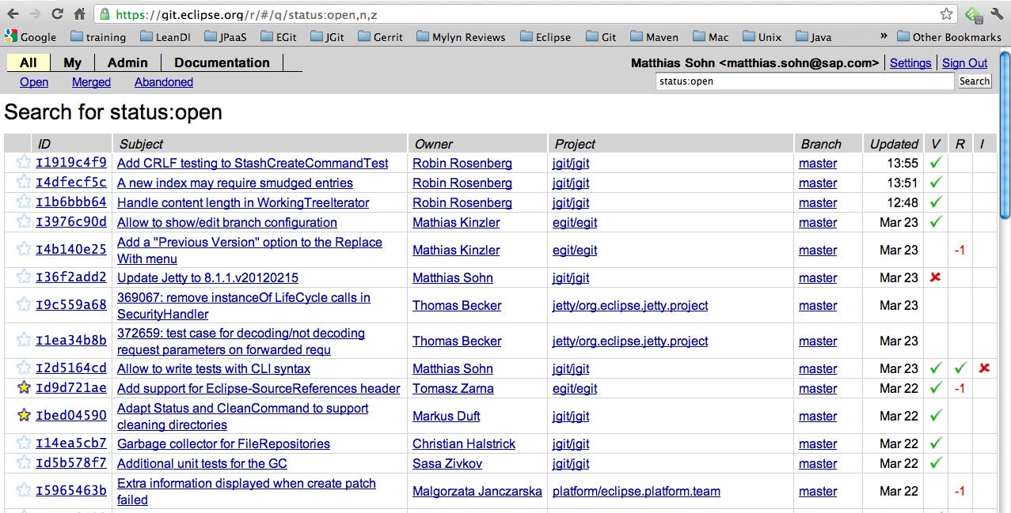
Gerrit Code Review @ Eclipse
https://git.eclipse.org/r/ is activated for most projects

Slide 20

Contributions in Git
I fix Eclipse

Slide 21
Contributions in Git
Git
Integration
repository
Fetch
Contributor 1
Fetch/ Push
I fix Eclipse

Slide 22

Contributions either via patches or commit rights
Reviews
I don't know this guy,
he does not get
commit rights.
Fetch/
Push
Committer

Slide 23
Reviewing patches
To much
work… especially if there is a feedback loop
Reviews
Fetch/
Push
Committer

Slide 24

Rule #1 of good code review - Make it easy!
Reviews must
be easy
Contributions
must be
easy

Slide 25
Roles in a Gerrit project
Contributor
Reviewer
Committer
Admin

Slide 26
Review feedback
-2 Blocks (committer only)
-1 Please adjust
1 OK
2 Good to go (commiter only)

Slide 27
CI Build
Server
Fetch
Gerrit
Integration
repository
Fetch
Fetch
Contributor 2
Contributor 1
Reviews
Fetch/ Push
Fetch/
Push
Fetch
Approve +1
Suggestion to improve -1
Reviewer

Slide 28
CI Build
Server
Fetch
Gerrit
Integration
repository
Reviews
Approve +2
Rejects -2
Committer

Slide 29
Advantages of Gerrit code review
“Safe” to contribute
Easy for all sides
Feedback possible on a line-by-line basis
Great learning environment

Slide 30
One Commit == one Gerrit review
Gerrit review is identified via the Change-ID in the commit message
Amend the commit and push the changes to update the review

Slide 31
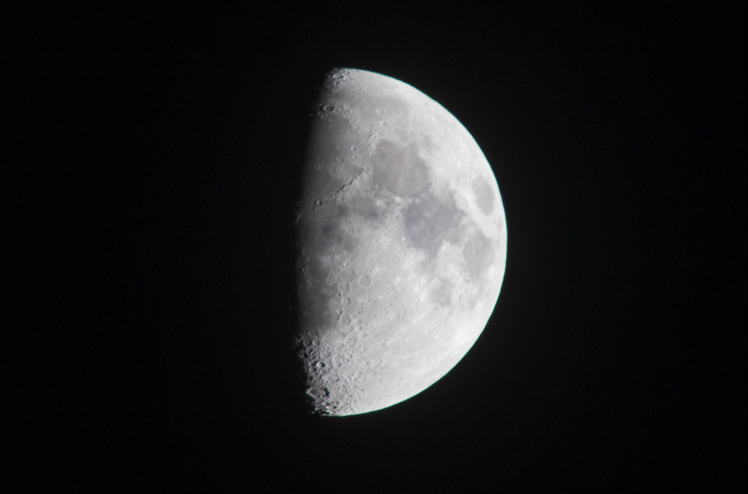
Dark side of Gerrit

Slide 32
Comparison to Github
Merge requests based on branches
Feels easier than reviews based on commits
But: Github review system not as advanced as with Gerrit

Slide 33


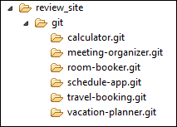

Gerrit
Access Control
Gerrit
git push

Slide 34
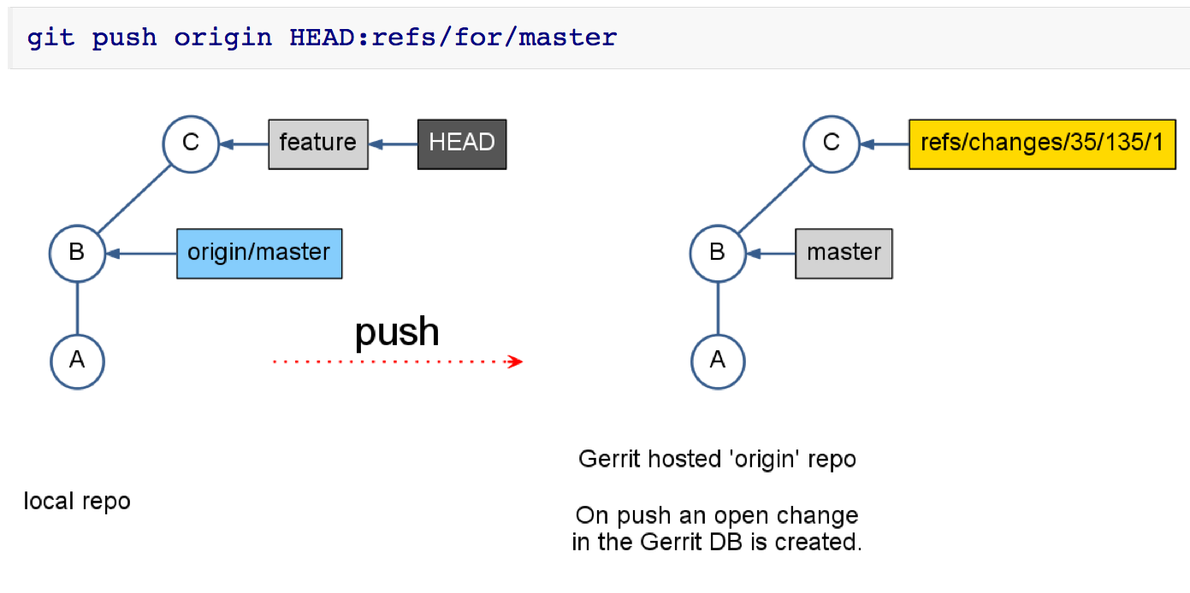
Git Concepts: Pushing to Gerrit
Notes:
Distribute per mail? Shared folder?
*

Slide 35
Demo

Slide 36
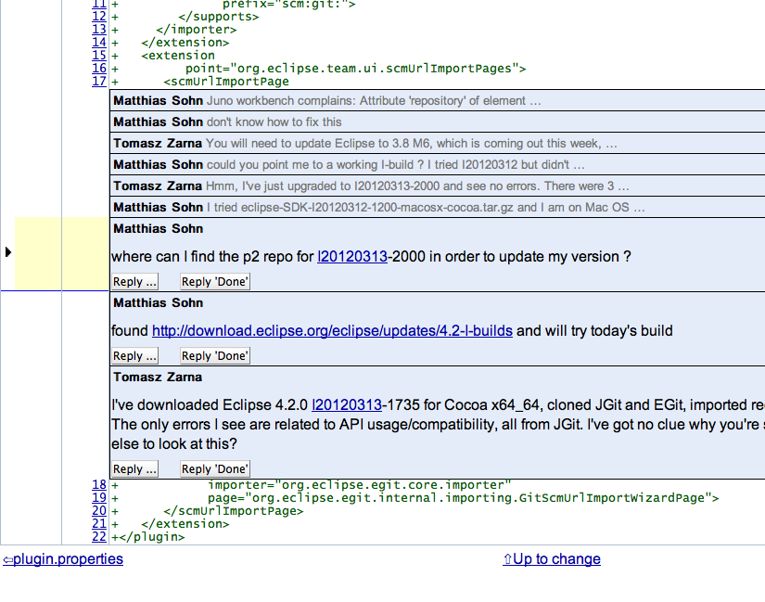
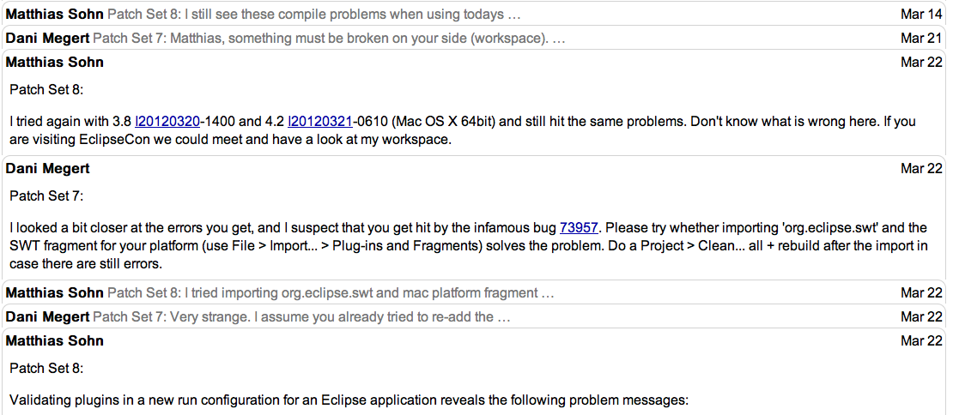
Gerrit
Commenting

Slide 37
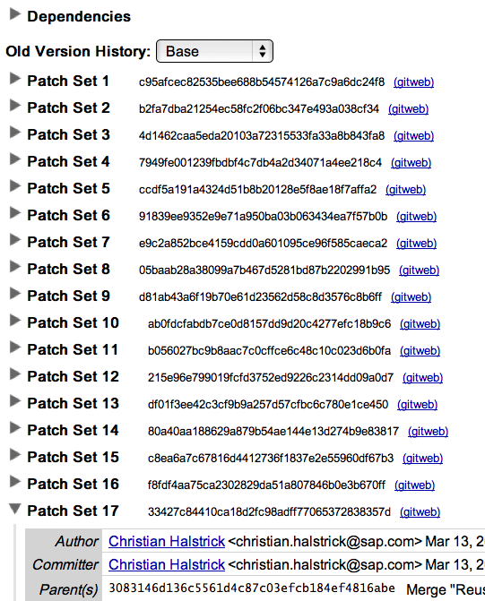
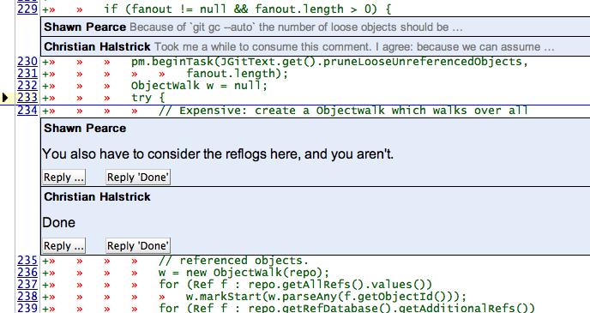
Gerrit
Discussing & Improving
Copyright © S. Lay, M. Sohn

Slide 38
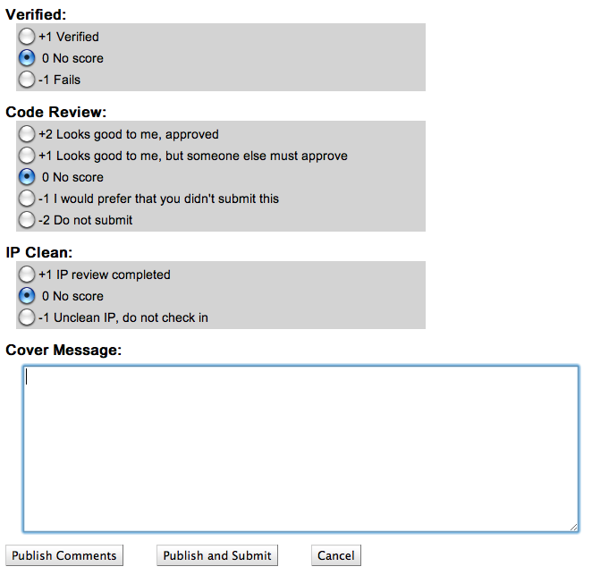
Gerrit
Voting

Slide 39
Gerrit
Learn more:
Talk by Shawn Pearce (Gerrit founder and Project Lead)
and Ian Bull
Extending Gerrit: A Look at the Gerrit Plugin API
Tuesday, 10:30 to 11:05, Bayside

Slide 40
Gerrit Exercises
1 Configure push to Gerrit
2 Push change to Gerrit
3 Review change
4 Improve a change
5 Submit a change to the codebase
6 New Changescreen
7 View Gerrit review notes
Notes:
*

Slide 41
Gerrit issue #1 – non fast forward change
origin/master
Gerrit review 2
Gerrit review 3
Commit A
Commit B
Common
ancestor
Commit 2
Commit 3
Commit 4

Slide 42
Solution issue #1 – Rebase
origin/master
Gerrit review 2
Gerrit review 3
More...
Commit 4
Commit A
Commit B

Slide 43
Gerrit issue #2 – Push a series of
unrelated changes
origin/master
Commit 1
Commit 2
Commit 3
Commit 4
Gerrit review 1
Gerrit review 2
Gerrit review 3

Slide 44
Gerrit issue #2 – Push a series of
unrelated changes
origin/master
Commit 1
Commit 2
Commit 3
Commit 4
NO WAY THIS
GETS INTO OUR
CODE BASE!!!
Gerrit review 2
Gerrit review 3

Slide 45
Gerrit issue #2 – Solution
origin/master
Commit 2
Commit 1
Commit 3'
Commit 4'
Gerrit review 2
Gerrit review 3
git reset --hard origin/master
git cherrypick 4
Push again to Gerrit → new change set

Slide 46
Gerrit issue #3 – Using the same Change-ID
in two commits
origin/master
Commit 1
Commit 2
Commit 3
Change-ID I123
Change-ID I123
Change-ID I123

Slide 47
Gerrit issue #3 – Solution: Squash commits
Change-ID I123
Changes from 2 and 3
origin/master
Commit 2'
Commit 1
Commit 2
Commit 3
Change-ID I123
Change-ID I123
Change-ID I123
Squash commits
Push again to Gerrit → new change set

Slide 48
Gerrit Code Review @ Eclipse
https://git.eclipse.org/r/ is activated for most projects

Slide 49
Case study: Contributing to Eclipse
Create a user account https://dev.eclipse.org/site_login/createaccount.php
Log into https://projects.eclipse.org/ and agree to the Contributor License agreement
Logon to the Gerrit Web UI at https://git.eclipse.org/r/ using the email address you registered with your Eclipse (and Bugzilla) account and your Eclipse password.
https://git.eclipse.org/r/#/settings/ and upload your public SSH key
Clone platform.ui from git.eclipse.org (this takes a while)
Fix something and upload the change

Slide 50
Q&A

Slide 51
Join us at the
EclipseCon Hackathon
and learn how to hack on JGit / EGit
Harbour - Tuesday, March 18, 2014 - 19:00 to 21:00

Slide 52


Evaluate This Session
1
Sign-in: www.eclipsecon.org
2
Select session from schedule
3
Evaluate:

