Slide 1
OST
Unit - 1

Slide 2
What does Open-source mean?
The term Open-source is closely related to Open-source software (OSS).
Open-source software is a type of computer software that is released under a license, but the source code is made available to all the users.
The copyright holders of such software allow the users to use it and do some valuable modifications in its source code to add some new features, to improve the existing features, and to fix bugs if there are any.
Because of this reason only Open-source software is mostly developed collaboratively.

Slide 3
Some famous examples of Open-source products are :
Operating systems –
Android, Ubuntu, Linux
Internet browsers –
Mozilla Firefox, Chromium
Integrated Development Environment (IDEs) –
Vs code (Visual Studio Code), Android Studio, PyCharm, Xcode

Slide 4
Open-source community and Contributions :
The open-source community is a worldwide community of programmers and software developers who are continuously working on various open-source projects to make our lives better. This community is self-governing and self-organizing, there are no executives to make the decisions solely. This community plays a very crucial role in the sustainability of various open-source organizations.
The contributions made in any open-source project that improves its usability are called open-source contributions. These contributions can be of any form not only some software codes we can work on improving its documentation, improving its UI/UX (user interface and design), organizing meetups, or finding new collaborators.

Slide 5
Benefits of Open-source contributions :
We code for real-world open-source projects.
It refines our existing knowledge of programming and also helps us to learn new skills.
Many open-source projects offer mentorship programs to guide and help us through our first few contributions.
We need not develop the whole thing from scratch, we just have to fork our favorite projects and start experimenting with them.
After making any open-source contribution, we get immediate feedback regarding our developmental work.

Slide 6
Benefits of Open-source contributions :
While doing open-source contributions, we interact with like-minded developers from all over the world and build connections along the way.
As we get more closer to the open-source community, we get to know much more about our field of interest and other related fields.
The most important aspect of open-source contributions is It may fetch us a job in our field of interest.

Slide 7
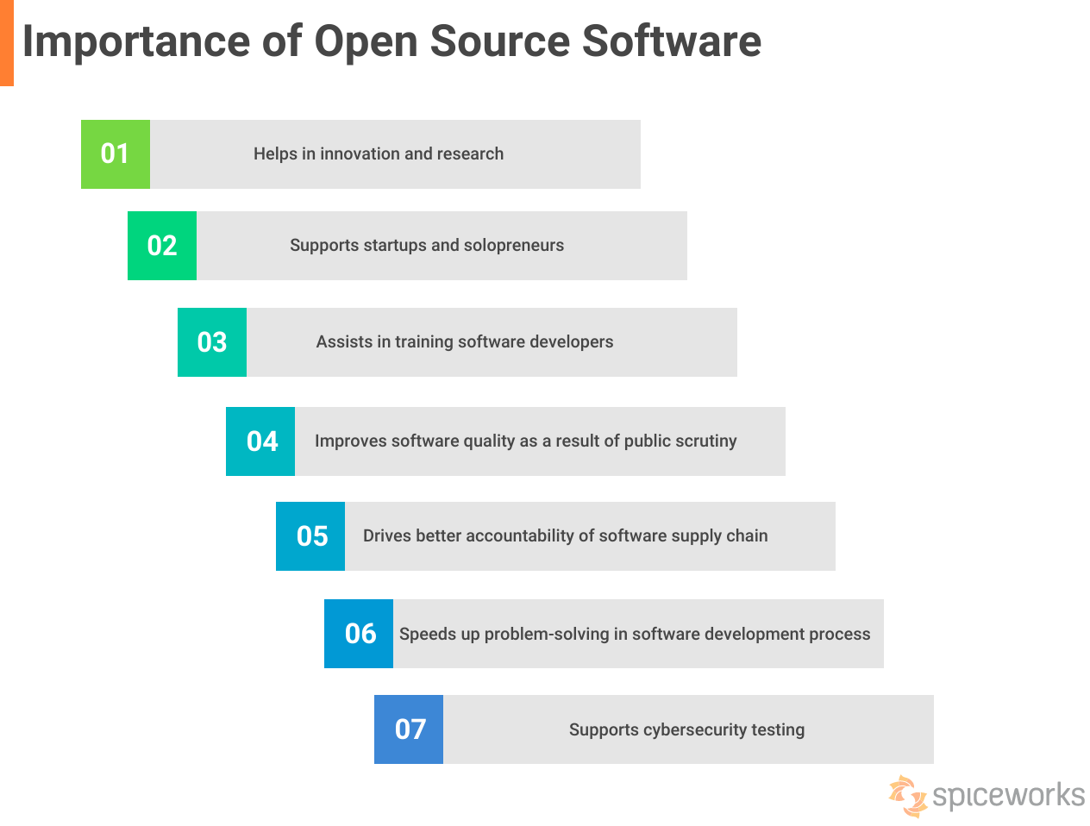

Slide 8
Importance of Open-source Technologies :
Access to source code :
In open-source software, the source code is freely available for users to view, modify, and distribute. This allows developers to customize the software according to their needs and contribute improvements back to the community.
Availability of features :
Closed-source software often has more features than open-source software because the companies or teams behind closed-source software have dedicated resources and expertise.
Transparency of functionality :
By providing transparency in functionality, open-source software promotes trust and allows users to understand how their applications work on a deeper level. They can examine every line of code and ensure no malicious activities occur within the software.

Slide 9
Importance of Open-source Technologies :
Availability of customer support :
In closed-source software, companies typically offer dedicated customer support services to assist users with any issues they may encounter. This includes access to a helpdesk or hotline where users can reach out for assistance.
Licensing systems :
Open source software is typically released under licenses that allow users to view, modify, and distribute the source code freely. The most common open-source license is the GNU General Public License (GPL), which ensures that any modifications or derivative works must also be made available as open-source.
Commercial usage and reusability restrictions :
Open-source software allows for unrestricted commercial use, meaning individuals or businesses can use the software for profit without any limitations. Additionally, open source software typically has no restrictions on code reuse, allowing developers to modify and distribute the code as they see fit.

Slide 10
Advantages of Open-source Technologies :
Lower cost :
Open-source projects are typically developed and maintained by a community of volunteers who share their skills and knowledge for free. This means anyone can access and use the software without paying hefty licensing fees or upfront costs.
Ease of integration :
Unlike closed-source software, which often requires proprietary application programming interfaces (APIs) and protocols, open-source software promotes interoperability and compatibility with other systems.
No vendor lock-in :
By providing transparency in functionality, open-source software promotes trust and allows users to understand how their applications work on a deeper level. They can examine every line of code and ensure no malicious activities occur within the software.

Slide 11
Advantages of Open-source Technologies :
Greater flexibility :
Developers have access to the underlying source code, giving them the freedom to make any necessary changes or enhancements.
The power of community:
Unlike closed-source software, where development and improvement are limited to a specific team or company, open-source projects benefit from a global community of developers, users, and enthusiasts.

