Slide 1

ClickUp Provider
Participants:
Richa Bagri

Slide 2
ClickUp
ClickUp Connector is a new webMethods CloudStreams Provider for ClickUp SAAS application.
ClickUp is a cloud-based collaboration and project management tool suitable for businesses of all sizes and industries. Features include communication and collaboration tools, task assignments and statuses, alerts and a task toolbar. The activity stream displays tasks as they're created and completed in real time.
You can use it to manage spaces, folders, list, tags, tasks and much more.
ClickUp Connector performs CURD operations. Helps in creating, updating, retrieving and deleting records from spaces, list, folders, tasks, tags.
ClickUp Connector is a lightweight connector, excellent collaboration and integrates easily.

Slide 3
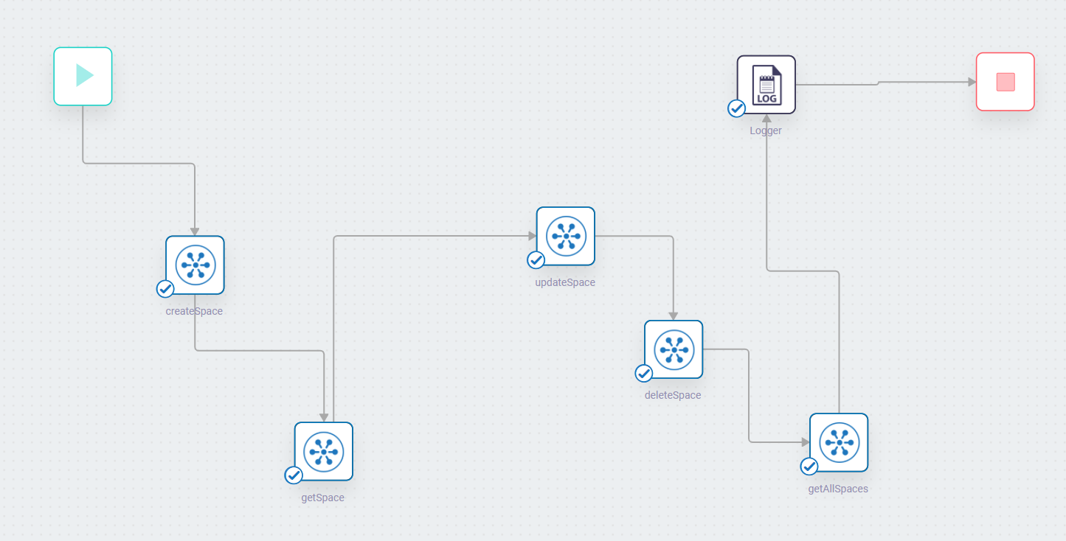
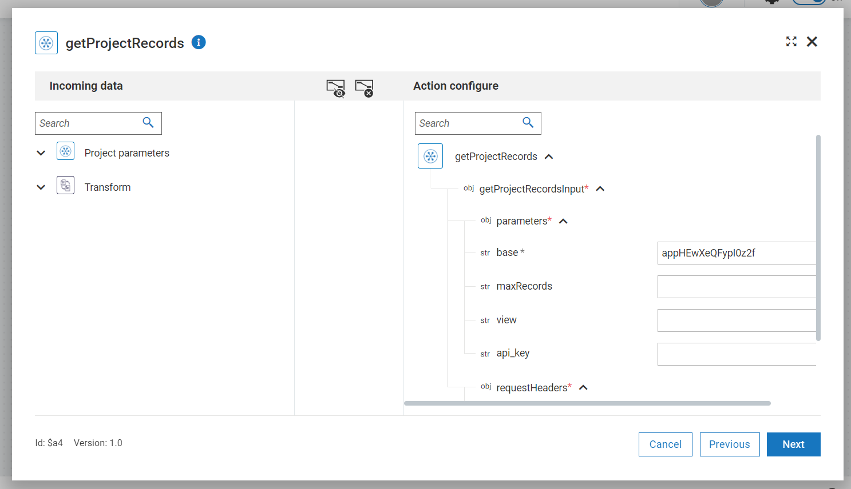
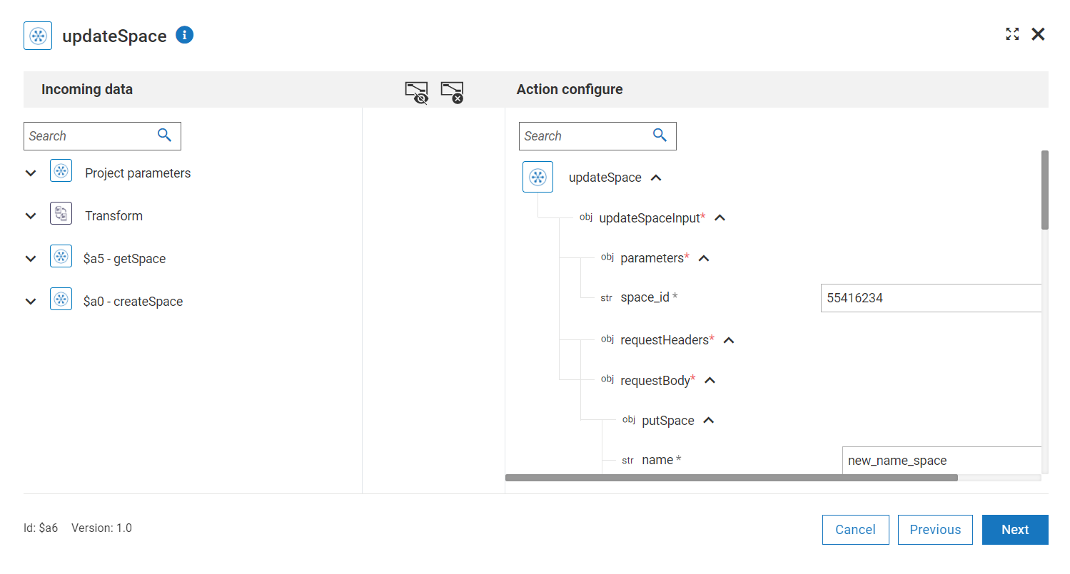
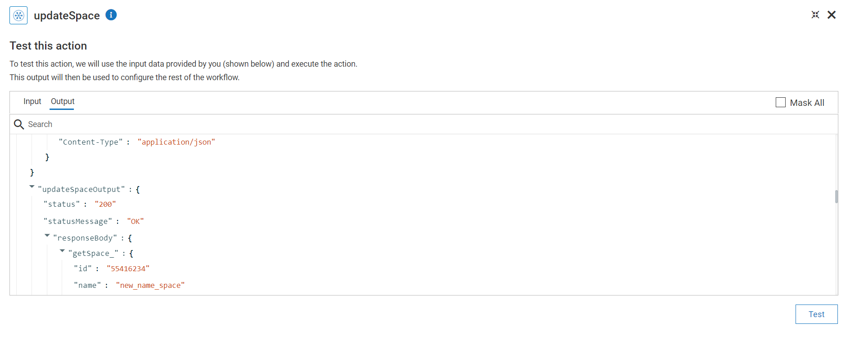
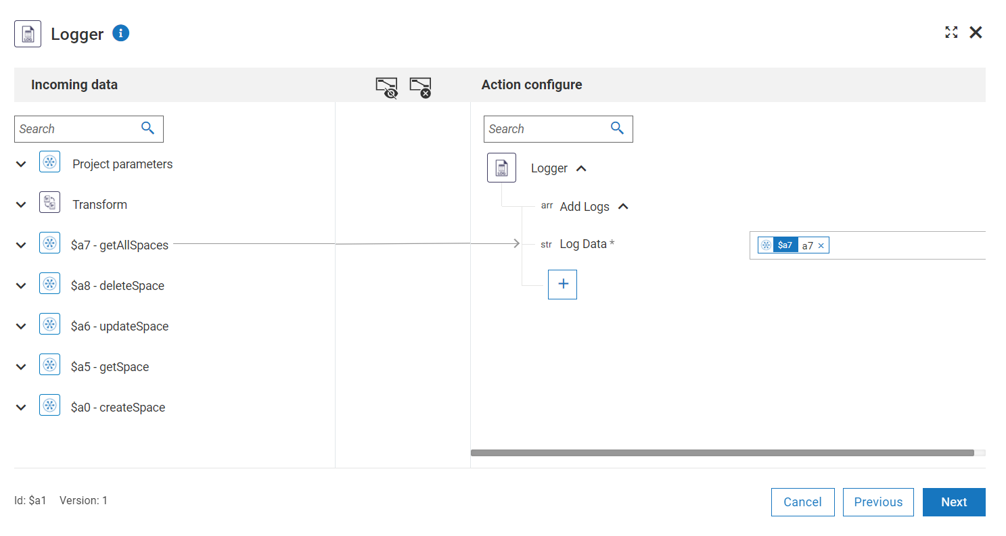
Screenshots for workflow
Workflow which helps in getting all records and getting a specific project record.
Select the operation to be performed by the connector.
Mapping the data for the action.
Logger information of the connecter data.

Slide 4
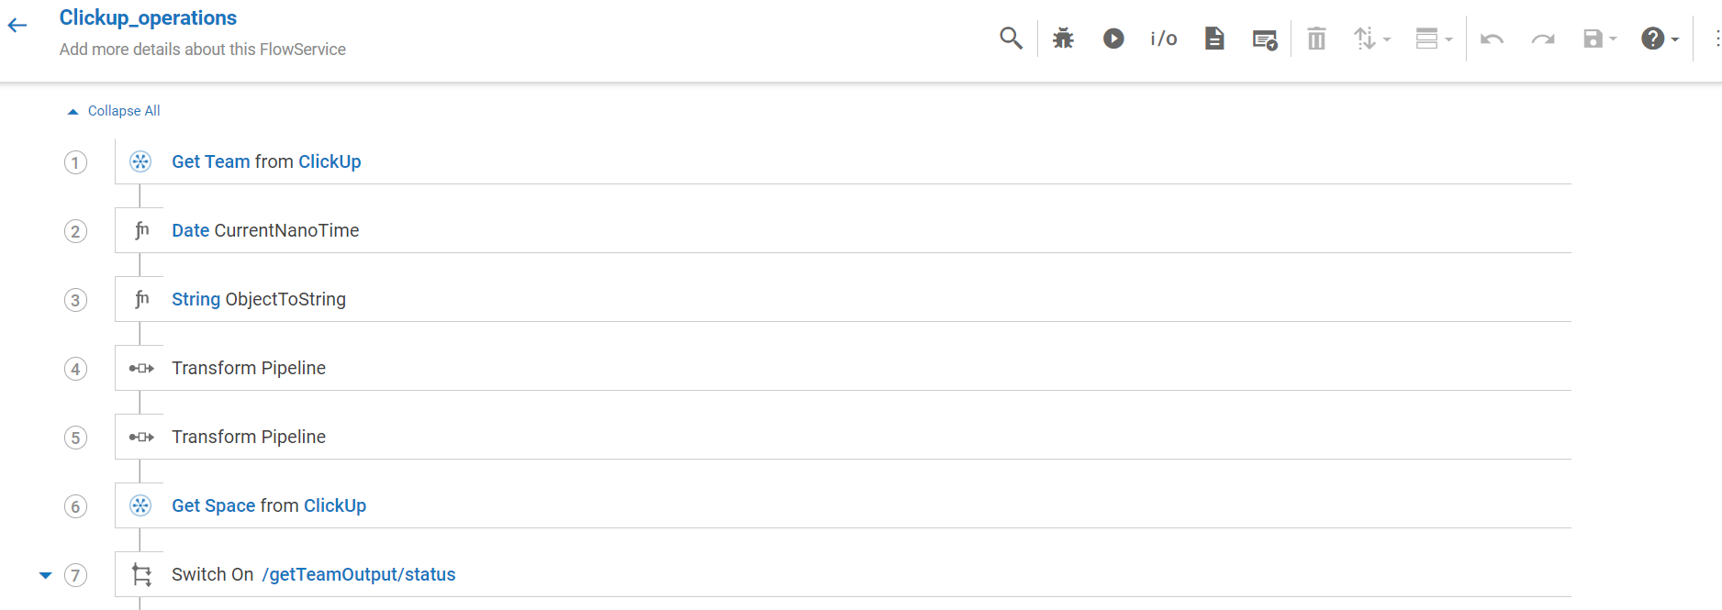
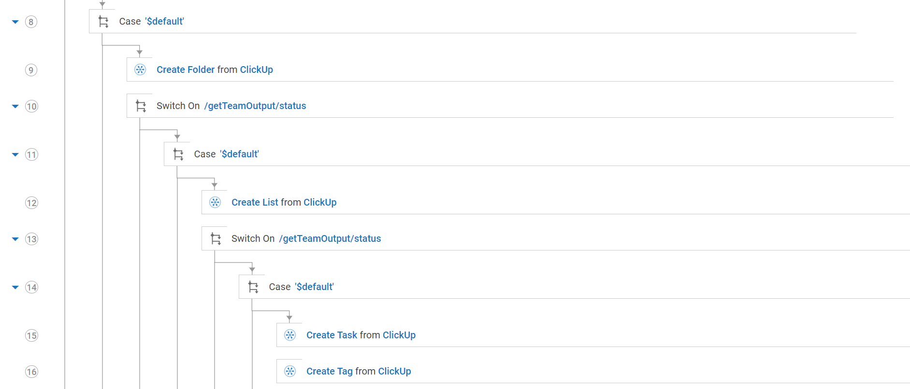
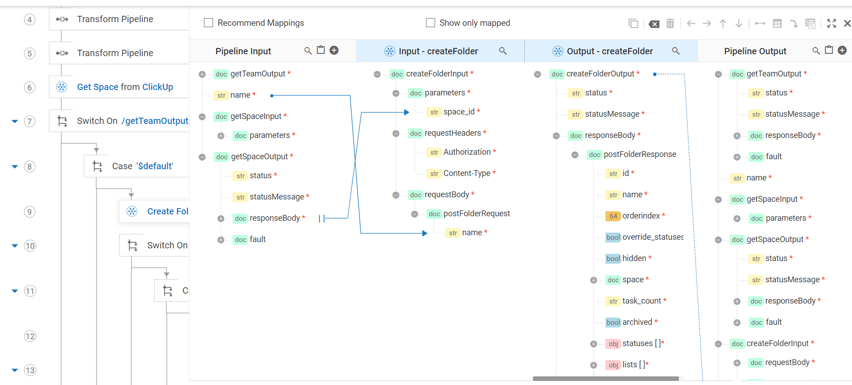
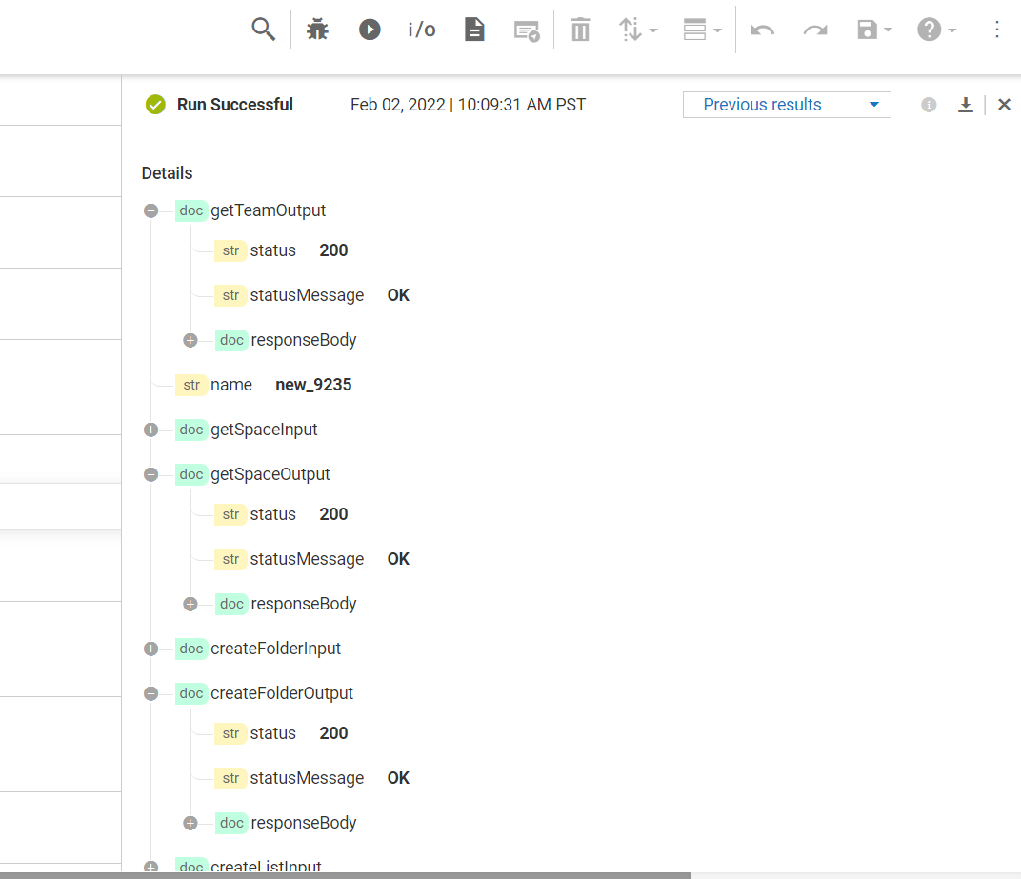
Screenshots for flow service
Flowservice using the clickup crud operations
Used all the nested operations for creating folders inside a space; List inside folder; Tag inside list; task inside list etc
Sample mapping from output of one step to input of another
Successful run results

