Slide 1
Meson: Workflow Orchestration for Netflix Recommendations

Slide 2
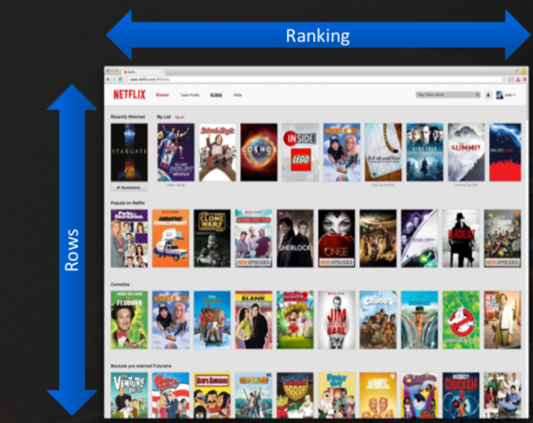
Problem Statement:
Solution:
Recommendation driven by Machine Learning
Meson
Predict what you want to watch before you watch it
Help members find content to watch and enjoy
Maximize member satisfaction and retention
Workflow Orchestration
Notes:
Highly personalised Content
Every row is personalised for a particular user based on the genre/category most likely to be liked by the user
In every Row the content is sorted according to the ranking.
Goal is to improve the recommendation and make it more personalised and accurate

Slide 3
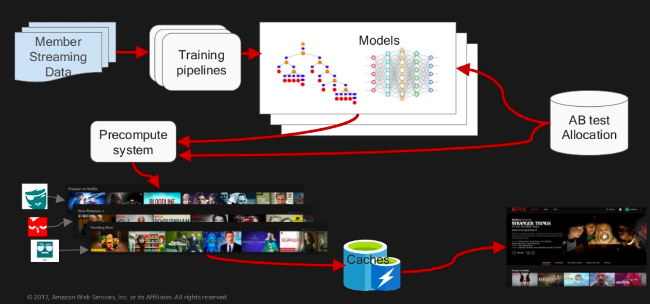
Recommendation Context
Notes:
Member Streaming Data:
Very good and rich streaming dataset as Netflix owns the stack from end to end
Example- all the user interaction like - history, playlist, bookmarked, liked videos etc.
Training Pipeline :
Focus of this paper, will talk about it a little later
Generates a series of model to create recommendation for each profile
Adjustments to serve the requirements of a large scale system like Netflix - PreCompute system and Caches are used where bunch of work is offloaded and batch computed into a pre-computed system and also stored in online caches so that the experience for the user is seamless.
All the results from various training pipelines and various ML models are run through different AB Testing setups.

Slide 4
Machine Learning Pipeline
User
Selection
Feature Generation
Model
Training & Validation
Model Selection
Publish
Model
Select set of users who have played movies in the past
But may be the recommendation was not accurate
So let’s try something with different set of features
Feature set can be things like - movies played in the past, genres liked etc.
There are 100’s of such feature so feature selection plays an important role
Determination of weights
Based on different weights & features different models are created
Compute various metrics and run though validation sets
Tries to find the model with minimum error
Goes through feature selection and hyper parameter tuning to find the best model
Makes sure that the model is properly regularized
Once the model is selected it is sent to online caches and pre-compute system

Slide 5
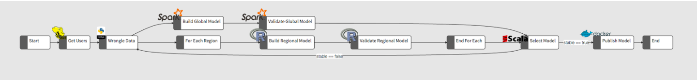
Powering Machine Learning Pipelines
Selecting a set of users — This is done via a Hive query to select the cohort for analysis
Cleansing / preparing the data — A Python script that creates 2 sets of users for ensuring parallel paths
In the parallel paths, one uses Spark to build and analyze a global model with HDFS as temporary storage. The other uses R to build region (country) specific models. The number of regions is dynamic based on the cohort selected for analysis. The Build Regional Model and Validate Regional Model steps in the diagram are repeated for each region (country), expanded at runtime and executed with different set of parameters as shown below

Slide 6
Validation — Scala code that tests for the stability of the models when the two paths converge. In this step we also go back and repeat the whole process if the model is not stable.
Publish the new model — Fire off a Docker container to publish the new model to be picked up by other production systems

Slide 7
Pipeline Challenges
Heterogeneous Systems
Failure Handling
Reproducibility
Multi-Tenancy
External Triggers

Slide 8
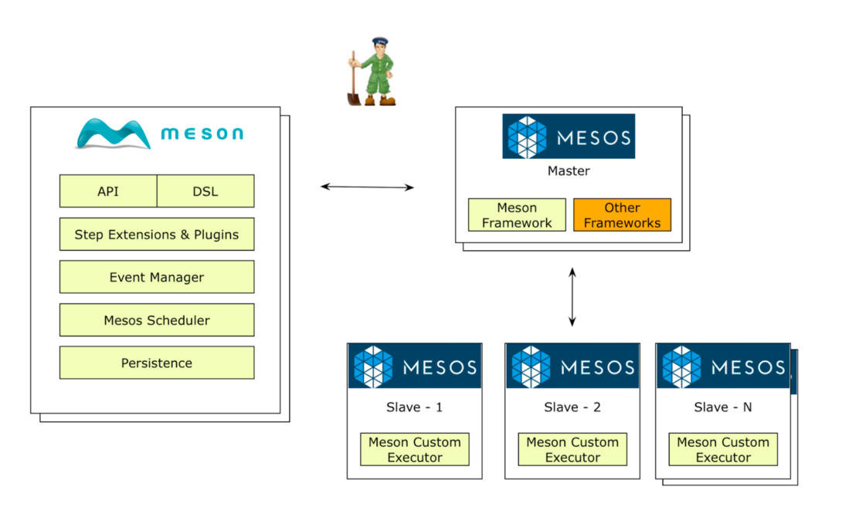
Meson Framework

Slide 9
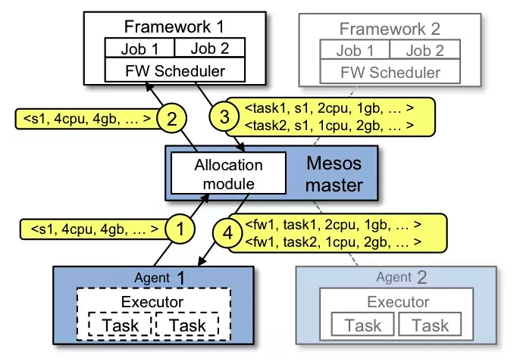
Mesos Overview

Slide 10
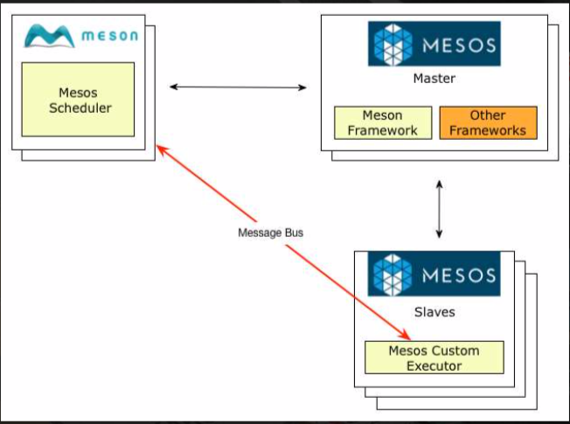
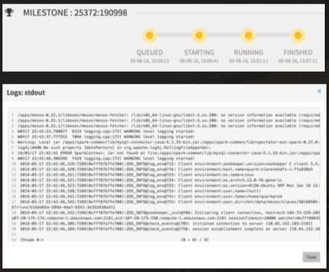
Meson Usage
Executors
Custom Executors

Slide 11
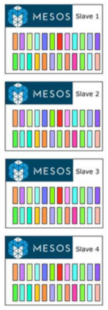
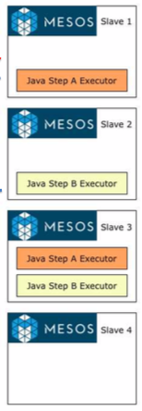
Meson Usage
Executor Caching and cleanup
Accepts
Offers
Java Step A Executor

Slide 12
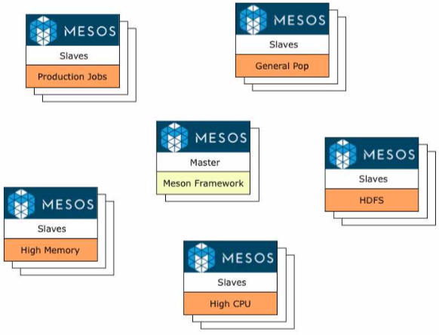
Meson Usage
Resource Attribute
Multi Tenancy
Cluster Management

Slide 13


