Slide 1


February 28, 2019
Case Study:
TFX: A TensorFlow-Based Production-Scale Machine Learning Platform
Advanced Data Mining and Web Analytics
LOVEKESH BANSAL
RICHA BATHIJA
MSITM, Spring 2018

Slide 2
Abstract
TensorFlow Extended (TFX) is a platform for reliably producing and deploying machine learning models implemented at Google.
Idea: orchestration of following:
A learner for generating models based on training data
Modules for analyzing and validating data and models
Infrastructure for serving models in production.
Uses: reduce the time to production from the order of months to weeks, while providing platform stability that minimize disruptions.
Underlying platform used by Play Store, increased install rate by 2%.

Slide 3
Complications
Building one machine learning platform for many different learning tasks
Products can have substantially different needs in terms of data representation, storage infrastructure, and machine learning tasks
Continuous training and serving
The platform has to serve up-to-date models through continuous training over evolving data
Human-in-the-loop
The platform needs to expose simple user interfaces
Production-level reliability and scalability
Resilient to disruptions from inconsistent data, software, user configurations, and failures in the underlying execution environment

Slide 4
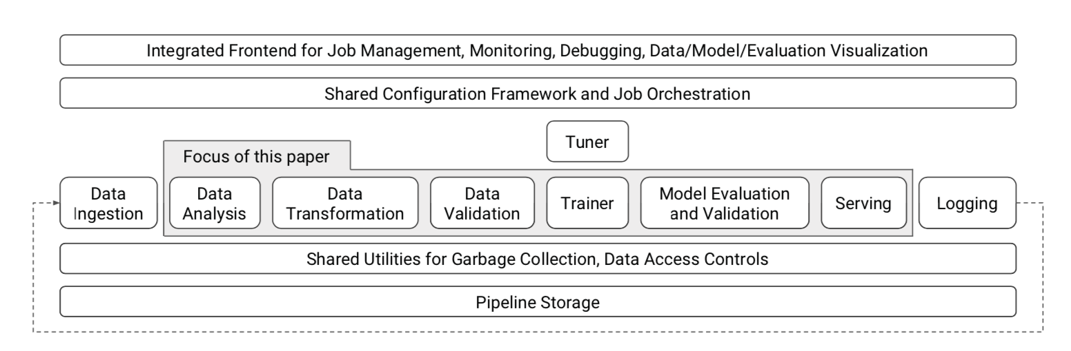
Data Analysis, Transformation and Validation
High-level component overview of a machine learning platform

Slide 5
Data Analysis and Transformation
For data analysis, the component processes each dataset fed to the system and generates a set of descriptive statistics on the included features.
Ditribution of features
Mean
Standard Deviation
For data transformations, the platform provides a suite to allow feature wrangling for model training and serving e.g. feature to integer mapping.
Feature to integer mapping
Assigning ID’s
Notes:
These statistics cover the presence of each feature in the data, e.g., the distribution of the number of values per example or the number of examples with and without the feature. The component also gathers statistics over feature values: for continuous features, the statistics include quantiles, equiwidth histograms, the mean and standard deviation, to name a few, whereas for discrete features they include the top-K values by frequency.
In most machine learning platforms that deal with sparse categorical features, both training and serving require mappings from string values of a sparse feature to integer IDs. The integer IDs allow operations like looking up model weights or embeddings given a specific value
Properties that can be encoded in the schema:
Features present in the data.
• The expected type of each feature.
• The expected presence of each feature, in terms of a min- imum count and fraction of examples that must contain the feature.
• The expected valency of the feature in each example, i.e., minimum and maximum number of values.
• The expected domain of a feature, i.e., the small universe of values for a string feature, or range for an integer feature.

Slide 6
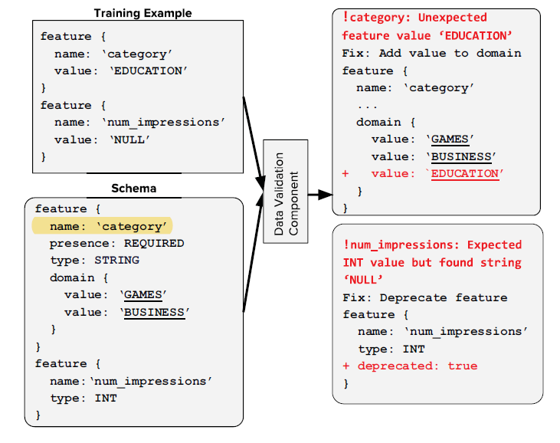
Data Validation
To perform data validation, the component checks whether the data is healthy or are there anomalies that need to be flagged.
Relies on a schema that provides a versioned, succinct description of the expected properties of the data
Type of each feature
Presence of each feature
Valency of each feature
Expected domain of each feature
Principles to follow while designing
are also present in paper.

Slide 7
Model Training
Warm Starting, which is inspired by Transfer Learning, is a technique used to attain high quality models without spending too many resources.
It offset the tradeoff between model quality and model freshness.
Train base network on some dataset, then use parameters to train target network on target dataset.
Provides ability to warm-start selective features, now open sourced.
Feature Columns is one of the useful abstractions that helps users to focus on which feature to use in their machine learning model
Estimator handles training and evaluation
Notes:
For many use cases freshness of ML model is important eg: Google PlayStore. Have huge training dataset which take hours of training to attain desired model quality . Train on dataset and use pretrained model to train new data (like resnet)
Feature Columns : similar to feature importance in PCA

Slide 8
Model Evaluation and Validation
TFX helps to answer if a specific model is good or not based on whether it is safe to serve and prediction quality
First offline evaluation using metrics such as AUC. Then conduct product specific A/B experiments online.
In production model quality is compared with a fixed threshold as well as against a baseline model – canary process.
Challenges: miss potential errors, distinguish variations
The Evaluation component offers ability to compute metrics on slices of data
It improved the user attitude towards validation of data before pushing it to production
Notes:
Safe to serve and desired prediction quality
Since A/B testing is time consuming and costly
Evaluate model quality against a fixed threshold. If not then model is not pushed to production. Challenges: canary process will not catch all potential errors.
Can be computed on subset, country = “US”

Slide 9
Model Serving
Serving systems for production environments require low latency, high efficiency, horizontal scalability, reliability and robustness.
Multitenancy: Enabling a single instance of the server to serve multiple machine learning models.
Provides soft model-isolation. Implemented feature that allows any operation to be executed with a caller-specified thread-pool.
It uses a common data format and specialized protocol was built
which enables the community to share their data models, tools etc.
Handles tradeoff between data intensive and CPU intensive algorithms.
Lazy parsing was employed
Notes:
Serving multiple models at production scale can lead to cross-model interference, which is a challenging problem to solve.
Refer Non neural network paragraph

Slide 10
Google PlayStore Deployment
The goal of the Google Play recommender system is to recommend relevant Android apps to the Play app users when they visit the PlayStore
The input to the system is a “query” that includes the information about the app user and context
The machine learning model that ranks the items is trained continuously as fresh training data arrives. The typical training dataset size is hundreds of billions of examples where each example has query features as well as impression features
The data validation and analysis component helped in discovering a harmful training-serving feature skew and improved app install rate by 2%
Warm-starting helped improve model quality and freshness while reducing the time and resources spent on training over hundreds of billions of examples.
Notes:
Serving multiple models at production scale can lead to cross-model interference, which is a challenging problem to solve.
Refer Non neural network paragraph

Slide 11
Google PlayStore Deployment
Model validation helped in understanding and troubleshooting performance differences between the old and new models.
The model serving component helped Google Play benefit from optimizations in the serving system, including support for isolation in a multi-tenant environment and fast custom proto parsing
Future Challenges:
Must be flexible to accommodate new innovations from the machine learning community
As machine learning becomes more prevalent, there is a strong need for understandability where a model can explain its decision and actions to users
Notes:
Serving multiple models at production scale can lead to cross-model interference, which is a challenging problem to solve.
Refer Non neural network paragraph

Slide 12
Thank you

