Slide 1

Austin-Bergstrom International Airport Expansion Project 2019
Henry Rossiter, Rebecca Chen, Richa Bathija, Claire Bilski

Slide 2
Objectives
Alleviate traffic congestion
Optimize travel experience
Increase airport revenue

Slide 3
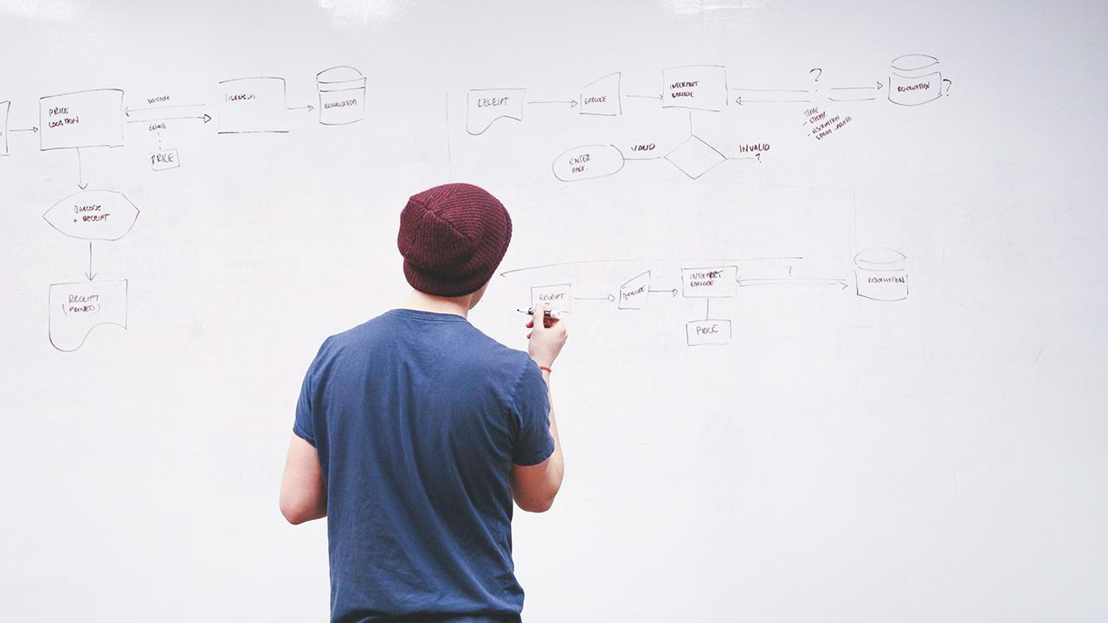
Solutions:
Data-Driven Transit Recommendations
Cross-platform application
Single touch point
SmartLounge
Personalized airport experience
…while increasing revenue!

Slide 4
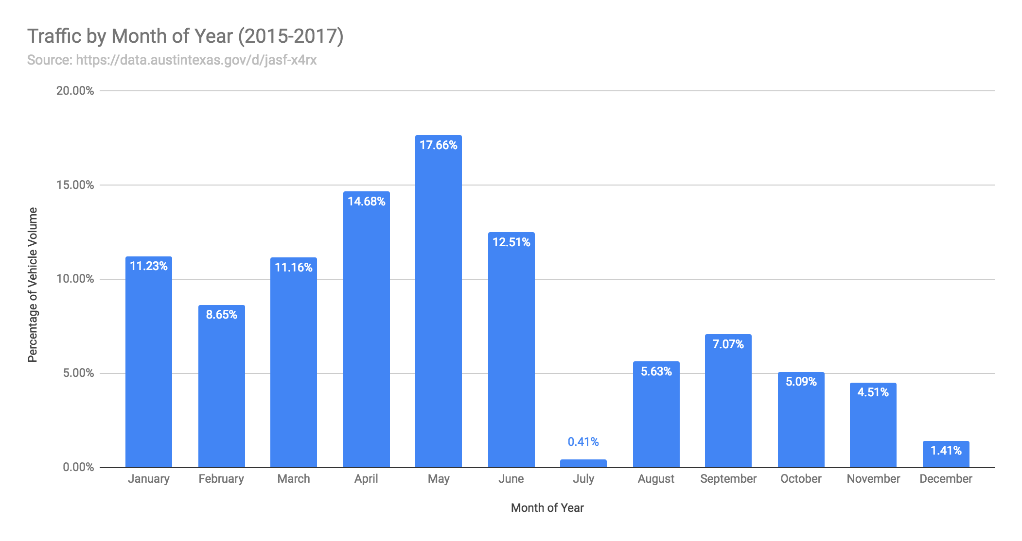
Peak Traffic Data by Month
Notes:
Becky

Slide 5
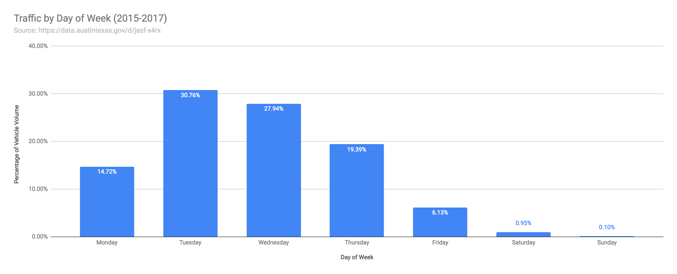
Peak Traffic Data by Day of Week
Notes:
Becky

Slide 6
Benefits of Different Transportation Options
 | Ride-Share Option (Cost Sensitive) | Alleviates Traffic | Generates Revenue for Airport | Time Sensitive
Uber
Lyft
CapMetro
Bird

Slide 7
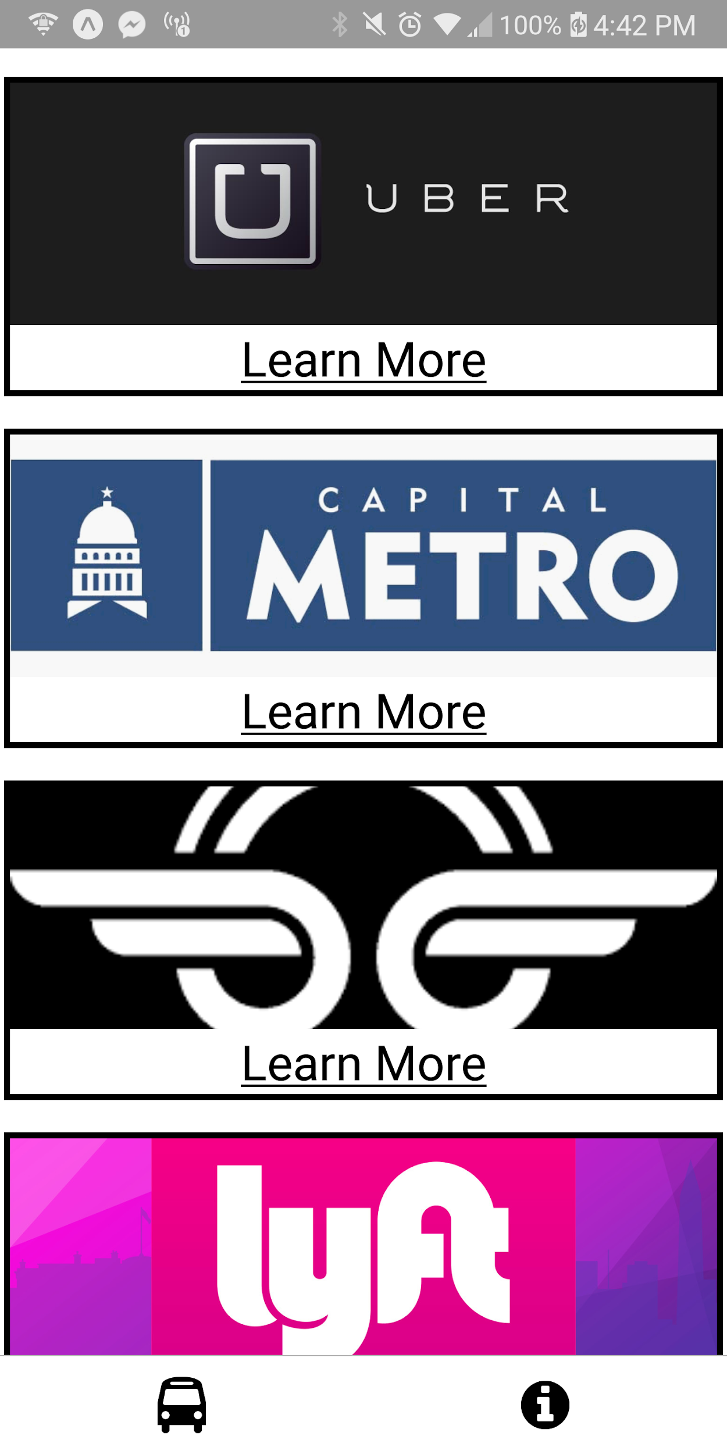
Frontend:
React Native
Multi-platform mobile application
Integrated APIs
Embedded deep links provide royalties
Maximize user engagement with Austin’s modern transit options
Backend:
Forecast traffic congestion with historical time series data
Optimization of transit recommendations
Maximize revenue, minimize traffic

Slide 8
Transit App Logistics
Total Population per Year | 15,000,000
Fraction of Population Using Transit App | 21%
Total Estimated Users of Transit App | 3,150,000
Total Estimated Number of Clicks that Produce Royalties (5% of estimated users of transit app) | 157,500
Revenue from Transit App per Click | $5
Total Revenue from Referral Royalties | $787,500

Slide 9
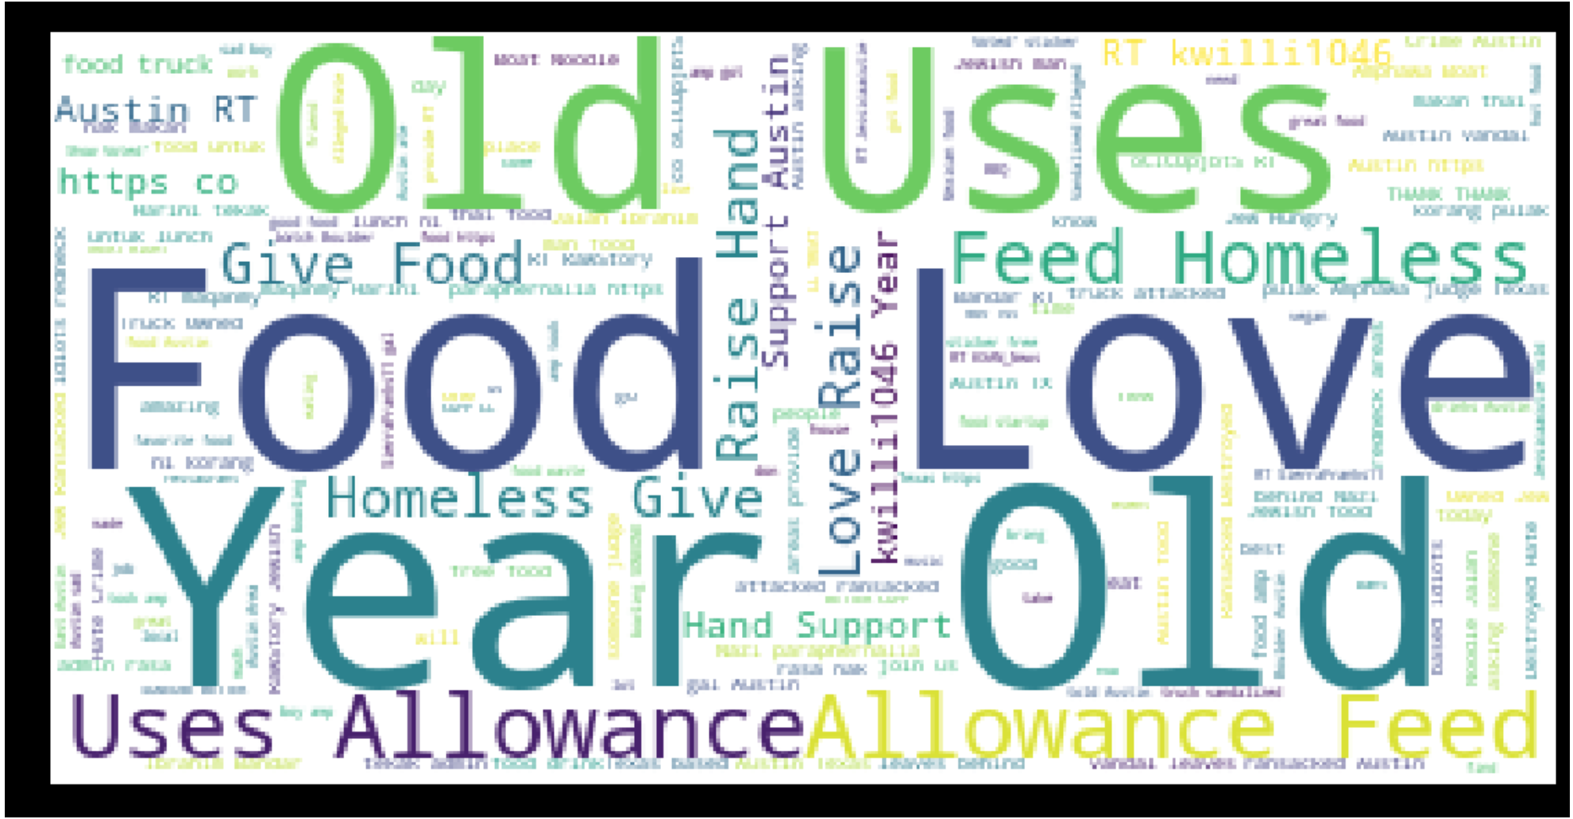
Airport Tweets World Cloud
Notes:
Richa----
Started our brainstorming process….

Slide 10
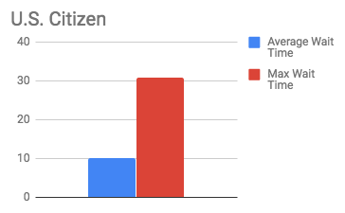
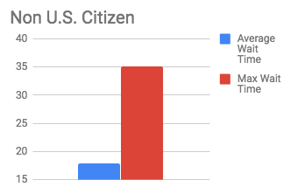
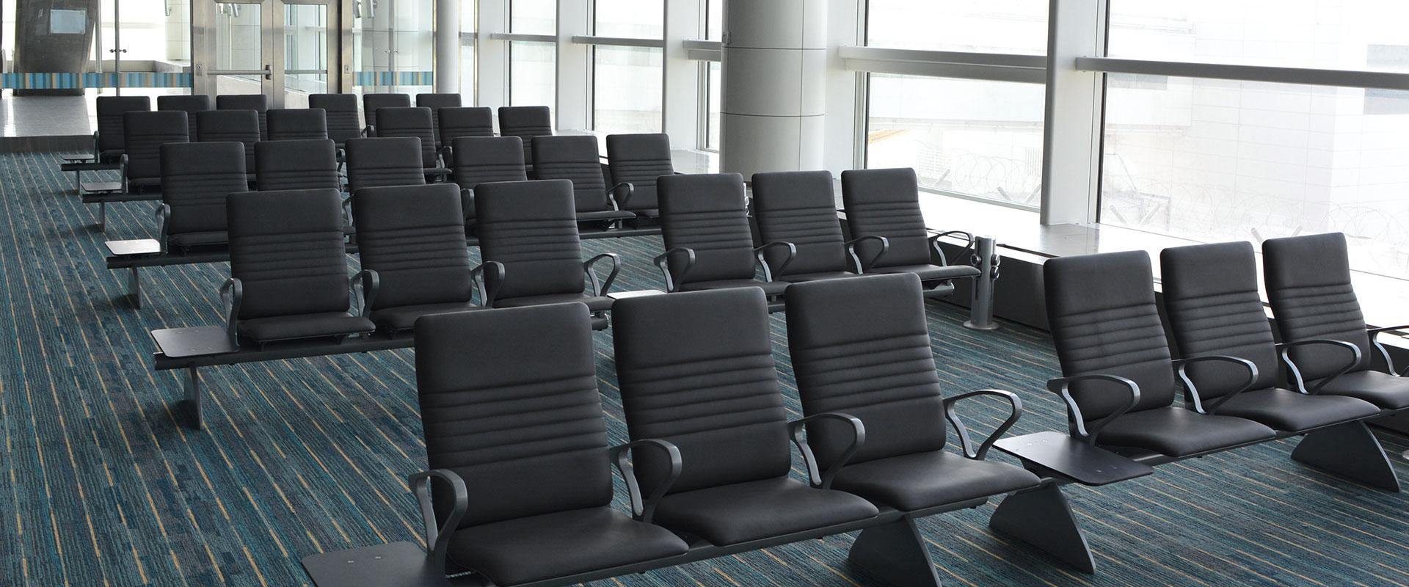
Austin Airport Wait Time per Year Data
Source: U.S. Customs and Border Protection

Slide 11
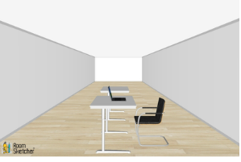
Smart Lounge Prototype
Personalized light and temperature controls
Collects passenger data

Slide 12
SmartLounge Logistics
Total Population | 15,000,000
Cost of Data per Person Using Smart Lounge | $0.20
Total Estimated Users of Smart Lounge per Day (200 seats in lounge; each person uses a seat for avg of 2 hours in a day) | 2,400
Revenue from Smart Lounge per Day | $480
Total Revenue from Smart Lounge per Year | $175,200

Slide 13
Total Revenues
Revenue | Amount
Collecting Data from SmartLounge and Transit App | $175,200
Referrals from Transit App | $787,500
Total Revenue | $962,700

Slide 14
Total Costs
Cost | Amount
SmartLounge Development and Maintenance ($100 per seat; 200 seats; $5,000 maintenance costs per yr) | $25,000
Transit App Development and Maintenance | $200,000
Total Costs | $225,000
Notes:
$100, 200 seats,

Slide 15
Net Value
Entity | Amount
Total Revenues | $962,700
Total Costs | $225,000
Net Value | $737,700

Slide 16
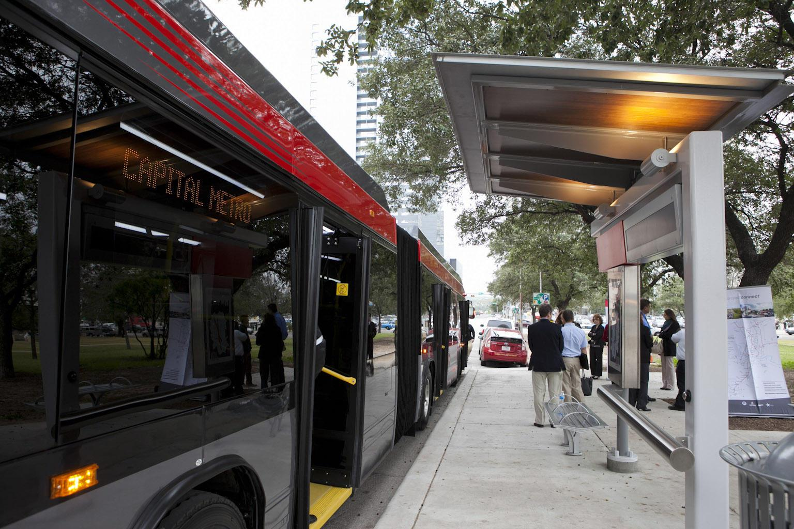
Recommendations for the City of Austin
Increase public transportation options
Continue collecting relevant traffic data

Slide 17

Greater Business Impact
Allows for Modularity
The Transportation Industry has been dynamic in the past few years. ex. Lime
We want to have a dynamic interface to welcome in new trends in transportation, such as self-driving cars.
Data-Driven Smart Systems
Smart beautification from inside the Austin-Bergstrom airport.
Gather data from the travellers in the Smart Lounge.
Make the Austin-Bergstrom International Airport a Well-Designed Entrance
Austin – 9th fastest growing city in Texas. (Source: Austin Monitor)

Slide 18
Questions?
Thank you!

