Slide 1
CARDIOVASCULAR DISEASE
PREDICTION USING DEEP NEURAL NETWORKS
GROUP-7
Pruthivi Raj Behera (MT20037)
Shreya Goel (MT20054)
Richa Dwivedi (MT20104)
Notes:
Good afternoon mam, we are group 7 Pruthivi, Shreya and Richa

Slide 2
Table of contents
1
2
3
4
5
6
Introduction
Background Work
Dataset
Brief Introduction and Problem Statement
Literature Review and Limitations of existing system
About Dataset , preprocessing and Analysis
Methodologies
Present Work Status
Conclusion
Implementation of different ML and NN models, evaluation and results
Replication of work done and Proposed Work
Conclusion and Future Work
Notes:
We’ll start with the table of contents. So first, we will have a brief introduction and explanation of the problem statement. Then, the background work such as literature review and limitations of existing system will be discussed. Then, about dataset in form of visualizations and analysis along with the data preprocessing. Then methodologies along with their implementation. Then, our present work done and finally we’ll wrap up with conclusion and future work.

Slide 3
01
Introduction
Notes:
Basic Introduction

Slide 4
What is Cardiovascular Disease?
Cardiovascular diseases (CVD's) is a set of high-risk diseases, which affects the heart and blood vessels of the body.
CVD is caused due to high blood pressure, high cholesterol, alcohol, smoking, etc.
It can moreover affect other organs in the body such as the mind, kidneys and eyes. Sometimes when it is not cured on time, it becomes the leading cause of death.
Notes:
So, what is cardiovascular disease?
Cardiovascular diseases (CVD's) is a set of high-risk diseases, which affects the heart and blood vessels of the body.
CVD is caused due to high blood pressure, high cholesterol, alcohol, smoking, etc.
It can affect other organs in the body such as the mind, kidneys and eyes. And when it is not cured on time, it becomes the leading cause of death.

Slide 5
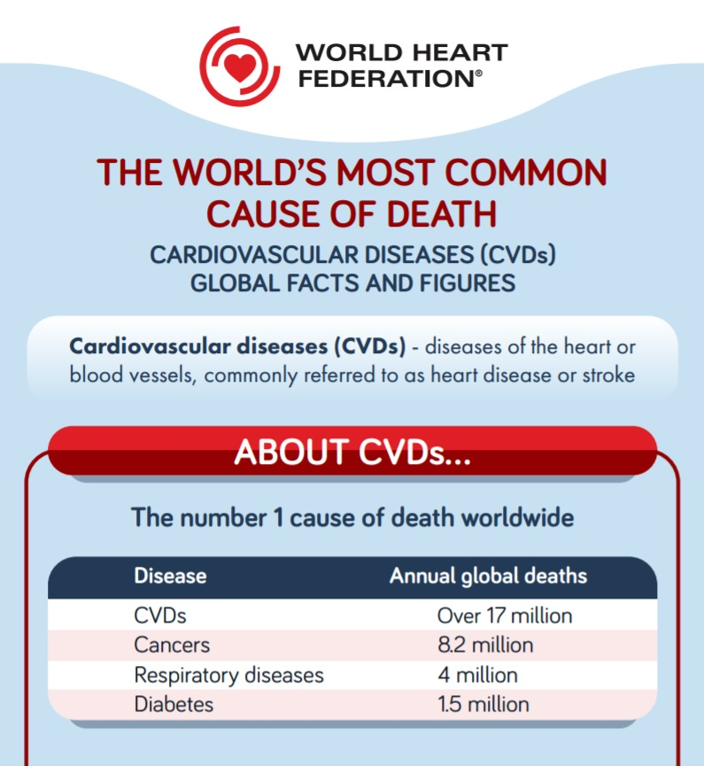
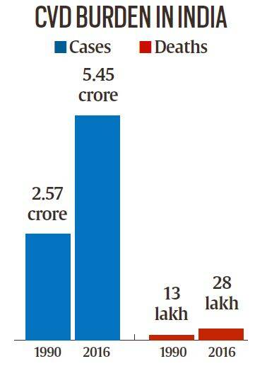
Notes:
As, we can see in the image, the number 1 cause of death worldwide is due to cardiovascular disease’s and it’s even higher than Cancers or diabetes. Even in India, it is responsible for most deaths with crores of cases and lakhs in death tolls. Hence, the motivation for our topic.

Slide 6
Problem Statement
Presently, the Medical Diagnosis System is playing an essential role in diagnosis and treatment.
The focus is on predicting the risk of Cardiovascular disease among patients using Machine Learning and Deep Learning techniques.
System’s automation will help the physicians for a fast and better diagnosis in the future with a reduction in costs.
Data Analysis also plays a vital role in the medical field progress by suggesting the proper treatment according to the patient’s characteristics.
Hence, a sound prediction system is required.
The main aim is to determine the individuals at higher risk of developing Cardiovascular disease at an earlier stage to avoid premature deaths.
Notes:
Presently, the Medical Diagnosis System is playing an essential role in diagnosis and treatment.
The focus is on predicting the risk of Cardiovascular disease among patients using Machine Learning and Deep Learning techniques.
System’s automation will help the physicians for a fast and better diagnosis in the future with a reduction in costs.
Data Analysis also plays a vital role in the medical field progress by suggesting the proper treatment according to the patient’s characteristics. Hence, a sound prediction system is required.
The main aim is to determine the individuals at higher risk of developing Cardiovascular disease at an earlier stage to avoid premature deaths.

Slide 7
02
Background Information
Notes:
Now some background information.

Slide 8
Literature Review
Some of the earliest works in prediction of cardiovascular disease
A medical diagnosis system for predicting cardiovascular disease through a combination of Genetic algorithm and neural network.
In another research, various machine learning techniques, including support vector machine, gradient boosting, random forest, naive bayes classifier and logistic regression were implemented for prediction of cardiovascular diseases. Since the dataset size was too small, the authors were able to achieve a decent score.
K-means clustering algorithms was also used, where data was clustered and based on clusters, Chest pain was predicted.
In another work, Multilayer perceptron (MLP) was also implemented along with machine learning models along with feature selection techniques.
Although ML algorithms showed promising results in some work, the results obtained were far from optimal.
Notes:
Some of the earliest work done in CVD prediction was in 2012 where a medical diagnosis system was made using genetic algorithm and neural network. After that several other strides were made in this field, with various machine learning techniques like SVM, Gradient boosting and so on.
In some studies, different clustering algorithms were used and in other MLP (Multilayer Perceptron) was used. Although the results they all got were decent, results were far from optimal.

Slide 9
Limitations in Existing Systems
Small Sample Size in the experiments. (300-900 records)
Biased pooled results.
Use of different kind of Feature Selection techniques with not promising results.
Different Evaluation metrics were reported for different work. Hence, incomparable results.
Insufficient Data Preprocessing which affected the results.
Notes:
Now limitations of the existing system:
First, Small Sample Size used in the experiments. They all used dataset of 300-900 patients.
Then, Biased pooled results. Due to small sample size, the results were biased since they were from a same place.
Use of different kind of Feature Selection techniques. (like some took all features while some took only few features) hence the inconsistency
Different Evaluation metrics were reported for different work. Hence, incomparable results.
Insufficient Data Preprocessing which affected the results. (need to do good exploratory data analysis first)
We combatted all these problems and fixed them.

Slide 10
03
Dataset Understanding
Notes:
Now for data understanding

Slide 11
About Dataset
The Cardiovascular Disease dataset is obtained from Kaggle
The dataset consists of 70,000 records of patient data.
Contains 12 features, which are broadly categorized into three categories:
Objective: factual information
Examination: results of medical analysis
Subjective: the patient gave information
Notes:
The data we used had 70000 records obtained from kaggle.
It contains 12 features, which are broadly categorized into three categories:
Objective: factual information (age, weight, height)
Examination: results of medical analysis (glucose test, cholesterol test)
Subjective: information given by patient (smoke and alcohol)

Slide 12
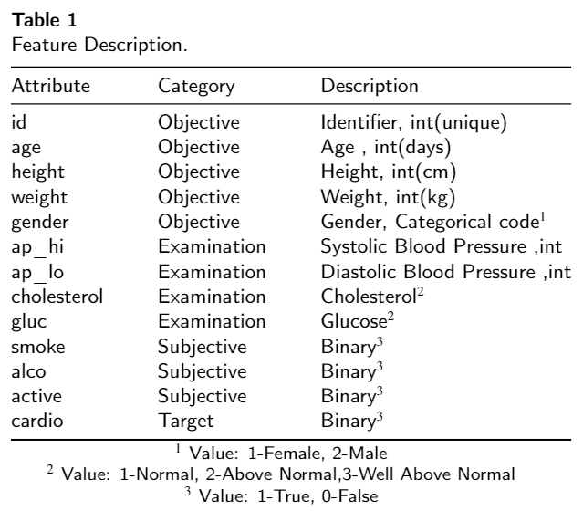
Notes:
This is the feature description. Here we can see in the category, these are objective……..., examination……..., subjective……...
As we can see in description, some were binary features some were categorical and others numerical.

Slide 13
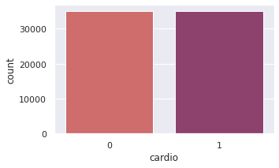
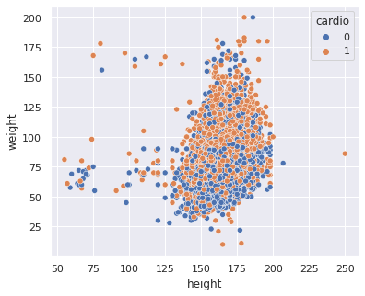
Class Distribution of Target Variable Cardio
Distribution of weight and Height
Notes:
Here, we can see in the left that the data is balanced. No class imbalance. Equal 1’s and 0’s. And in the right, we see some outliers in height and weight. I.e. how can height be 75 cm and weight 150 kg right? Therefore, we did data preprocessing to clean and transform the data.

Slide 14
Data Cleaning
Removal of Duplicate Data
The duplicate rows were dropped from the data. There were 48 duplicate rows present in the data.
Missing Values or Inconsistencies
There was no missing value found in the data and any discrepancies in the values.
Outliers Removal
The Interquartile Range method was used to remove outliers from columns - ap_lo, ap_hi, weight and height.
Notes:
First the cleaning, we removed duplicate data (there were 48 duplicate rows). No missing values was there so no problem there. Outlier removal (IQR was used to remove outlier i.e. extreme values were removed from columns ap_lo, ap_hi, weight/ height)

Slide 15
Data Transformation
The age column was converted into years by dividing the values with 365.24.
The weight and height columns were integrated into BMI Index.
Notes:
Then data was transformed. Age was converted from days to years. And as the height and weight are highly correlated, they were converted to BMI feature.

Slide 16
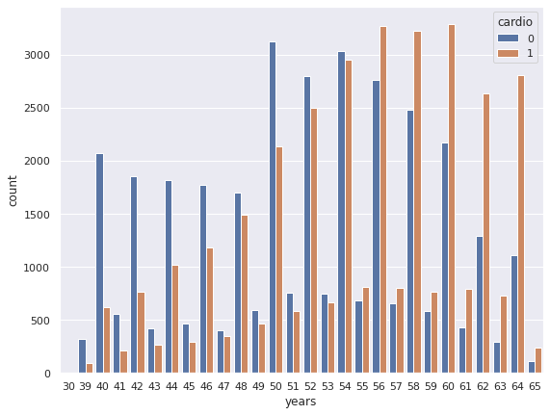
Data Analysis
Risk of Cardiovascular Disease Based on Age
Notes:
Then some visualizations, here we see the presence of cvd across age and count. As we can see elder people are at more risk.

Slide 17
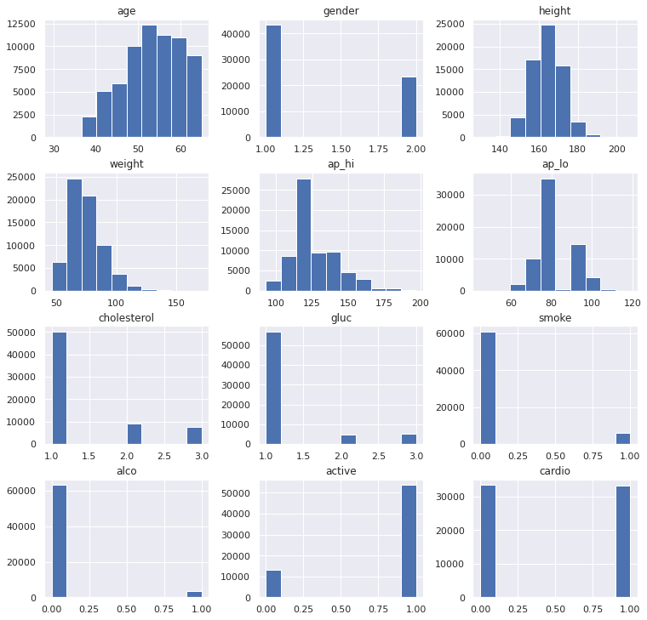
Histogram plot of all the Variables.
Notes:
We can also see a visualization of data in histogram form for all features.

Slide 18
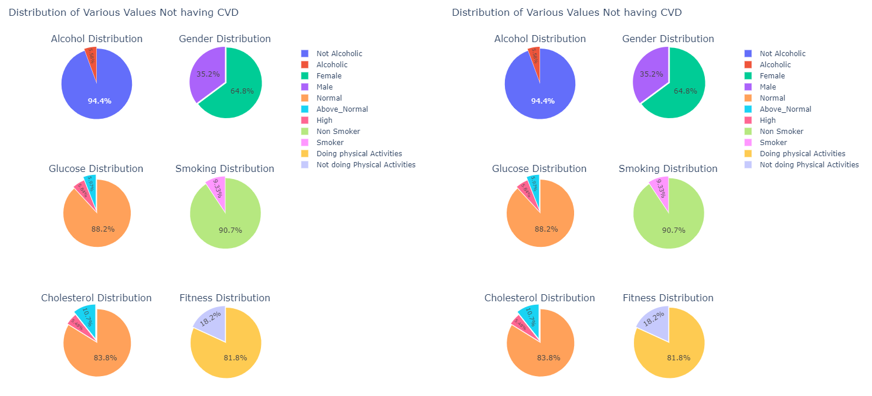
Distribution of Variables for Cardiovascular Disease
Notes:
An alternative representation in form of pie chart is shown here. Same inference can be made in this also.

Slide 19
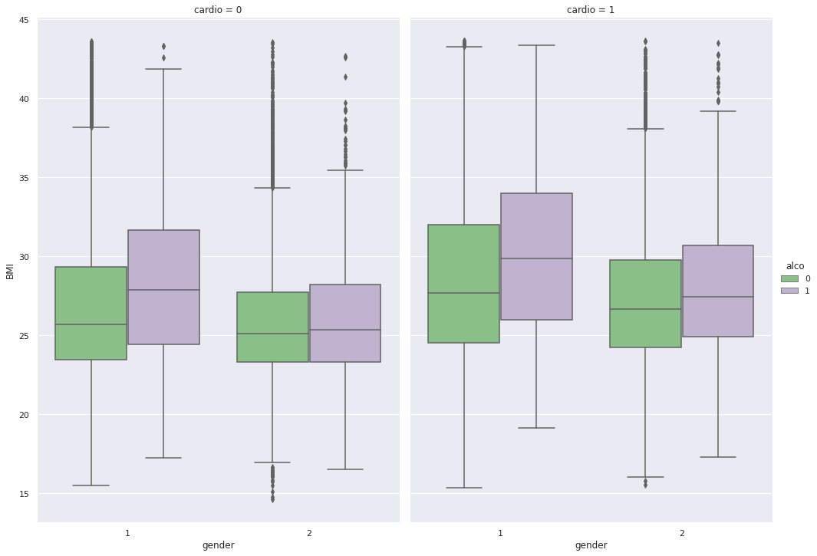
Distribution of Gender, Alcohol and BMI for cardiovascular disease
Notes:
Here we have a cat plot showing the distribution of Gender, Alcohol and BMI for cardiovascular disease. We can observe that women drinking alcohol have higher risk for CVD than men.

Slide 20
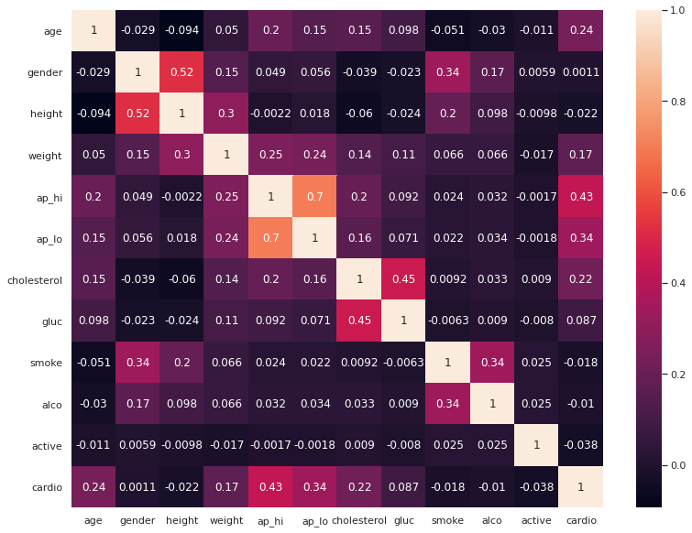
Pearson Correlation of the Features
Notes:
We also have a heatmap showing corelation b/w diff features. (height/weight) (alco/smoke), (highbp/CVD)

Slide 21
04
Methodology
Notes:
For the methodology

Slide 22
Methodology
ML Models
Evaluation
Results
Logistic Regression (LR), Support Vector Machine (SVM), k Nearest Neighbour (k-NN), Naive Bayes (NB), Decision Tree (DT), Random Forest (RF), Gradient Boosted Tree (GBT), Light Gradient Boosted Tree (LGBM), XGBoosting (XGB) and CatBoost (CB)
Models were evaluated on (70:30) split validation on various metrics such as Accuracy, Precision, Sensitivity, Specificity, F1 Score, AUC and MCC
CatBoost and Neural networks performed better compared to traditional classifiers
Notes:
we replicated the paper by Martins et al. In that, they implemented 10 algorithms, we did all that plus we tried some boosting algorithms such as XGB, CatBoost etc. Training was done after 70:30 split validation. The Models implemented were then evaluated across various metrics. In the paper, they tested with only 4 metrics (Acc, precision, sensitivity, specificity), we tested for 7 metrics. The results were then compared, and it was observed that Catboost and Neural net performed better compared to traditional classifiers. Results obtained were comparable to the results obtained by Martins et al.

Slide 23
Experiments
Experiment 1
Considered all features
Experiment 2
Remove features with less importance (gluc, active, alcohol, smoke, gender)
Notes:
All these experiments were done in 2 configurations. In exp 1, we considered all features. In exp 2, we removed features with less importance (gluc, active, alcohol, smoke, gender). And how did we know about which feature to remove?

Slide 24
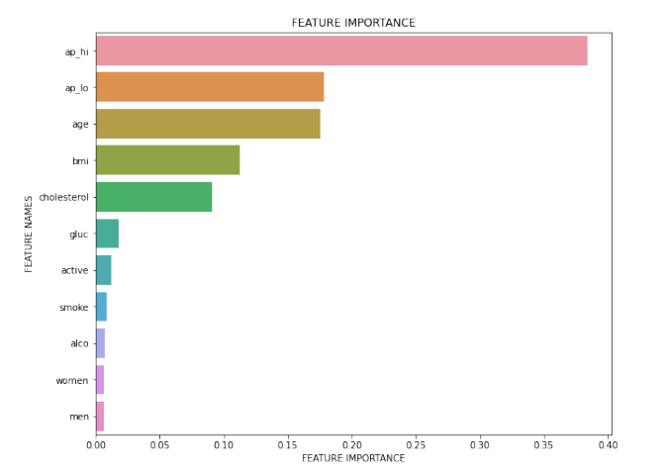
Feature Importance
Notes:
We calculated feature importance for all features across various classifiers from experiment 1. Here, we can see High BP, Low Bp, age are very important for CVD and features like gluc, active, gender, smoke, alco are less important.

Slide 25
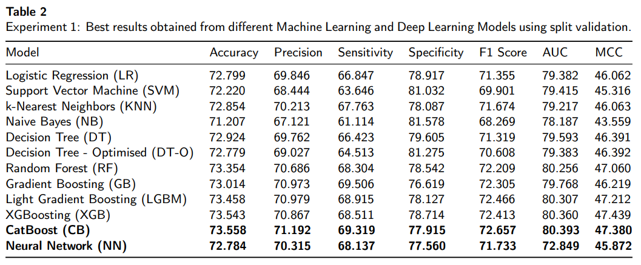
Results (Experiment 1)
Notes:
Here we can see the results, catboost and neural network gave respectable results. A point to be noted even though we have just implemented a simple neural network with 2 layers only, it gave good scores. Another point is that for medical purposes, Precision and sensitivity are more important than accuracy and specificity since the impact due to false positives is more than true negatives. Overall, F Score, along with MCC score are also good measure.
(Accuracy: How many people were correctly labeled out of all the people?
• Precision: How many of those labeled has having CVD had actually CVD?
• Specificity: Of all the people who are healthy, how many of those were correctly predicted?
• Sensitivity: Of all people who have CVD, how many of those were correctly predicted?)

Slide 26
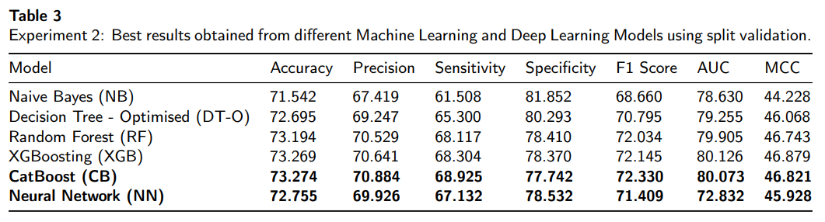
Results (Experiment 2)
Notes:
Similarly for exp 2, catboost gave the highest score across most metrics comparable to other boosting techniques. Also ,we observe from exp 1, for some classifier, score got better and for some it got more due to the fact of reduced number of features.

Slide 27
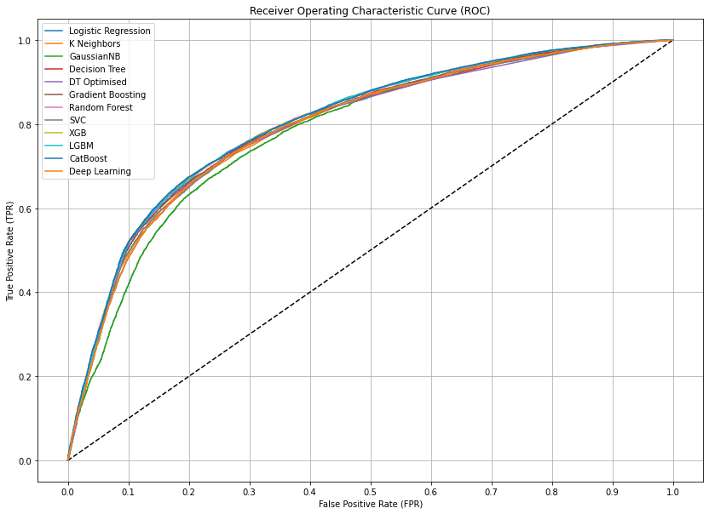
ROC Curve
Notes:
Here, we can see the ROC curve for all the classifiers.

Slide 28
05
Present Work Status
Notes:
Now present work status

Slide 29
Present Work Status
We have replicated the work done by Martins et al.
We have also tested Neural Network based implementation showing promising results.
Proposed Work:
Implement CNN-LSTM based model for improved results.
Trying with different activation functions.
Hyper-parameter tuning.
Experimenting with batch normalization layers.
Different regularization and dropout techniques.
Notes:
We have replicated the work done by Martins et al. We have also tested Neural Network based implementation showing promising results.
Now for the Proposed Work:
We are planning to implement a CNN-LSTM based model for improved results and trying with different activation functions along with Hyper-parameter tuning.
We will also be experimenting with batch normalization layers, different regularization and dropout techniques to get even better results, enough to publish it in a highly reputed journal.

Slide 30
06
Conclusion
Notes:
And in conclusion

Slide 31
Conclusion
It was observed that machine learning models were able to achieve around 70 percent score in balanced dataset. Overall, it can be noted that boosting algorithms and neural network will perform better. Some achieved decent score also hence, viable to use in prediction of Cardiovascular Disease.
Hence, a sound prediction system can be developed and automated for cardiovascular disease so that people can stay more healthy and safe.
Notes:
It was observed that almost all machine learning models were able to achieve around 70 percent score in balanced dataset. Overall, it can be noted that boosting algorithms and neural network will perform better. Some achieved decent score also hence, viable to use in prediction of Cardiovascular Disease.
Hence, a sound prediction system can be developed and automated for cardiovascular disease so that people can stay more healthy and safe.

Slide 32
THANK YOU!
Notes:
That’s all. Thank you.

