Slide 1
Project Presentation of CO-OP Project at Industry (Module-2) (22CS421)
On
Smart Contract-Driven Energy Trading Mechanism Using Blockchain
Richa
2210992150
Supervised By
Dr. Ajay Kumar
Associate Professor
Department of Computer Science and Engineering,
Chitkara University, Punjab

Slide 2
Introduction
Traditional energy systems operate on centralized grids where electricity flows from power plants to consumers.
Such systems suffer from major inefficiencies like high transmission losses and lack of transparency.
Operational costs increase due to involvement of intermediaries such as utilities and brokers.
With renewable energy adoption, users now act as prosumers (both producers and consumers).
This shift demands a decentralized and flexible energy trading mechanism.
2

Slide 3
Problem Statement
Current systems do not support direct peer-to-peer energy exchange.
Consumers have limited control over pricing and energy sourcing.
Centralized control creates a single point of failure and security risk.
Settlement processes are slow, often taking hours or days.
Lack of trust and transparency reduces system efficiency.
3

Slide 4
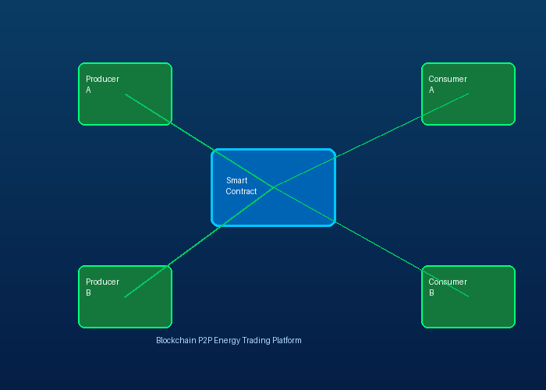
Proposed solution
A blockchain-based decentralized energy trading platform is proposed.
Uses Ethereum blockchain to ensure transparency and security.
Smart contracts automate energy transactions without intermediaries.
Each transaction is immutable and recorded on a distributed ledger.
Users can directly trade surplus energy in real time.
4

Slide 5
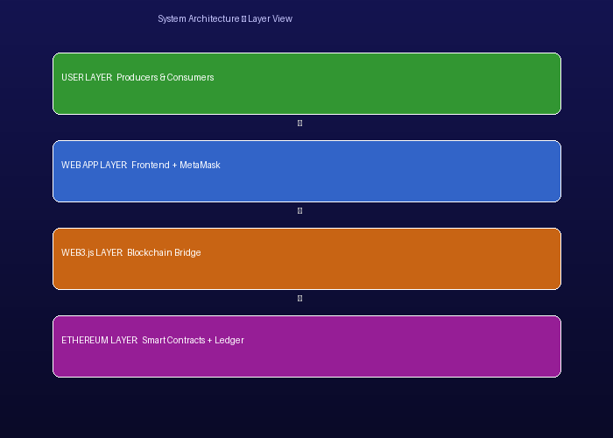
System architecture
The system consists of producers, consumers, smart contracts, and blockchain.
Producers list surplus energy with price and quantity.
Consumers browse listings and initiate purchase transactions.
Frontend interacts with blockchain using Web3.js.
Smart contracts validate and execute transactions automatically.
5

Slide 6
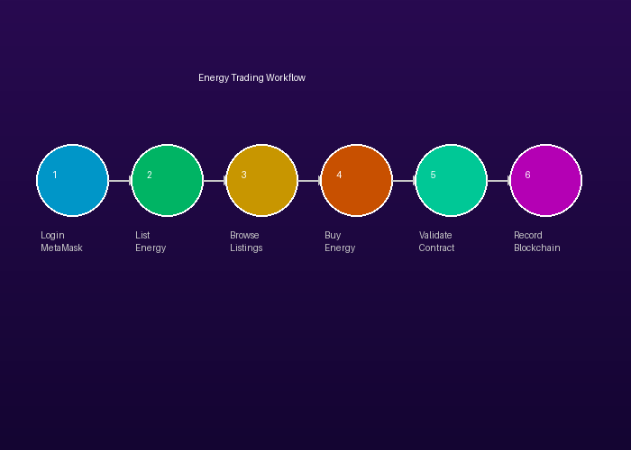
Workflow
User logs into the system using MetaMask wallet.
Producer uploads energy listing with required details.
Consumer selects desired energy listing.
Smart contract checks conditions like balance and availability.
Transaction is executed and ownership is transferred.
Transaction is permanently recorded on blockchain.
6

Slide 7
Fututre Scope
Integration with IoT devices for real-time energy tracking.
Use of Layer-2 solutions to improve scalability.
Incorporation of AI for demand prediction and pricing.
Cross-chain interoperability for broader adoption.
Alignment with government regulations and policies.
7

Slide 8
Conclusion
Blockchain enables a secure and decentralized energy trading ecosystem.
Smart contracts ensure automation and trust.
System improves efficiency, transparency, and cost-effectiveness.
Has strong potential for real-world implementation.
Future improvements can further enhance scalability and adoption.
8

Slide 9
Thank You
9

