Slide 1
PERFORMANCE ANALYSIS OF MACHINE LEARNING ALGORITHMS FOR MONITORING HUMAN ACTIVITY RECOGNITION
Submitted by:
Richa Goel
M.SC LJMU Cohort 3

Slide 2
Objective
Problem Statement:
The purpose of this study to predict Human activity by using six Machine Learning algorithms and compare the results to classify the behaviors of six algorithms, which will help to develop a tracking and monitoring system for older people.
Abstract:
Two Data set , one is smartphone based sensor data and another one is wearable sensor data set is used for this thesis project.
Six machine learning algorithm(Random Forest,Deep Neural Network , Logistics Regression, SVM, KNN, GBM) is used to classy Human activity.
Six Machine algorithm is compared based upon performance metrics like accuracy, precision, recall ,F-score, Specificity , ROC curve, Negative predicted value , Overall Misclassification Ratio, Positive likelihood ratio,

Slide 3
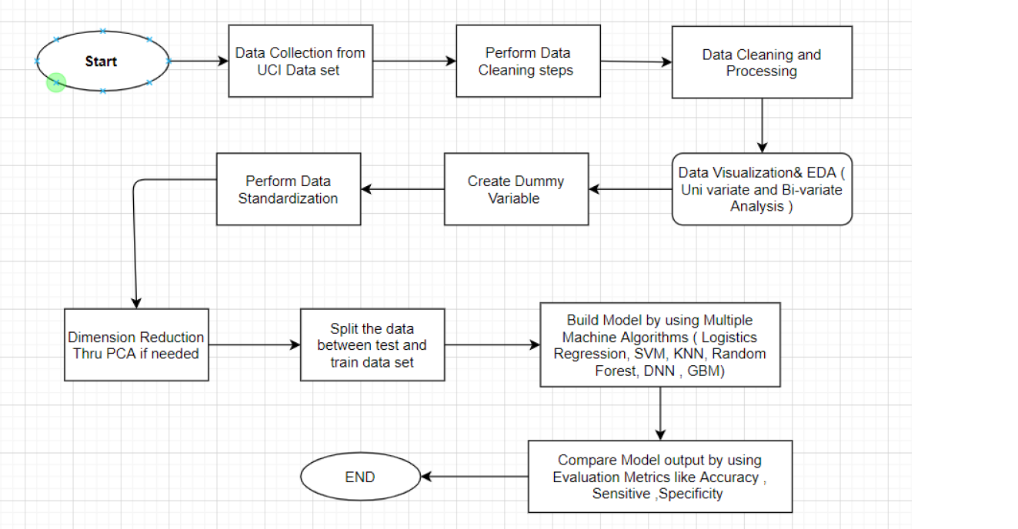
Problem Solving Methodology

Slide 4
Dataset Description
We used two datasets for this study . Both the datasets are taken from UCI dataset. One is wearable sensor dataset and other one is smartphone based sensor dataset.
1. Wearable Sensor based dataset
In wearable sensor based experiment, 14 older people who were above 65 asked to perform four common activity (Sit on bed , Sit on chair, Lying, ambulating).
Dataset is available in two folder (S1_dataset) and S2 Dataset.
Folder S1 has 60 files and folder S2 has 30 files.
2. Smart Phone based Sensor dataset.
For this dataset,30 people age range(19-49) performed common six activity.
Data is collected with the help of smartphone integrated sensors.

Slide 5
Data Descriptions
Wearable Sensor Dataset
It has total 75128 rows and 11 columns .
Two new columns Room and gender created based upon file name.
We checked for duplicate rows and missing values , there is no missing value and duplicate rows.
There are 8 numeric columns , 2 categorical columns(Room and Gender) and 1 output columns as Activity performed by user.
Output column has 4 activity label as 1: sit on bed, 2: sit on chair, 3: lying, 4: ambulating

Slide 6
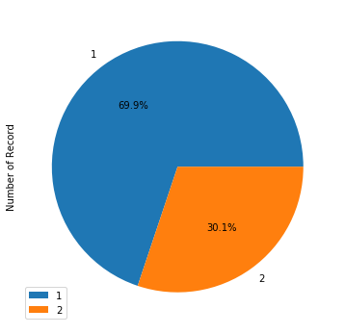
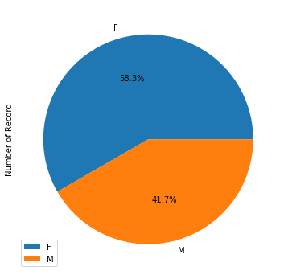
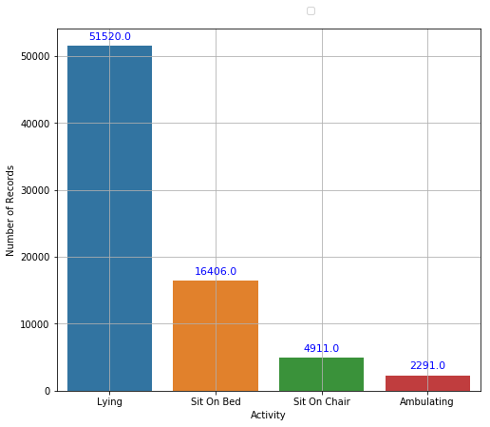
Dataset Description
Wearable Sensor based dataset
.
There are 68.6% data for Activity Lying.
There are 21.8% data for activity Sit on Bed.
There are 6.5% data for activity Sit on chair.
There are 3.0% data for activity Ambulating
There are 58.3% data for female and 41.7% data for male participants.
There are 70% data for Room 1
and 30% data for room2.

Slide 7
Data Descriptions
Smartphone based sensor data
It has total 10299 rows and 563 columns.
Output column has 6 activity label as Running , Walking, Sitting , Lying, Walking Upstairs , Walking downstairs.
Data is available in two folder (test and train)
There are 561 float type columns that consist sensor data,1 column for subject id and 1 output column.
We checked for missing value and duplicate , there is no data quality issue.

Slide 8
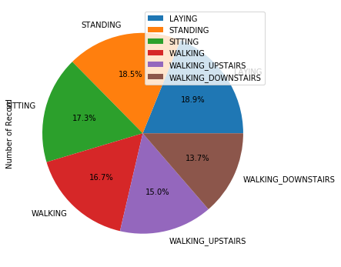
Data Quality Checks
Smart phone based sensor dataset.
Activity | No of Record | Percentage of Record
Laying | 1944 | 18.9
Standing | 1906 | 18.5
Sitting | 1777 | 17.3
Walking | 1722 | 16.7
Walking Upstairs | 1544 | 15
Walking Downstairs | 1406 | 13.7
Total | 10299 | 100%

Slide 9
Exploratory Data Analysis (EDA)

Slide 10
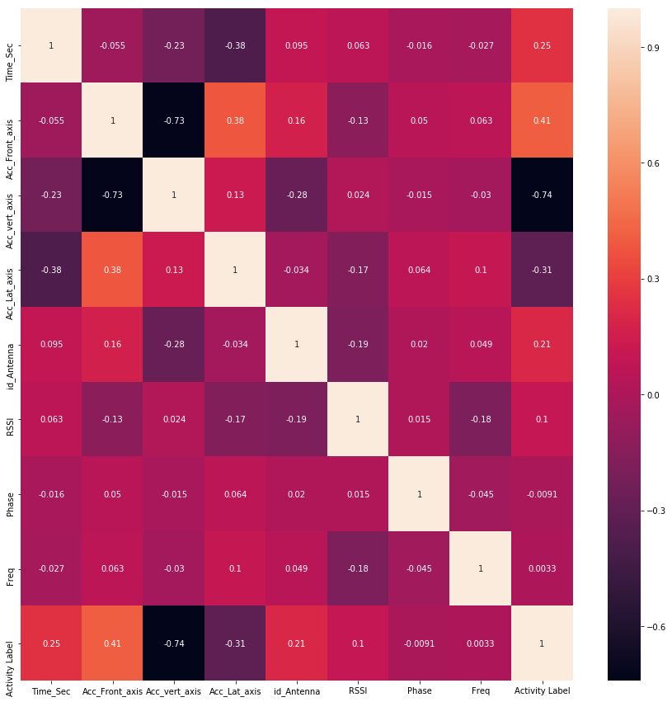
Correlation between all the columns(Wearable Sensor Data)
Insight: As per the above correlation graph, the Activity label is highly correlated with acceleration in the vertical axis, and frequency and phase have the lowest correlation.

Slide 11
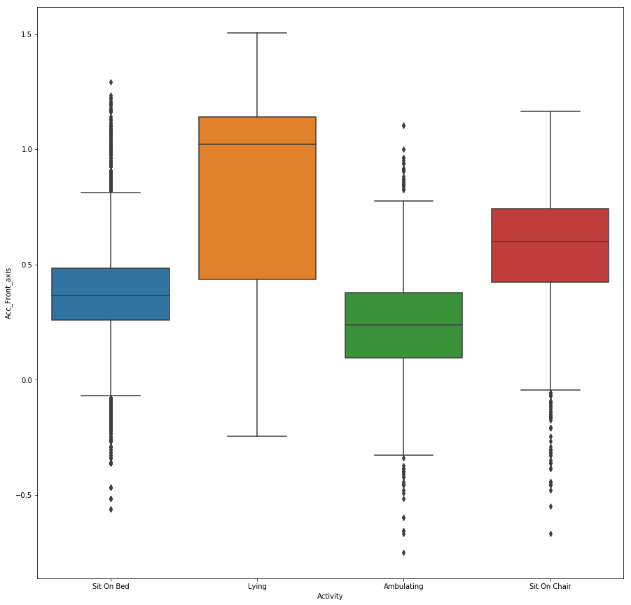
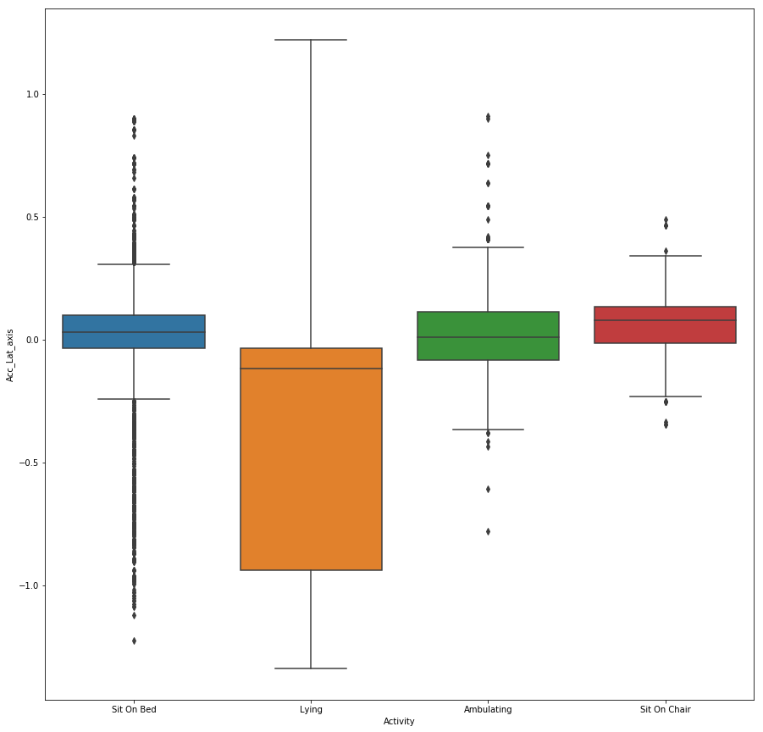
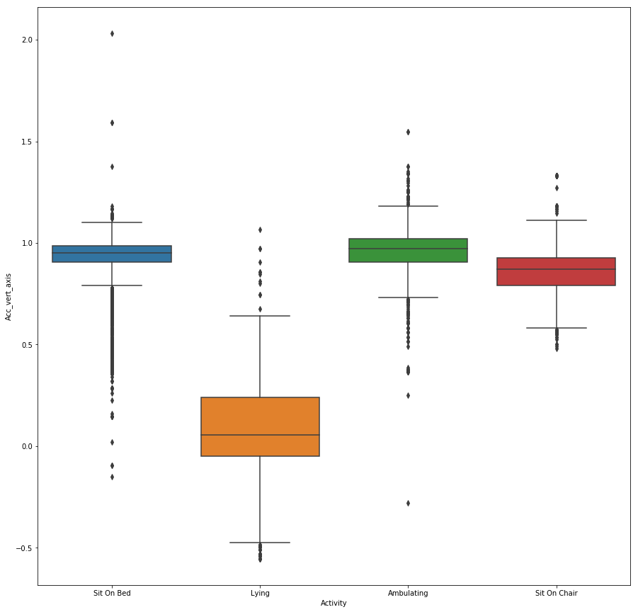
Mean Distribution of Acceleration in Vertical, Lateral and Front axis(Wearable Sensor Data)
Insight:-
Acceleration in the Lateral axis is negative for activity Lying but positive for other activity.
Acceleration in the vertical axis is the lowest for activity lying if Acc_vert_axis is more than 0.5 only for Sitting and Ambulating.
Acceleration in the frontal axis is highest for activity lying.
ACC_frontal_axis
ACC_Vert_axis
ACC_Lat_axis

Slide 12
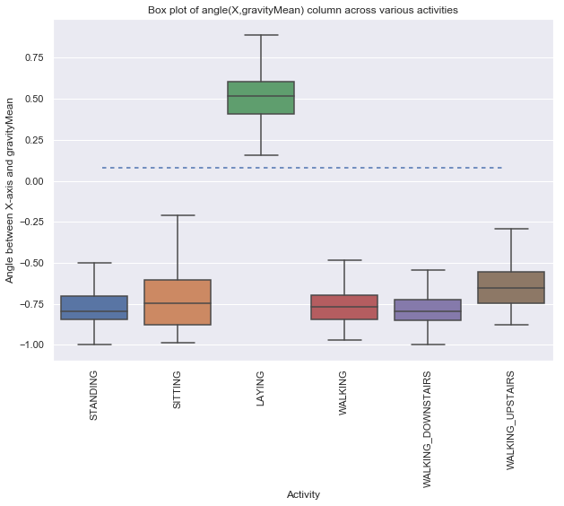
Feature Distribution(Smartphone Sensor based Dataset)
Insight:-
The angle between X-axis and gravity mean is
higher than 0 only in case of Activity Laying.
Activity Laying can be easily predicted only
Based upon angular between X axis and gravity
mean in this data set.
.

Slide 13
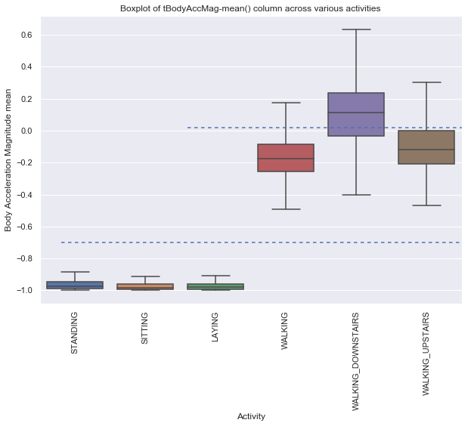
Feature Distribution(Smartphone Sensor based dataset)
Insight
Acc Mean is highest for Activity Walking downstairs and almost the same as walking up staircase and down staircase.
For a static activity like Standing, Sitting and lying acceleration magnitude mean is negative and less than -0.8
.

Slide 14
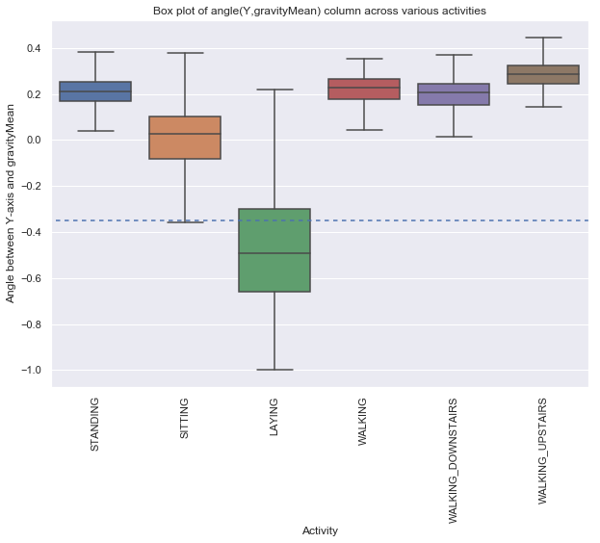
Feature Distribution(Smartphone Sensor based dataset)
Insight
Angle between Y axis and gravity means
is lowest for Activity Laying and high for
dynamic acidity like walking, walking_downstairs,
and upstairs.
.

Slide 15
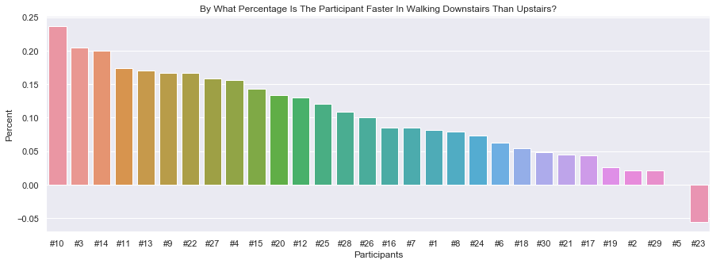
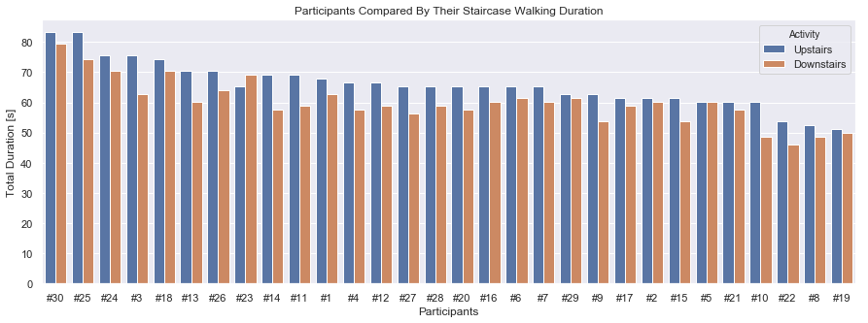
Duration for walking upstairs and down stairs (Smartphone Sensor based dataset)
Insight
Almost all the participants took less time in walking
Down stairs than walking upstairs
.

Slide 16
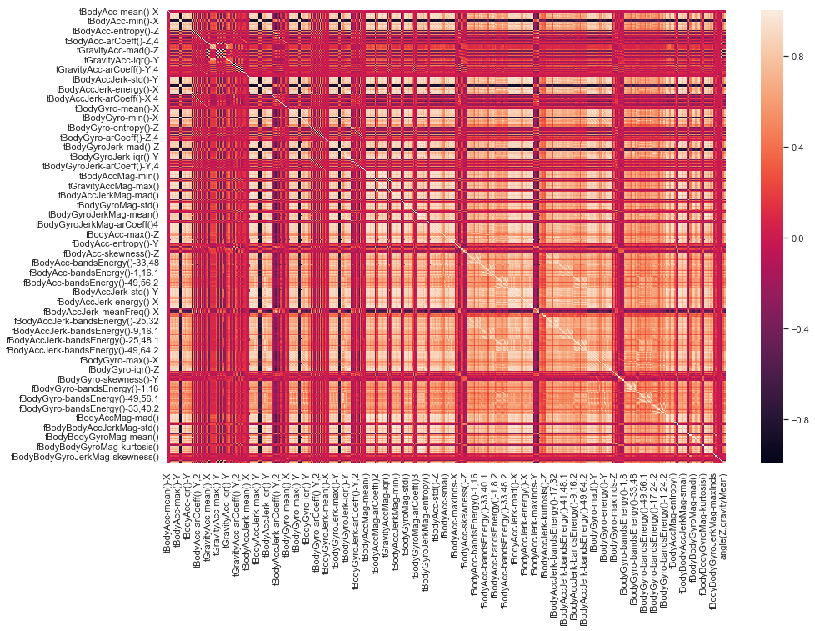
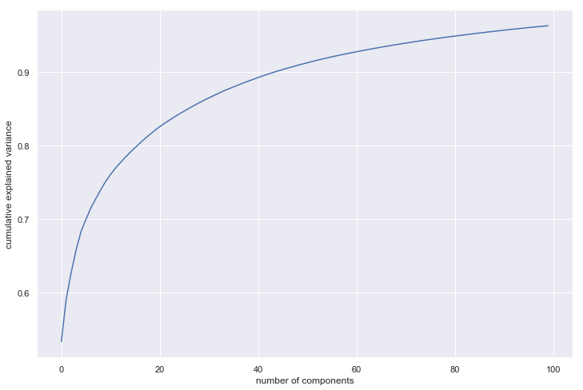
PCA(Smartphone sensor dataset)
Insight:
As per Correlation graph, smartphone based senors dataset has multicollinearity.
To remove multicollinearity and reduce no of features, we used PCA approach for this dataset.
Cumulative variance and found that PCA Components 102 is able to show more than 95% variance of data.

Slide 17
Optimization of Hyper Parameter
.
Grid searchCv is used to find optimized parameter for all models.
Below are the optimized parameter for all the models.
Algorithm | Best Parameter
Logistics Regression | C=1000, and Penalty=L1
KNN Classifier | n_neighbors =1
SVM Classifier | C=1000
GBM Classification | max_depth =15
Random Forest Classification | n_estimators=20 and Learning rate =0.15
DNN Classification | 2 hidden layer and epochs =20
Algorithm | Best Parameter
Logistics Regression | C1 and Penalty L1
KNN Classifier | n_neighbors =8
SVM Classifier | C=1000
GBM Classification | max_depth =100
Random Forest Classification | n_estimators=20 and Learning rate =0.15
DNN Classification | 2 hidden layer and epochs =20
Wearable sensor based dataset
.
Smartphone sensor based dataset

Slide 18
Comparison between all Algorithm results (Wearable Sensor based Dataset)
Model Name | Sit On Bed | Sit on Chair | Lying | Ambulating
DNN Classifier | 0.9556 | 0.9664 | 0.9983 | 0.9343
GBM Classification | 0.7997 | 0.8755 | 0.9861 | 0.9063
KNN Classifier | 0.9757 | 0.9678 | 0.9961 | 0.9036
Logistics Regression | 0.7771 | 0.7138 | 0.9929 | 0.9472
Random Forest | 0.9776 | 0.9740 | 0.9985 | 0.9643
SVM Classifier | 0.9665 | 0.9640 | 0.9978 | 0.9011
Algorithm | Accuracy
DNN Classifier | 0.9850
GBM Classification | 0.9324
KNN Classifier | 0.9872
Logistics Regression | 0.9260
Random Forest | 0.9913
SVM Classifier | 0.9862
Precision Metrics
Accuracy
Model Name | Sit On Bed | Sit on Chair | Lying | Ambulating
DNN Classifier | 0.9920 | 0.9857 | 0.9989 | 0.6291
GBM Classification | 0.9537 | 0.4565 | 0.9999 | 0.2482
KNN Classifier | 0.9784 | 0.9864 | 0.9992 | 0.7889
Logistics Regression | 0.9499 | 0.3167 | 0.9994 | 0.3581
Random Forest | 0.9934 | 0.9893 | 0.9992 | 0.8088
SVM Classifier | 0.9840 | 0.9922 | 0.9986 | 0.7147
Algorithm | Elapsed Time
DNN Classifier | 45.8
GBM Classification | 1.27
KNN Classifier | 0.10
Logistics Regression | 1.21
Random Forest | 0.50
SVM Classifier | 66.09
Recall
Elapsed time

Slide 19
Comparison between all Algorithm Results (Wearable Sensor based Dataset)
Accuracy is 99% for Random Forest , 98.72% for KNN , 98.50% for DNN and 98.62% for SVM and 93.24%% for GBM and 92.60%Logistics Regression.
Recall is the ability to identify all the activity correctly. Accuracy is 98.62% for SVM model but it is not able to identify all the activity correctly .
If we consider recall parameter for all the activity then KNN and Random forest are top 2 model. Recall parameter for Activity “Ambulating “ for Random forest was 80.88%% and for KNN it is 78.89%.
Based upon elapsed time, KNN classifier is fastest and SVM took maximum time.
Based upon all the performance matrix , KNN and Random forest were top 2 mode for Human activity recognition for wearable sensor based dataset.

Slide 20
Comparison between all Algorithm results (Smartphone Sensor based Dataset)
Model-Name | Laying | Sitting | Standing | Walking | Walking Downstairs | Walking Upstairs
DNN Classifier | 1 | 0.91 | 0.91 | 0.97 | 0.93 | 0.93
GBM Classification | 0.9 | 0.74 | 0.64 | 0.71 | 0.76 | 0.79
KNN Classifier | 0.99 | 0.86 | 0.84 | 0.83 | 0.93 | 0.9
Logistics Regression | 1 | 0.89 | 0.91 | 0.96 | 0.91 | 0.95
Random Forest Classification | 0.96 | 0.74 | 0.79 | 0.78 | 0.75 | 0.85
SVM_Classification | 0.91 | 0.48 | 0.68 | 0.61 | 0.61 | 0.59
Algorithm | Accuracy
DNN Classifier | 0.94
GBM Classification | 0.76
KNN Classifier | 0.89
Logistics Regression | 0.94
Random Forest | 0.81
SVM Classifier | 0.63
Accuracy
Precision Metrics
Model-Name | Laying | Sitting | Standing | Walking | Walking Downstairs | Walking Upstairs
DNN Classifier | 0.99 | 0.9 | 0.92 | 0.96 | 0.94 | 0.94
GBM Classification | 0.96 | 0.6 | 0.78 | 0.73 | 0.66 | 0.78
KNN Classifier | 0.95 | 0.81 | 0.91 | 0.95 | 0.79 | 0.88
Logistics Regression | 1 | 0.9 | 0.9 | 0.95 | 0.95 | 0.92
Random Forest Classification | 0.94 | 0.74 | 0.81 | 0.86 | 0.72 | 0.78
SVM_Classification | 0.83 | 0.7 | 0.45 | 0.65 | 0.47 | 0.67
Algorithm | Elapsed Time
DNN Classifier | 10.97
GBM Classification | 0.54
KNN Classifier | 0.07
Logistics Regression | 2.00
Random Forest | 1.24
SVM Classifier | 6.56
Elapsed time
Recall Metrics

Slide 21
Comparison between all Algorithm Results (Smartphone Sensor based Dataset)
Accuracy is 94% for Logistics Regression and DNN,89% for KNN, 81% for Random Forest,76% for GBM and 63% for SVM.
Recall is the ability to identify all the activity correctly. Recall parameter for activity Lying is more than 0.9 for all the model but only Logistics Regression and KNN is able to identify all the activity with recall parameter of 0.9%
If we consider recall parameter for all the activity then DNN and Logistics regression are top 2 model.
Based upon elapsed time, KNN classifier is fastest and FNN took maximum time.
Based upon all the performance matrix , DNN and Logistics Regression were top 2 mode for Human activity recognition for wearable sensor based dataset.

Slide 22
CONCLUSION & FUTURE WORK
For wearable sensor based dataset , Random forest & KNN are the top 2 model with the accuracy of 99% and 98.72%
For Smartbased sensor dataset, DNN and KNN are the top 2 model with accuracy of 94%.
The output of this study can be used in Smart home application , Human monitoring application , Fall detection system for elders.
As a future scope of this project, similar to individual human activity group activity can also be predicted.
As a part of this project we just identified basis human activity . In future we can work to predict more activity like Jogging , Running , Exercise , Sleeping , Skipping , Jumping.

Slide 23
References
Posted by Sheetal Sharma on August 8, 2017 at 7:00pm, Blog, V., n.d. Artificial Neural Network (ANN) in Machine Learning [WWW Document]. URL https://www.datasciencecentral.com/profiles/blogs/artificial-neural-network-ann-in-machine-learning (accessed 5.5.20).
A complete guide to the random forest algorithm [WWW Document], n.d. . Built In. URL https://builtin.com/data-science/random-forest-algorithm (accessed 2.23.20).
Ali, H.M., Muslim, A.M., 2016a. Human Activity Recognition Using Smartphone and Smartwatch. ijcert 3, 568. https://doi.org/10.22362/ijcert/2016/v3/i10/48906
Balli, S., Sağbaş, E.A., Peker, M., 2019. Human activity recognition from smart watch sensor data using a hybrid of principal component analysis and random forest algorithm. Measurement and Control 52, 37–45. https://doi.org/10.1177/0020294018813692

