Slide 1
Final Project Presentations
Names:

Slide 2
Problem Statement
Our project focuses on understanding humour using a carefully chosen set of 100 jokes that different people have rated. Our main goal is to create a smart computer program that can predict how people would rate a joke. This task involves figuring out the patterns in how different people like different types of humour. People's ratings range from -10 to 10, reflecting the diverse ways they feel about the jokes.
In our presentation, we'll explain the step-by-step process we used, including getting the data ready, picking the right features, and training our model. This project not only adds to what we know about how computers understand humour but also has the potential to be useful in other areas like understanding how people feel about different things in written language.

Slide 3
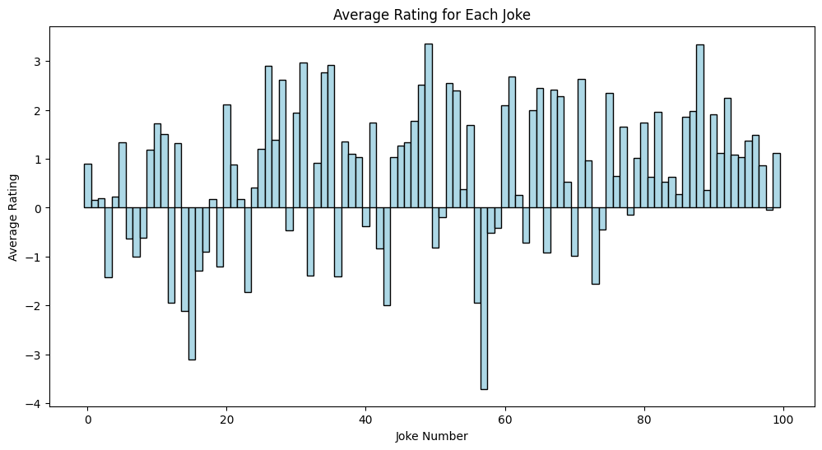
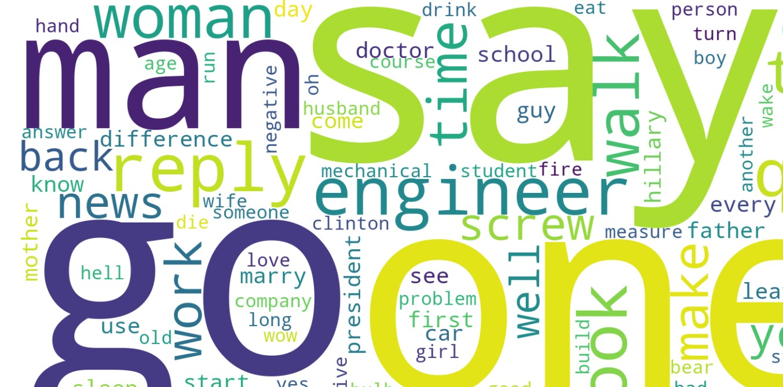
EDA/Dataset
Given dataset consists of 100 jokes rated by 73,421 different users.
The rating scale ranges from -10 (not funny) to +10 (very funny).

Slide 4
Preprocessing
Each joke undergoes sequential preprocessing through the following pipeline to generate a processed version. The steps we used are Lowercasing, Abbreviation, Forward Slash Removal, Contractions replacement, Special Character removal, Stop word removal and lemmatization.
The final processed string is then sent for vectorization. Vectorization transforms the textual data into numerical vectors, making it suitable for machine learning algorithms to analyze the text. For featurization, a combination of n-grams and tf-idf vectorization is employed.

Slide 5
Methodology
When we treat it as a Classification problem:
Model Set: The classification analysis involved the utilization of various models, including SVM with a linear kernel, Random Forest, K- Nearest Neighbours, Naive Bayes, Logistic Regression and Decision Tree.
Hyperparameter Tuning: The models underwent hyperparameter tuning to optimize their configurations. Notably, SVM, with a change in specific parameter settings (the kernel) demonstrated a 20 percent jump in accuracy.
Performance Metrics: The evaluation of models employed key classification metrics, such as Accuracy and F1-Score.

Slide 6
Methodology
When we treat it as a Regression problem:
Model Set: The regression analysis involved the utilization of various models, including SVM, K-Nearest Neighbours and Linear Regression.
Hyperparameter Tuning: The models underwent hyperparameter tuning to optimize their configurations. Notably, K-Nearest Neighbours showed a better accuracy after the value of k was changed.
Performance Metrics: The evaluation of models employed key regression metrics, such as R2 score.

Slide 7
Results for Classification
Model | Accuracy | F1-Score
Linear SVM | 0.8822222222222222 | 0.8747245520826133
Random Forest | 0.8177777777777778 | 0.810920284183958
K-Nearest Neighbours | 0.7822222222222223 | 0.7854385700714054
Naive Bayes | 0.4955555555555556 | 0.49418816715753916
Logistic Regression | 0.6644444444444444 | 0.6545321517625144
Decision Tree | 0.4888888888888889 | 0.4869467751416128

Slide 8
Results for Regression
Model | R2 | MSE
SVM | 0.7169882598292873 | 0.6054428364645724
Linear Regression | 0.8167202284017401 | 0.3920877088565129
K-Nearest Neighbours | 0.8085019173791494 | 0.4096690202659405

Slide 9
Comparison with Existing Analysis
In the Eigentaste Paper, they treat it as a regression problem. The algorithm they used was Nearest Neighbour Algorithm with Nearest Neighbour = 1.
Their NMAE was 0.237.

Slide 10
Conclusion
For Regression, both KNN Regressor and Linear Regression models performed well, with Linear Regression having slightly higher R-squared value and lower MSE.
Among the classification models, Support Vector Classifier outperformed other models in terms of both accuracy and F1 score making it the best model for the rating prediction task.

