Slide 1
SERVICE MANAGEMENT COMPONENT
WS23/24

Slide 2
Agenda
01
Introduction
Overview of the Provider Management Platform
Key features of the Service Management Component
02
Agile Methodology
Kanban Framework
SCRUM as Agile
Sprints
03
Results
UI
APIs
04
Conclusion

Slide 3
Introduction

Slide 4
The Service Management Component in the Provider Management Platform efficiently handles IT service requests. Users can initiate, track, and manage requests, including creating them, evaluating provider offers, and assessing service quality. It also promotes collaboration with providers and gathers user feedback on service delivery.
Over view of Service Management Component

Slide 5
Key features
Service Request Creation
Users can initiate service requests, including multi-requests and team requests, specifying details such as expertise level and required roles.
Request Status Tracking
User can monitor the status of the service requests they initiated, providing transparency and accountability in the workflow
Offer Evaluation
The component allows users to evaluate offers received from providers in response to service requests, enabling informed decision-making.
Collaboration with Customers
collaborate effectively with customers to gather requirements and incorporate feedback during the service delivery process.
Provider Evaluation
Users can assess and evaluate providers based on their performance and the quality of services delivered.

Slide 6
Agile Methodology

Slide 7
Timeline
Sprint 1
Sprint 2
Sprint 3
Sprint 4
Sprint 5,6
1 week
1 week
1 week
2 weeks
3 weeks
The project requirements were outlined and distributed
User interface development
Information gathering from other groups
Adding user features and integrating with other groups APIs
Finalizing end-to-end functionality

Slide 8
Results

Slide 9
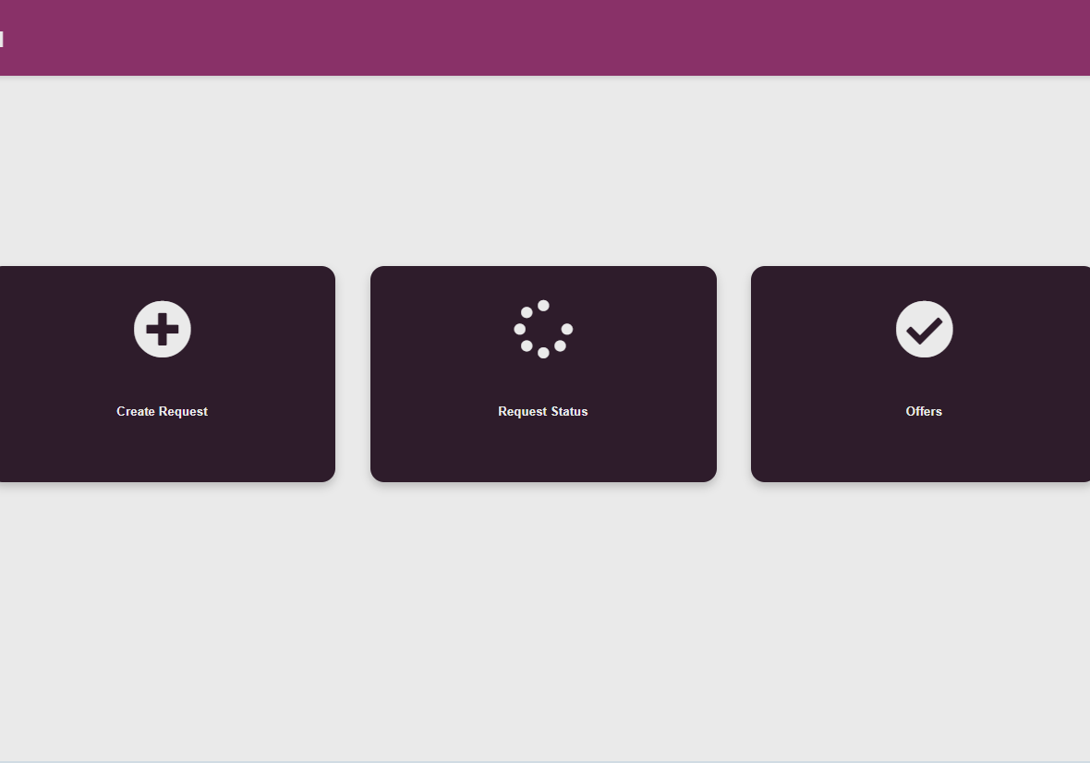
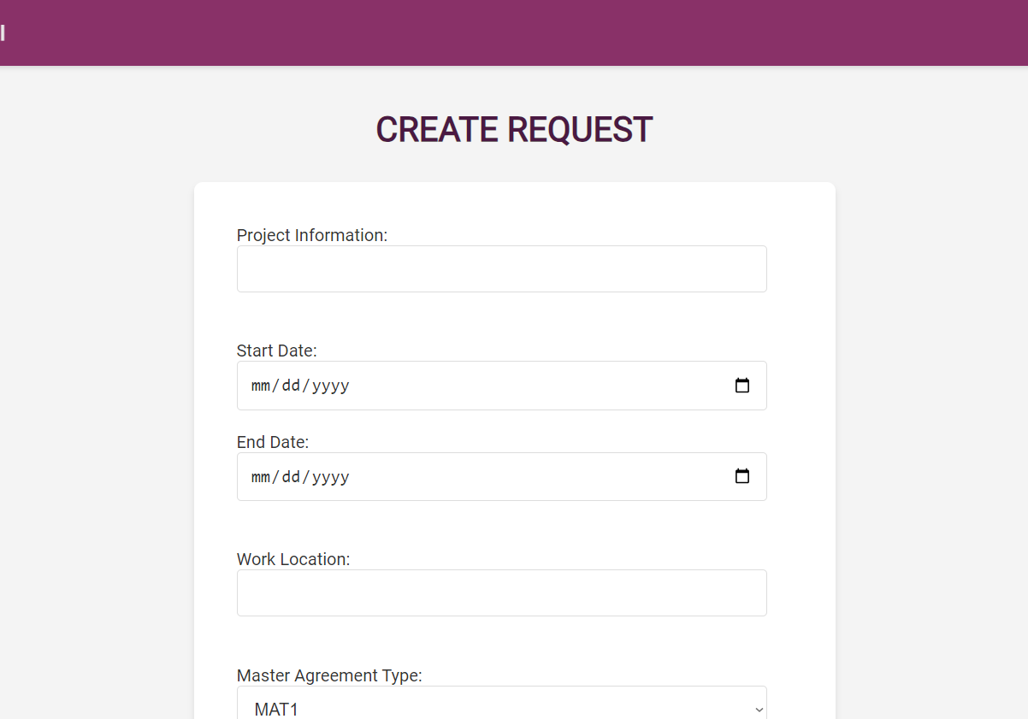
Service management UI
Home page
Create request page
Providing user with three main functions
User can enter the information and create a new request

Slide 10
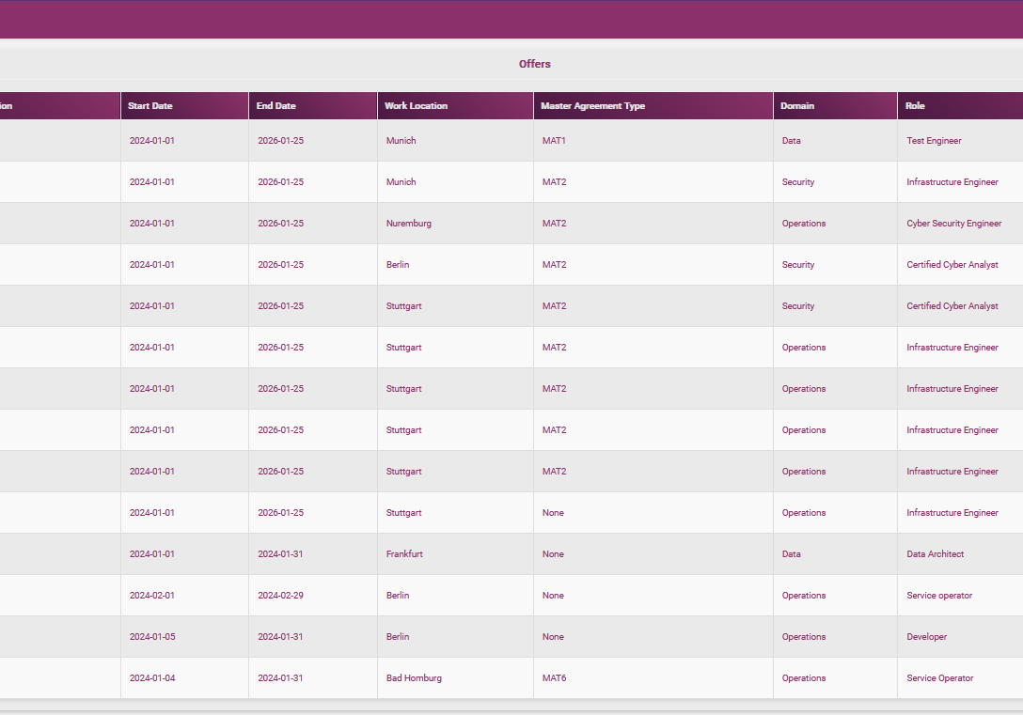
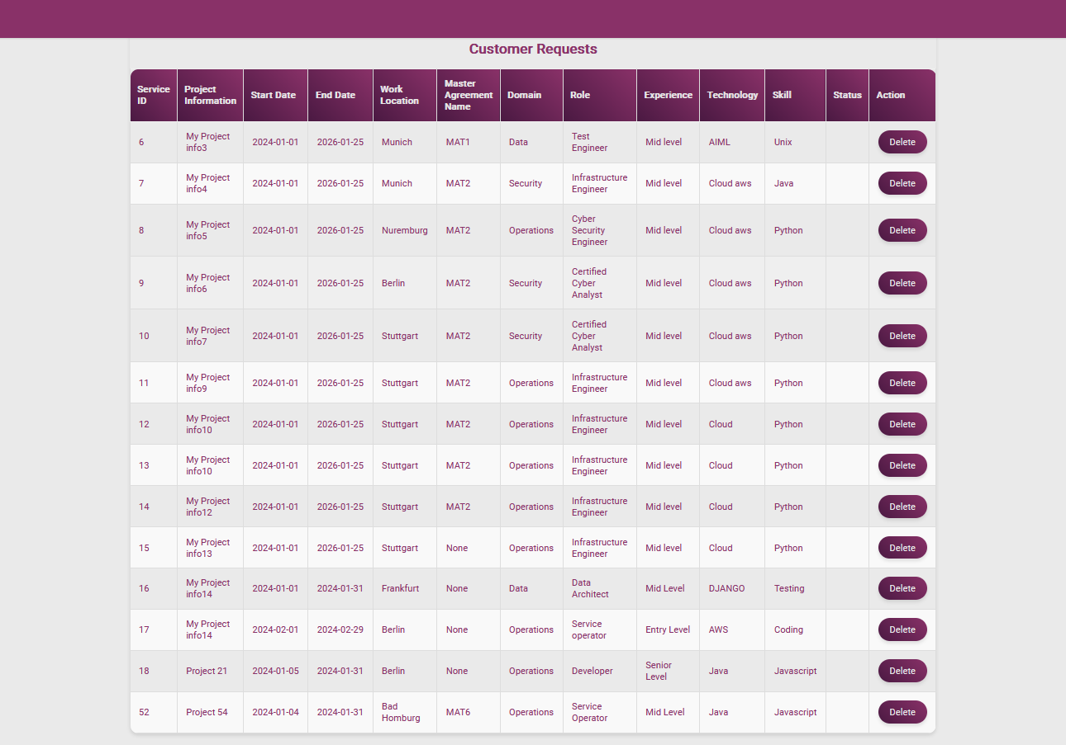
Service management UI
Offers
Request status
User can see the offers
User can see the status of the requests

Slide 11
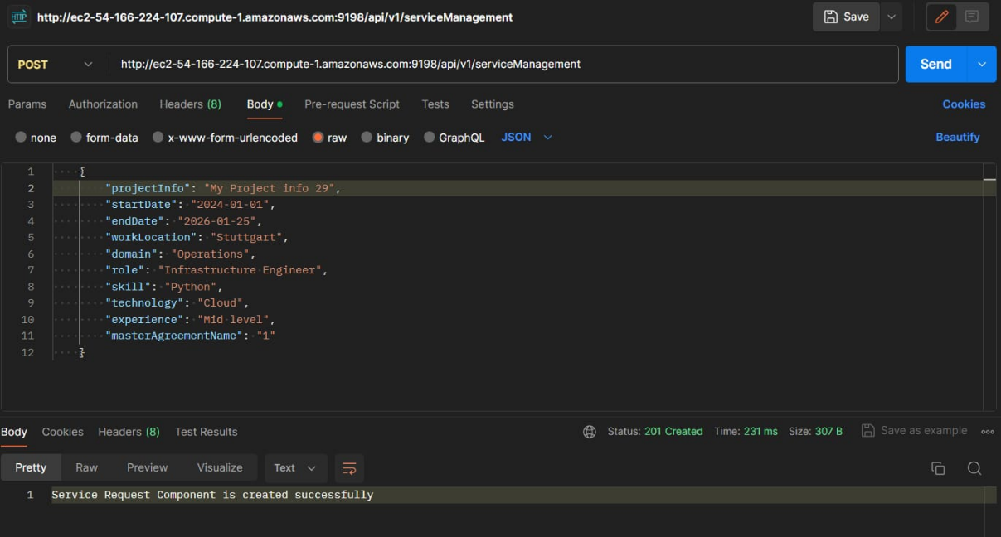
API
POST
….

Slide 12
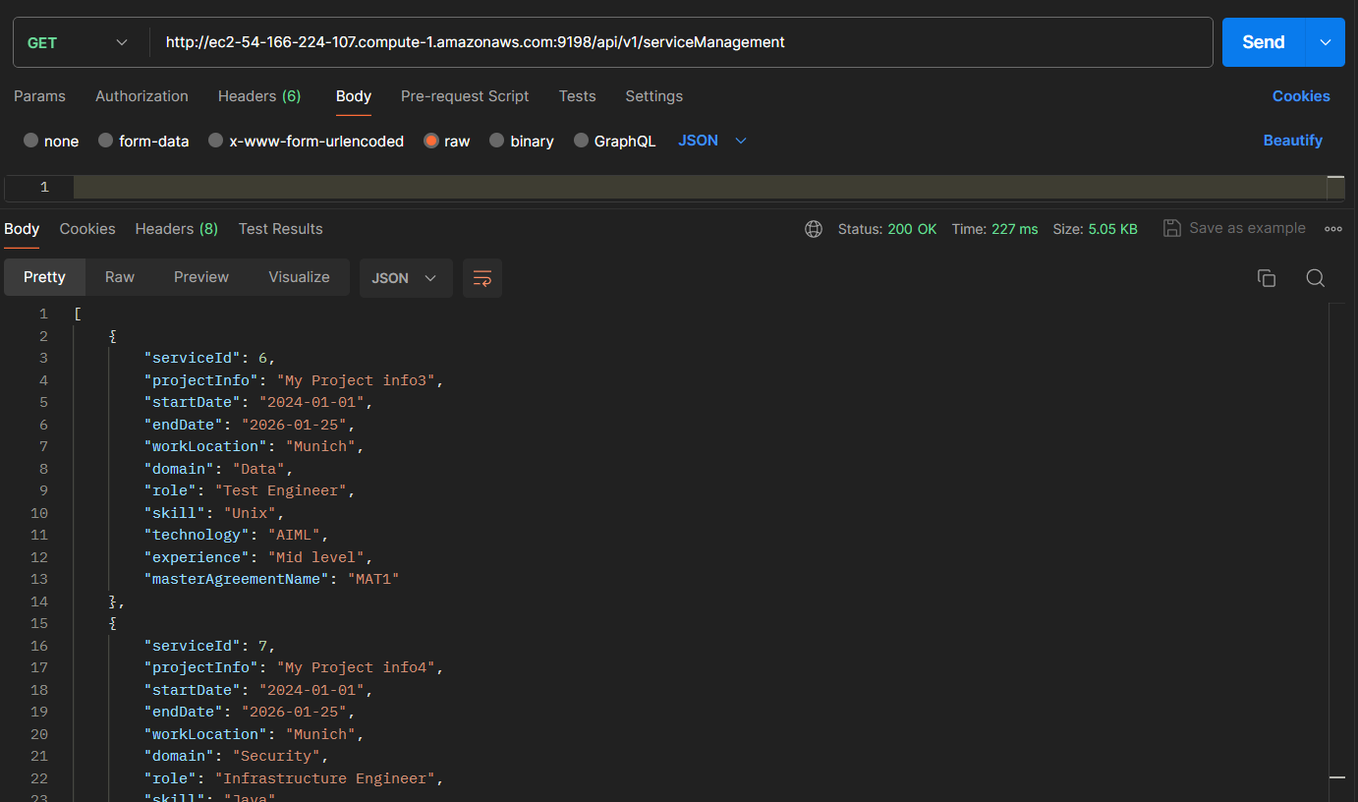
API
GET
….

Slide 13
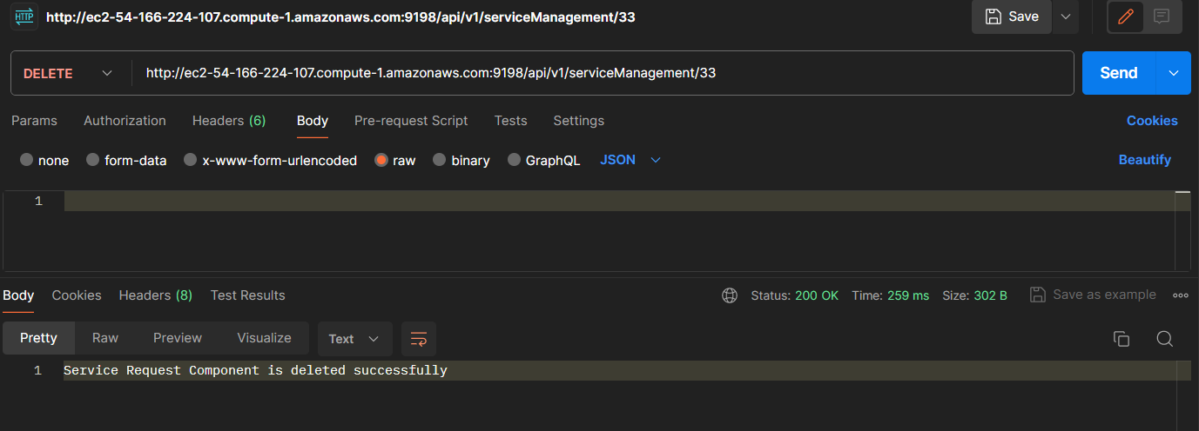
API
DELETE
….

Slide 14
Conclusion

Slide 15
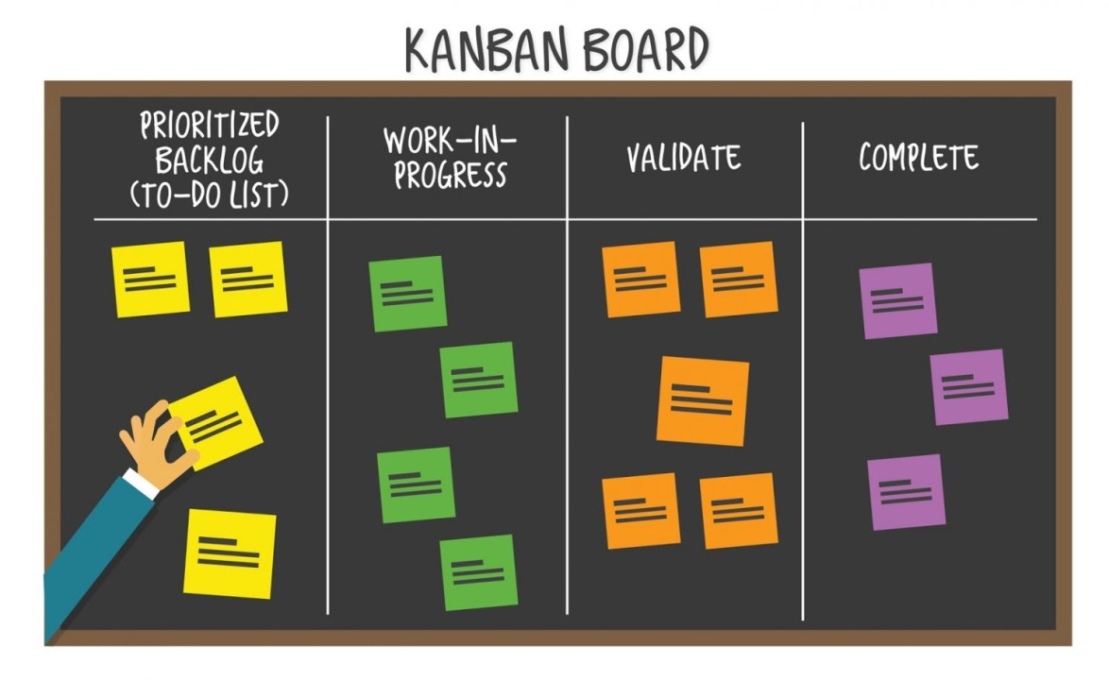
Conclusion
The adoption of Agile methodology and the integration of a Kanban board proved instrumental in managing user stories, sprint timelines, and project progress.
The structured use of the Kanban board for user story assignment enhanced our understanding of tasks, ensuring a cohesive approach to project development. This methodology not only streamlined our workflow but also allowed for effective communication, reducing dependencies on traditional scrum or stand-up meetings.

Slide 16
THANK YOU
For your attention

