Slide 1
SERVICE MANAGEMENT COMPONENT
WS23/24

Slide 2
Agenda
01
Introduction
Overview of Service Management Component
Key Components
02
Agile Methodology
Kanban Framework
SCRUM as Agile
Sprints
03
Results
UI
APIs
04
Conclusion

Slide 3
Introduction

Slide 4
The Service Management Component in the Provider Management Platform efficiently handles IT service requests. Users can initiate, track, and manage requests, including creating them, evaluating provider offers, and assessing service quality. It also promotes collaboration with providers and gathers user feedback on service delivery.
Overview of Service Management Component

Slide 5
Key features
User Authentication and Access
Users can securely login using the authentication component, ensuring a personalized and secure experience.
Service Request Management
Users can create service requests specifying detailed requirements such as expertise level and role.
Request Tracking and Management
Users can follow the status of initiated service requests, providing transparency and real-time updates on the progress of their requests.
Cancellation and Provider Access
Users can cancel service requests, triggering corresponding actions on the access platform for service providers
Offer Evaluation and Profile Selection
Users can evaluate offers received, provide reasons for rejecting offers that do not match requirements, and select profiles from matching offers.

Slide 6
Agile Methodology

Slide 7
Timeline
Sprint 1
Sprint 2
Sprint 3
Sprint 4
Sprint 5,6
1 week
1 week
1 week
2 weeks
3 weeks
The project requirements were outlined and distributed
User interface development
Request tracking and monitoring
Adding offer page integration and adding feedback mechanism. Worked with different groups to fetch API.
Finalizing end-to-end functionality. Also signup and login functionality added

Slide 8
Results

Slide 9
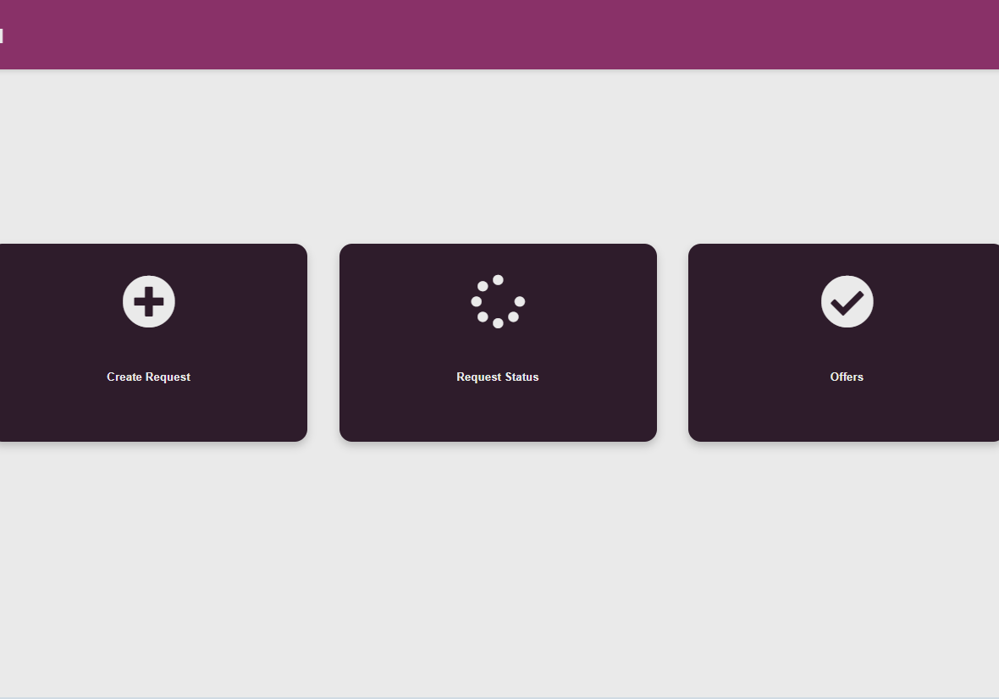
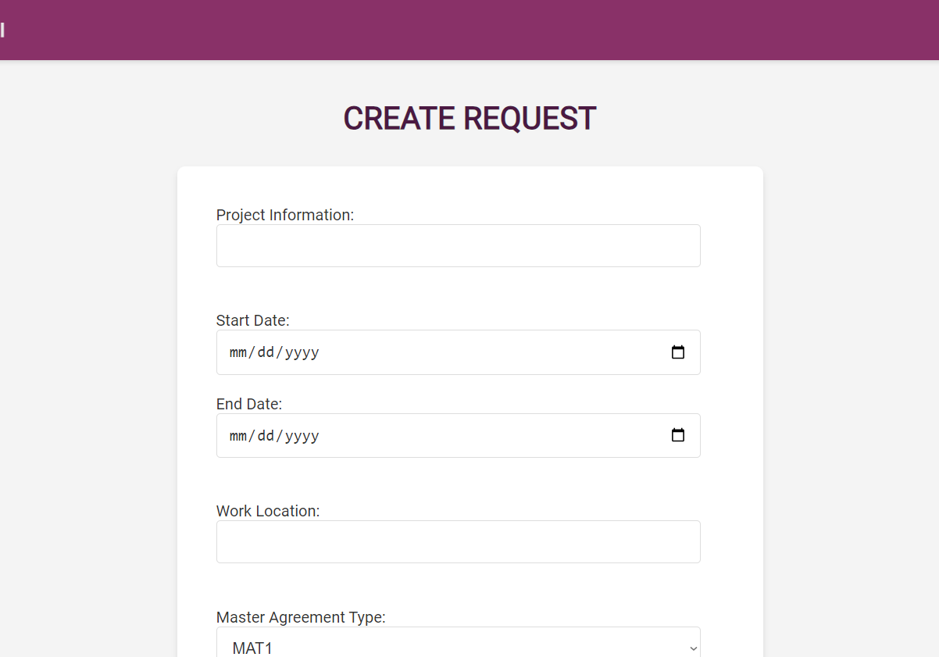
Service management UI
Dashboard
Create request page
Providing users with three main functions – creating requests, monitoring, and showcasing the offers
Users can enter the information and create a new request based on master agreement, domains, roles, experience.

Slide 10
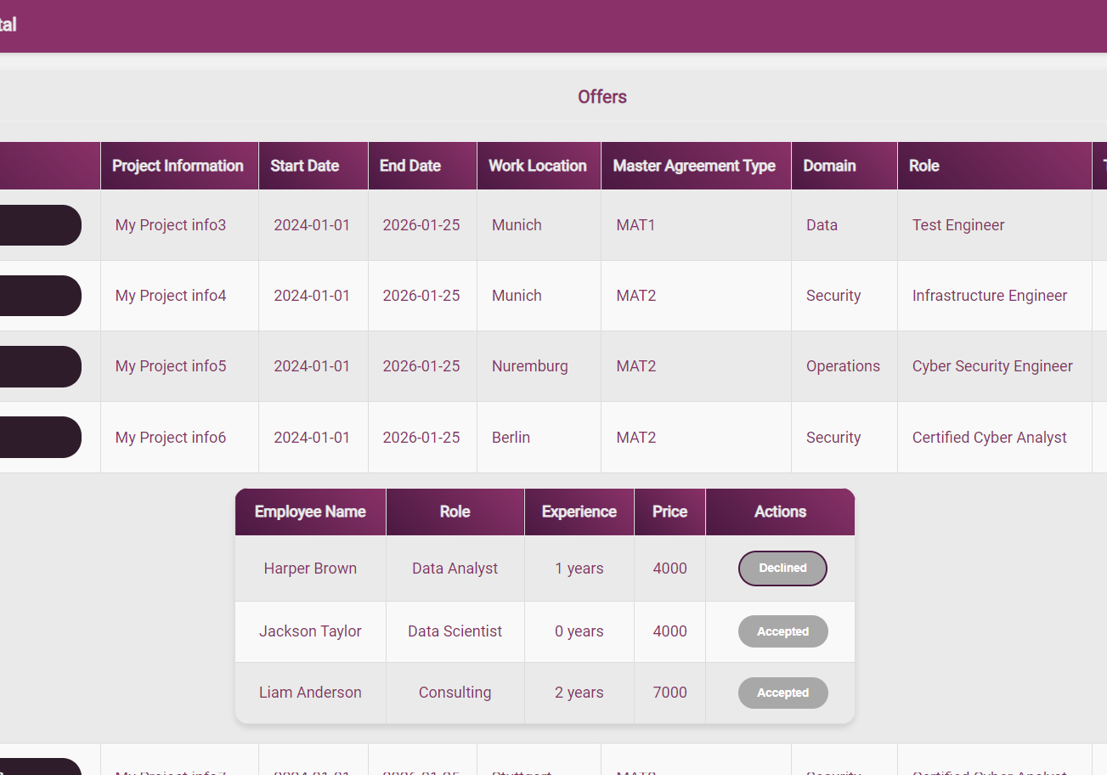
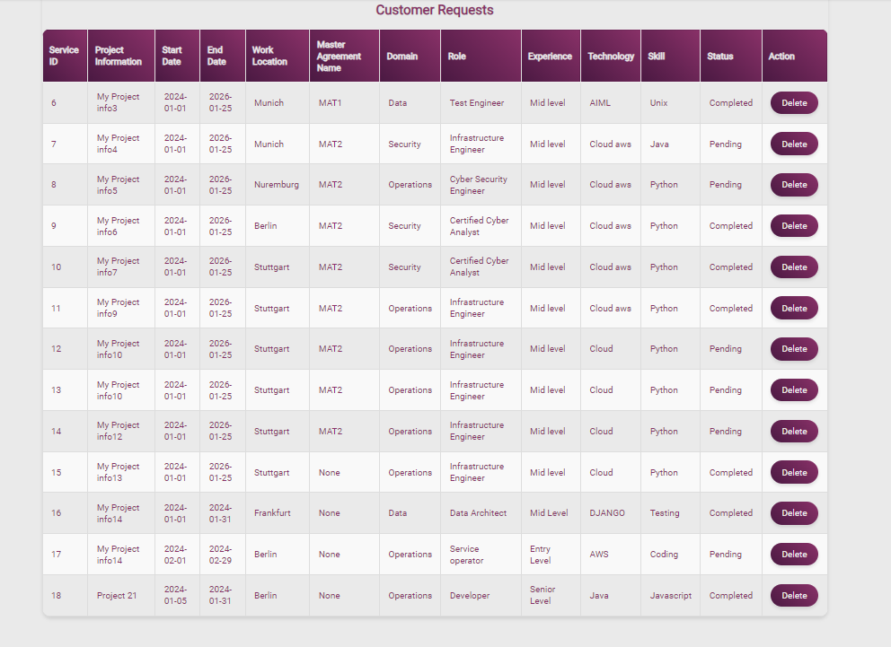
Service management UI
Offers
Request status
Users can see the offers with the accept/decline button. If we decline, then we can provide the reason for it.
Users can see the status of the requests (pending/completed). Also, requests can be deleted(only for the serviceIds whose offers are not available)

Slide 11
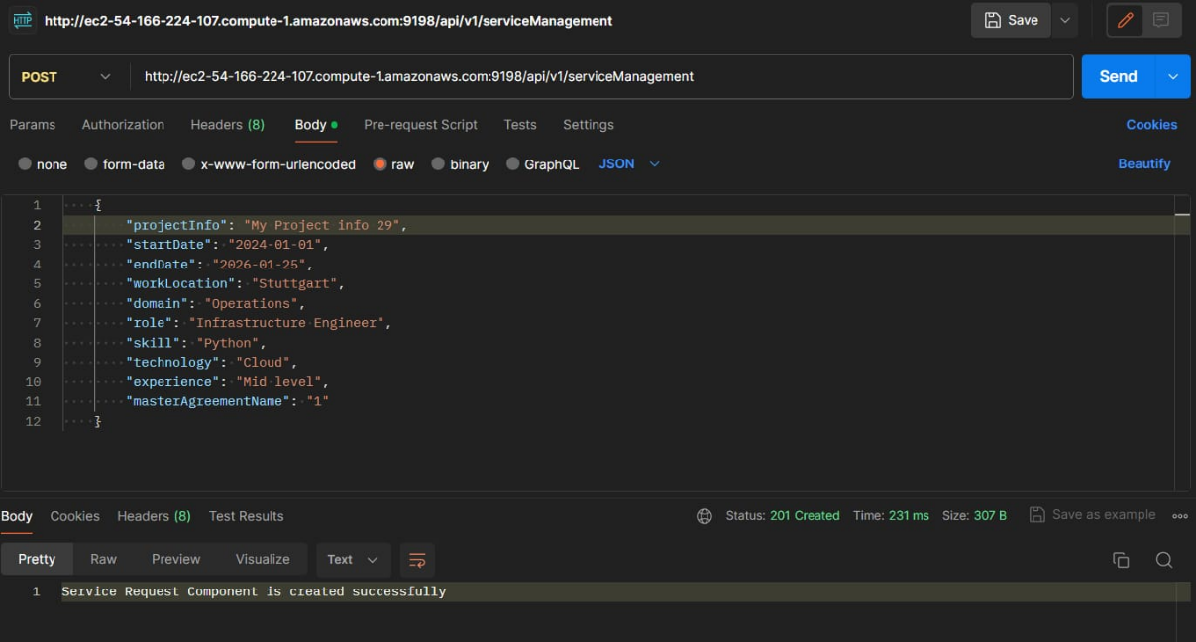
API
POST
….

Slide 12
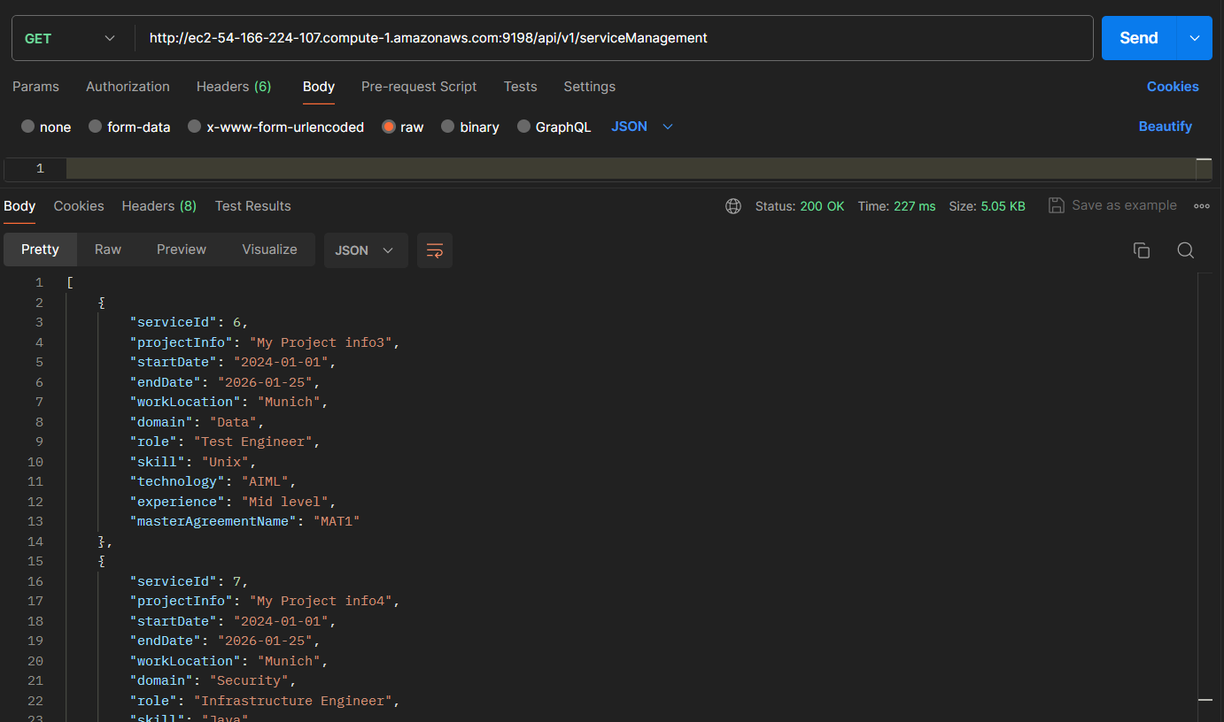
API
GET
….

Slide 13
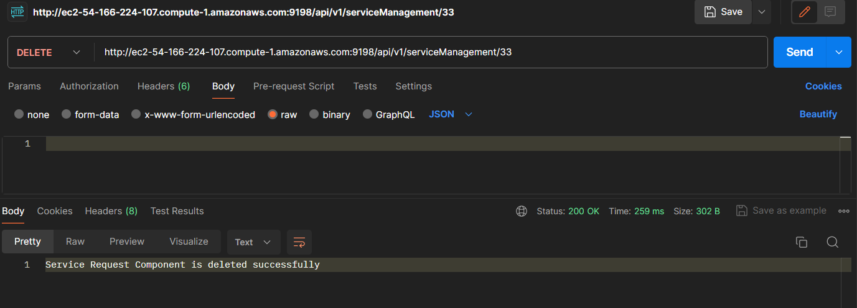
API
DELETE
….

Slide 14
Conclusion

Slide 15
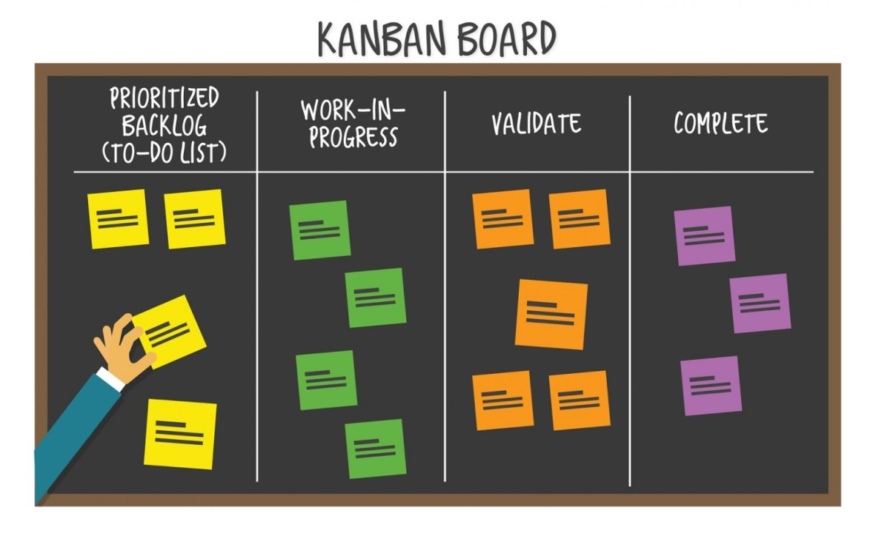
Conclusion
Project Objectives: The Service Management Component has been instrumental in contributing to the successful realization of our project goals.
Agile Methodology: Our agile approach has fostered collaboration, adaptability, and a focus on customer value, aligning seamlessly with the dynamic nature of our project.
Kanban Integration: The incorporation of a Kanban board has proven invaluable in managing user stories, sprint timelines, and overall project progress with clarity and efficiency.

Slide 16
THANK YOU

