Slide 1

Perth crime analysys
Richard allen
Conor mccabe

Slide 2
Approach:
- Neil Armstrong

Slide 3
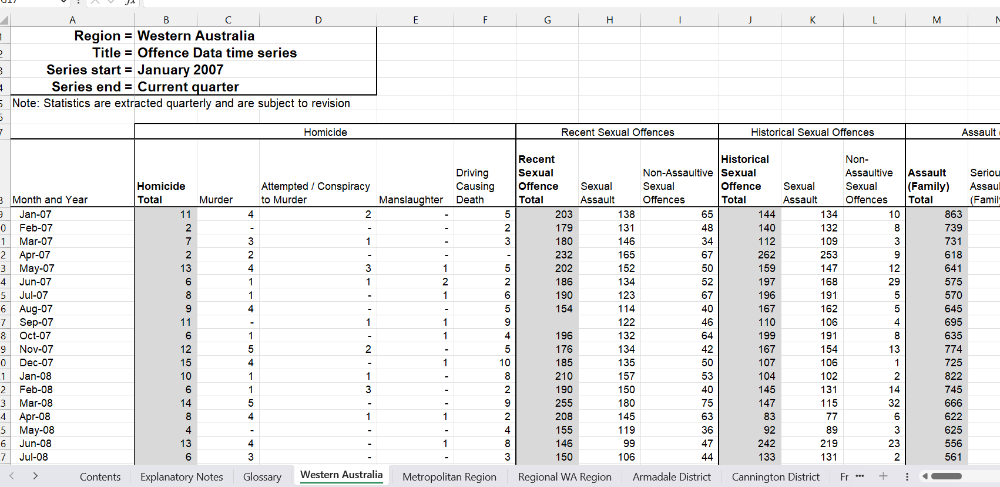
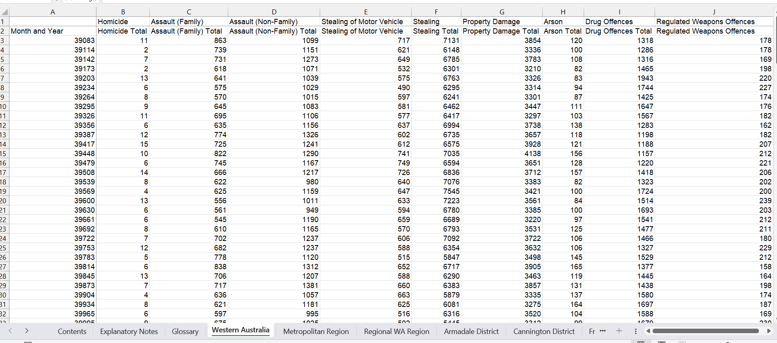
Raw data

Slide 4
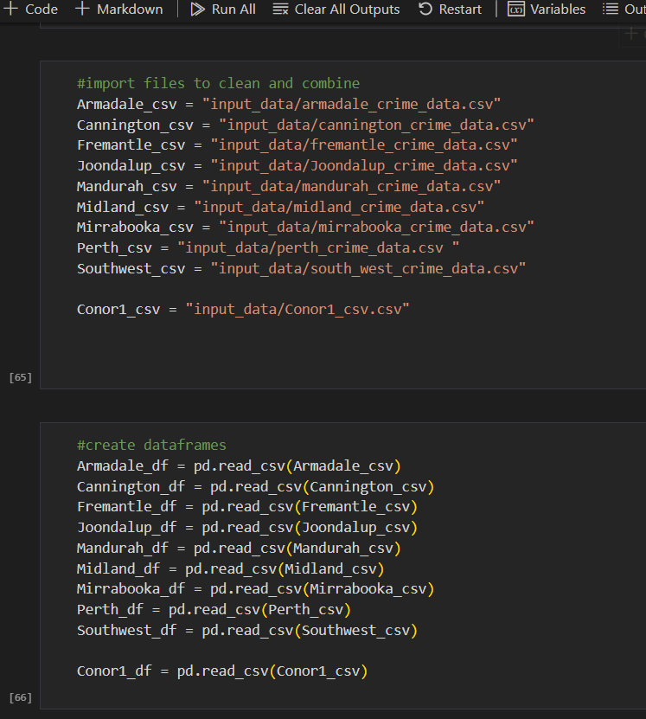
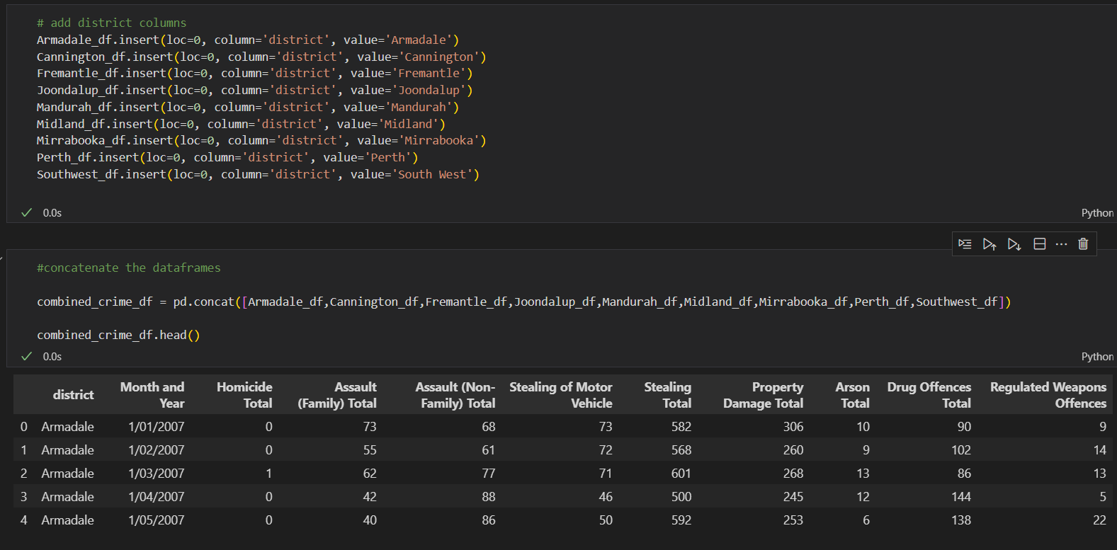
Cleaning and organising

Slide 5
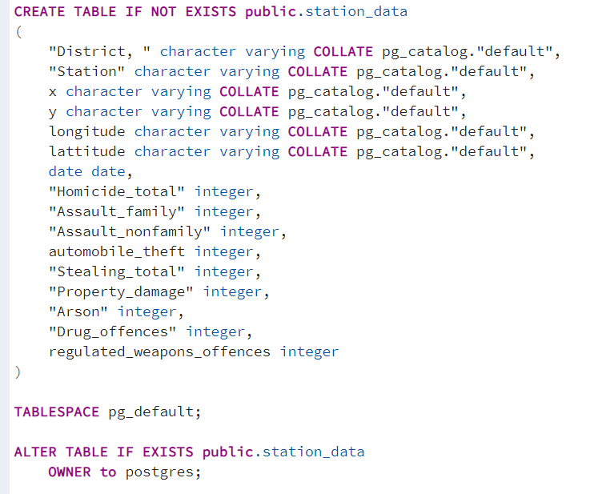
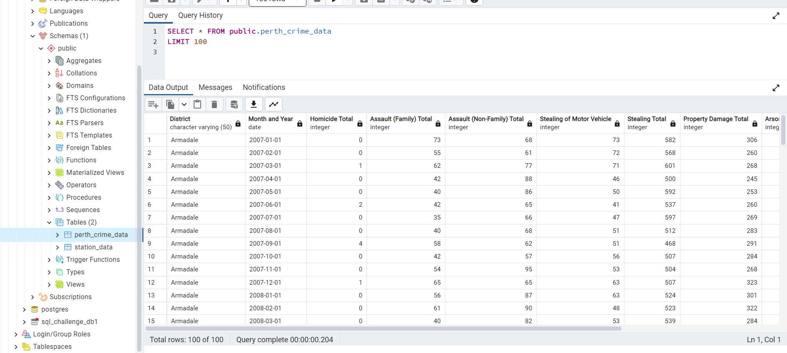
Created tables in a SQL database

Slide 6
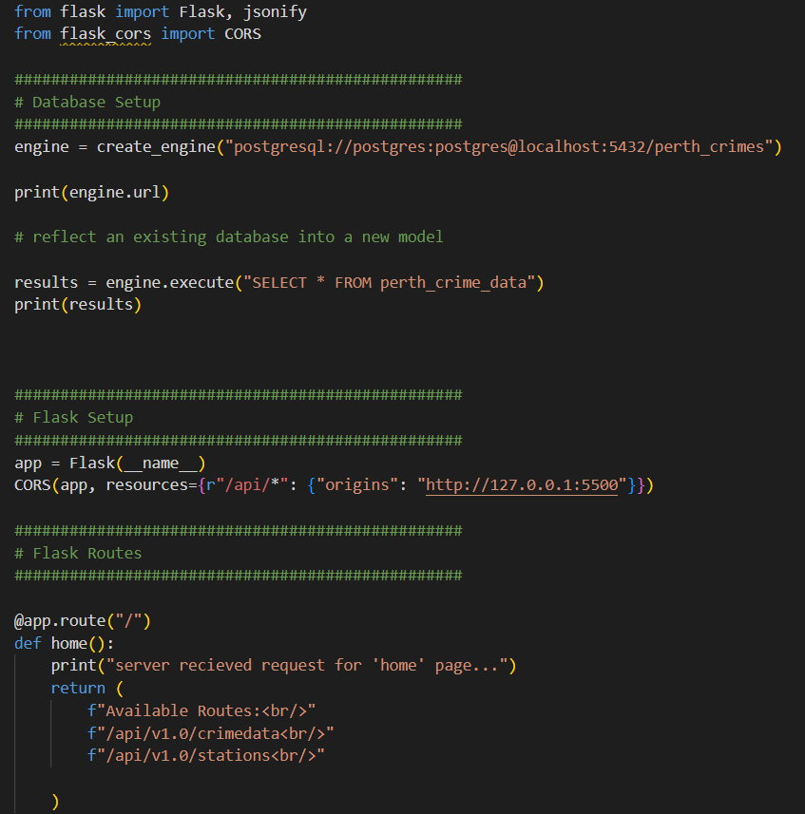
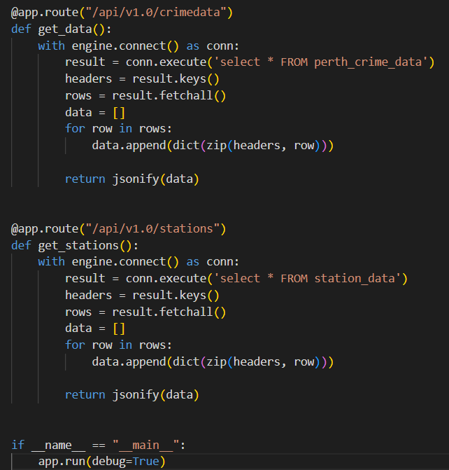
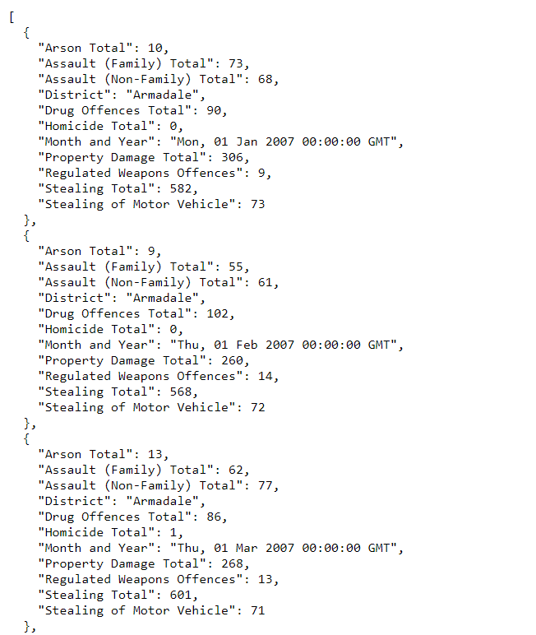
Creating flask api from
the sql databse
Very Very annoying

Slide 7
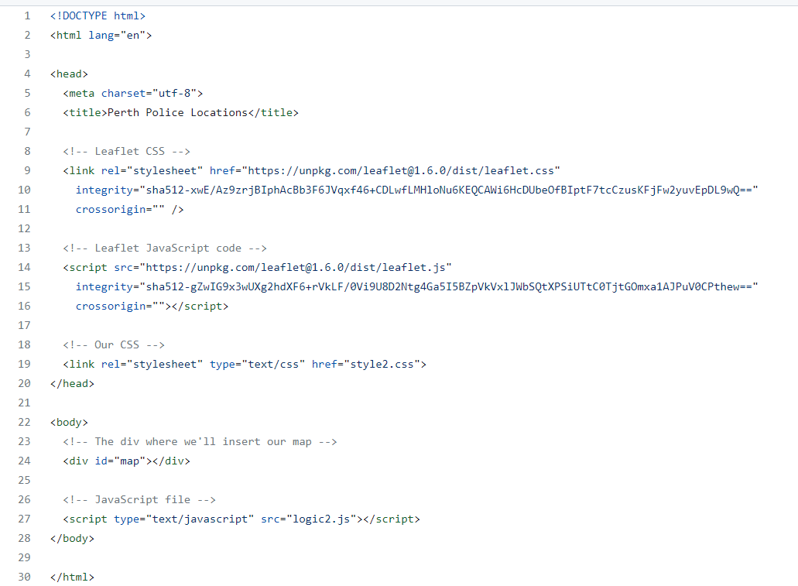
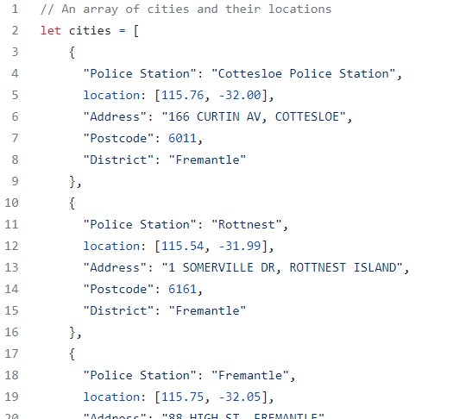
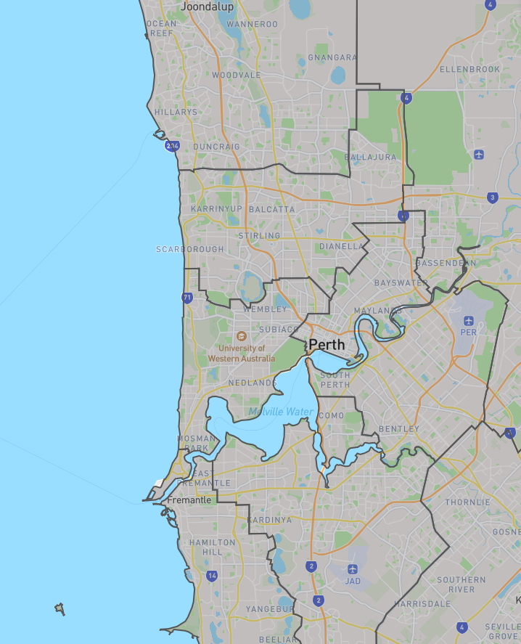
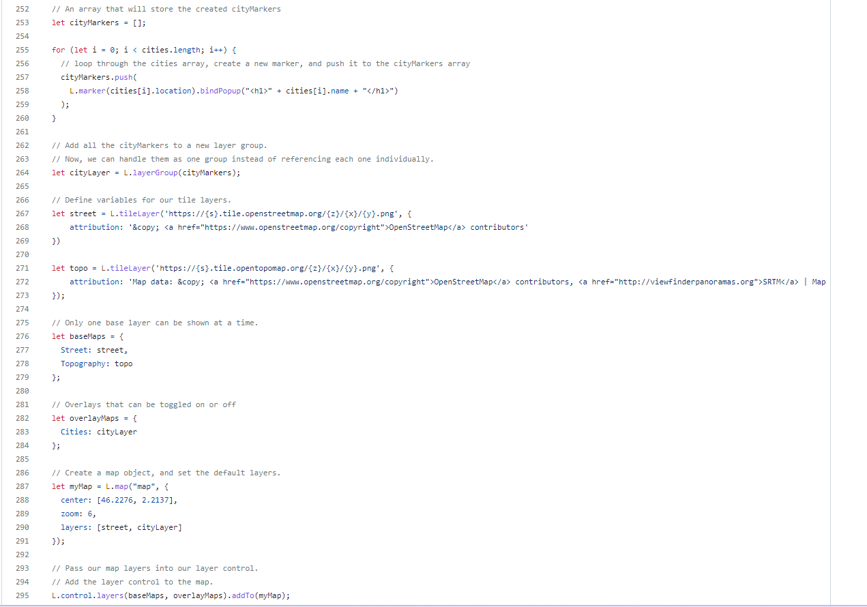
Mapping
Joondalup
Attempted maps
1., Heat map
2. Markers
3. District Map through Geo.json data
Perth
Fremantle

Slide 8
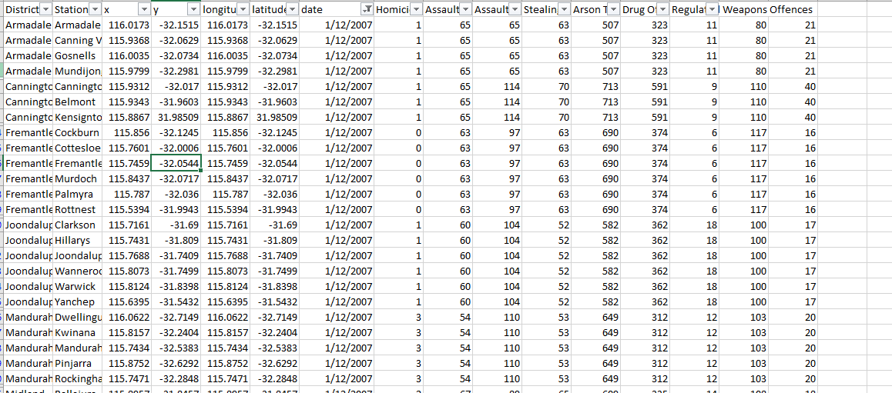
Challenges with mapping
- Data didn’t provide coordinates
- API error, failed to load data
Districts totals did not outline
crimes within suburbs

Slide 9
Findings from our analysis
- Suburbs which we expected to have a lower crime rate due to higher average house prices, was not necessarily proven. Crime was still significant in these areas.
- Peaks in all areas of crime around the 2015 and 2016 time period.
- All areas of crime increase at similar times and at the same rate.
- There has been an increase in stealing, arson, drug and weapon related offences.

Slide 10
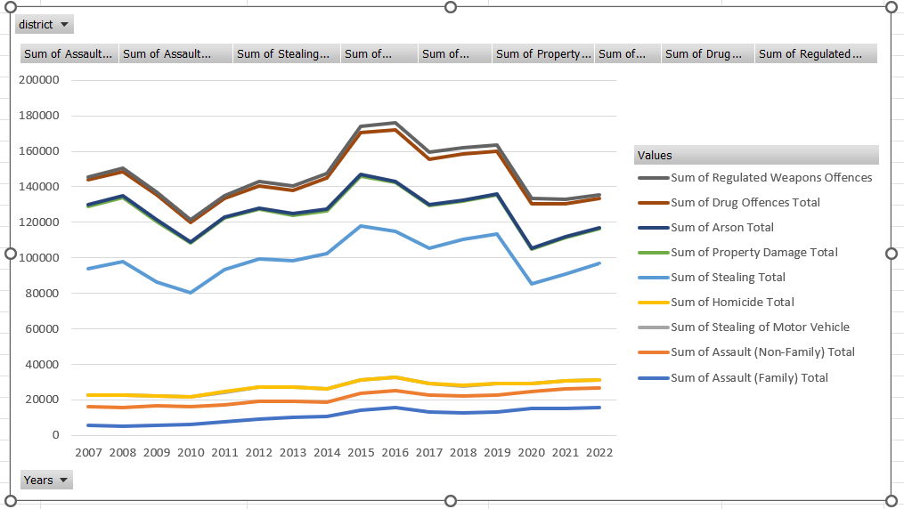
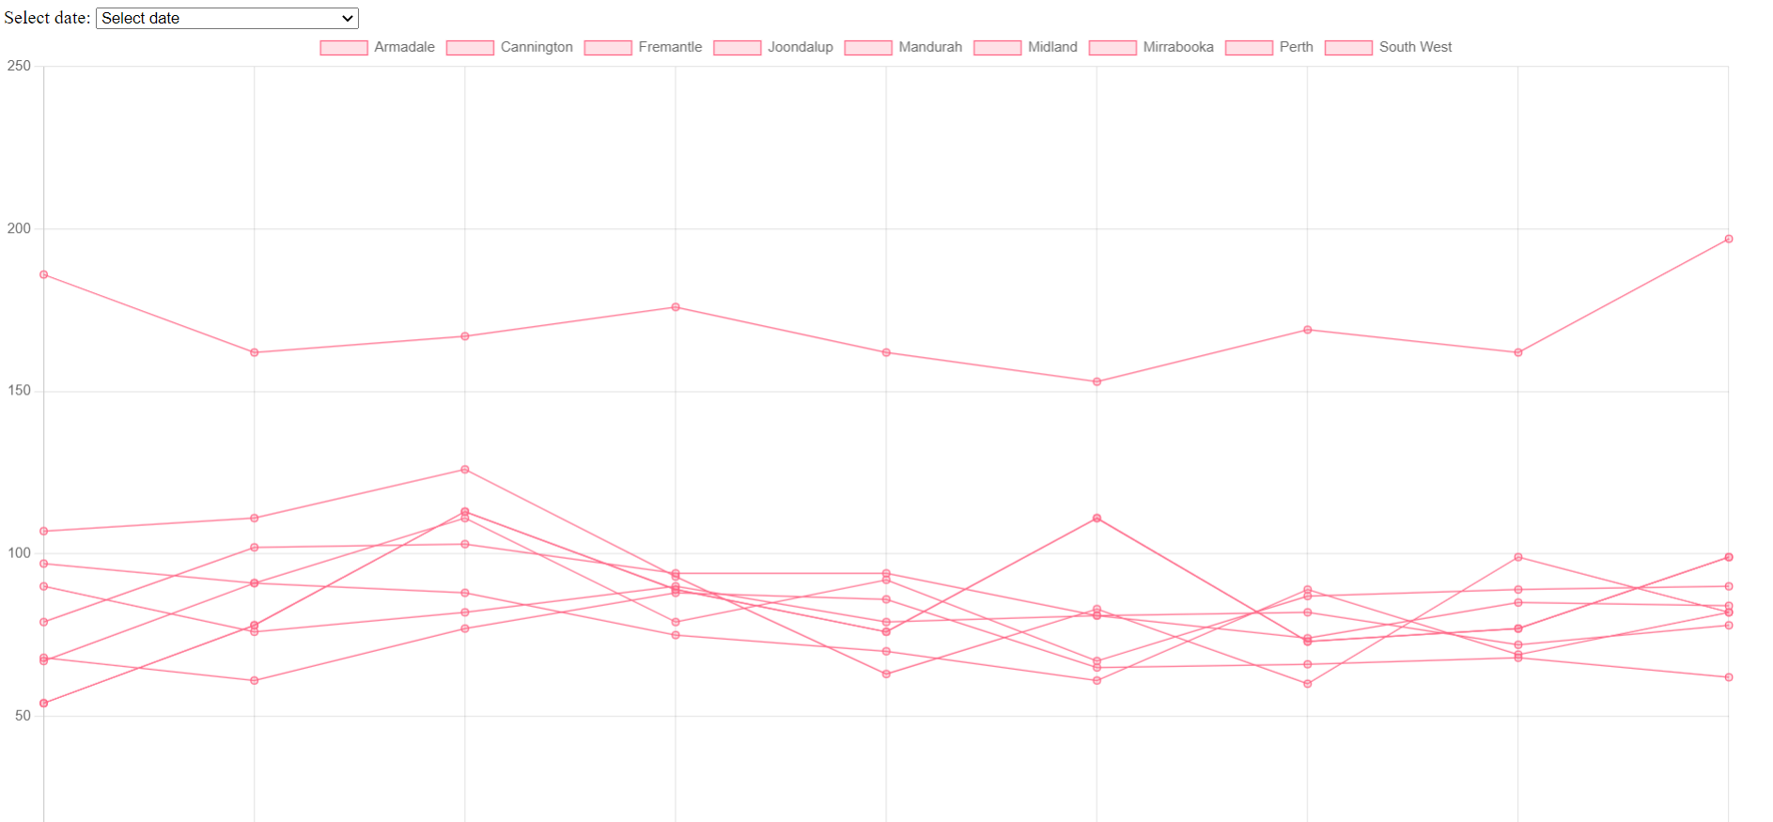
Overall Perth crime trends
expectations
reality

Slide 11
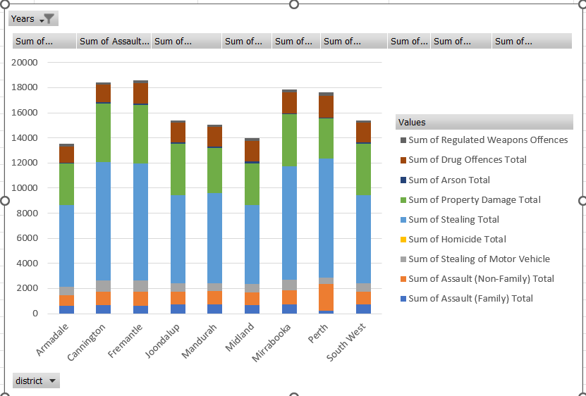
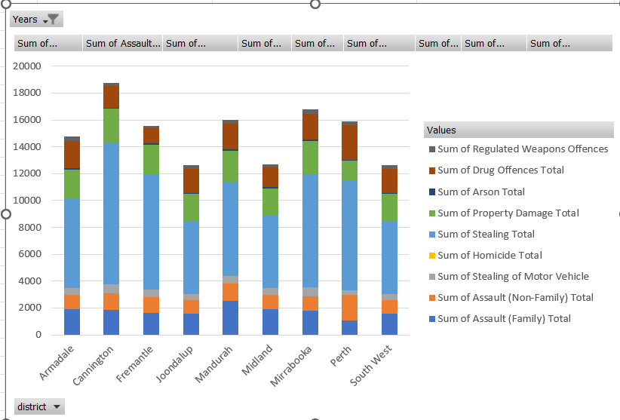
2007 vs 2022 crimes in each district

Slide 12
What further analysis would we like to do

