Slide 1

Perth crime analysys
Richard allen
Conor mccabe

Slide 2
Approach:
- Neil Armstrong

Slide 3
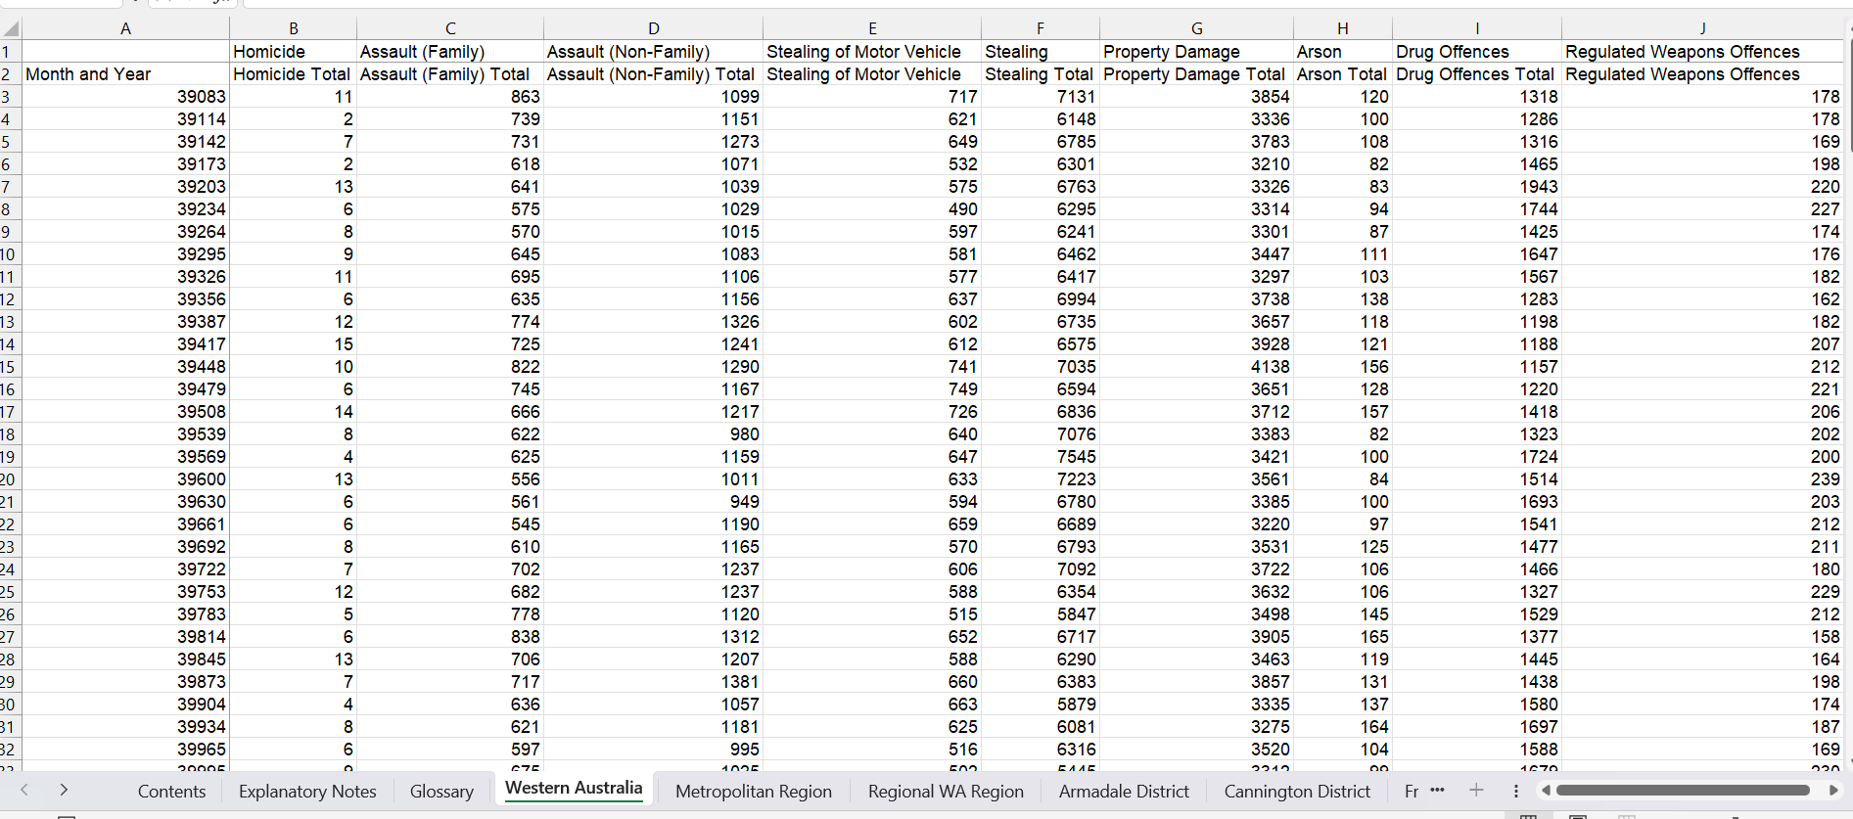
Raw data

Slide 4
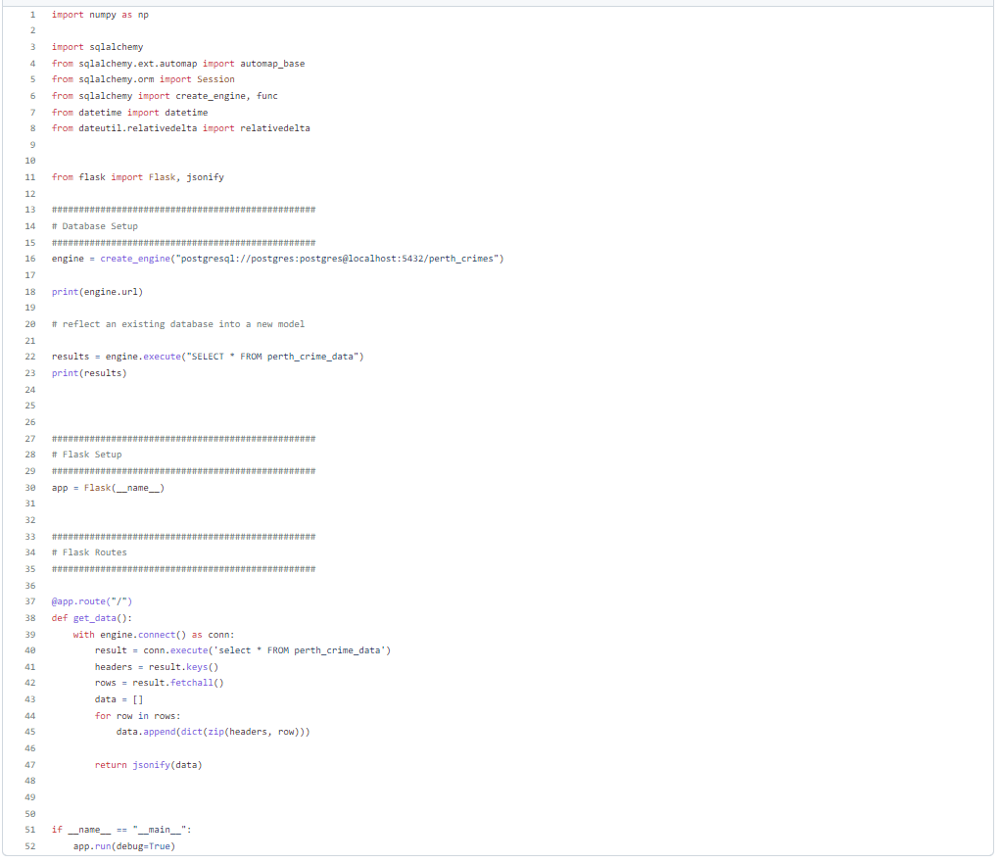
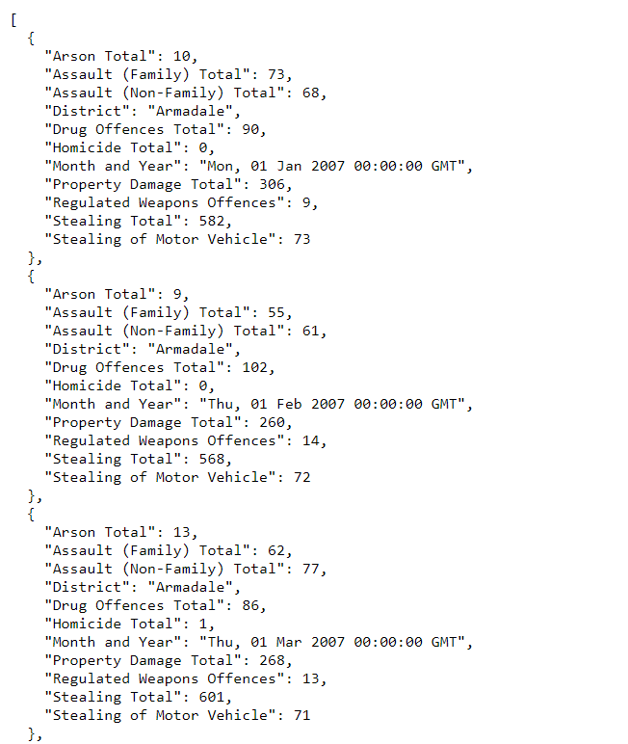

Slide 5
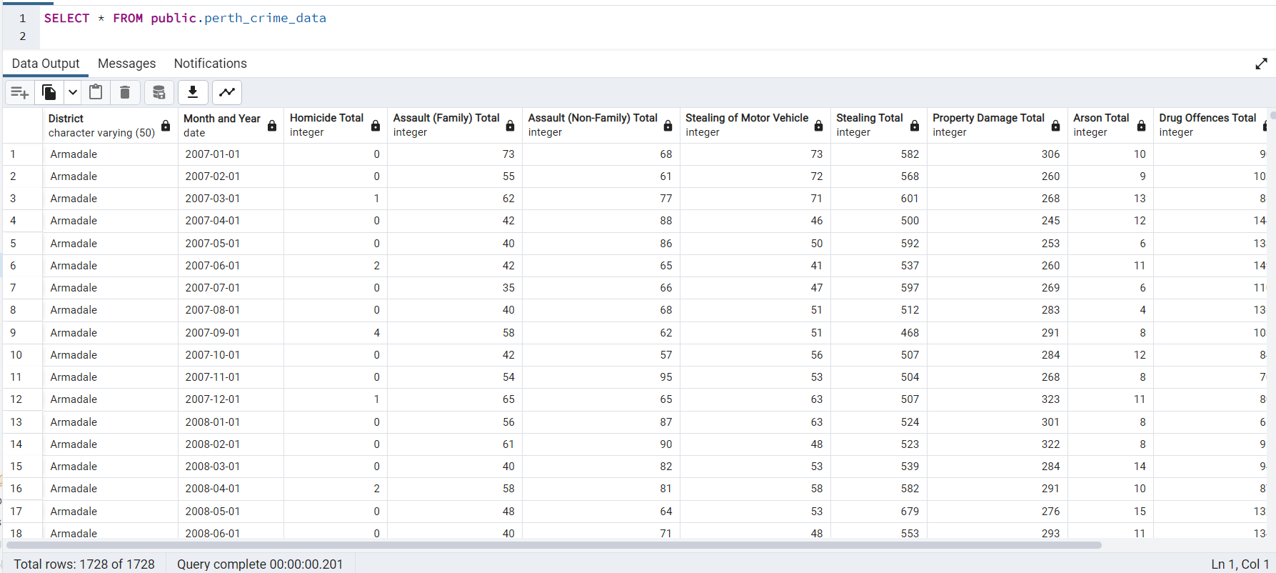
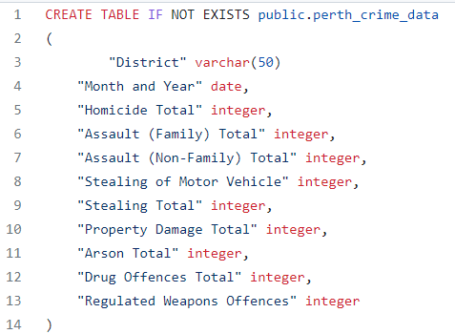

Slide 6
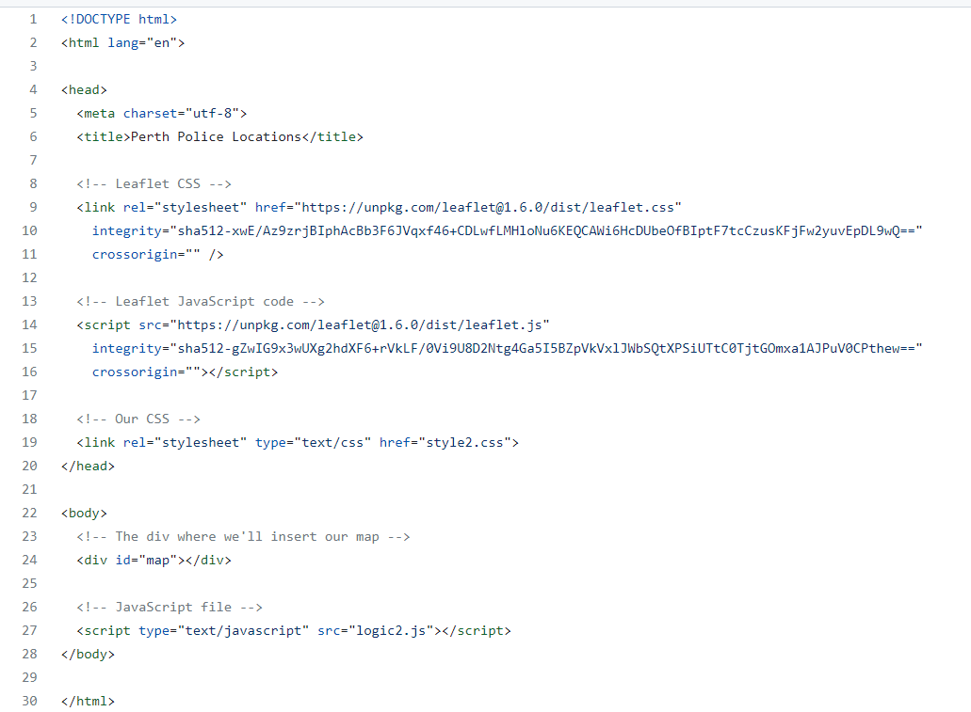
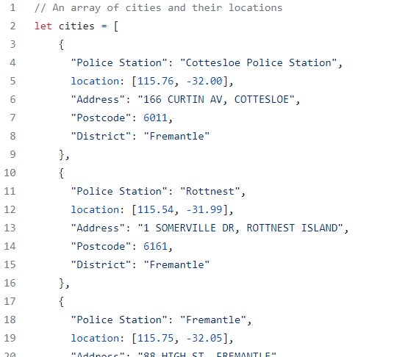
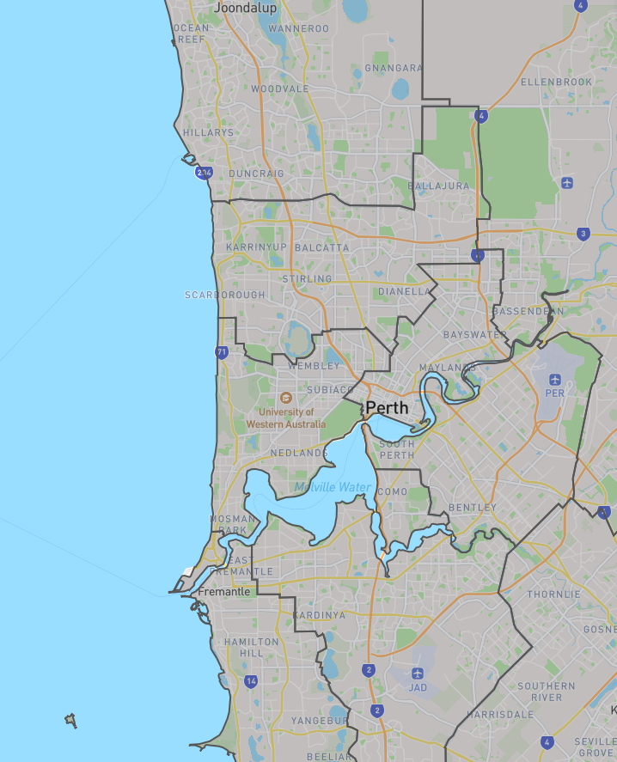
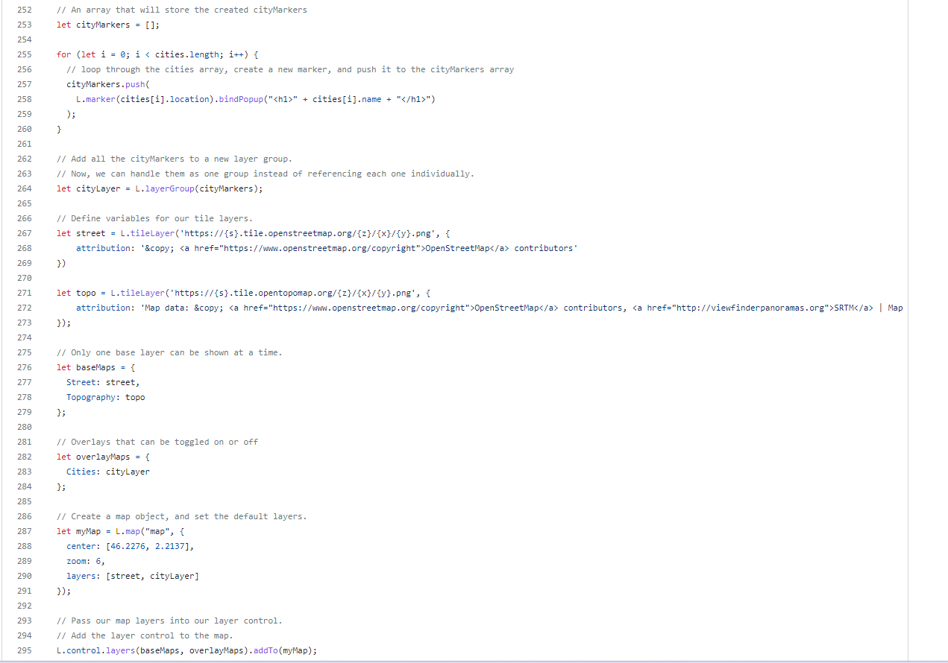
Mapping
Joondalup
Attempted maps
1., Heat map
2. Markers
3. District Map through Geo.json data
Perth
Fremantle

Slide 7
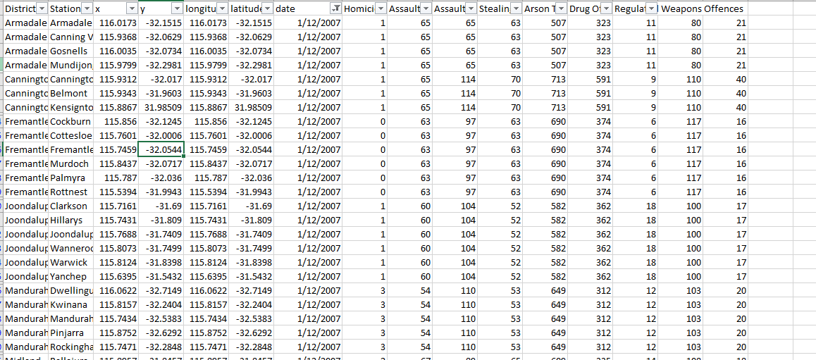
Challenges with mapping
- Data didn’t provide coordinates
- API error, failed to load data
Districts totals did not outline
crimes within suburbs

Slide 8
Findings from our analysis
- Suburbs which we expected to have a lower crime rate due to higher average house prices, was not necessarily proven. Crime was still significant in these areas.
- Peaks in all areas of crime around the 2015 and 2016 time period.
- All areas of crime increase at similar times and at the same rate.
- There has been an increase in stealing, arson, drug and weapon related offences.
- On average there is more crime in 2022 than 2007.

Slide 9
What further analysis would we like to do

