Slide 1
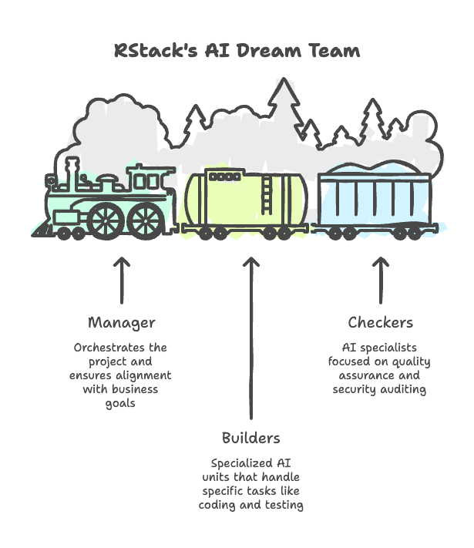
RStack: The Future of Software Development
Building Better Software with AI Teammates
196
15
156
AI AGENTS
PIPELINE STAGES
SKILLS
Richardson Gunde
Evoke Technologies | Project Proposal

Slide 2
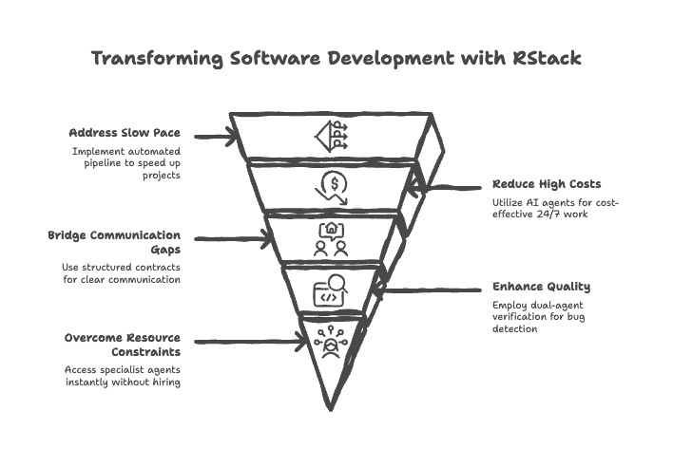
Introducing RStack: Your AI-Powered SDLC Framework
The AI Orchestrator
A revolutionary system that uses AI to manage and execute every stage of software development, ensuring consistency and quality at every step.
Key Framework Pillars
End-to-End Orchestration: From idea to deployment.
AI Dream Team: 196 specialist agents and 156 skills.
Technical Foundation: Built on Pi SDK with Node.js runtime.
Lifecycle Hooks: 6 hooks for complete process control.
Verified Reliability
Governed by an 11-module harness and a 15-stage pipeline for enterprise-grade delivery.

Slide 3
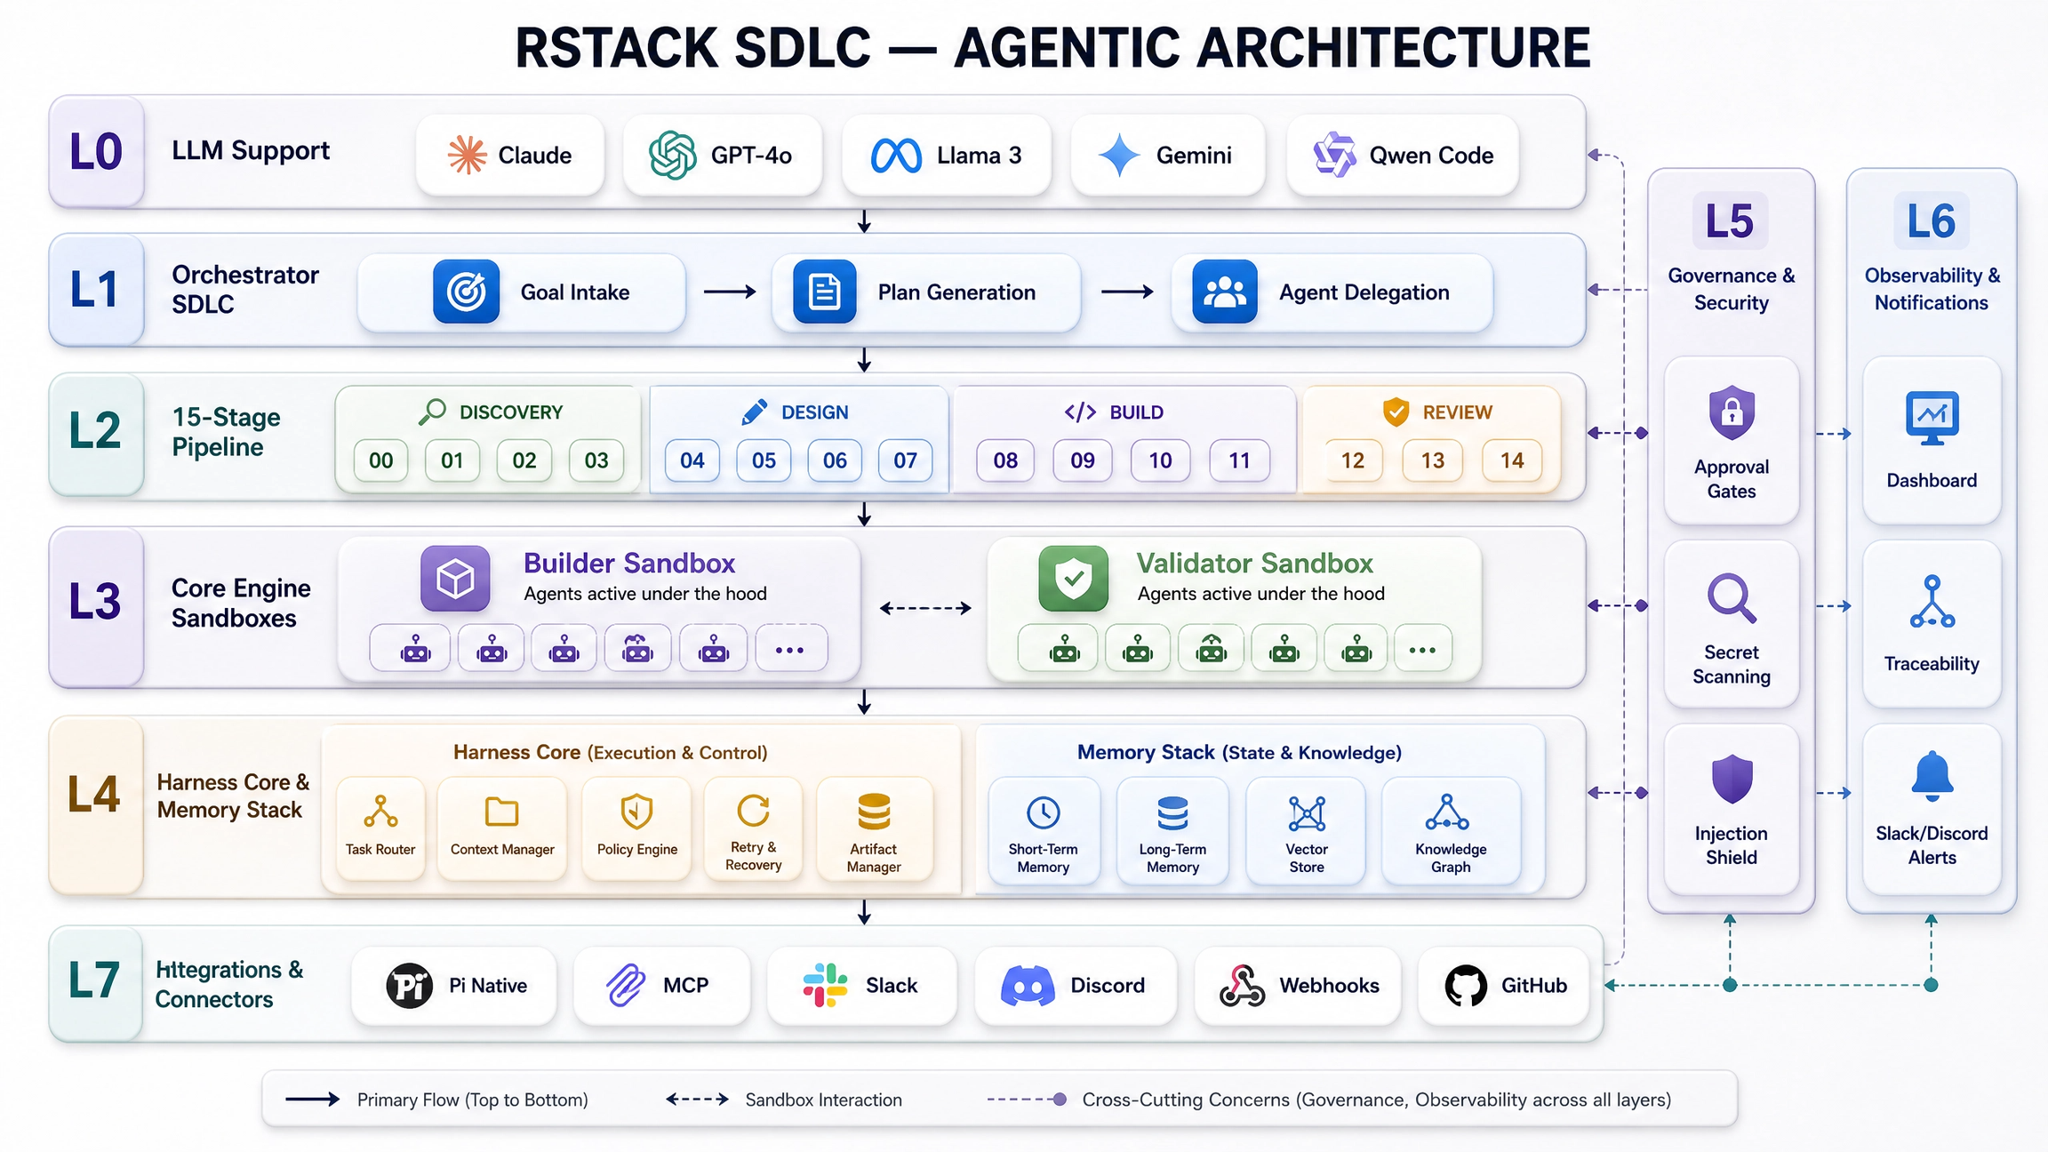

Slide 4

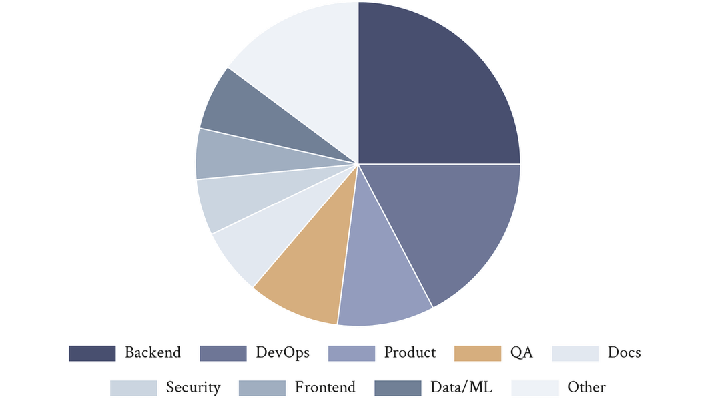
Your New AI Dream Team: Managers, Builders, & Checkers
Core Architecture
196 Specialist Agents by Domain
RStack utilizes a tripartite agent structure to ensure project alignment, technical excellence, and rigorous quality control.
Manager
Builders
Checkers
1
196
18
Orchestrator
Specialists
Validators
Specialized AI Experts
The Manager: Orchestrates goals and routes work.
The Builders: 49 Backend, 34 DevOps, 10 Frontend specialists.
The Checkers: Independent QA and security auditors.
Strategic Advantage
Independent audits eliminate self-grading bias, ensuring that every deliverable meets enterprise standards.
Source: RStack SDLC Repository (v1.0.2)

Slide 5

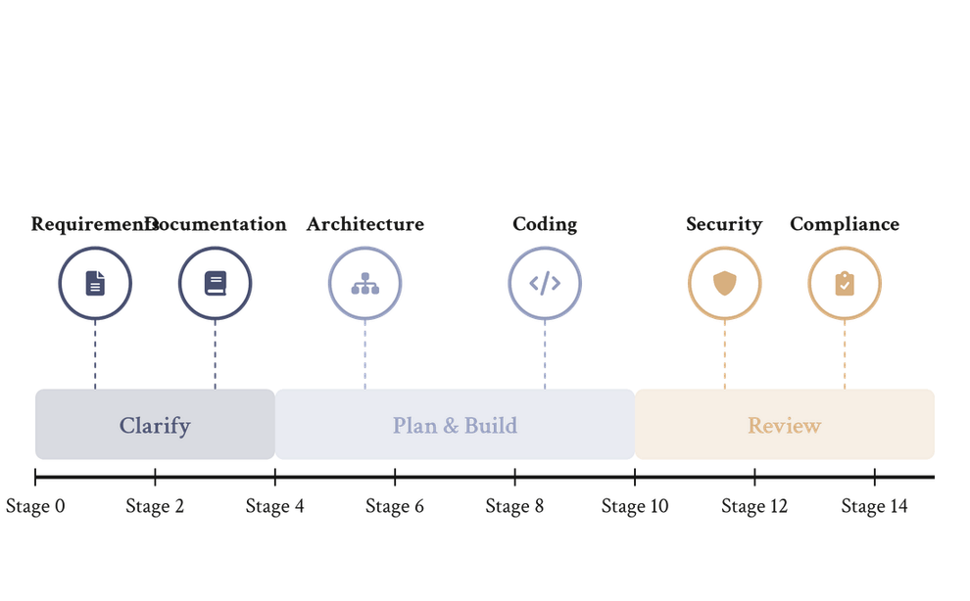


From Idea to Reality: The Automated Workflow
15-Stage Automated SDLC Pipeline
The RStack Process
Business goals are automatically decomposed into actionable tasks, executed by specialists, and verified by independent validators.
Discovery & Planning
Agents clarify the vision, lock requirements into a brief, and generate structured plans with milestones and risk registers.
Execution & Validation
Specialist builders write production-ready code in sandboxes, while independent validators audit every deliverable against contracts.
Source: RStack Canonical Pipeline Architecture (Stages 00-14)
Approval & Delivery
Human oversight at key gates ensures alignment. Final delivery includes a full immutable evidence ledger for auditability.

Slide 6
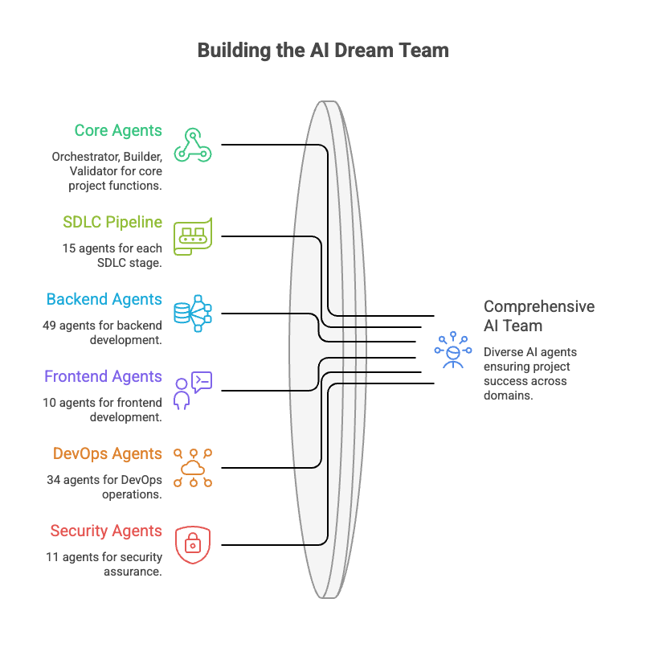
Specialized AI Experts: Departmental Precision
Domain Mastery
RStack deploys 196 highly specialized AI units, each a master of its specific domain, ensuring expert-level execution across the entire SDLC.
Backend
DevOps
Security
49
34
11
Agents
Agents
Agents
Core Agent Capabilities
Requirements: Captures business needs with testable criteria.
Architecture: Designs scalable structures and tech stacks.
Code: Optimizes production-ready code in 20+ languages.
Strategic Advantage
Access a full department of specialists on demand, eliminating the overhead of hiring and onboarding for niche technical roles.
Agent Domain Distribution (196 Total)
Source: RStack Agent Registry v1.0.2

Slide 7

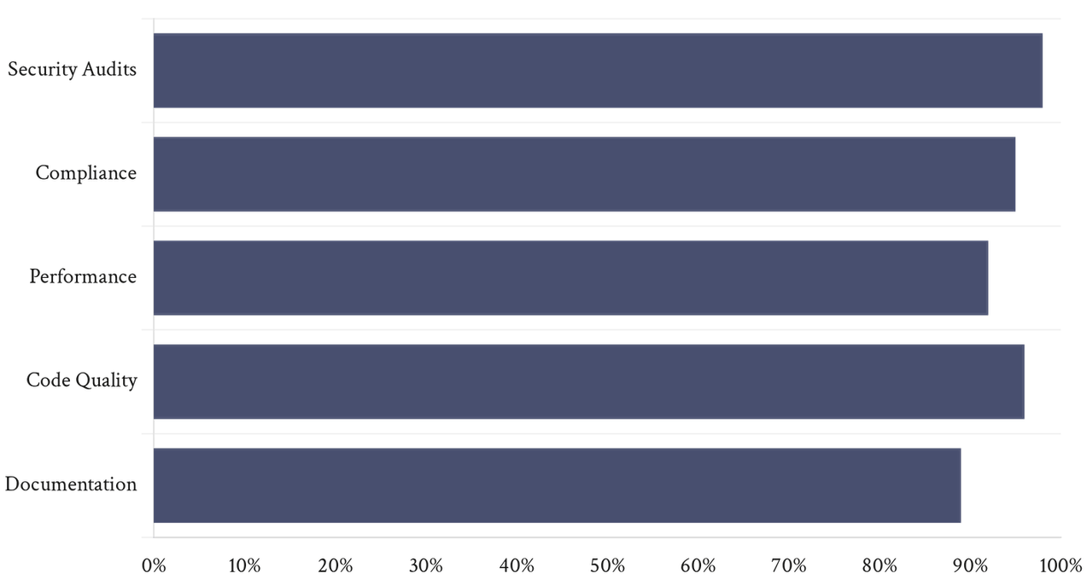
Quality Guaranteed: The Validator Team
Rigorous Pipeline Checks
Validation Performance Across Pillars
Every task in the 15-stage pipeline receives an evidence-based verdict. No deliverable proceeds without a PASS status.
Security & Compliance
Automated secret scanning (4 regex groups)
Prompt injection detection (6 patterns)
GDPR, HIPAA, and SOC 2 gap analysis
HMAC-SHA256 integrity checks
Full Traceability
The append-only ledger ensures every decision, test result, and approval is immutable and traceable.
Source: RStack Internal Validation Ledger (evidence.jsonl)

Slide 8

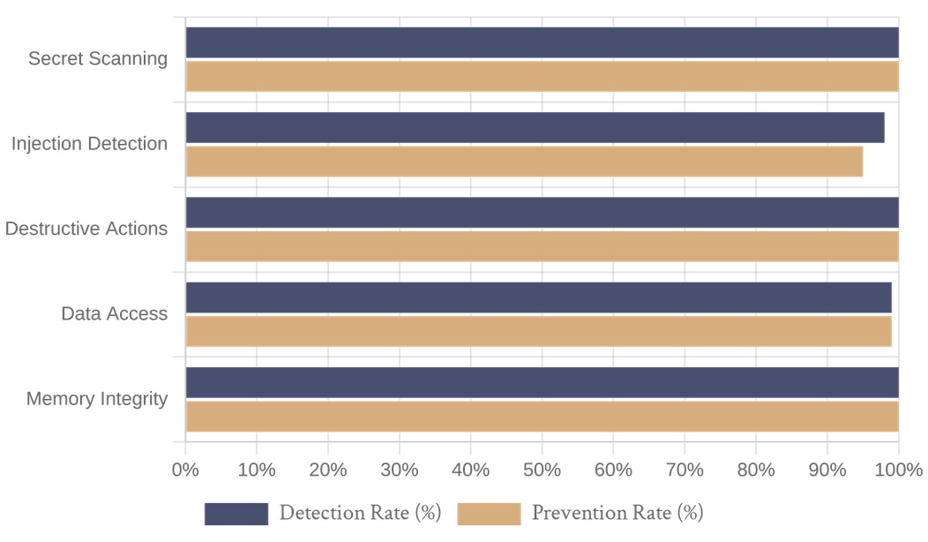
Safety & Guardrails: Secure & Controlled
Built-in Protection
RStack implements real-time lifecycle hooks to block destructive commands and protect sensitive data without manual intervention.
Security Guardrail Effectiveness
Four Safety Pillars
Protected Actions: Blocks destructive commands like `rm -rf` or `DROP TABLE`.
Data Protection: Prevents writing to `.env` or leaking API keys.
Approval Workflows: Human oversight for critical gates and releases.
Full Traceability: 21 tracked event types with HMAC-SHA256 signatures.
Audit Readiness
Detection and prevention rates across core security modules.
Every action is logged in an immutable evidence ledger, ensuring compliance with GDPR, HIPAA, and SOC 2.

Slide 9

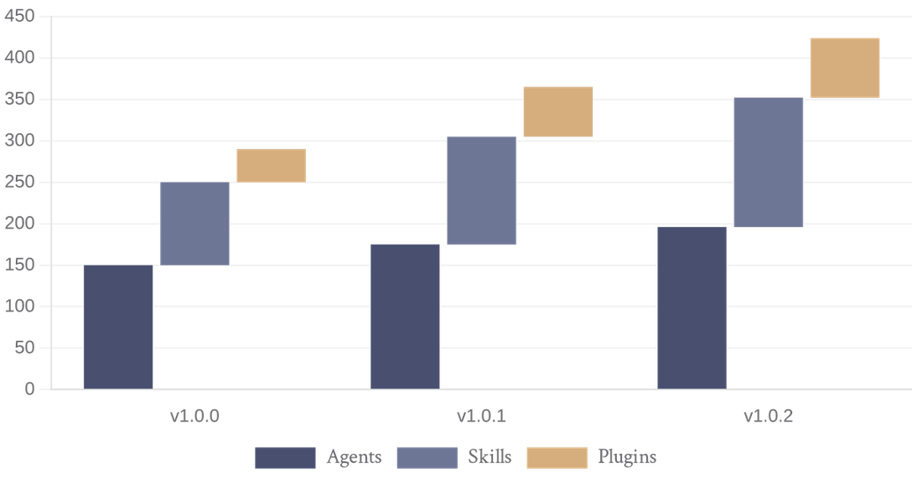



Flexible & Scalable: Built for Extensibility
RStack Ecosystem Growth (v1.0.0 - v1.0.2)
Adaptive Architecture
RStack is designed to grow with your business, offering multiple extensibility points to tailor the AI dream team to your specific needs.
Customizable Agents
Plugin System
Tailor 196 agents with custom prompts and skills per project.
72 plugin packs ready to integrate new frameworks instantly.
Episodic Memory
Local Overrides
Learns from past runs to make future builds smarter.
Adapt behavior for individual repos without core changes.
Strategic Implication
RStack scales effortlessly from rapid prototyping in Express mode to enterprise-grade multi-team delivery.
Source: RStack SDLC Version History & Repository Metrics

Slide 10

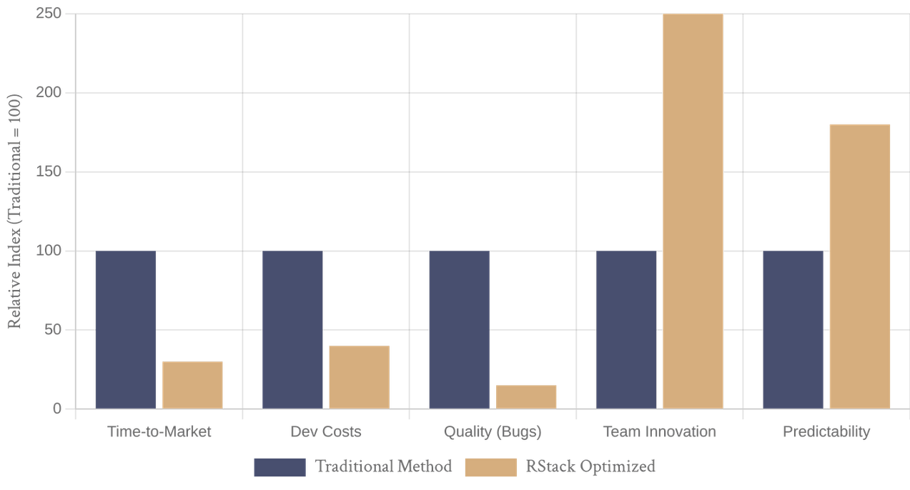
The Business Impact: Delivering Value
Accelerated Delivery
Projected Efficiency Gains with RStack
Automated pipelines eliminate manual handoff delays, resulting in up to 70% faster time-to-market for new features.
Quantifiable Benefits
Significant reduction in manual labor costs
Enhanced product quality via dual-agent verification
Increased innovation through automated boilerplate
Predictable outcomes with real-time cost tracking
Cost Optimization
AI agents work 24/7 at a fraction of human resource costs, driving an estimated 60% reduction in development expenses.
Estimated improvements based on 15-stage automated pipeline benchmarks.

Slide 11
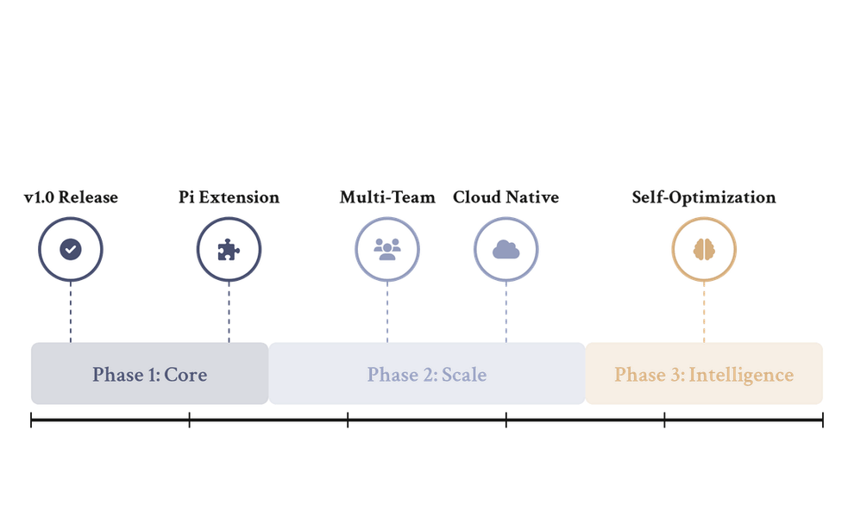



The Road Ahead: The Future of Development
RStack Evolution Roadmap
Our Vision
We are shaping a future where human creativity is amplified by 196 AI specialists, turning vision into reality with unprecedented speed and precision.
Continuous Evolution
Every run improves organizational memory through episodic learning, making future builds smarter and more efficient.
Expanding Ecosystem
Deepening integrations with GitHub, Jira, Slack, and major cloud providers to create a seamless, automated toolchain.
Call to Action
Install:
npm install rstack-agents
Repository:
github.com/richard-devbot/SDLC-rstack
Vision for AI-Driven Software Creation (2026-2028)
Contact:
Richardson Gunde, Evoke Technologies

