Slide 1
Using the VAMPIRE Data Converter

Slide 2
Installation
VAMPIRE source: https://github.com/richard-evans/vampire.git Use “develop” branch
In terminal: make vdc
The vdc executable can then be found at: …/vampire/util/vdc/vdc

Slide 3
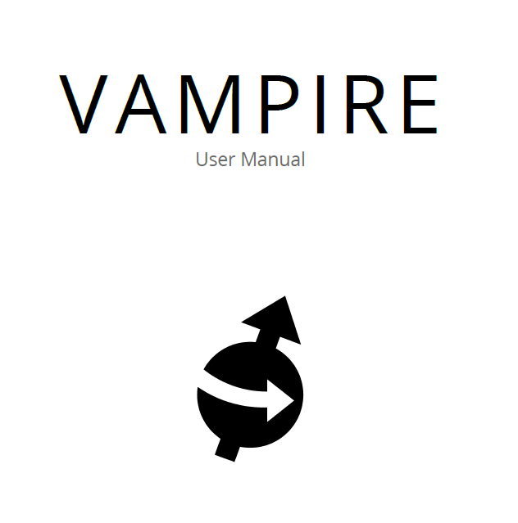
The Manual
Included in the source under …/vampire/manual/vampire-manual.tex
A LaTeX file must be compiled into a pdf

Slide 4
Displaying Atomic positions
Requires input file parameter:
config:atoms
This must be included before running the simulation
New files: data and meta files
Run vdc: util/vdc/vdc –xyz
New file: crystal.xyz
Use a .xyz file viewer such as Jmol or VESTA

Slide 5
Customisation and Troubleshooting
VDC should also be used to check inputs
Using slices
--slice [x_{min}, x_{max}, y_{min}, y_{max}, z_{min}, z_{max}]
Parameters are in fractional coordinates
Removing materials
--remove-material [material1,material2,...]
Material numbers correspond to those in material file
More options are explained in the Manual

Slide 6
Displaying Spins in POV-Ray
Initial requirements:
Use config:atoms
POV-Ray installation
Ubuntu: sudo apt install povray
Otherwise find binaries at http://povray.org/download/
Run vdc:
utils/vdc/vdc –-povray
Several new files: .inc .ini .pov

Slide 7
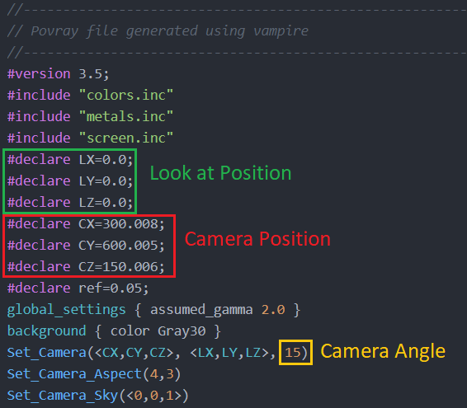
POV-Ray Customisation
The spins.pov file:

Slide 8
Displaying Spins in POV-Ray
To run povray: povray –w3600 –h2700 +A0.3 spins
-w and –h choose the image width and height (resolution) and +A0.3 uses antialiasing.
The spins.pov file contains additional options

Slide 9
POV-Ray Customisation
Command line parameters:
--vector-z [x,y,z] to change primary axis
--colourmap [name] to change palette
Some colourmaps lend themselves better to different systems
For Vortex systems try “C2”

Slide 10
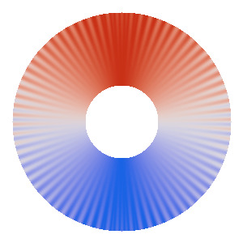
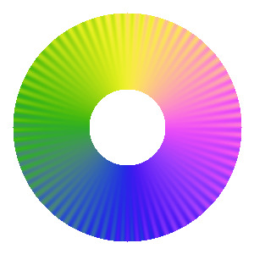
POV-Ray Colourmaps
Default: Red-White-Blue-White-Red
Other options:
For vortex: C2

