Slide 1
MOLS8411 Molecular Genomics Analysis and Design
Introduction to R
R Analysis
R Analysis Poster Presentation

Slide 2
R

Slide 3
Introducton to R
What R and Rstudio
Calculations
Data Objects
Calling Functions
Loading Data
Data Frames
Subsetting
Factors

Slide 4
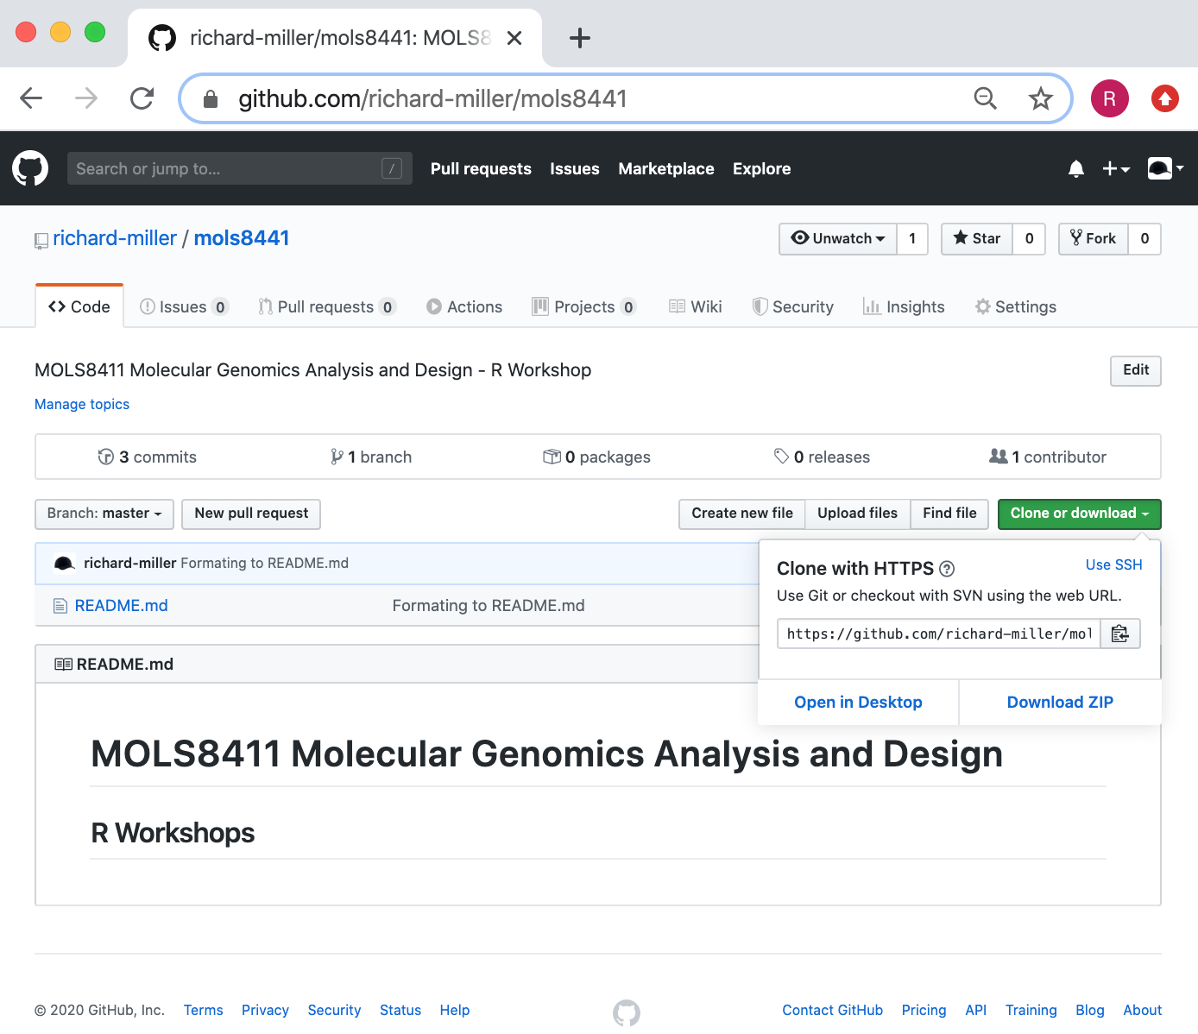
https://github.com/richard-miller/mols8411

