Slide 1
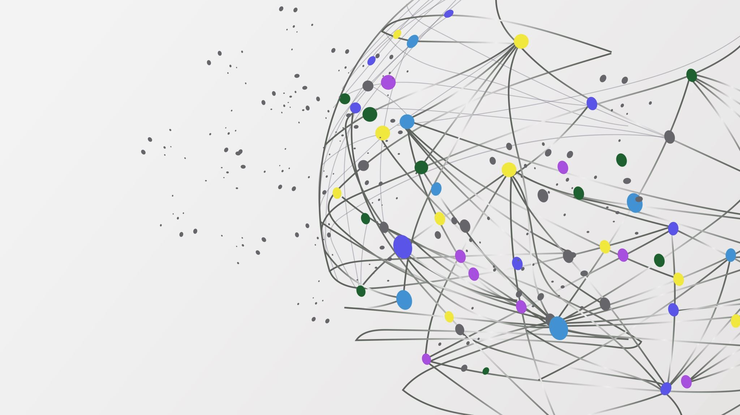
MetaPlatform Proposal
Doing more with less time and effort

Slide 2
There’s a unique opportunity right in front of us.
Ensemble Software Systems (ESS) has some unique, powerful software technology enabling rapidly building highly-complex systems
Uniphore is building out their Platform X technology, and using it to unify their products
Proposal: ESS and Uniphore partner on building a powerful metaplatform providing a comprehensive seamless supervisory, command, and control facility that helps pull Platform’s many pieces together

Slide 3
What Ensemble brings to the party
EnsembleWorks (EWorks) is an advanced application platform and toolkit, born in 1990, and evolving to now
EWorks has a uniquely powerful and flexible object model, and many building blocks and tools
EWorks makes possible building rich, seamless, and high-performance applications and systems, that are inherently distributed, and supported by a powerful type system, universal addressing, and many other higher-order software facilities
Ensemble is actively seeking partners to bring EWorks to the industry, and the world

Slide 4
What Uniphore brings to the party
A massive opportunity – leveraging Platform to enable Uniphore to dominate its market
Many challenges in doing so, including complexity, heterogeneity, and a patchwork of system configuration, management, architectural models, and piecemeal visibility, all of which slow development, lengthen time to market, increase TCO, and the like

Slide 5
What can we do together?
MetaPlatform: a powerful management, configuration, visualization, and ops control meta-layer hovering over Platform X
Pulls together all components into a coherent graph
Provides advanced visualization tools to enable viewing the system at any granularity desired
Allow high-level system design using the same canvas
Build a rigorous, declarative, extensible foundation underlying Platform, and over time, Core Services, Beehive, and product lines
Provide system maps that lucidly show topology, and real-time operational status, for all employees to see

