Slide 1
COMP 1531 Week 1
Introductions
Problem Solving & Teamwork
Discussion
Notes:
Are your classroom colors different than what you see in this template? That’s OK! Click on Design -> Variants (the down arrow) -> Pick the color scheme that works for you!
Feel free to change any “You will…” and “I will…” statements to ensure they align with your classroom procedures and rules!

Slide 2
About me
3rd Year, Computer Science/Commerce
3rd semester teaching 1531
Interested in AI, and Full Stack Development.

Slide 3
Expectations
Ask for help! (after trying to solve the problem yourself)
Respect other’s right to learn
Participate if you can
Provide feedback as soon as possible

Slide 4
Introduce Yourselves!
Find a partner (you don’t know)
Brainstorm a creative name for your partnership (mix the letters of your names)
5 minutes

Slide 5

Problem Solving
You have 10 minutes to solve the following.
Question:
You can create infinitely many perfect copies of tables.
How tables can you reasonably fit in the room?

Slide 6
Problem Solving
Discussion:
How did your group come up with the solution?
Why?
A lesson of how DIFFERENT teams produce VARYING solutions to the SAME problems.

Slide 7

Discussion
Question:
Should and will a SENG process always yield the same result for the same requirements?
Answer:
Should? It depends on the project. (NASA vs Web Dev)
Will? Almost never.

Slide 8
Discussion
Question:
How important is detail in requirements? Can you have too much or too little?
Answer:
The right detail is important.
Too little we produce something completely wrong.
Too much we leave little flexibility for changing requirements.

Slide 9
Discussion
Question:
Should a process require all requirements to be fully known and specified before project start?
Answer:
Yes, if waterfall method.
These days not really, as we adopt more agile approaches.
Changing requirements are a guarantee for most software.

Slide 10
Discussion
Question:
What is the distinction between good practices and a process?
Answer:
Process is just a sequence of steps to meet a goal.
Good practice is a process, widely accepted to be superior to alternatives.

Slide 11
Discussion
Question:
What are traits you believe make good team members?
How do you decide who is on your team?
My opinion:
Friendly, empathetic, punctual and willing to learn.
Skill is a secondary trait for me.

Slide 12

Discussion
Question:
Is Python a good programming language.
Answer:
It depends on what you use it for.
Programming languages are a TOOL for solving problems.
Python is great for data science, scripting and fine for backend servers.

Slide 13
Conclusion
Software requirements yield differing solutions.
Requirements should tell us just enough to proceed with little error.
Good practices are widely accepted processes.
Look at languages as a tool to solve problems, they all have their uses.

Slide 14
Bonus Content
Git Basics
https://unwiredlearning.com/blog/git-basic-for-beginners/
Git Cheat Sheet
https://education.github.com/git-cheat-sheet-education.pdf
Python vs C
https://www.geeksforgeeks.org/difference-between-c-and-python/
Python Docs Tutorial
https://docs.python.org/3/tutorial/index.html

Slide 15
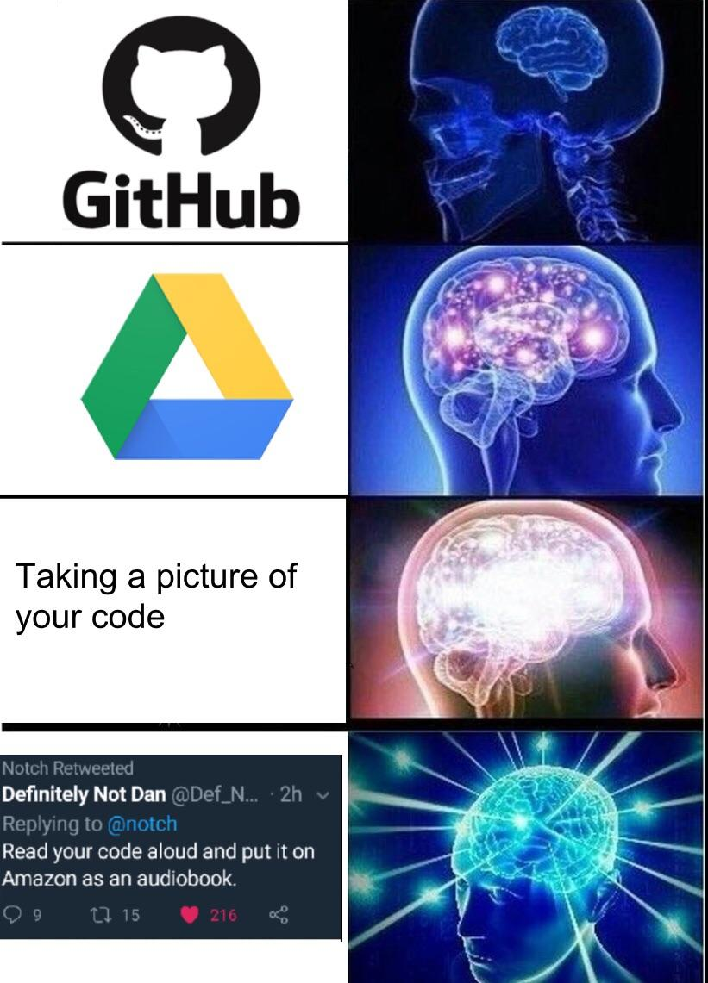
Bonus Content

