Slide 1
Project 1 – Out and Back Physics 4A
Richard The

Slide 2
Price
Bearings
4*1.5$
Wheels
8*0.25$
Total
Mouse trap
2$
17.7$
Metal Stands
2*2$
Nails
2*0.1$
String
0.5$
All wooden parts
3$

Slide 3
Mission Design
To get the maximum travel distance and least displacement
Minimize the friction
Equalize the power for forward and backward motion
Come up with a braking system
Find the most balance weight

Slide 4
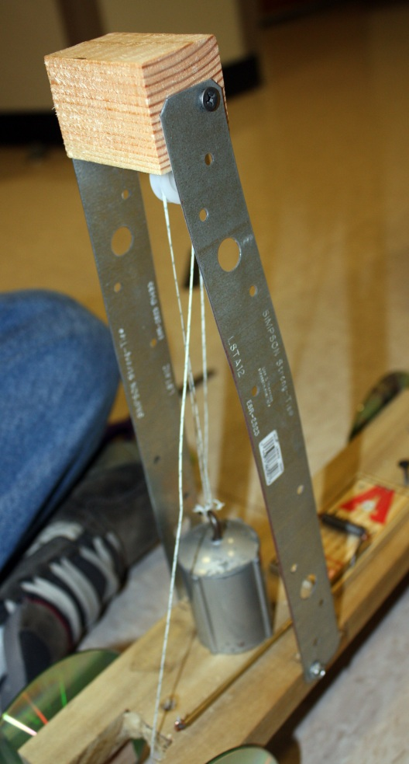
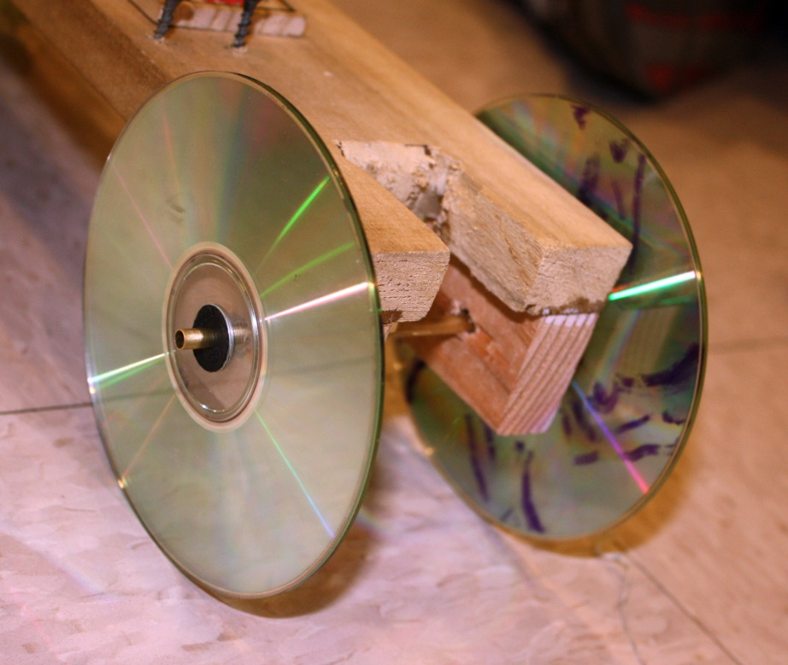
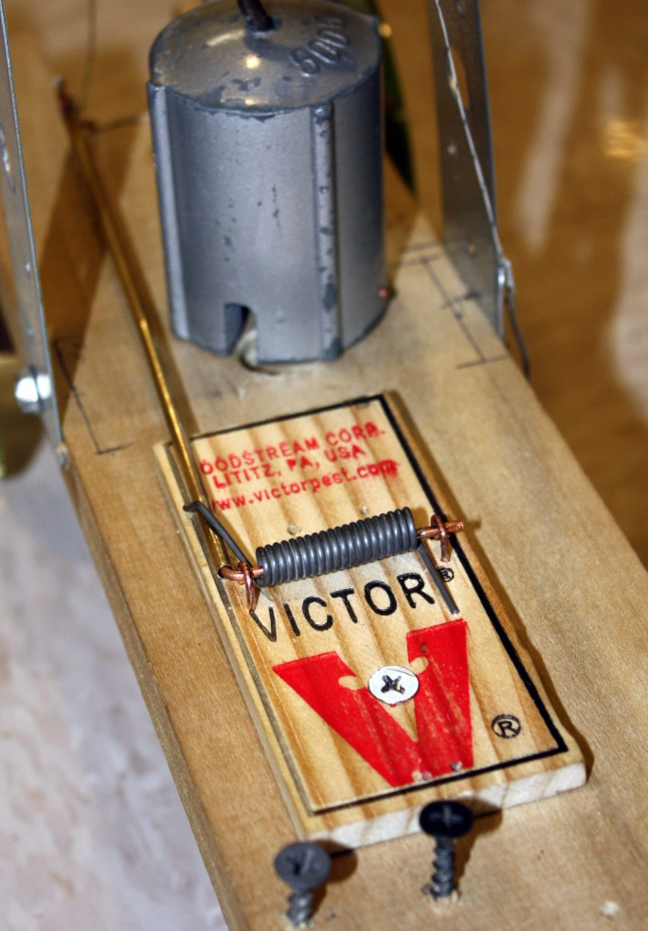

Slide 5
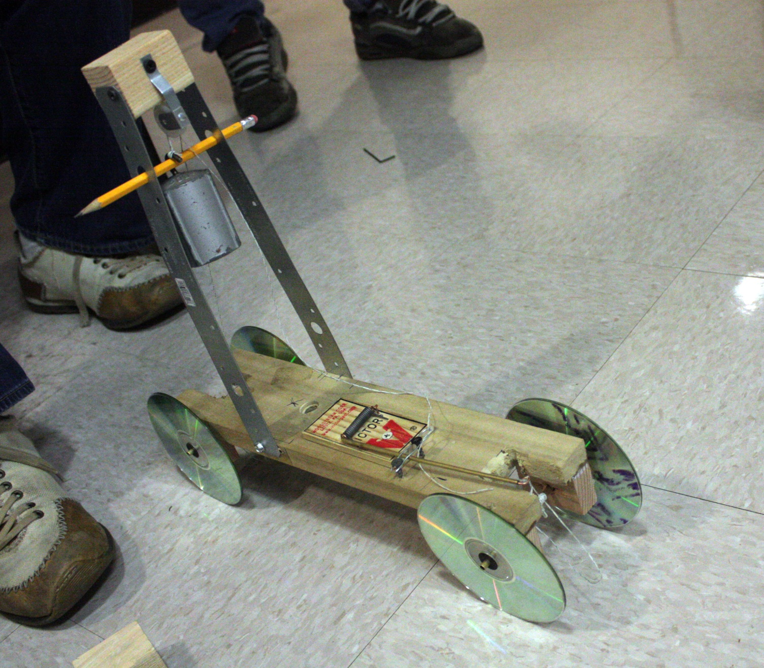
Final Design

Slide 6
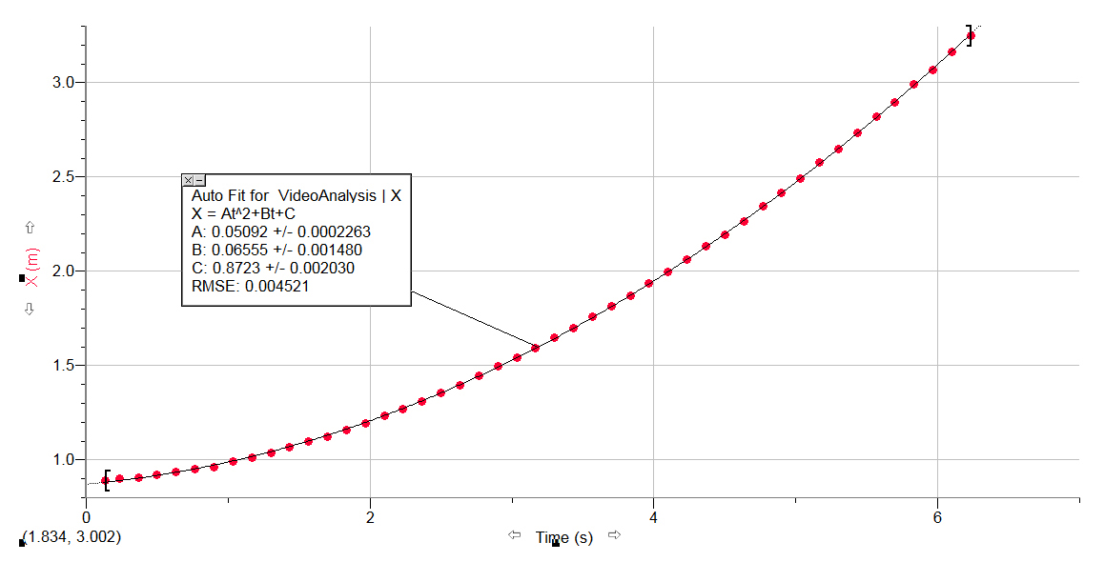
LoggerPro - Video Analysis (Forward Movement - Mass)
Graph of Position vs Time

Slide 7
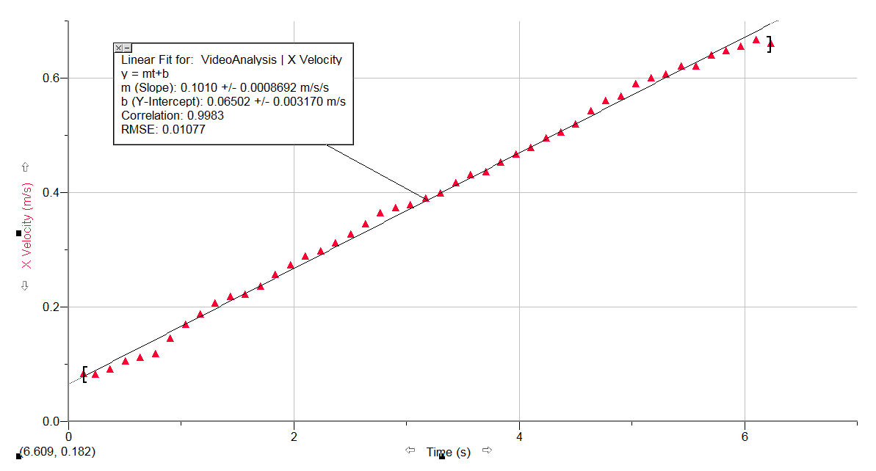
LoggerPro - Video Analysis (Forward Movement - Mass)
Graph of Velocity vs Time

Slide 8
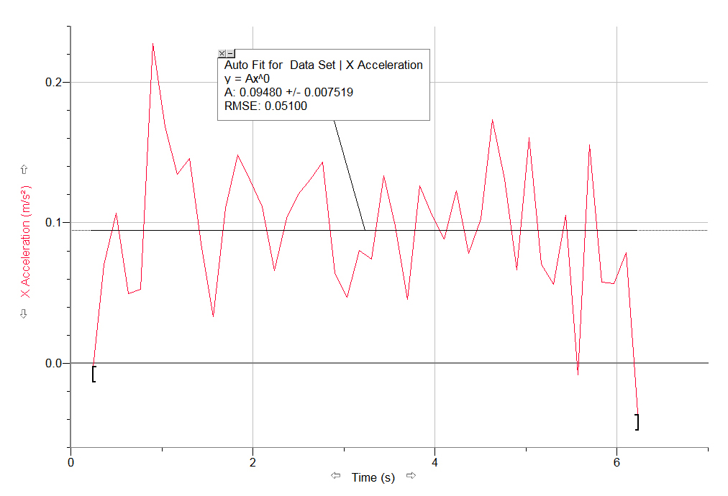
LoggerPro - Video Analysis (Forward Movement - Mass)
Graph of Acceleration vs Time

Slide 9
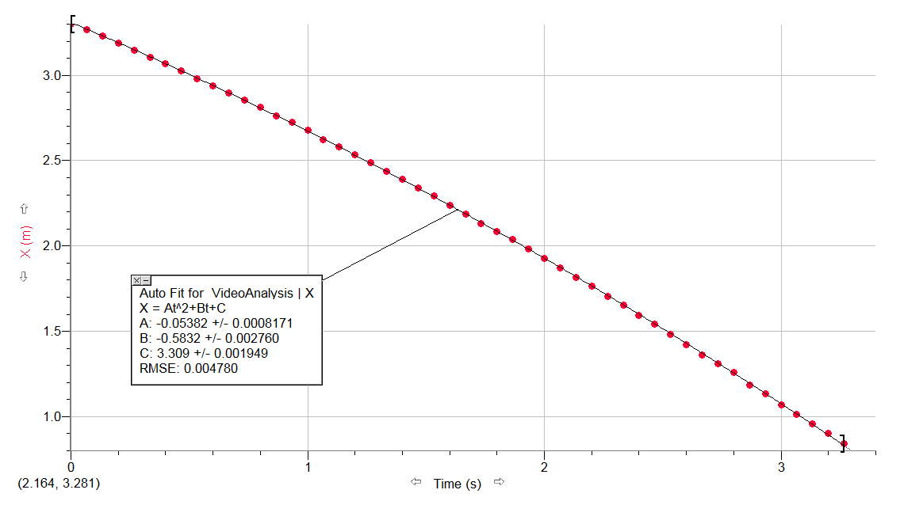
LoggerPro - Video Analysis (Backward Movement – Mousetrap)
Graph of Position vs Time

Slide 10
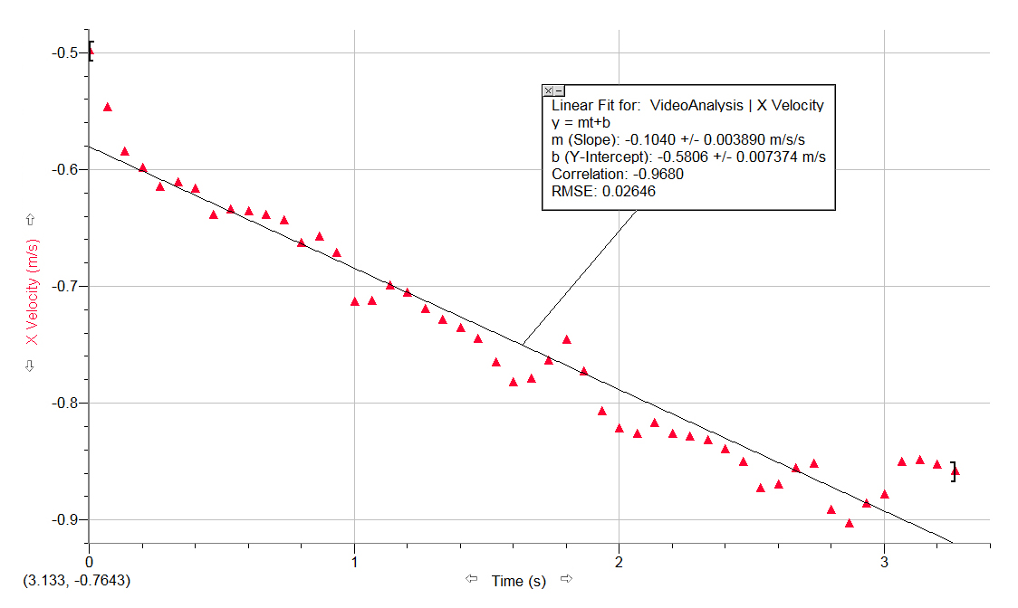
LoggerPro - Video Analysis (Backward Movement – Mousetrap)
Graph of Velocity vs Time

Slide 11
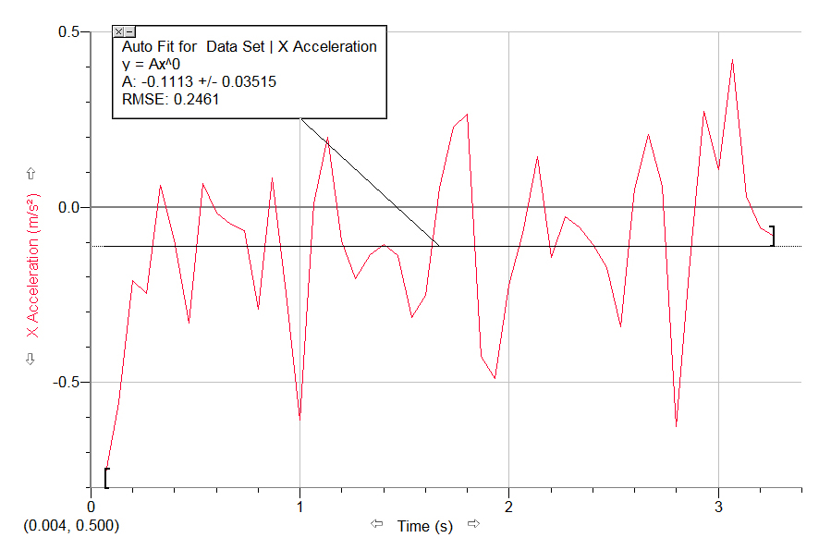
LoggerPro - Video Analysis (Backward Movement – Mousetrap)
Graph of Acceleration vs Time

Slide 12
Measurable Data
Hanging mass = 0.5 ± 0.01 kg
Car mass = 1.1804 ± 0.0005 kg
∆h of the falling mass = 0.262 ± 0.001 m
Radius of the spring = 0.16 ± 0.001 m
The spring angle when the car stops = 90⁰
Gravitational acceleration = 9.81 m/s²

Slide 13

Kinematics
Forward Movement
$\text{position}\text{ = 0.0509∗(}\text{t}\text{2}\text{) + 0.0655∗}\text{t}$
$\text{velocity}\text{ = 0.1018∗}\text{t}$
$\text{acceleration}\text{ = 0.1018}$
Backward Movement
position = -0.0536*(t²) + 0.9699*t - 0.3489
velocity = -0.1073*t + 0.9699
acceleration = -0.1073

Slide 14
Forces (some are negligible)
Force of friction on the four axles
Force of friction between the wheels and the floor
Force of friction between the string and the wood
Force of friction on the pulley
Weight (gravitational force) of the mass
Tension on the springs
Air resistance

Slide 15
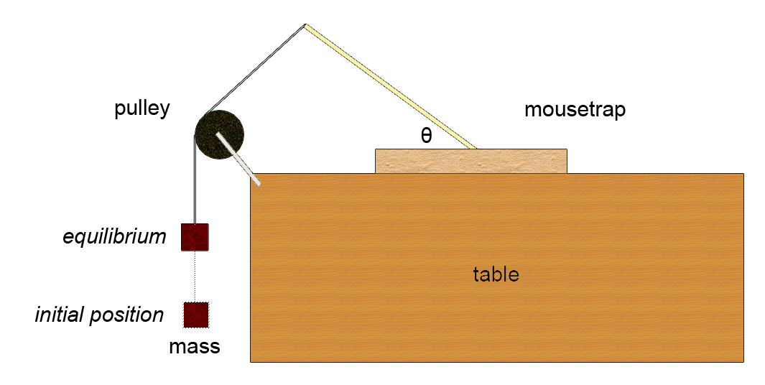
Solving for the force and energy of the spring

Slide 16
Solving for the force and energy of the spring
# | mass (kg) | ∆h (m) | angle (º) | F (N)
1 | 0.25 | 0.0875 | 57.54 | 2.45
2 | 0.30 | 0.0485 | 41.01 | 2.94
3 | 0.35 | 0.0350 | 34.23 | 3.43
4 | 0.40 | 0.0250 | 31.04 | 3.92
5 | 0.45 | 0.0175 | 25.94 | 4.41

Slide 17
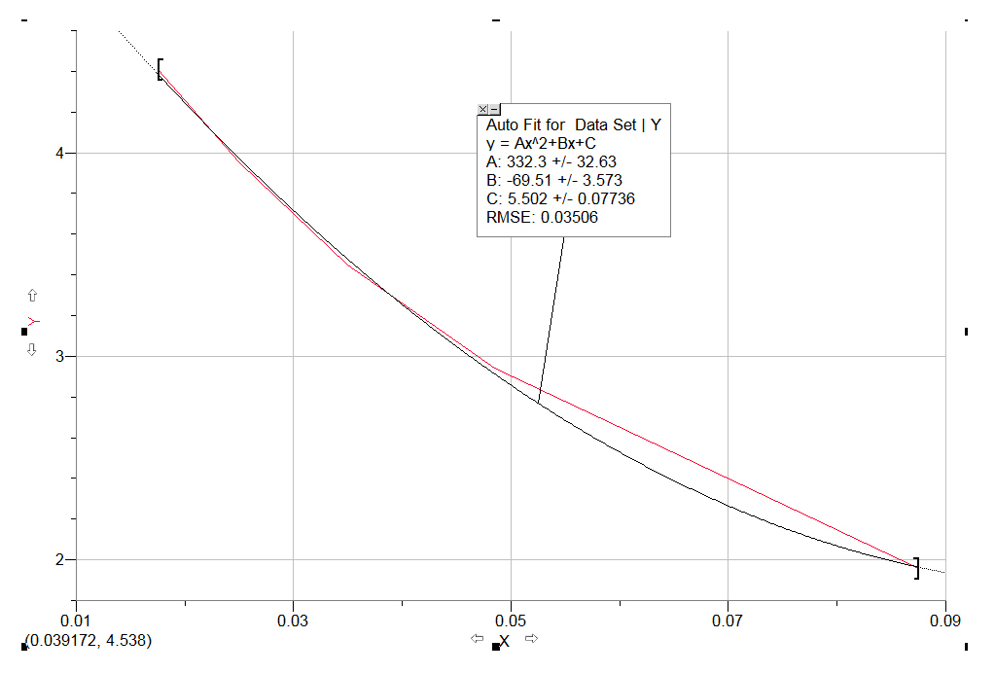

Solving for the force and energy of the spring
Graph of Spring Force vs ∆h
$$W(x)=\int{\left(332.3x2−69.51x+5.502\right)dx}$$
$$W(x)=110.77x3−34.76x2+5.502x$$

Slide 18
Works and Energy Forward Movement
m g h ➔ ½ m v²
Gravitational potential energy on the hanging mass
Kinetic energy of the car

Slide 19
Works and Energy Backward Movement
½ k x² ➔ ½ m v²
Spring potential energy on the mousetrap
Kinetic energy of the car

